Slide 1
Concept of Support (Operation Black Horse) 204th BSB SPO CPT Joseph Callejas

Slide 2
Agenda
Purpose
Tactical Overview
Concept of Support Overview
Class I
Class III (B)
General Supplies and Field Services
CL V
Maintenance
Medical
Transportation

Slide 3
Purpose
This is a mission brief allowing the 204th BSB commander to review and offer guidance to the concept of support for 2 ABCT during Operation Black Horse.

Slide 4
4th Infantry Division (4th ID) Mission
Mission
4th Infantry Division attacks Arianan Forces and seizes OBJ ASP, OBJ RATTLER, and OBJ MAMBA IOT prevent the Arianan Forces from executing counter attacks into Azerbaijan and IOT support the Azerbaijan territorial integrity and border with Ariana.
Intent
The purpose of this operation is to defeat Arianan Forces in the 4ID AOR and restore the international border between Azerbaijan and Ariana.
Key Tasks
1ABCT (ME) seize OBJ ASP IOT prevent enemy from destroying the Oil Refinery vic 39 SUE 2388 2187.
2ABCT (SE) seize OBJ RATTLER IOT prevent enemy from destroying the regional railway depot in Hajikabul.
3ABCT (SE) seize OBJ MAMBA IOT prevent enemy from destroying/sabotaging the Mil-Mugan Dam.
End State
At the conclusion of this operation, the 4ID will have:
Established hasty defensive near the international border
Restored the international border

Slide 5
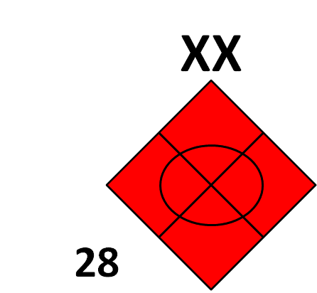
Area of Operations 4 ID
N
II
OBJ RATTLER
X
145th ACR
II
2nd
122 CAB
X
II
OBJ ASP
X
1st
II
130 CAB
II
II
II
214 CAB
131 CAB
140 ARR
3rd
185 FA
OBJ MAMBA

Slide 6
2nd ABCT Mission
Mission
2 ABCT attacks H+60 along AXIS CARIBOU as a 4ID supporting effort (SE) to seize OBJ RATTLER IOT prevent Arianan forces from destroying the regional railway depot in Hajikabul vic. 39TUE23923488.
Intent
The purposes of OPERATION BLACK HORSE is to maneuver rapidly from BSA Agquabedi along AXIS CARIBOU to seize OBJ RATTLER, destroy Arianan Forces in zone and secure objectives along the international border IOT reestablish the international border between Ariana and Azerbaijan.
Key Tasks
Rapid advance along AXIS CARIBOU
Destroy enemy armor that engages our elements or occupies positions on key terrain along our AXIS of advance
Aggressive reconnaissance of suspected and known enemy locations along the axis to identify and fix bypassed enemy elements
End State
2 ABCT will be at least 70% combat power
Enemy forces in AOR defeated
Established hasty defensive positions along the newly restored international border

Slide 7
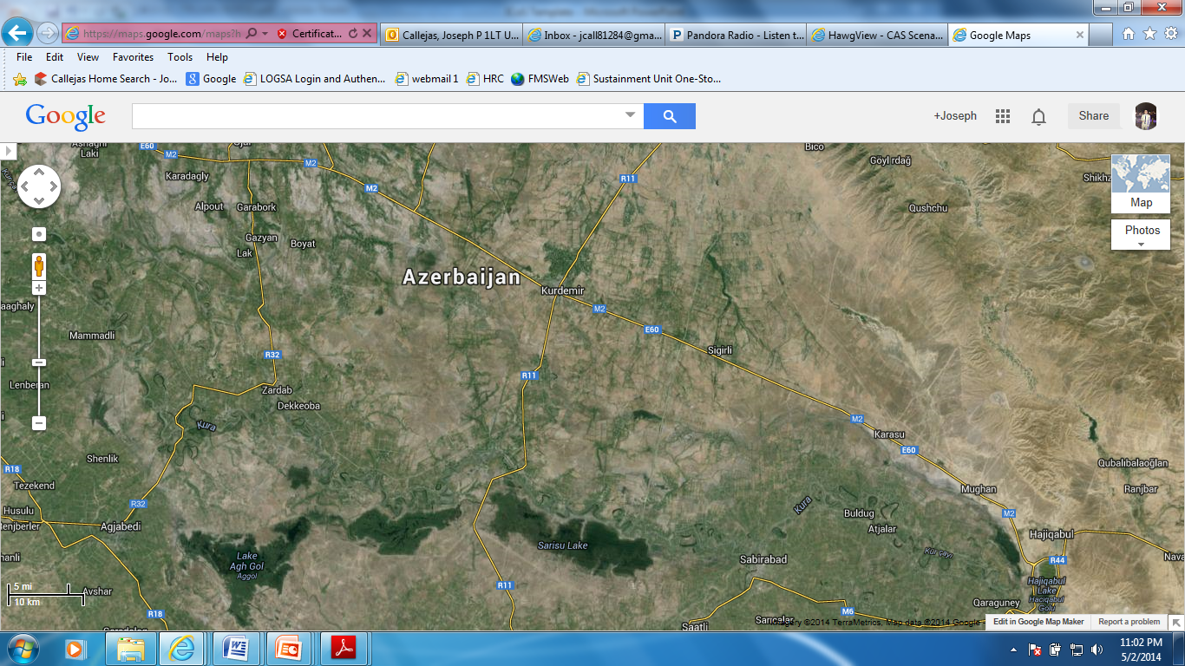
Area of Operations 2 ABCT 4 ID
II
N
II
3
16
1
67
OBJ RATTLER
II
II
2
8
Hajiqabul Railway Complex
1
10
AXIS CARIBOU
AXIS CARIBOU
TAA VIPER
X
II
OBJ RATTLER
BSTB
2
2nd
BSA AQUABEDI
II
BSB
204

Slide 8
Maneuver Concept of the Operation
2-8 CAB
2-8 CAB attacks 12 0800 APR 2014 along AXIS CARIBOU as the 2 ABCT main effort (ME) to seize OBJ Rattler IOT prevent Arianan forces from destroying the regional railway depot in Hajikabul vic 39 TUE 2392 3488.
Key Tasks
Rapidly advance along AXIS Caribou
Destroy enemy armor that engages our elements or occupies key terrain
Seize OBJ Rattler
1-67 CAB
1-67 attacks 12 1000 APR 2014 along AXIS CARIBOU as the supporting effort (SE) for 2 ABCT to seize OBJ Rattler IOT prevent Arianan forces from destroying the regional railway depot in Hajikabul vic 39 TUE 2392 3488
Key Tasks
Advance along AXIS CARIBOU
Fix all enemy along AXIS CARIBOU allowing 2-8 CAB to seize OBJ Rattler
Destroy enemy armor that engages our elements or occupies key terrain
O/O transition to (ME) due to change in operational environment.
CAV
1-10 CAV conducts reconnaissance along AXIS CARIBOU as the shaping operation for 2 ABCT to seize OBJ Rattler IOT identify enemy locations along AXIS CARIBOU.
Key Tasks
Interdict the enemy from seizing key terrain.
Report enemy locations and dispositions.
3-16 FA
3-6 FA conducts support by fire 12 0500 APR 2014 along AXIS CARIBOU as the shaping operation for 2 ABCT to seize OBJ Rattler IOT seize OBJ Rattler.
Key Tasks
Focus of fires during the initial entry and shaping phase is on Arianan pockets of resistance along AXIS CARIBOU.
Priority of Fires
. For Phase 1: 1-10th CAV, 2-8th CAB, 1-67th CAB
For Phase 2: 1-67th CAB, 1-10th CAV, 2-8th CAB
Three Phases:
Phase 1 – H+60 thru H+86 – ATTACK ALONG AXIS CARIBOU
Phase 2 – H+86 thru H+94 – SEIZURE OF OBJ RATTLER
Phase 3 – H+94 thru UTC(H+96) – SECURE OBJ RATTLER

Slide 9
2nd ABCT 4th ID Task Organization
X
3946 PAX
(550)
2nd
4 ID
(207)
(680)
(822)
(822)
(504)
(361)
HHC
2
BSTB
1
10
2
8
1
67
3
16
204
BSB
OPCON
HHC
HHC
HHC
HHC
HHC
HHC
2
318th
(21)
MI
E
Attached
A
5-5th
OPCON
B
(62)
OPCON
OPCON
E
FSC
(129)
OPCON
OPCON
OPCON
(6)
362nd
Multi-Role
Bridge Company
(MRBC)
(180)
FSC
(129)
FSC
(198)
FSC
(198)

Slide 10
204th BSB Mission
Mission
204th BSB conducts forward support of 2nd ABCT beginning H+60 from BSA AQUABEDI IOT support 2nd ABCT attack along AXIS CARIBOU and seizure of OBJ RATTLER. O/O Transition BSA AQUABEDI to BSA BLACKHORSE 38T QK 26686 85877 NLT H+78.
Intent
The purpose of this operation is to provide logistics support to the 2nd ABCT during offensive operations. Upon the completion of offensive operations, we will posture all units for defensive operations along the reestablished international border between Ariana and Azerbaijan.
Key Tasks
Provide forward support from BSA Grant.
O/O establish BSA vic intersection of ASR JEEP and MSR MAZDA. (BSA Blackhorse)
Posture the BDE for future operations.
End State
204th BSB established BSA vic the intersection of ASR JEEP and MSR MAZDA and logistically prepare 2 ABCT for future combat operations with at least 70% combat power.

Slide 11
Area of Operations 204th BSB
BSA
BLACKHORSE
38T QK 26686 85877
OBJ RATTLER
ASR JEEP
MSR MAZDA
N
LRP
38T QK 26686 85877
K
TAA VIPER
38T QK 18005 49776
OBJ RATTLER
II
39T UE 2392 3488
BSA AQUABEDI
BSB
204
38T QK 08598 34344

Slide 12
Updated IPB
Terrain Effects on Logistics Operations
Terrain is lowland farm area. Under wet conditions terrain becomes restrictive for tracked vehicles.
MSR Mazda is a multi-lane highway and connects Baku to Tbilisi, Georgia. MSR Mazda is 40 km/hr
ASR Jeep is a two-lane road improved road. A narrow bridge crosses the Kura River. The bridge is key terrain is essential for sustainment operations. Speed along this ASR is 40 km/hr.
Weather Effects on LOG Operations
Ground fog will inhibit visibility, particularly in the low ground along the Kura and Araks Rivers, but will not seriously impact transportation operations. However, aerial resupply may be limited during the times of ground fog.
Effects on Enemy:
The AO is open, rolling terrain that provides for extended fields of fire and observation; however, it also limits the amount of cover and concealment for daytime operations.
Greatest impact of weather will be periods of low visibility due to fog and dust, when enemy will have difficulty maintaining control of mounted formations and conducting air operations.
Fog in the morning hours in low-lying areas will limit visibility, and hinder reconnaissance operation. These same conditions support non-conventional operations.
= 65% Combat Power
= 85% Combat Power
MSR MAZDA
N
II
TAA VIPER
ASR JEEP
145th ACR
Civil Considerations
OBJ Rattler is located in the city of Hajikabul. Hajikabul is part of the greater Shirvan Metropolitan area which is the 2nd biggest population center in the country of Georgia.
Shirvan is an important transportation node for the country of Georgia.
There will be a large populations of displaced persons in the area. As such, SAPA insurgents have been operating in and out of the displaced persons camp. Insurgent attacks are likely near populated areas.
II
122 CAB
BSA AQUABEDI
OBJ RATTLER

Slide 13
Sustainment Overlay
LSA Wabash
4 SB
927 CSSB
228 PLS Co
724 POL Co
541 QM Co (POL)
2 HET Co
303 QM Co (Wtr/Distr)
196 QM Det (Wtr Pure)
1/54 QM Co (MA)
394 CSSB
221 OD Co
584 SMC
53 QM Co (POL)
1011 QSC (SSA)
755 TC
ISB Lions
553 CSSB (-)
3655 CRC
3654 SMC (-)
ISB Giants
501 SB
345th CSSB
445 PLS Co
416 POL Co
594 TMT Co
257 HET Co
403 ICTC
553 CSSB (-)
110 QM (POL)
395 OD Co
289 QSC (GSP)
3654 SMC (-)
LRP
204 BSB
BSA BLACKHORSE
204 BSB, 2 ABCT
TAA Stuart
B CO, 28th CSH
16 CAB (AVN)
BSA
4 BSB, 1 ABCT
BSA AQUABEDI
204 BSB, 2 ABCT
OBJ Rattler
BSA
64 BSB, 3 ABCT

Slide 14
Logistics Concept of Support Overview
MSR MAZDA
Concept:
204th BSB will provide forward support to 2 ABCT by establishing BSA BLACKHORSE at 38T QK 26686 85877 NLT H+78.
204th BSB will establish a LRP at 38T QK 26686 85877 to posture for future logistical resupplies.
204th BSB will resupply all units with two resupply missions NET H+68 at BSA BLACKHORSE and NLT H+80 at the LRP.
The resupply mission at H+66 will resupply CL I thru CLV . A second CL III (B) only mission will SP at H+78.
Priority of Support
Phase 1: 1-10th CAV, 2-8th CAB, 1-67th CAB, 3-16th FA, 2 BSTB, 204th BSB
Phase 2: 2-8th CAB, 1-67th CAB, 1-10th CAV, 3-16th FA, 2 BSTB, 204th BSB
Priority of Supply
CL III(B), CL V, CL I (H2O), CL I MRE, CL IV, CL II, CL III(P), CL IX
Method of Distribution
Supply Point Distribution
H>76 – resupply at BSA BLACKHORSE
H<76 – resupply at LRP
SVC/
REC
BSA BLACKHORSE
FLD
FEEDING
ASR JEEP
MSL ELC
REP
Barracks
X
ARM
REP
2nd
STB
GSE
REP
MI
HHC
E
BSB
E
HLZ
N
BSA BLACKHORSE: 38T QK 26686 85877.
Approx 2.5 KM perimeter.
ECP located at the yellow circle.
BSA includes: 204th BSB, 2nd BSTB, 2nd BDE HQ
Total Headcount = 1748 PAX (500 EPW/CIVILIAN)

Slide 15
Time Distance Factors
Distances in KM:
Air Time Factors (Minutes): Rate of speed 222 km/hr
 | LSA WABASH | TAA STEWART | BSA AQUABEDI | BSA BLACKHORSE | LRP | OBJ RATTLER
LSA WABASH |  | 57.9 | 141 | 123 | 183.5 | 244
TAA STEWART | 57.9 |  | 97.5 | 90 | 150.5 | 211
BSA AQUABEDI | 141 | 97.5 |  | 70.3 | 130.8 | 191.3
BSA BLACKHORSE | 123 | 90 | 70.3 |  | 60.5 | 121
LRP | 183.5 | 150.5 | 130.8 | 60.5 |  | 60.5
OBJ RATTLER | 244 | 211 | 191.3 | 121 | 60.5
 | LSA WABASH | TAA STEWART | BSA AQUABEDI | BSA BLACKHORSE | LRP | OBJ RATTLER
LSA WABASH |  | 16.1 | 38.1 | 33.2 | 49.6 | 65.9
TAA STEWART | 16.1 |  | 26.4 | 24.3 | 40.7 | 57.0
BSA AQUABEDI | 38.1 | 26.4 |  | 19.0 | 35.4 | 51.7
BSA BLACKHORSE | 33.2 | 24.3 | 19.0 |  | 16.4 | 32.7
LRP | 49.6 | 40.7 | 35.4 | 16.4 |  | 16.4
OBJ RATTLER | 65.9 | 57.0 | 51.7 | 32.7 | 16.4
Ground Time Factors (Hours): Rate of speed 40 km/hr
Additional BSAs in AOI (Distances in KM):
 | LSA WABASH | TAA STEWART | BSA AQUABEDI | BSA BLACKHORSE | LRP | OBJ RATTLER
LSA WABASH |  | 1.5 | 3.5 | 3.1 | 4.6 | 6.1
TAA STEWART | 1.5 |  | 2.4 | 2.3 | 3.8 | 5.3
BSA AQUABEDI | 3.5 | 2.4 |  | 1.8 | 3.3 | 4.8
BSA BLACKHORSE | 3.1 | 2.3 | 1.8 |  | 1.5 | 3.0
LRP | 4.6 | 3.8 | 3.3 | 1.5 |  | 1.5
OBJ RATTLER | 6.1 | 5.3 | 4.8 | 3.0 | 1.5
 | 4 BSB BSA | 64th BSB BSA
BSA AQUABEDI | 76.9 | 61.9
BSA BLACKHORSE | 111 | 132
Additional BSAs in AOI (TIME FACTORS air/ground):
 | 4 BSB BSA | 64th BSB BSA
BSA AQUABEDI | 20.8 min /1.9 hr | 16.7 min /1.5 hr
BSA BLACKHORSE | 30 min /2.7 hr | 35.7 min /33 hr

Slide 16
Concept:
Issue Cycle: 1.5 DOS
Ration Cycle: M-M-M
SUS BDE will resupply 1.5 DOS (28,000 GAL CL 1 H20 Bulk, 15 pallets of UGRA) to BSA BLACKHORSE at H + 92 and every 36 hours after H+92.
BSB will resupply 1.5 DOS ( 26 Pallets MRE, 99 Pallets of Bottled Water) to BSA Blackhorse at H+68.
After H+76 all resupplies will occur at LRP.
Class I
Requirements: 1.5 DOS
EPW/Civilian count has been added to the BSA count. 8 x pallets of HALAL meals for EPW/Civilians will be handed out prior to operation.
 | Bottled Water Pallets | Bulk Water Consumption (GAL) | MRE Pallets
2-8 CAB | 12 | 5672 | 8
1-67 CAB | 12 | 5672 | 8
1-10 CAV | 8 | 3795 | 5
3-16 FA | 7 | 3478 | 5
BSA | 26 | 8611 | 12
Capabilities:
Brigade Support Battalion Water Storage Capabilities:
16 x HIPPO: 32,000 GAL Bulk Water Storage
6 x 400 H20 Water Trailers: 2,400 GAL Bulk Water Storage
Total Bulk Water Storage: 34,400 GAL
2-8 CAB FSC
8 x 400 H20 Water Trailers: 3,200 GAL Bulk Water Storage
1-67 CAB FSC
8 x 400 H20 Water Trailers: 3,200 GAL Bulk Water Storage
1-10 CAV FSC
6 x 400 H20 Water Trailers: 2,400 GAL Bulk Water Storage
3-16 FA FSC
6 x 400 H20 Water Trailers: 2,400 GAL Bulk Water Storage
2 BSTB
10 x 400 H20 Water Trailers: 4,000 GAL Bulk Water Storage
 | 1st Reupply | 2nd Resupply
2-8 FSC | H+68 | H+104
1-67 FSC | H+70 | H+106
1-10 CAV | H+72 | H+108
3-16 FA | H+74 | H+110
4th SB | H+92 | H+128
Shortfalls/Mitigations:
Bulk Water shortfalls during operation. However, FSCs will receive HIPPOS after H+96 to increase bulk water storage capabilities.
3 x HIPPO – 2-8 CAB and 1-67 CAB
2 x HIPPO – 1-10 CAV
2 x HIPPO – 3-16 FA

Slide 17
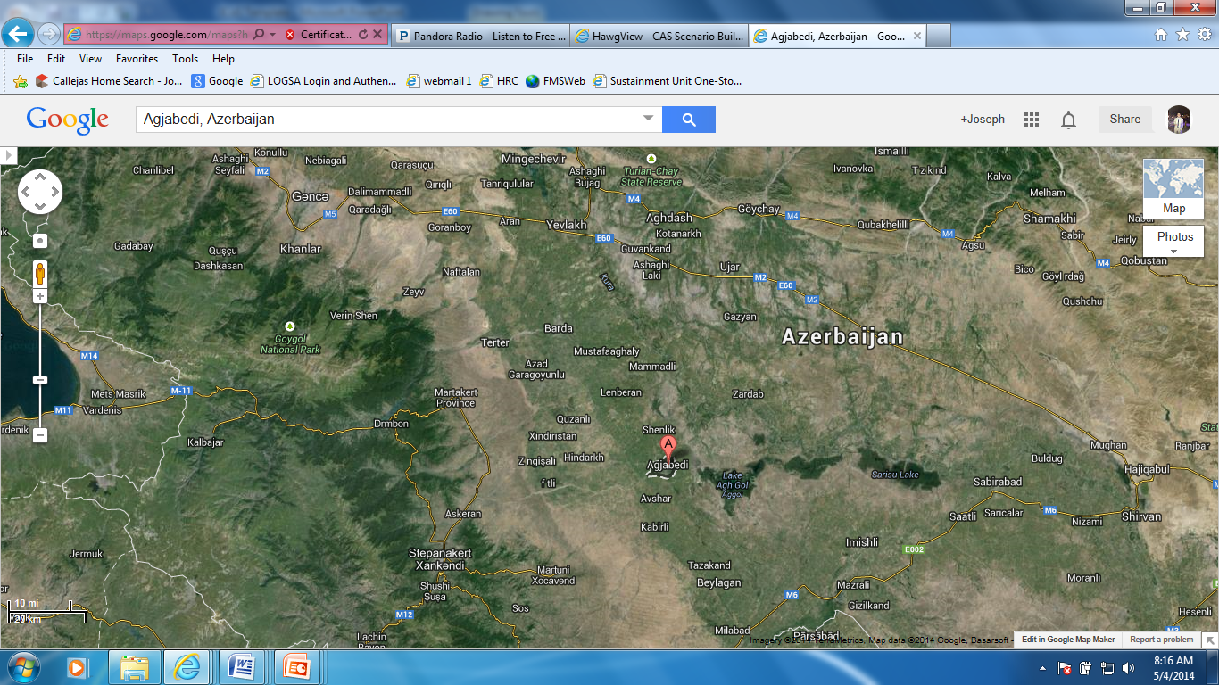
CL I Concept of Support
LSA WABASH
BSA AQUABEDI
204 BSB
Resupply mission of FSCs begins download at H+68.
Resupply mission to LRP every 36 hours.
1st Resupply mission at H+ 104
N
BSA BLACKHORSE
LSA Wabash
4 SB
Conducts Resupply mission every 36 hours begin NLT H+89 to BSA BLACKHORSE.
Amount delivered is equal to 1.5 DOS.
1st Resupply from 4 SB contains the following:
28,000 GAL CL 1 H20 Bulk,
15 pallets of UGRA
MSR FORD
LRP
ASR JEEP
LRP
204 BSB
All resupply missions after H+76 occur here.
MSR MAZDA
BSA AQUABEDI
204 BSB
Conducts one resupply from BSA AQUABEDI to BSA BLACKHORSE at H+ 66.
Amount delivered is equal to 1.5 DOS.
BSA will cease operations at H+64
BSA AQUABEDI
OBJ RATTLER

Slide 18
Concept:
SUS BDE will resupply 62,410.7 GAL at BSA BLACKHORSE NLT H+92.
BSB will resupply maneuver units from H+82 thru H+88 at LRP.
Fuel resupply will occur every 18 hours from H+88 at LRP.
Class III (B)
Shortfalls/Mitigations:
No Shortfalls for Bulk Fuel
Capabilities:
Brigade Support Fuel Storage Capabilities:
15 x 5K Fuelers: 75,000 GAL Bulk Fuel Storage
14 x 2.5K Fuelers: 35,000 GAL Bulk Fuel Storage
Total Bulk Fuel Storage: 110,000 GAL
2-8 CAB FSC
12 x 2.5K Fuelers: 25,000 GAL Bulk Fuel Storage
1-67 CAB FSC
12 x 2.5K Fuelers: 25,000 GAL Bulk Fuel Storage
1-10 CAV FSC
4 x 2.5K Fuelers: 10,000 GAL Bulk Fuel Storage
3-16 FA FSC
4 x 2.5K Fuelers: 10,000 GAL Bulk Fuel Storage
2 BSTB
5 x 2.5K Fuelers: 12,500 GAL Bulk Fuel Storage
Resupply: Times of Resupply
 | Time of resupply to supported units | Time of resupply from higher
2-8 FSC | H+78 | H+82
1-67 FSC | H+80 | H+84
1-10 FSC | H+82 | H+86
3-16 FSC | H+84 | H+88
4th SB | H+92 | N/A
Requirements: Amount of fuel to be resupplied in GAL.
 | Consumption rate per hour | H-Hour Refueled | amount consumed by time of refuel
2-8 CAB | 536.4 | 78 | 9,654.8
1-67 CAB | 536.4 | 80 | 10,727.5
1-10 CAV | 87.8 | 82 | 1,931.4
3-16 FA | 262.2 | 84 | 6,293.0
BSA | 1056.4 | 92 | 33,804.0

Slide 19
CL III (B) Concept of Support
LSA WABASH
BSA AQUABEDI
204 BSB
Resupply mission to LRP every 18 hours.
1st Resupply mission at SP for LRP at H+78
N
MSR FORD
BSA BLACKHORSE
LSA Wabash
4 SB
Conducts Resupply mission every 18 hours begin NLT H+89 to BSA BLACKHORSE.
Amount delivered on first resupply is 62,410.7 GAL
LRP
ASR JEEP
MSR MAZDA
LRP
204 BSB
All resupply missions for fuel occur here.
FSCs will receive first fuel resupply mission at H+80:
2-8 CAB at H+82 = 9654.8 GAL
1-67 CAB at H+84 = 10727.5 GAL
1-10 CAV at H+86 = 1931.4 GAL
3-16 FA at H+88 = 6293 GAL
2nd Refuel Operation will begin at H+106
BSA AQUABEDI
204 BSB
BSA will cease operations at H+64
BSA AQUABEDI
OBJ RATTLER

Slide 20
Concept General Supplies:
No CL IV requirements until Phase 3 of mission
Each soldier has on them 2 JLIST
SUS BDE will resupply 1 MCL of General Supplies at H+92 to BSA BLACKHORSE.
MCL = 20 STONS of CLIV, 4.5 STONS of CL II, and 1 STON of CLIII (P)
There will be no resupply of General Supplies during H+60 thru H+96. BSB will resupply General Supplies to the LRP after H+96.
General Supplies and Field Services
Capabilities:
1 x MA Team can process 20 KIA per day.
1 x MIRCS can hold up to 16 casualties at one time.
Shortfalls/Mitigations:
There are no shortfalls for General Supplies or Field Services
Concept Field Services:
No SLCR Team available from H+60 thru H+96.
Aerial Resupply is available for resupply, however priority of resupply is 1 ABCT. Aerial assets will only be allocated for:
Casualties
Ammunition (emergency)
Fuel (emergency)
CL I (emergency)
CL IX (emergency)
1 Mortuary Affairs (MA) team has been allocated to the unit for the duration of the operation. They will be co-located with ROLE 2.
MACP will be established at BSA BLACKHORSE NLT H+68
Evacuation Flow:
CCP (LRP)
MACP (BSA BLACKHORSE)
MACP (LSA WABASH)
TMACP (ISB LION)
DOVER AIR FORCE BASE
Requirements: Projected KIA for the 36 hour operation is 19.
 | KIA
2-8 CAB | 9
1-67 CAB | 9
1-10 CAV | 1

Slide 21
General Supplies and Field Services
LSA WABASH
(MACP)
MSR FORD
BSA AQUABEDI
204 BSB
Resupply mission of FSCs of General Supplies occurs after H+96
N
TAA STUART
BSA BLACKHORSE
(MACP)
LSA Wabash
4 SB
Conducts Resupply mission after H+96 for general supplies
1st Resupply from 4 SB contains the following:
1 MCL of General Supplies.
TAA STUART
16 CAB (AVN)
16 CAB conducts all aerial resupply from TAA Stuart.
LRP
(CCP)
MSR MAZDA
ASR JEEP
LRP
204 BSB
All resupply missions after H+76 occur here.
BSA AQUABEDI
204 BSB
BSA will cease operations at H+64
BSA AQUABEDI
OBJ RATTLER
(CCP)

Slide 22
Concept:
SUS BDE will resupply the following DODIC at H+92: C791 (in lieu of C791) , CA26 (in lieu of C380), A974, A975, A986, D864.
BSB will resupply maneuver units with the exact same ammunition as above to BSA Blackhorse at H+68.
After H+76 all resupplies will occur at LRP.
Class V
Resupply Amount:
2-8 CAB
DODIC |  | ROUNDS
C787 |  | 168
C380 |  | 288
A974 |  | 7752
A975 |  | 15456
A986 |  | 7752
TOTAL |  | 31416
1-67 CAB
DODIC |  | ROUNDS
C787 |  | 168
C380 |  | 288
A974 |  | 7752
A975 |  | 15456
A986 |  | 7752
TOTAL |  | 31416
1-10 CAV
DODIC |  | ROUNDS
A975 |  | 17388
A986 |  | 8721
TOTAL |  | 26109
3-16 FA
DODIC |  | ROUNDS
D563 |  | 6210
TOTAL |  | 6210
Requirements: Amount of Ammo consumed during the operation. (CSR)
Type of Round | DODIC | Total for all Systems
120 MM HEAT-MP-T | C787 | 336
120 MM APFSDS-T | C380 | 576
25 MM APDS-T | A974 | 15504
25 MM HEI-T | A975 | 48300
25 MM APFSDS-T | A986 | 24225
155 MM HEDP ICM | D563 | 6210
Shortfalls/Mitigations:
CSR for C380 (1) and C787 (2). Mitigation is to request C791 and CA26 for resupply.
Emergency resupply for Ammo is Aerial Delivery from LSA Wabash. (Approx resupply time is 1.5 hours).
Resupply Times:
 | 1st Reupply | 2nd Resupply
2-8 FSC | H+68 | H+104
1-67 FSC | H+70 | H+106
1-10 CAV | H+72 | H+108
3-16 FA | H+74 | H+110
4th SB | H+92 | H+128

Slide 23
CL V
LSA WABASH
(ATHP)
MSR FORD
BSA AQUABEDI
204 BSB
Resupply mission of FSCs begins download at H+68.
Resupply mission to LRP every 36 hours.
1st Resupply mission at H+ 104
N
TAA STUART
BSA BLACKHORSE
(ATHP)
LSA Wabash
4 SB
Conducts Resupply mission every 36 hours begin NLT H+89 to BSA BLACKHORSE.
Amount delivered is 21.76 STONS.
1st Resupply from 4 SB contains the following DODICS:
C791, CA26, A974, A975, A986, D864
TAA STUART
16 CAB (AVN)
16 CAB conducts all aerial resupply from TAA Stuart.
LRP
(AHP)
MSR MAZDA
ASR JEEP
LRP
204 BSB
All resupply missions after H+76 occur here.
BSA AQUABEDI
204 BSB
Conducts one resupply from BSA AQUABEDI to BSA BLACKHORSE at H+ 66.
Amount delivered is equal to 34.35 STONS.
BSA will cease operations at H+64
BSA AQUABEDI
OBJ RATTLER

Slide 24
Concept:
Priority of Maintenance:
Phase 1: 1-10th CAV, 2-8th CAB, 1-67th CAB, 3-16th FA, 2 BSTB, 204th BSB
Phase 2: 2-8th CAB, 1-67th CAB, 1-10th CAV, 3-16th FA, 2 BSTB, 204th BSB
Recovery Flow:
LRP/BSA BLACKHORSE
LSA WABASH
ISB LION
UMCP will be established at BSA BLACKHORSE NLT H+78
MCP will be established at LRP NLT H+78
4th SB will conduct two backhaul missions at H+78 at BSA BLACKHORSE and at H+96 at LRP for M1, M2, M3, and M109 vehicles.
Capabilities:
BSA:
4 x M88A1 (MED)
1 x M88A2
1 x LMTV Wrecker
2-8 FSC:
2 x M88A1
6 x M88A2
1 x LMTV Wrecker
1-67 FSC:
2 x M88A1
6 x M88A2
1 x LMTV Wrecker
1-10 FSC:
4 x M88A1
1 x LMTV Wrecker
3-16 FSC:
3 x M88A1
1 x LMTV Wrecker
Maintenance
Requirements:
Projected Equipment Loss until H+96
Projected OR of Critical Equipment
Vehicles | Total | Loss Rate | Vehicle Loss
M1 | 48 | 0.18 | 9
M2 | 48 | 0.22 | 11
M3 | 27 | 0.22 | 6
M109 | 16 | 0.1 | 2
Vehicles | Total | Losses | Repair | NMC | FMC | OR
M1 | 48 | 9 | 1 | 8 | 40 | 87%
M2 | 48 | 11 | 2 | 9 | 39 | 81%
M3 | 27 | 6 | 1 | 5 | 22 | 81%
M109 | 16 | 2 | 0 | 2 | 14 | 87%
Shortfalls/mitigations:
BSB/FSC do not have capabilities to back haul loss fighting vehicles to LSA Wabash.
Emergency resupply is aerial resupply from LSA Wabash.
The following are critical CL IX shortages for the operation:
1 x FUPP, M1A2 for 2 ABCT
1 x Transmission (ODS), M2/M3 for 2 ABCT
1 x Final Drive, M109, 1 X BCT
50 x Truck Pads, M1 for 2ABCT (250 for Division)

Slide 25
Maintenance
LSA WABASH
(UMCP)
MSR FORD
BSA AQUABEDI
204 BSB
First backhaul mission RP at H+78
N
TAA STUART
BSA BLACKHORSE
(UMCP)
LSA Wabash
4 SB
Conducts two backhaul missions. First ission SP at H+75, second mission SP at H+91.
TAA STUART
16 CAB (AVN)
16 CAB conducts all aerial resupply from TAA Stuart.
LRP
(MCP)
MSR MAZDA
ASR JEEP
LRP
204 BSB
Second Backhaul Mission RP at H+96
BSA AQUABEDI
OBJ RATTLER
BSA AQUABEDI
204 BSB
BSA will cease operations at H+64

Slide 26
Concept:
Prefered method for casualty evacuation is Aerial, then ground.
The Role 2 will not be operational from H+60 thru H+74
The Role 2 will be established at BSA BLACKHORSE NLT H+74
B/28th CSH operates a ROLE 3 at TAA Stuart
28th CSH operates a ROLE 3 at LSA Wabash
All casualties from H+60 thru H+74 will be evacuated to ROLE 3 at TAA Stuart.
All casualties from H+74 thru H+96 will be evacuated to the ROLE 2 at BSA BLACKHORSE.
No casualties from H+94 to H+96
All CCP and ROLE are also AXPs.
Evacuation Flow:
CCP (OBJ RATTLER
CCP (LRP)
ROLE 2 (BSA BLACKHORSE)
ROLE 3 (TAA STUART)
ROLE 3 (LSA WABASH, if needed)
Capabilities:
Medical
UNIT | ROLE | LOCATION | BED SPACE
204th BSB | ROLE 2 | BSA BLACKHORSE | 20
B/28th CSH | ROLE 3 | TAA STUART | 84
28th CSH | ROLE 3 | LSA WABASH | 164
Requirements:
UNIT | ROLE | LOCATION | BED SPACE | BED USAGE from H+60 thru H+74 | BED USAGE from H+74 thru H+86 | BED USAGE from H+86 thru H+94
204th BSB | ROLE 2 | BSA BLACKHORSE | 20 | 0 | 20 | 0
B/28th CSH | ROLE 3 | TAA STUART | 84 | 38 | 11 | 18
Shortfalls/Mitigations:
No shortfalls for Medical.

Slide 27
Medical
LSA WABASH
(ROLE 3)
MSR FORD
BSA AQUABEDI
204 BSB
ROLE 2 operational at H+74.
N
TAA STUART
(ROLE 3)
BSA BLACKHORSE
(ROLE 2)
LSA Wabash
28th CSH
ROLE 3 with 164 Beds
TAA STUART
16 CAB (AVN)
B/28th CSH
B/28th CSH operates ROLE 3 with 84 beds.
16 CAB conducts all casualty evacuation from here.
LRP
(CCP)
MSR MAZDA
ASR JEEP
LRP
204 BSB
BSA AQUABEDI
OBJ RATTLER
(CCP)
BSA AQUABEDI
204 BSB
BSA will cease operations at H+64

Slide 28
Transportation
BSB Capabilities:
20 x LHS Systems (320 pallets)
15 x 5k Fuelers
14 x 2.5k Fuelers
135 x Flatracks
Requirements:
 | CL I Pallets | CL V STONS | CL III(B) GAL
2-8 CAB | 20 | 6.45 | 9655
1-67 CAB | 20 | 6.45 | 10728
1-10 CAV | 13 | 1.65 | 1932
3-16 FA | 12 | 19.8 | 6293
2-8 FSC Capabilities:
5 x LHS Systems (90 pallets)
10 x PLS Systems (160 pallets)
12 x 2.5K Fuelers
50 x Flatracks
 | # of PLS Required | # of 2.5k Fuelers Required
2-8 CAB | 2 x PLS System, 1 x PLS | 5
1-67 CAB | 2 x PLS System, 1 x PLS | 6
1-10 CAV | 1 x PLS System, 1 x PLS | 1
3-16 FA | 2 x PLS System | 3
1-67 FSC Capabilities:
5 x LHS Systems (90 pallets)
10 x PLS Systems (160 pallets)
12 x 2.5K Fuelers
50 x Flatracks
Concept:
4th SB will conduct a resupply mission SP LSA Wabash at H+89. 24 Vehicle Convoy carrying various amount of CLI, CL III(B), and CLV. RP BSA BLACKHORSE at H+ 92
204th BSB will conduct two resupply missions. The first resupply mission will SP BSA Aquabedi NLT H+64. 24 Vehicle Convoy carrying various amount of CLI, CL III(B), and CLV. RP BSA BLACKHORSE at H+ 66
The second resupply mission will consist of fuel only. 13 x 2.5k Fuel Trucks (accompanied by 5 x LMTV as force protection) will SP BSA BLACKHORSE NLT H+78 and RP LRP at H+80.
All FSCs will conduct two resupply missions. One resupply mission to collect CL I and CL V at BSA BLACKHORSE. The second mission is to collect CL III(B) at the LRP.
1-10 FSC Capabilities:
6 x LHS Systems (108 pallets)
4 x PLS Systems (72 pallets)
4 x 2.5K Fuelers
31 x Flatracks
3-16 FSC Capabilities:
2 x LHS Systems (36 pallets)
13 x PLS Systems (234 pallets)
4 x 2.5K Fuelers
57 x Flatracks
Shortfalls/Mitigations:
There are no trans shortfalls.

Slide 29
Transportation (Resupply Mission)
4th SB Resupply Mission H+92:
LSA WABASH to BSA BLACKHORSE
13 x 5K Fuel Trucks – 65,000 GAL
1 x PLS System – 15 pallets of UGRA
8 x PLS System w/ 16 HIPPO – 32,000 GAL Bulk Water
3 x PLS Systems w / 34.35 STONS CLV
204th Resupply Mission 1 H+66:
BSA AQUABEDI to BSA BLACKHORSE
13 x 2.5K Fuel Trucks – 37,500 GAL
1 x 5K Fuel Truck – 5,000 GAL
1 x PLS System – CL V for 3-16 FA
3 x PLS – CL V (1 ea. for 2-8, 1-67, 1-10)
6 x PLS System CL I– 67 Pallets
1 x PLS w/ MIRCS
204th Resupply Mission 2 H+80:
BSA BLACKHORSE to LRP
13 x 2.5K Fuel Trucks – 37,500 GAL
1 x 5K Fuel Truck – 5,000 GAL
2-8 FSC Resupply Mission 1 H+68:
FLOT to BSA BLACKHORSE
2 x PLS Systems – 20 pallets CL I
1 x PLS – 6.45 STONS CL V
2-8 FSC Resupply Mission 1 H+82:
FLOT to LRP
5 x 2.5K Fuelers – 9655 GAL
1-67 FSC Resupply Mission 1 H+70:
FLOT to BSA BLACKHORSE
2 x PLS Systems – 20 pallets CL I
1 x PLS – 6.45 STONS CL V
1-10 FSC Resupply Mission 1 H+72:
FLOT to BSA BLACKHORSE
1 x PLS System – 13 pallets CL I
1 x PLS – 1.65 STONS CL V
3-16 FSC Resupply Mission 1 H+74:
FLOT to BSA BLACKHORSE
1 x PLS System – 12 pallets CL I
1 x PLS System– 19.8 STONS CL V
1-67 FSC Resupply Mission 1 H+84:
FLOT to LRP
6 x 2.5K Fuelers – 10,728 GAL
1-10 FSC Resupply Mission 1 H+86:
FLOT to LRP
1 x 2.5K Fuelers – 1923 GAL
3-16 FSC Resupply Mission 1 H+86:
FLOT to LRP
3 x 2.5K Fuelers – 6293 GAL

Slide 30
Transportation (BSA JUMP)
The BSA Jump will occur in four stages.
Stage 1 – ADVON (The Resupply Mission briefed eariler), MA Team
Stage 2 – Charlie CO, BN CDR, SPO
Stage 3 – Bravo and HHC
Stage 4 – Alpha, BN XO, BN CSM
Advon will leave when 2-8 CAB reaches PL AUSTIN (approx H+64)
Each stage will start two hours after previous stage has SP BSA Grant.
The BSA will be partially operational (ROLE 2) by H+72
The BSA will be fully operational by H+78 (Beginning of Phase 2 of Operation)

