Slide 1
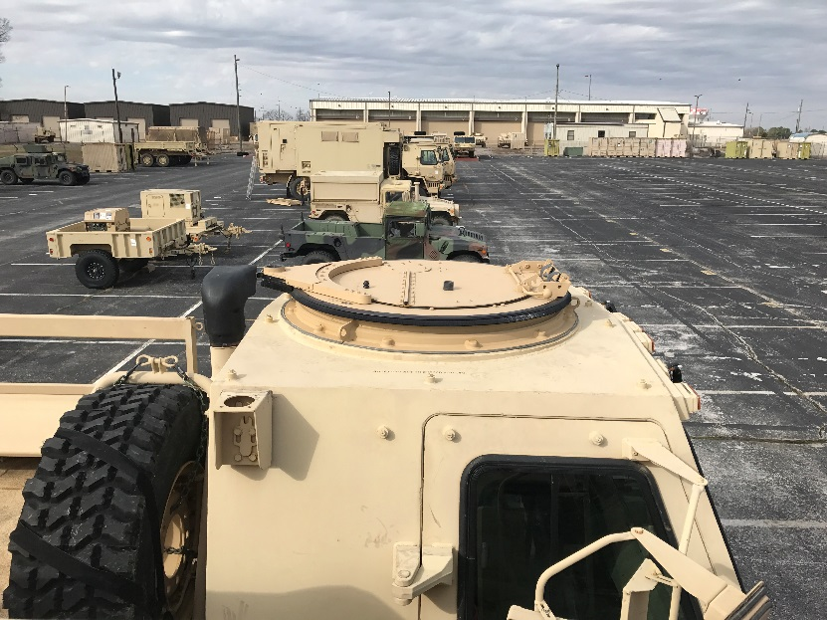
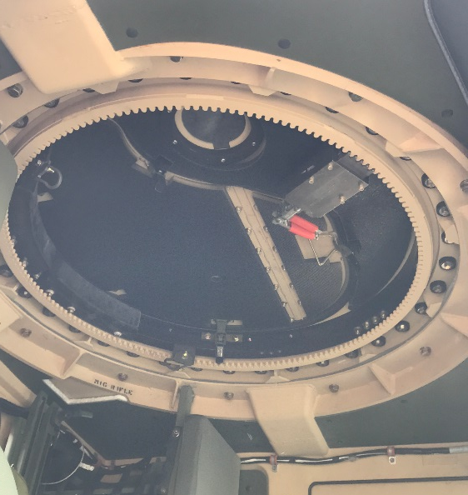
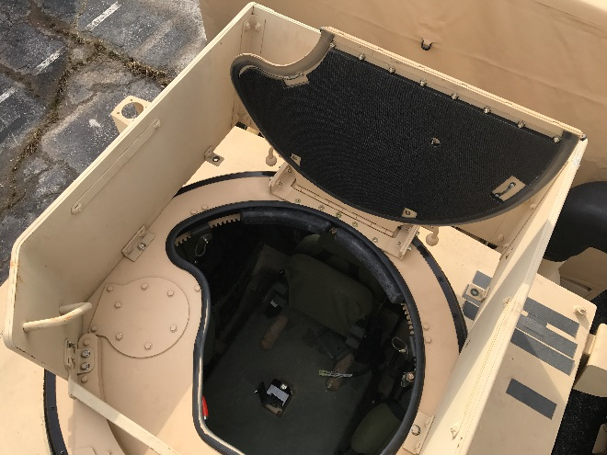
FMTV Ring Mounts
M1114 Gun Ring Mount Kit
NSN: 2510-01-567-8727
Cost: $13,028.40
Class IX
Includes everything you need for install and use (weapon station assembly, seals, washer, bolt, restraint kit)
Use with LTAS cab style FMTV (attached pg. 10)
Allows you to mount crew serve weapon systems and a Gunner Protection Kit (GPK)
Gunner Protection Kit (GPK)
NSN: 2510-01-532-5221
Cost: $3,697.00
Class IX
Compatible w/ M1114
Approved for LTAS & LSAC cabs
Does not come with Gun Shield (NSN: 510-01-498-4996)

Slide 2
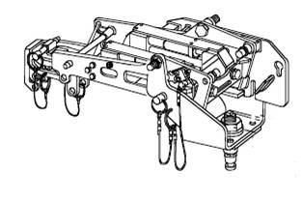
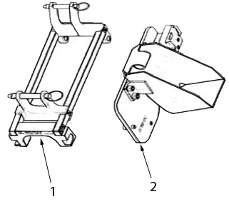
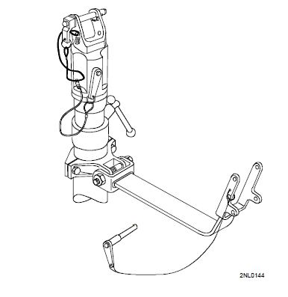
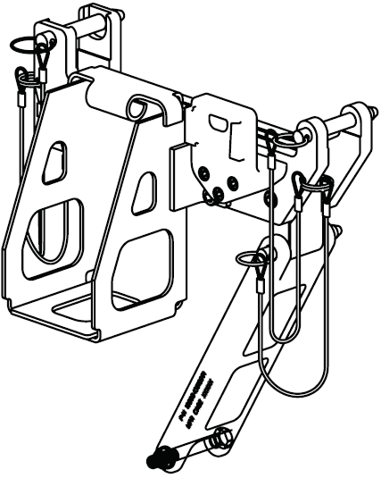
Weapon Mounts & Adapters
MK93 MOD 2 (MTOE’d)
MK93 Adapter & Bracket
To vehicle mount the M240B or the M249 SAW using the MK93 MOD2 MG mount.
GUN MOUNTING ADAPTER NSN: 1005-01-531-1676
AMMUNITION BRACKET ADAPTER NSN: 1005-01-531-1666 *Will NOT work with GPK or OGPK.
M197 MG Mount
Light Machine Gun / Medium Machine Gun adapter
Ability to attach 200 round ammunition can for either M240 or the M249 machine gun.
Able to provide same compact configuration as M197 without the LMG/MMG adaptor while increasing ammunition capacity.
NIIN: 01-553-0683
PN: 13016071
Designed to attach M60, M249, and M240 B machine guns to a gun pedestal or pintle adapter.
Travel lock feature to support weapon while in transport.
Allows for a more compact arrangement for mounting small caliber machine guns.
NSN: 1005-01-413-4098
PN: 12956264

Slide 3
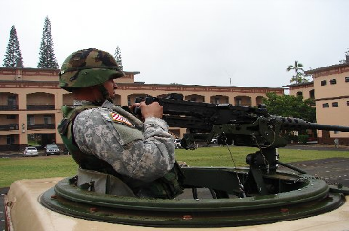
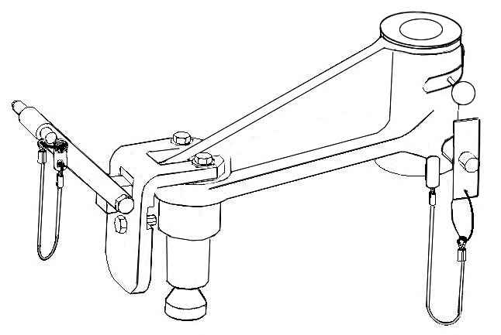
Cantilever Arm
Cantilever Arm
- The Cantilever Arm was developed in response to the large number of Operational Needs Statements (ONS) submitted in response to the lack of sufficient clearance between the gunner and the M2 machine gun when utilizing the M66 ring mount.
- The M66 Cantilever Arm provides an additional 9 inches of clearance between the gunner and weapon when applied on the M66 Ring Mount. The primary weapon of concern is the M2 Machine Gun used in conjunction with the MK93 Mount.
WITHOUT EXTENSION ARM
WITH EXTENSION ARM
NSN: 1090-01-568-5052

