Slide 1
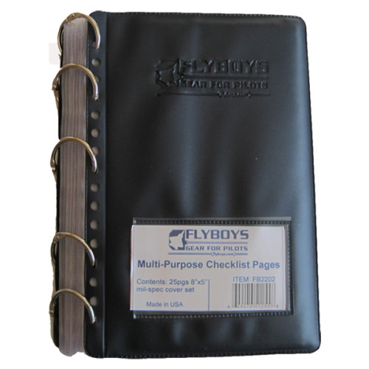
How to Use this Quick Reference Book
This is intended to be used with the “Flyboys” binder which can be found at most Clothing and Sales stores. Print out slides 3-27, cut around the borders and insert them in order within the binder sleeves.
Directions to Print:
Do not scale to fit paper
Do not print hidden slides
Only print on one side of each page

Slide 2
Title
Title
EXAMPLE FORMAT

Slide 3
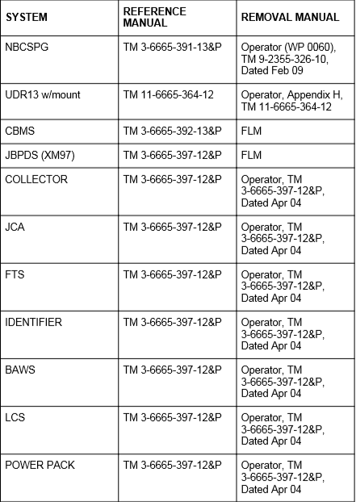
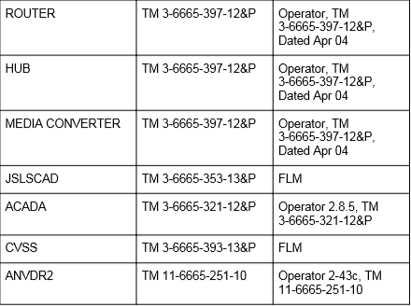
1
Table of Contents
Sensor References
Sensor References 1
NBCRV Startup and Shutdown Procedures 2
SPDP Circuit Breaker List
Sensor Startup Procedures
Sensor Shutdown Procedures
Sensor Capabilities
Sensor Flow Chart
Operating Under Unusual Conditions 8
Slat Armor
Dusty or Sandy Conditions
Hot Weather
Rocky Terrain
Prepare NBCRV for Vehicle Decontamination 14
Mission Planning and Considerations 18
OPORD Structure
Planning Considerations
Order of Events
Location and Survey Techniques 22
Technique Advantages and Disadvantages
Zig-Zag (Locate)
Lane (Locate)
Cloverleaf (Locate)
Grid (Locate)
Nearside – Farside (Survey)
Box (Survey)
Star (Survey)
Bounce and Bypass (Survey)
Course Leg (Survey)
Preselected Dose Rate (Survey)
BWA Survey Techniques 30
Dice Five
Circle
Picket Line
Semi Circle
Dense Picket
Sample Collection and Processing 34
CVSS Canister Installation
JBPDS Cold Weather Procedures
JBPDS Dry Sample Process
DD 1911 Example
Description of Different Sample Containers and Disk Mailers
Inventory Checklists 40
Sample Collection and Evacuation Inventory Checklist
JBPDS Inventory and Sample Documentation Checklists
Miscellaneous Item Checklist
Miscellaneous Reports 44
9-Line
UXO, SALUTE, LACE, Call for Fire
Marker Report
NBC-1
NBC-4

Slide 4
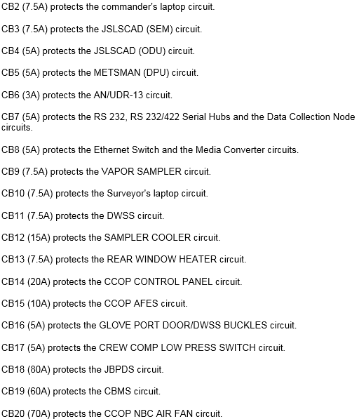
3
2
SPDP Circuit Breaker List
(WP 0028)
NBCRV Startup and Shutdown Procedures
(TM 9-2355-326-10-1)

Slide 5
4
5
Sensor Startup Procedures
(WP 0086)
Sensor Shutdown Procedures
(WP 0086)
Deploy METSMAN Sensor Assembly (WP 0085)
Remove all covers as necessary (METSMAN cover, JSLSCAD cover, environmental cover, RWS covers, CBMS probe cover)
Open and adjust rear-view mirrors (WP 0004)
Install JBPDS BAWS and Collector Stacks (WP 58 & 59)
Start engine (WP 0062; vehicle must be placed in high idle (WP 0017) whenever vehicle is stationary and sensor components are operating to ensure adequate power is available)
Turn on SPDP (WP 0028)
Startup JSLSCAD (WP 0082; ensure CB3, CB4 and CB12 are pushed in on SPDP; turn on ODU within 60 seconds of turning on SPDP; ensure 5 minutes have passed after turning on ODU before turning on the NBCSPG)
Startup inverters (WP 0123)
Startup C4ISR (WP 0118; CB33 on PDP)
Startup DWSS (WP 0078; CB11 & CB19 on SPDP)
Startup METSMAN (WP 0085)
Startup CBMS II (WP 0074; CB19 on SPDP)
Startup AN/UDR-13 (WP 0087; CB6 on SPDP)
Startup M88 (WP 0083)
Startup AN/VDR-2 (WP 0088)
Startup CVSS (WP 0076; CB9 on SPDP)
Startup JBPDS (WP 0081; CB18 on SPDP; ensure vehicle is stopped and stacks are installed before turning on. Do not move vehicle until JBPDS is turned off.)
Startup NBCSPG (WP 0067; start Surveyor’s NBCSPG first; start Cdr’s NBCSPG once Surveyor’s NBCSPG is at dacsOP login)
Shutdown JBPDS (WP 0081; if operated ensure stack assemblies are removed) - VC
Shutdown DWSS (WP 0078) - Surveyor
Shutdown AN/VDR-2 (WP 0088) - Surveyor
Shutdown M88 (WP 0083) - Surveyor
Shutdown JSLSCAD (WP 0082) - Surveyor
Pull out circuit breakers 3 and 4 on SPDP – Driver
Shutdown AN/UDR-13 (WP 0087) - Surveyor
Shutdown CBMS II (WP 0074; after shutting off the CBMS, allow the chemical probe to cool down for 20 minutes prior to closing the chemical probe port cover) - Surveyor
Shutdown METSMAN (WP 0085) - Surveyor
Shutdown CDR’s NBCSPG (WP 0067) - VC
Shutdown Surveyor’s NBCSPG (WP 0067) - Surveyor
Shutdown C4ISR (WP 0118) - All
Shutdown inverters (WP 0123) - VC
Place radio(s) in STANDBY mode - VC
Shutdown engine (WP 0137) – Driver
Open material port - Surveyor
Close rear-view mirrors (WP 0004)
Reinstall covers (METSMAN cover, JSLSCAD cover, environmental cover, RWS covers, CBMS probe cover)
Stow METSMAN sensor (WP 0085)

Slide 6
Sensor Capabilities
7
6
Sensor Flow Chart
Sensor | Detects, Collects, or Both | Outputs | Limitations
M22 ACADA | Nerve (G) & Blister (H) Vapors | Level of contamination & class of CWA | Can detect air vapors within immediate area only
JSLSCAD | Nerve (G) & Blister (H) Vapors | Class, type, and relative position of CWA | Detects out to 5 kilometers with clear line of sight
CBMS2/ DWSS | All known & unknown CWA Liquids | Records data, shows level of contamination & class of CWA | Detects ground contamination liquids only, 0-5 mph limit when in operation
CVSS | All CWA Vapors | N/A | Maximum of 12 sample collections, vapor only
JBPDS | All BWA Vapors (10 at a time depending on installed card) | Name of BWA and physical sample | Vehicle must be stopped for min of 65 minutes (20 min to turn on, 25 min to collect one sample, 20 min to turn off)
AN/VDR-2 | Gamma radiation & Beta particles | Dose rate & total accumulated dose | Cannot detect Alpha particles
AN/UDR-13 | Gamma radiation | Dose rate & total accumulated dose | Cannot detect Alpha or Beta particles
Glove Port and Sample Bottles | All solid and/or liquid CWAs | N/A | Vehicle must be stopped, difficult to collect
M22 ACADA
Detect
JSLSCAD
CWA
CBMS2/DWSS
Collect
CVSS
Glove & Bottles
Detect
BWA
JBPDS
Collect
Detect
AN/VDR-2
Nuclear
AN/UDR-13
Collect
N/A

Slide 7
8
9
Slat Armor (WP 0150)
SLAT ARMOR PMCS: With SLAT armor installed on vehicle, perform the following PMCS checks every time you perform(After) PMCS Checks (Volume 5, WP 0850)after completion of daily vehicle operation.
Inspect SLAT armor on Front, Left Side, Rear, and Right Side of vehicle for damage and missing hardware. Check for loose bolts and if found, tighten and mark in any manner for future torque application. Notify Field Maintenance of any damage, missing hardware, or tightened bolts requiring torque application.
TOWING WITH SLAT ARMOR INSTALLED: Comply with the following requirements and limitations when towing with SLAT Armor installed.
NOTE The standard tow bar issued with the Stryker is not acceptable for towing Stryker to Stryker with SLAT armor installed. The new extended split tow bar must be used.
TIRE PRESSURE WITH SLAT ARMOR INSTALLED: Comply with the following requirements and limitations for speed and tire pressures when operating a Stryker vehicle equipped with SLAT Armor.
For highway (primary road) operations/marches, the Central Tire Inflation System (CTIS) must be turned "OFF". The tires must be inflated to 95 PSI and vehicle speed must not exceed 45 MPH. This maximum speed is for ideal road conditions (i.e. straight sections, no visible obstructions, etc.). Drivers must use common sense and reduce their speed when road conditions are not ideal due to: adverse weather conditions, increased traffic, reduced road width, turns, curves, hill-crests, or any other adverse terrain.
Operating Under Unusual Conditions
(TM 9-2355-326-10-1)

Slide 8
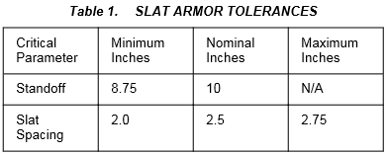
Slat Armor Cont. (WP 0150)
11
10
Dusty or Sandy Conditions
(WP 0151)
For cross country movement requiring greater traction (i.e., soft soil, mud, or snow) or slow speeds, switch the CTIS "ON" and select "HIGHWAY" setting (81 PSI) as required by factors of the mission, enemy troops, terrain, and time available METT-T. With the CTIS "ON" at 81 PSI, a dash up to 40 MPH for a one hour duration is acceptable.
For terrain ranging from cross country to secondary roads, the ICV may be driven with the CTIS "ON" at 81 PSI. This is also as required by METT-T and the unit commanders judgment. With resumed extended secondary road movement and as soon as the tactical situation permits, the CTIS should be switched "OFF" and the tires inflated to 95 PSI.
UNEXPLODED ORDNANCE (UXO) PROCEDURES: Once the operator knows that a round is lodged in the armor, he should:
Immediately evacuate the vehicle.
Call for Explosive Ordinance Division (EOD) support.
Mark off the area around the vehicle for a safe distance.
NEVER try to dislodge the round.
Engage eight-wheel drive (WP 0017) if required.
Adjust the Central Tire Inflation System (CTIS) (WP 0010) to the Mud and Snow position if required.
Stop only on level ground or downgrade to facilitate movement.
Allow as much distance as possible between vehicles.
NOTE Perform the maintenance procedures identified below to ensure reliable system operation in severe sand and dust environment.
Monitor restricted air flow indicator every hour.
Check and clean any accumulations of debris from engine grilles at each stop.
Keep equipment and operating controls as clean as possible.
Protect optical components from etching by removing sand or dust at each stop.
Install environmental cover (WP 0052) and sand protection kit and front cover (Volume 2, WP 0157) if vehicle is to be parked for extended periods of time.

Slide 9
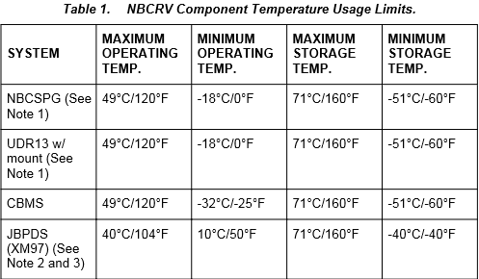
Hot Weather (WP 0152)
13
12
Hot Weather Cont. (WP 0152)
During hot weather operation, 104°F (40°C) and above, perform the following:
Check engine coolant (Volume 5, WP 0871) levels every hour during operations.
Check engine oil (Volume 5, WP 0872) levels every hour during operations.
Park vehicle in shade or under tarpaulin. If entire vehicle cannot be covered, ensure that weapons and periscopes are covered (WP 0052).
Keep vehicle, instruments and weapons clean (Volume 5, WP 0879). Fungus and mildew can grow quickly during humid conditions.
Both engine preheat and crew/driver heater (WP 0122) valves should be set to the CLOSED position to prevent heat from entering troop compartment and to permit efficient engine coolant circulation.
When temperatures fall below or exceed the operating or storage temperatures, it may be necessary to remove mission equipment from the vehicle. Refer to NBCRV Component Temperature Usage Limits for operating and storage temperatures and NBCRV Equipment Manual References for removal information for NBCRV mission equipment.
Observe the above notes when referencing the data in the NBCRV Component Temperature Usage Limits table.
Rocky Terrain (WP 0153)
Use Central Tire Inflation System (CTIS) (WP 0010) to adjust tire pressure for terrain.
Reduce vehicle speed
CAUTION The drivetrain and steering components could be damaged if obstacles such as rocks, which exceed the vehicle ground clearance of 16 in. (406 mm), are straddled. Do not straddle obstacles that exceed vehicle ground clearance. Failure to comply may result in damage to equipment.
If unable to avoid 16 in. (41 cm) obstacles, position vehicle so that tires drive over them.
Follow procedures for cross-country driving (WP 0131).

Slide 10
14
15
DECON Preparation Procedure
Power down Mission Equipment, except CCOPS (WP 0086).
Power down RWS (WP 0112). Ensure Thermal Imaging Module (TIM) and Visual Imaging Module (VIM) lens covers are installed.
Remove Joint Biological Point Detection System (JBPDS) Collector Intake Stack (WP 0059).
Remove Biological Agent Warning Sensor (BAWS) Intake Stack (WP 0058).
If equipped with BAWS Intake Closure Assembly (ICA), remove BAWS ICA (Volume 5, WP 0885).
Cover Joint Services Lightweight Standoff Chemical Agent Detector (JSLSCAD) (1) with three plastic bags (one over the top of the other). Secure plastic bags with tape at base of JSLSCAD (1).
Cover Meteorological Sensor (METSMAN) (2) with three plastic bags (one over the top of the other). Secure plastic bags with tape at base of METSMAN(2).
Place M88 air inlet valve to Internal (WP 0068).
Cover up M88, Chemical Vapor Sampling System (CVSS), and Chemical Biological Mass Spectrometer (CBMS II) air inlet cover (3) with three plastic bags (one over the top of the other). Secure plastic bags with tape at base of air inlet cover (3).
Cover Driver's Vision Enhancer (DVE) (4) with three plastic bags (one over the top of the other). Secure plastic bags with tape at base of mounting bracket.
Replace five shielding gaskets (Volume 5, WP 0859).
Pneumatic system breather and coalescing filter are mandatory replacement items. Notify Field Maintenance for mandatory replacement.
Decontaminate vehicle and equipment IAW FM 3-11.5 and unit SOP's.
Prepare NBCRV for Vehicle Decontamination
(TM 9-2355-326-10-1, WP 0154)

Slide 11
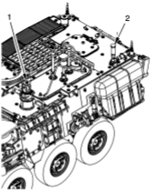
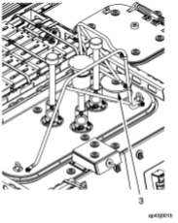
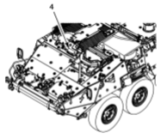
16
17
Decontamination Procedure Figures
Page Intentionally Left Blank

Slide 12
18
19
OPORD Key Considerations for Mounted CBRN Recon Mission
Situation
Friendly Forces
Enemy Forces
Weather (Wind direction/speed)
Mission (Stated twice)
Execution
Concept of the Operation
Timeline (SP time, Mission Complete time)
Route (Primary/alt routes, checkpoint grids, grid to Button Up Point, order of march, speed, movement formation, vehicle spacing, weapon orientations)
Actions on OBJ (Locate technique, survey technique)
Tasks to Subordinate Units
Coordinating Instructions
Actions on contact
Recovery plan
DECON plan
MOPP Level
Sustainment
Command and Control
Succession of command
Call signs
Radio frequencies
Mission Planning and Considerations
(ATP 3-11.37)

Slide 13
20
21
Recon Planning Considerations
Actions During Each Phase
Troop Leading Procedures
Receive the mission
Issue WARNO
Make a tentative plan
Start/begin movement
Recon
Complete plan
Issue OPORD
Supervise and refine
5 Mounted Movement Formations
Column
Staggered Column
Wedge
V Formation
Left or Right Echelon
3 Mounted Movement Techniques
Traveling
Traveling Overwatch
Bounding Overwatch
Principles of CBRN Operations
Ensure continuous CBRN recon
Do not keep CBRN assets in reserve
Orient on the CBRN recon objective
Report information rapidly and accurately
Retain freedom of action
Gain and maintain CBRN hazard understanding
Develop the situation rapidly
PCCs/PCIs
WARNO
OPORD
Rehearsals
Request SP from higher (PAX, VICs, WPN Systems)
Planning and SP
Call up all checkpoints
Transition from ‘movement’ to ‘maneuver’ when in area of possible enemy contact
Movement to BUP
Confirm Clean
Obtain required control samples
Button Up
Combat Lock
Confirm required sensors are turned on and operational
Inform higher BUP procedures complete
Button Up Point
Conduct Lane, Zig-Zag, Cloverleaf or Grid (refer to pages 15 and 16)
Deploy DWSS (unless conducting cloverleaf technique)
Report to higher when you have achieved preliminary detection
Locate
Probe and confirm dirty
Collect sample if confirmed dirty
Drop DWSS
Drop gloves
Send reports to higher (NBC 1 and NBC4)
Coordinate for DECON
Confirm Dirty
Conduct Box, Near side/far side, Star, or Bounce and Bypass (see pages 16 and 17)
Send Marker Report (page 47) to higher
Survey
CBRN Tasks
Detect
Locate
Identify
Quantify
Collect
Survey
Mark
Report
Take the designated dirty route to the DECON site (coordinate with DECON POC if unknown)
Follow DECON instructions on page 15
DECON

Slide 14
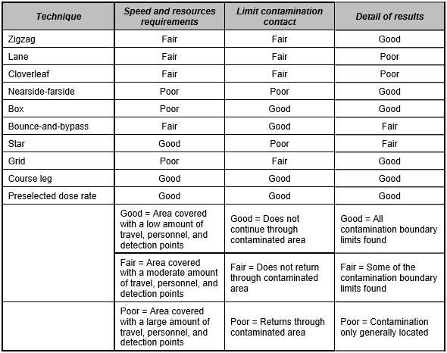
23
22
Technique Advantages and Disadvantages
Location and Survey Techniques
(ATP 3-11.37, Appendix D)

Slide 15
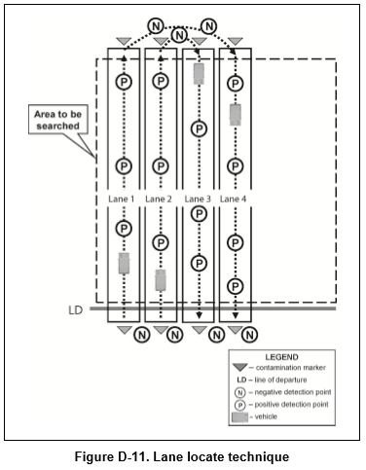
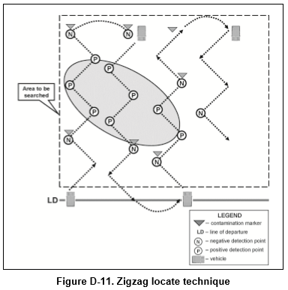
Zig-Zag (Locate)
25
24
Lane (Locate)

Slide 16
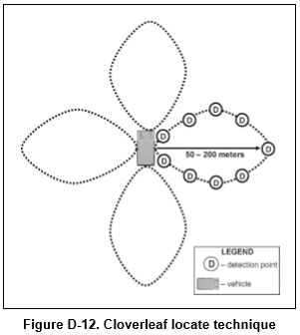
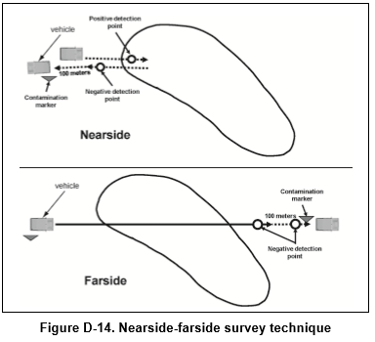
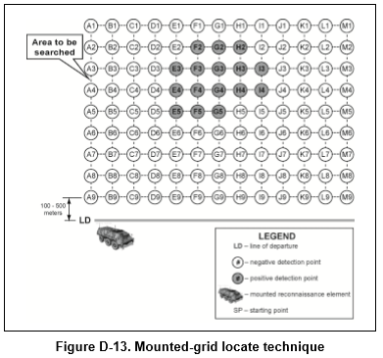
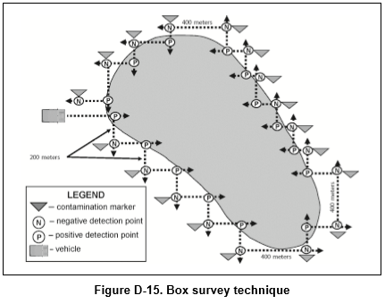
Cloverleaf and Grid (Locate)
27
26
Nearside/Farside & Box (Survey)

Slide 17
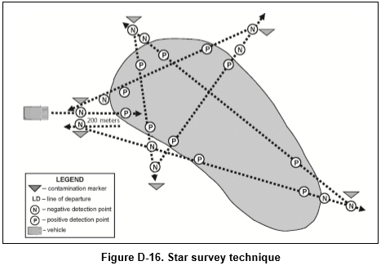
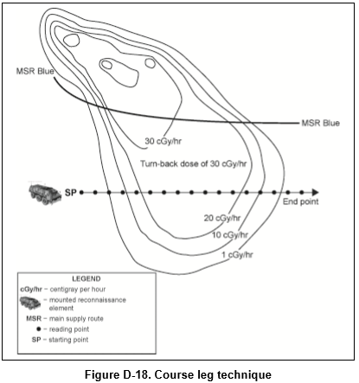
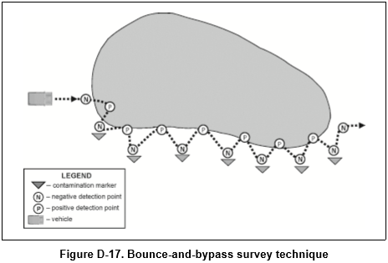
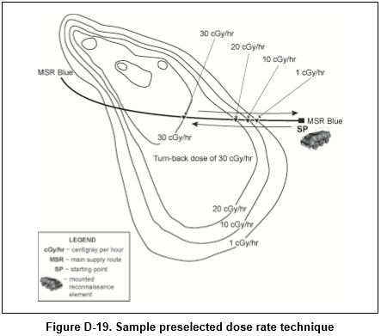
28
29
Star & Bounce/Bypass (Survey)
Course Leg & Preselected Dose Rate (Radiological Survey)

Slide 18
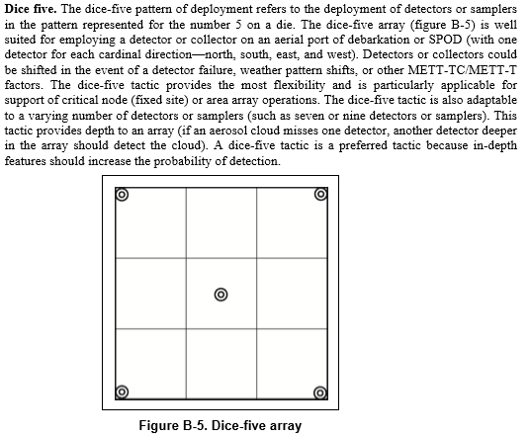
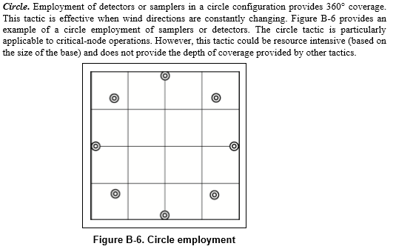
30
31
Dice Five & Circle
JBPDS Survey Techniques
(ATP 3-11.37, Appendix B)

Slide 19
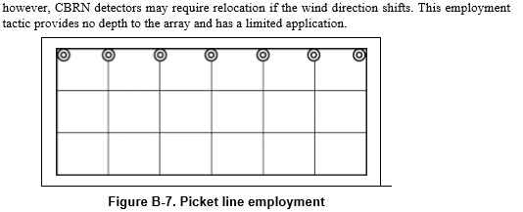
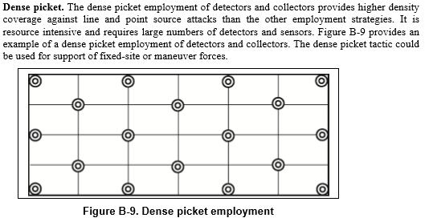
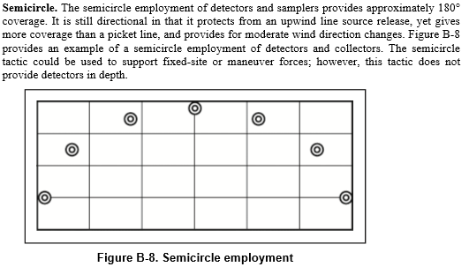
Picket Line & Semi-Circle
33
32
Dense Picket

Slide 20
CVSS Canister Installation
(TM 3-6665-393-13&P, WP 0006)
34
35
Open the CVSU and CSR doors
Remove a sealed packaged Sample Canister from the Canister Stowage Container
Check the certification date on the outer package of the Sample Canister. Mark Canister on the outside of package as expired if it has been one year from the last day of the month of the certification date and return packaged Canister to Stowage Container. Choose another Sample Canister that is within the acceptable time frame of its certification date.
Unpackage Canister. Remove outer packaging and inner packaging. Confirm certification date on Sample Canister label. Dispose of wrapping in accordance with local SOP.
Remove the protective metal cap from the Sample Canister QD. Visually examine the Sample Canister male QD for signs of damage. If quick disconnect is bent, damaged or missing, or if the Canister is expired, mark, wrap and stow Canister and repeat Steps 2 - 5 with another packaged Sample Canister.
Align the male Sample Canister QD with the female QD fitting in the Pneumatic Unit.
Grasp the QD collar and slide sleeve downward and hold.
Insert the Sample Canister into the sleeve until it is flush with the QD collar.
Release the QD collar and gently pull upward on the Sample Canister to ensure that there is a secure connection.
Secure the metal protective cap on the storage clamp
Repeat steps 5 through 10 until all three canister bay positions are occupied.
Close Canister Stowage Container
Perform a canister Reset. Depress and hold the RESET button for at least one second while the CSR is still open.
Align the CSR locator pin with corresponding hole in the CSR microswitch mounting plate and close the CSR to initiate BIT. Rotate the CSR knob clockwise until it is tight and activates the CSR microswitch.
Wait for BIT to complete. Upon completion of the BIT, the POWER LED and any CAN LED corresponding to installed Sample Canisters will be lit.
Close the CVSU door, insert latch in locking mechanism, and rotate latch clockwise until securely fastened
Sample Collection and Processing

Slide 21
36
Process JBPDS Dry Collection
JBPDS Cold Weather Procedures (Outside Temp <18ºF)
(TM 3-6665-397-12&P, WP 0028)
37
Put on mask, gloves, and goggles.
Retrieve an unused Carrier Card (refer to WP 0034 00).
Allow the collection process to complete.
At the JBPDS Main Panel screen, touch Change Mode
At the Change Mode screen, touch Standby then Apply
Bring handle back and rotate ¼ turn (advancing to detent). Dry Collection Filter will drop into the Sample Extraction Bottle
Open Bottle Shuttle
Secure bottle cap onto Sample Extraction Bottle
Remove Sample Extraction Bottle
If required, install a new Dry Collection Filter and place the system back in Dry Collection Mode.
The Dry Collection Filter may contain a collected sample. Follow these steps to process samples:
Agitate for one minute by shaking the Sample Extraction Bottle twice per second using an up-and-down motion.
Prepare the identification strip of the Carrier Card for inoculation by removing the clear plastic film covering the wells. Forceps may be used if necessary.
Remove small cap from the Sample Extraction Bottle.
Fill each well of the Carrier Card Assembly.
Replace the small cap on the Sample Extraction Bottle and retain.
After 15 minutes, the control line and test line (in the event of a positive result) should be clearly visible. Read the results within one minute of the completion of the 15-minute incubation period.
When results are known, notify supervisor IAW SOP. The Sample Extraction Bottle with the 10 ml PBS fluid is now the liquid sample. Evacuate samples IAW SOP.
At the JBPDS Main Panel screen, touch Change Mode
When the Change Mode screen opens, touch Standby
Touch Apply
When the system has entered Standby, install Dry Collection Filter (refer to WP 0029 00).
After the Dry Collection Filter is installed, touch Change Mode at the JBPDS Main Panel screen.
From Change Mode screen, touch Dry Collection and then Apply
A Dry Collection Advisory dialog box will appear displaying “Do You Wish To Continue In Dry Collection Mode?”. Touch Yes to continue or No to cancel.
NOTE The Dry Collection Advisory dialog box reads, “Install the Dry Collection Filter...” The Dry Collection Filter should already be installed by this step.
Put on PPE (mask, goggles, and gloves).
Bring handle back and rotate1/4 turn (advancing to detent). Dry Collection Filter will drop into the Sample Extraction Bottle.
Open Bottle Shuttle
Secure bottle cap onto Sample Extraction Bottle
Remove Sample Extraction Bottle
Process Dry Collection Filter (refer to WP 0030 00).
Discard Sample Extraction Bottle IAW SOP.
Remove PPE in the following order: gloves, goggles, and mask.
Select Desired Mode of Operation.

Slide 22
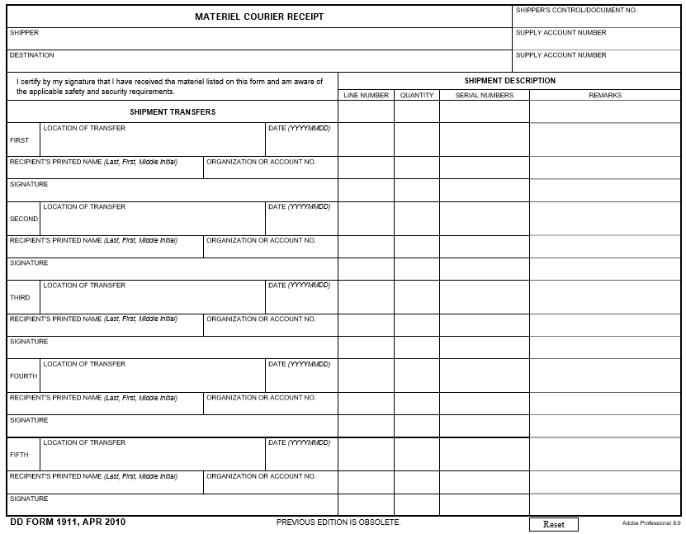
38
39
Example of DD 1911
Description of Different Sample Containers and Disk Mailers
-----------------------------Sample Bottle -----------------------------
Sample bottle containing less than 50 ml of sample, wrapped with lab film, sealed with tamper resistant tape, with absorbent material, placed into double clear plastic bags. Sample bottle and individual clear plastic bags labeled with 17 digit sample ID: *WRITE IN SAMPLE ID #
***SKIP ONE LINE***
Disk mailer sealed with tamper resistant tape, containing 1-ea BIDS incident report, and 1-ea BIO event log. Disk mailer, BIR, and BEL individually labeled with *WRITE IN SAMPLE ID #
----------------------------- Sample Extraction Bottle (SEB) -----------------------------
Sample extraction bottle (SEB) containing a dry collection filter, placed in less than 10 ml of collection fluid, wrapped with lab film, sealed with tamper resistant tape with absorbent material placed into first clear plastic bag, then placed into second clear plastic bag and individual clear plastic bags labeled with *WRITE IN SAMPLE ID #
***SKIP ONE LINE***
Disk mailer sealed with tamper resistant tape, containing 1-ea BIDS incident report, and 1-ea BIO event log. Disk mailer, BIDS incident report, and BIO event log individually labeled with *WRITE IN SAMPLE ID #
----------------------------- Teflon Sample Vial -----------------------------
Teflon sample vial containing less than 50 ml of sample, placed inside of sample rack tubes. Teflon sample vial labeled with *WRITE IN SAMPLE ID #
***SKIP ONE LINE***
Disk mailer sealed with tamper resistant tape, containing 1 each DA Form 1971-6-R. Disk mailer and DA Form 1971-6-R individually labeled with *WRITE IN SAMPLE ID #
----------------------------- Sample Vial -----------------------------
Sample vial containing less than 10 ml of sample, wrapped with laboratory film, sealed with tamper resistant tape, placed in a 50 ml conical tube with absorbent material placed in a clear bag, with all excess air removed, then placed in another clear plastic bag with all excess air removed. Sample vial, 50 ml conical tube and clear plastic bag labeled with *WRITE IN SAMPLE ID #
***SKIP ONE LINE***
Disk mailer sealed with tamper resistant tape, containing 1-ea BIDS incident report, and 1-ea BIO event log. Disk mailer, BIR, and BEL individually labeled with *WRITE IN SAMPLE ID #
----------------------------- Sample Canister -----------------------------
Sample canister containing less than 300 ml of sample, wrapped with lab film, sealed with tamper resistant tape, with absorbent material placed into first clear plastic bag, then placed into second clear plastic bag. Sample canister and individual clear plastic bags labeled with *WRITE IN SAMPLE ID #
***SKIP ONE LINE***
Disk mailer sealed with tamper resistant tape, containing 1-ea DA Form 1971-6-R. Disk mailer and DA Form 1971-6-R individually labeled with *WRITE IN SAMPLE ID #
Grid of sample collection location
Name, grade and title of person taking sample
Team ID (Ex: A TM, 1st PLT, A CO)
Destination of sample and DTG
Unit Designation (Ex: A CO, 1st BN)
1
1
Sample ID #
Description of sample taken
Grid of transfer and reason
Transfer Date
Name, grade and title of transfer recipient
Unit of transfer recipient
Signature of transfer recipient
2
1
Sample ID #
Description of disk mailer

Slide 23
40
41
Sample Collection & Evacuation
Inventory Checklist per VIC
Collection/Marking Items | Min. Required
Glove for Glove Port | 2
DWSS Wheels | 10
Marker bases, stems, and flags | 12 each
Roll of Duct Tape | 1
Teflon Sample Vials | 16
CVSS Canisters | 12
CBMS2 Probe Membrane | 2
CBMS2 Probe Union Nut | 2
Inventory Checklists for
PCCs and PCIs
Evacuation Items | Min. Required
Conical Tube | 1
8x8 Baggies | 4
10x10 Baggies | 4
Cheese Cloth | 4
Squares of Parafilm | 15
Tweezers | 1
Scissors | 1
Twisty/Zip Ties | 15
Rolls of Tamper Resistant Tape | 1
Label Stickers | 5
PPE (Latex Gloves, Goggles, Mask) | 2 each
Printer Paper | 20 Sheets
Disk Mailers | 4
CDs/Flash Drives | 4
All Required Paperwork (See next) | 5 copies of each

Slide 24
JBPDS Inventory and Sample Documentation Checklists
43
42
Miscellaneous Item Checklist
JBPDS Consumables | Minimum Required
Sample Vials | 4
Sample Bottles | 2
Detergent Bottle | 1 (min ¾ full)
DI Water Bottle | 1 (min ¾ full)
PBS Bottle | 1 (min ¾ full)
Waste Bottle | 1
Carrier Box Assembly | 1
Control Carrier Card | 1
Sample Extraction Bottle | 1
Dry Collection Filter | 4
Forceps | 1
Pipette | 1
Miscellaneous Items | Minimum Required
Fuel Cans | 4
MRE Boxes | 1
Water Jugs | 1
Ammunition | METT-TC
Map | 1
Map Marker Set | 1
Protractor | 1
Required Forms | Purpose
BIDS Incident Report | Document details of a biological incident
Biological Event Log
DA 1971-6-R | Document details of a chemical incident
DD 1911 or DA 4137 | Show chain of custody
DA 1594 (Staff Duty Log) | Document all actions taken

Slide 25
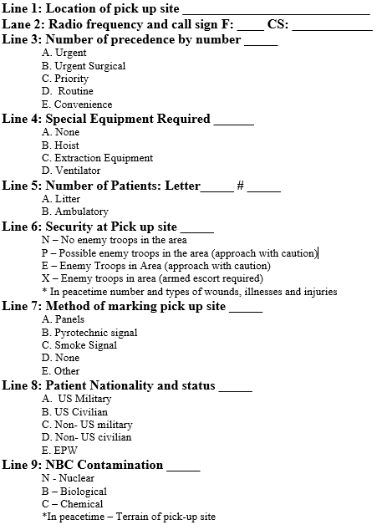
44
45
9-Line Medevac
Miscellaneous Reports

Slide 26
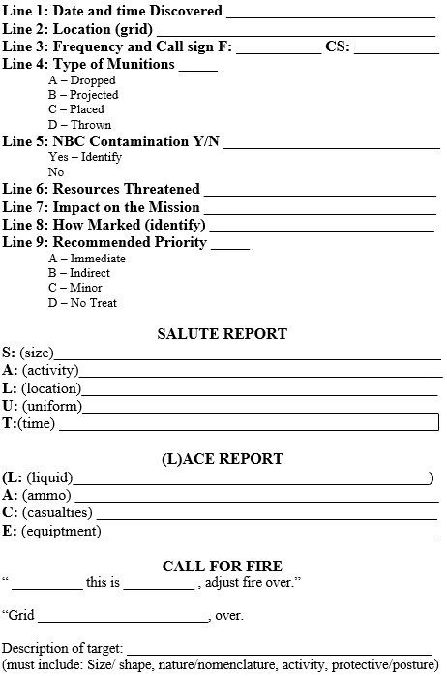
UXO, SALUTE, LACE, CFF
47
46
Marker Report (CBRN 5)
Marker 1:
CWA, BWA, or RAD
DTG__________________
Type__________________
MGRS________________
Marker 2:
CWA, BWA, or RAD
DTG__________________
Type__________________
MGRS________________
Marker 3:
CWA, BWA, or RAD
DTG__________________
Type__________________
MGRS________________
Marker 4:
CWA, BWA, or RAD
DTG__________________
Type__________________
MGRS________________
Marker 5:
CWA, BWA, or RAD
DTG__________________
Type__________________
MGRS________________
Marker 6:
CWA, BWA, or RAD
DTG__________________
Type__________________
MGRS________________
Marker 7:
CWA, BWA, or RAD
DTG__________________
Type__________________
MGRS________________
Marker 8:
CWA, BWA, or RAD
DTG__________________
Type__________________
MGRS________________
Marker 9:
CWA, BWA, or RAD
DTG__________________
Type__________________
MGRS________________
Marker 10:
CWA, BWA, or RAD
DTG__________________
Type__________________
MGRS________________
Marker 11:
CWA, BWA, or RAD
DTG__________________
Type__________________
MGRS________________
Marker 12:
CWA, BWA, or RAD
DTG__________________
Type__________________
MGRS________________

Slide 27
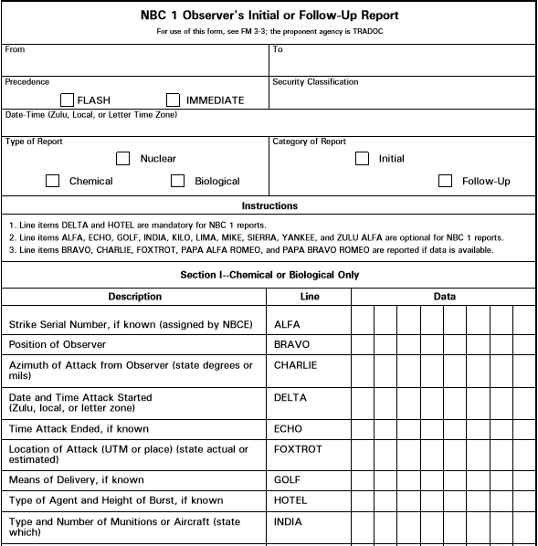
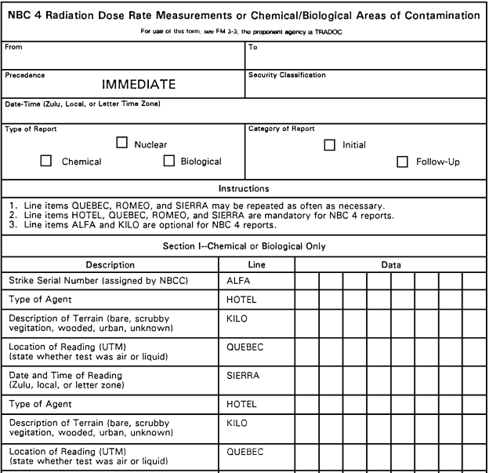
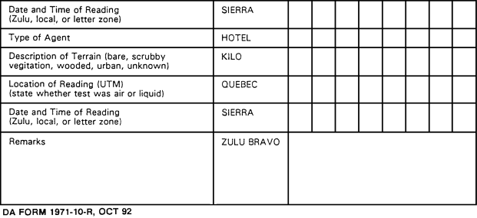
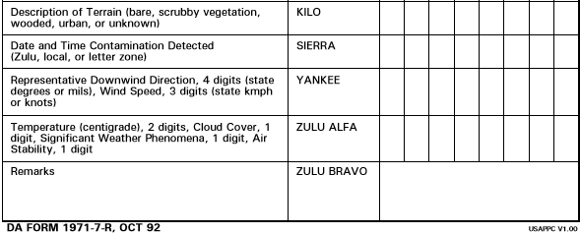
NBC-1
49
48
NBC-4

