Slide 1
SQUAD Movement to Contact
One of the four Offensive tasks
You will conduct a MTC “to develop the situation and establish or regain contact”
You will conduct a MTC when the enemy situation is vague or not specific enough to conduct an attack
You want to make contact with the smallest force as possible
A MTC may result in a “meeting engagement”
Combat action (direct fire) occurring when a moving force engages an enemy at an unexpected time and place
If the enemy engages your squad first…you must quickly react and respond (see page J-2 in TACSOP)
Fire team fight
Squad Fight
Larger than squad fight
Operational guidelines
You might be given a route, an axis, or an area to clear
Analyze the enemy situation & terrain to determine likely enemy positions
(TLPs….step 3…subset “A”)
Attempt to make visual contact first (IE the enemy doesn’t see you), assess the situation, and be prepared to execute a squad attack (hasty)
1 - Assembly Area (AA)…where TLPs occur
2 - Line of Departure (LD)
3 - Axis or Route (RT) with Rally Points
4 - Objective (OBJ)
5 - Limit of Advance (LOA)
Performance steps
TLPs in AA or patrol base
Cross LD
Movement along route/axis (using rally points) towards OBJ
Attempt to make visual contact with enemy (you don’t want him to see you first)
If visual contact is made…assess situation (enemy/terrain)
If it’s a “squad fight”…execute a hasty attack
Quickly identify SBF location
Quickly identify assault position
Emplace SBF
Maneuver assault element to assault position
Initiate fires with SBF as assault element closes with/destroys enemy
SBF shifts fire (15 degree rule…coordinated with Assault element)
Assault element clears OBJ
SBF ceases fire (15 degree rule…coordinated with Assault element)
Assault element hits LOA
Support element links up w/ Assault element on OBJ to establish hasty defense
EPW, Aid and Litter, demo, site exploitation (gain intel)
Consolidate/Reorganize
Secure OBJ (IE defend it), or move out….receive guidance from higher
If ENY makes contact with you…execute leader decisions during battle drill execution (TACSOP J-2)

Slide 2
SQUAD Attack
One of the four Offensive tasks
An attack “destroys or defeats enemy forces, seizes and secures terrain, or both”
You plan to initiate contact…instead of reacting to contact
An attack differs from a MTC because the enemy locations are at least partially known, allowing the leader to achieve greater synchronization
Deliberate attack
Conducted when there is lots of time to plan/prepare
Preplanned/coordinated employment of firepower & maneuver to close with and destroy the enemy
Hasty attack:
Conducted with little preparation (IE minutes)
Can be done as part of a MTC
Simple plan (execute violently)
Task organization
Support (Support-by-fire)
Assault
Security (if needed)
You will move along your selected route to your pre-designated OBJ rally point (ORP)
You will need to establish an ORP and conduct a leader’s recon to identify: security positions (if needed), SBF position, the assault position, and the assault element’s route to the OBJ (look for obstacles), and emplace a surveillance team (to watch for changes on the OBJ)
Leader’s Recon: SL, Support TL, Assault TL, surveillance team
ORP:
Can be occupied by force…or by recon (if there is time)
Out of sight, sound, smell of OBJ (or terrain feature away)
Primary purpose is to conduct a leader’s recon (leave GOTWA)
Adjust your plan based on the leader’s recon
While leader’s recon is out, rest of unit makes final preparations (camo, drops rucks, etc)
ORP should be secured if there is enough people
Unit returns to ORP for reconsolidation after action on OBJ
Support-by-fire position: position for you to establish setup machine guns to engage OBJ with direct fire weapons (concealed approach)
Assault position: last covered/concealed position short of the OBJ, where final preparations are made before the assault element hits OBJ
Make sure your SBF is emplaced before your assault element reaches their assault position
Initiate contact with your SBF (this will keep the enemy from seeing the assault element advancing towards them)
As the assault element moves toward the OBJ, they do not need to IMT/bound if:
Cover/concealment favors the assault element and
Enemy on OBJ has not spotted them
SBF will coordinate with assault element to shift / cease fire (15 degree rule). The following must be planned:
PACE plan for shift/lift/cease signals (visual and audible)
Assault element will clear the OBJ and reach LOA
SBF will join the assault element to form a hasty perimeter
Conduct EPW search, Aid and Litter, demo, etc.
Consolidation / Reorganization
Get guidance from higher…secure the OBJ or move out

Slide 3
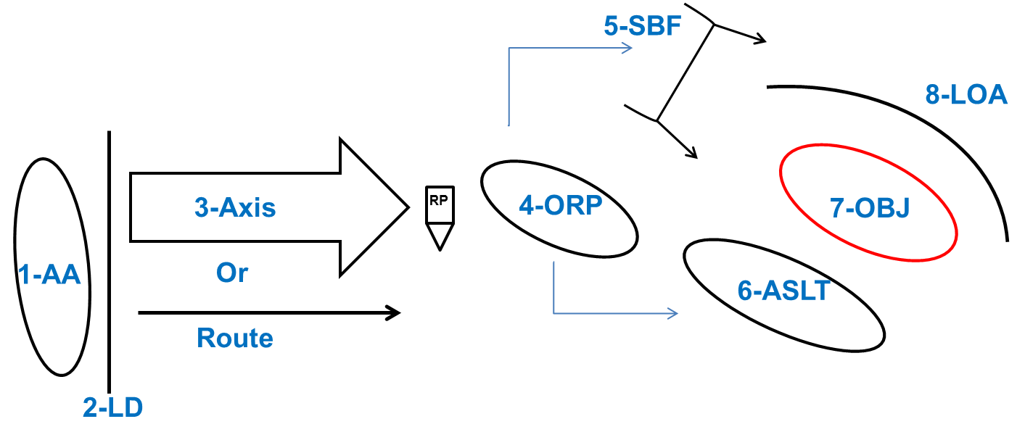
SQUAD Attack
1 – Assembly Area (AA)…where TLPs occur
2 – Line of Departure (LD)
3 – Axis of Advance
4 – ORP (leader’s recon departs from here)
5 – Support by Fire Position (SBF)
6 – Assault Position (ASLT PSN)
7 – Objective (OBJ)
8 – Limit of Advance (LOA)
Performance steps
TLPs in AA or patrol base
Cross LD
Movement along route/axis (using rally points)
Occupy ORP (by force or by recon)
Leader’s recon (issue GOTWA)
Pinpoint OBJ (confirm/deny enemy situation)
Identify SBF position
Identify Assault position
Emplace surveillance team (IVO SBF position)
Return to ORP; issue FRAGO if needed
Support element occupies SBF position
Assault element occupies assault position
SBF initiates fire
Assault element maneuvers towards OBJ
SBF shifts fire (15 degree rule…coordinated with Assault element)
SBF ceases fire (15 degree rule…coordinated with Assault element)
Assault element clears OBJ
Assault element hits LOA
Support element links up with Assault element on OBJ to establish hasty defense
EPW, Aid and Litter, demo
Grab gear from ORP
Consolidate/Reorganize
Secure OBJ (IE defend it), or move out….receive guidance from higher

Slide 4
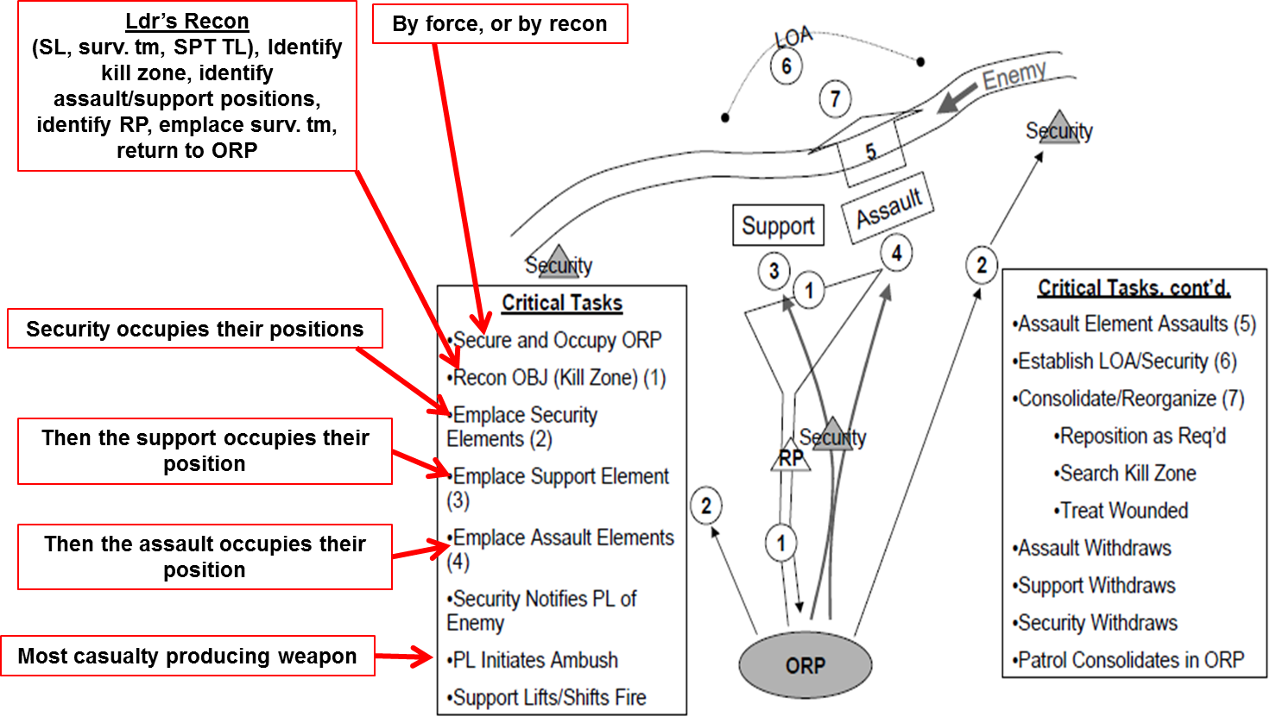
SQUAD Ambush
Starts on TACSOP page I-7
Ambush is a special purpose attack
Its “an attack from a concealed position on a moving or temporarily halted enemy”
Purpose is to destroy and/or capture personnel/equipment or to harass the enemy
Deliberate ambush
Conducted when there is lots of time to plan/prepare
Hasty ambush:
Conducted with little preparation (IE minutes)
Simple plan (execute violently)
Forms/types of ambushes
Area (PLT and larger)
Anti-armor
Point (rifle squads use this form)
Ambush formations
Linear (simplest)
L-shaped
V-shaped
Task Organization
Security
Support
Assault
Performance steps

Slide 5
SQUAD Ambush
Performance steps
TLPs in AA or patrol base
Cross LD
Movement along route/axis (using rally points)
Occupy ORP (by force or by recon)
Leader’s recon (issue GOTWA)
Identify kill zone
Identify surveillance location
Identify security positions
Identify support position
Identify assault position
Identify release point (can be same as surveillance location)
Emplace surveillance team (leave a GOTWA)
Return to ORP; issue FRAGO if needed
Security occupies their positions
Support occupies their position
Assault occupies their position
Security element warns SL of enemy
SL initiates with most casualty producing weapon
SBF shifts fire (15 degree rule…coordinated with Assault element)
SBF ceases fire (15 degree rule…coordinated with Assault element)
Assault element clears kill zone; hits LOA
EPW, Aid and Litter, demo etc.
Assault returns to ORP
Support returns to ORP
Security elements return to ORP
Squad consolidates/reorganizes in ORP

Slide 6
SQUAD Recon
Starts on TACSOP page H-1
Recon is used to gather information on the enemy or terrain
Avoid enemy contact…be light and stealthy
3 types of recon
Area: focuses on obtaining detailed info about the enemy, terrain, or civil consideration in a certain area.
Zone: obtains detailed information about a specific route and terrain where the enemy could influence movement along a route
Route: involves a directed effort to obtain detailed information on all routes, obstacles, terrain, enemy forces, or specific civil considerations within a zone defined by boundaries
Squads mainly execute Area Recons
Reconnaissance Team: Reconnaissance teams reconnoiter the objective area from various vantage points once the security teams are in position. Normally reconnaissance teams are two-Soldier teams (buddy teams), to reduce the possibility of detection.
Reconnaissance and Security Team: You normally use R&S teams in a zone reconnaissance, but they may be useful in any situation when it is impractical to separate reconnaissance and security.
Security Element: When the responsibilities for reconnaissance and security are separate, the security element provides security at danger areas, secures the objective rally point (ORP), isolates the objective, and supports the withdrawal of the rest of the platoon once the recon is complete. The security element may have separate security teams, each with an assigned task or sequence of tasks.
Surveillance Team: The surveillance team is a two-Soldier team that you place at a static vantage point. It observes the objective for an extended or determined period and gathers PIR or IR on the enemy or the objective. A surveillance team differs from a recon team in that the recon team maneuvers around the objective on multiple approaches in order to observe the objective from many vantage points.
Recon patrols should produce detailed OBJ sketches to include:
Enemy/Friendly Infil and exfil routes
Building locations (to include building construction materials)
Composition/disposition/strength of enemy
Locations of doors/windows (direction of opening)
Recon patrols should take photos/videos when possible

Slide 7
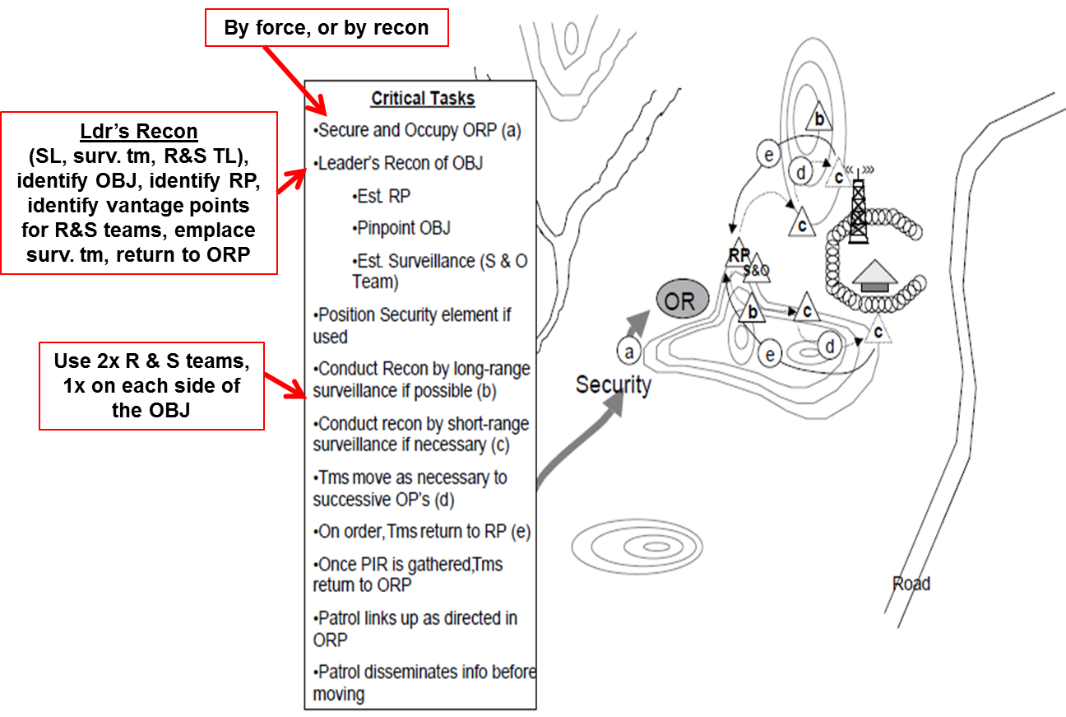
SQUAD Recon
Performance steps
TLPs in AA or patrol base
Cross LD
Movement along route/axis (using rally points)
Occupy ORP (by force or by recon)
Leader’s recon (issue GOTWA)
Pinpoint OBJ
Identify surveillance location
Identify vantage points for the R & S teams
Identify release point (can be same as surveillance location)
Emplace surveillance team (leave a GOTWA)
Return to ORP; issue FRAGO if needed
R & S teams move to RP and then conduct their reconnaissance (SALUTE)
After set amount of time, R & S teams return to RP
R & S teams determine if they have gathered enough intel; if so, they return to ORP
Squad consolidates/reorganizes in ORP

Slide 8
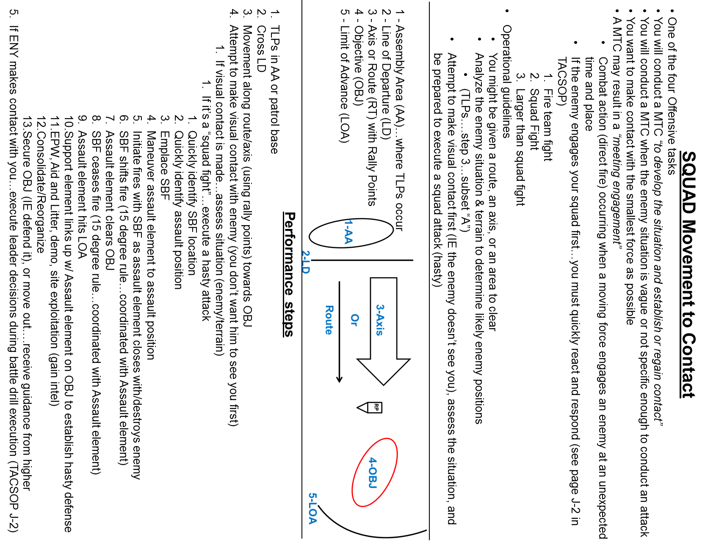
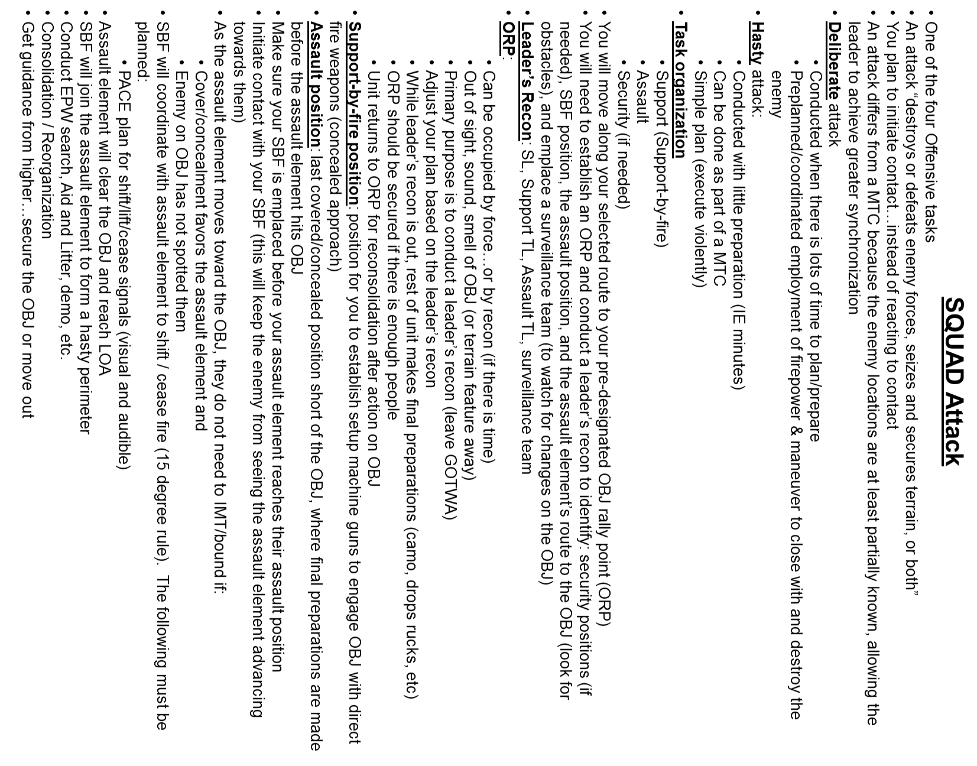

Slide 9
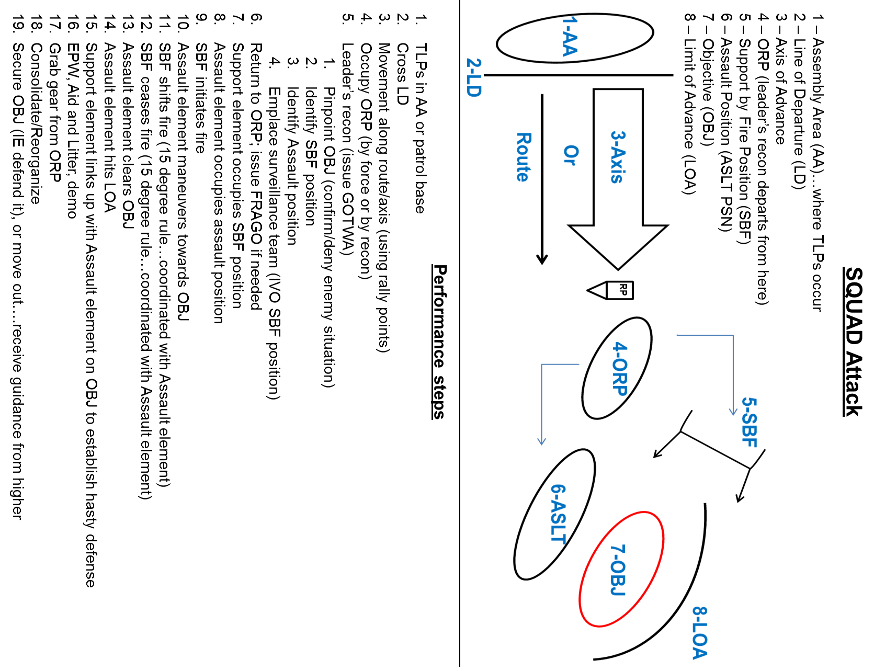
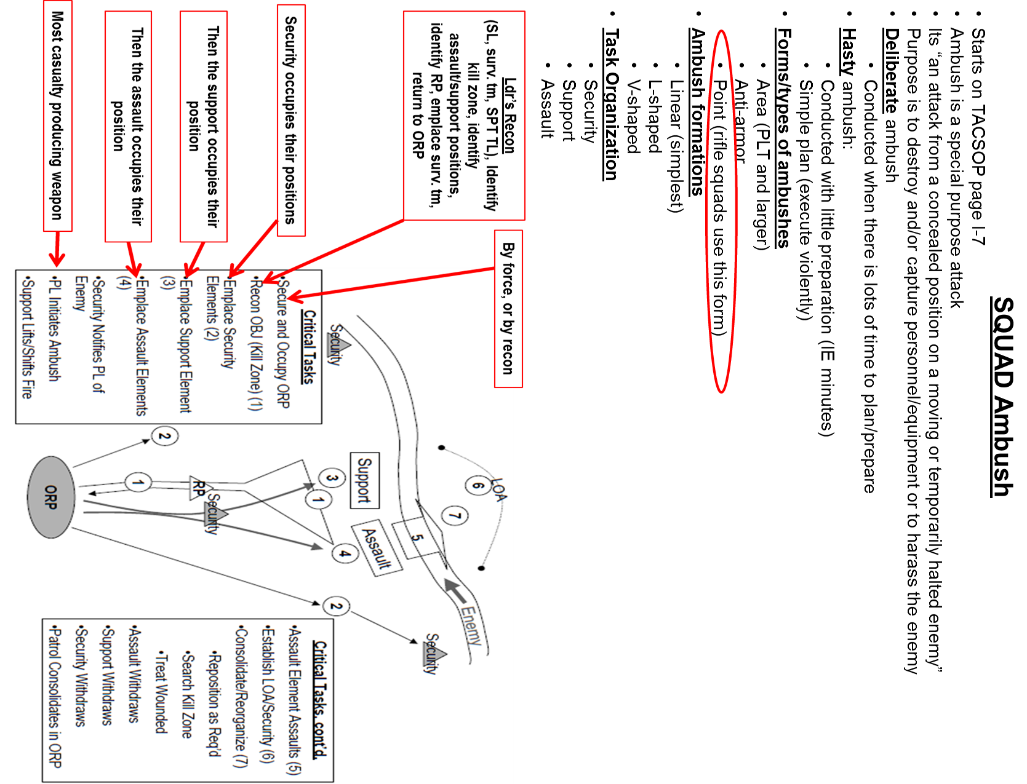

Slide 10
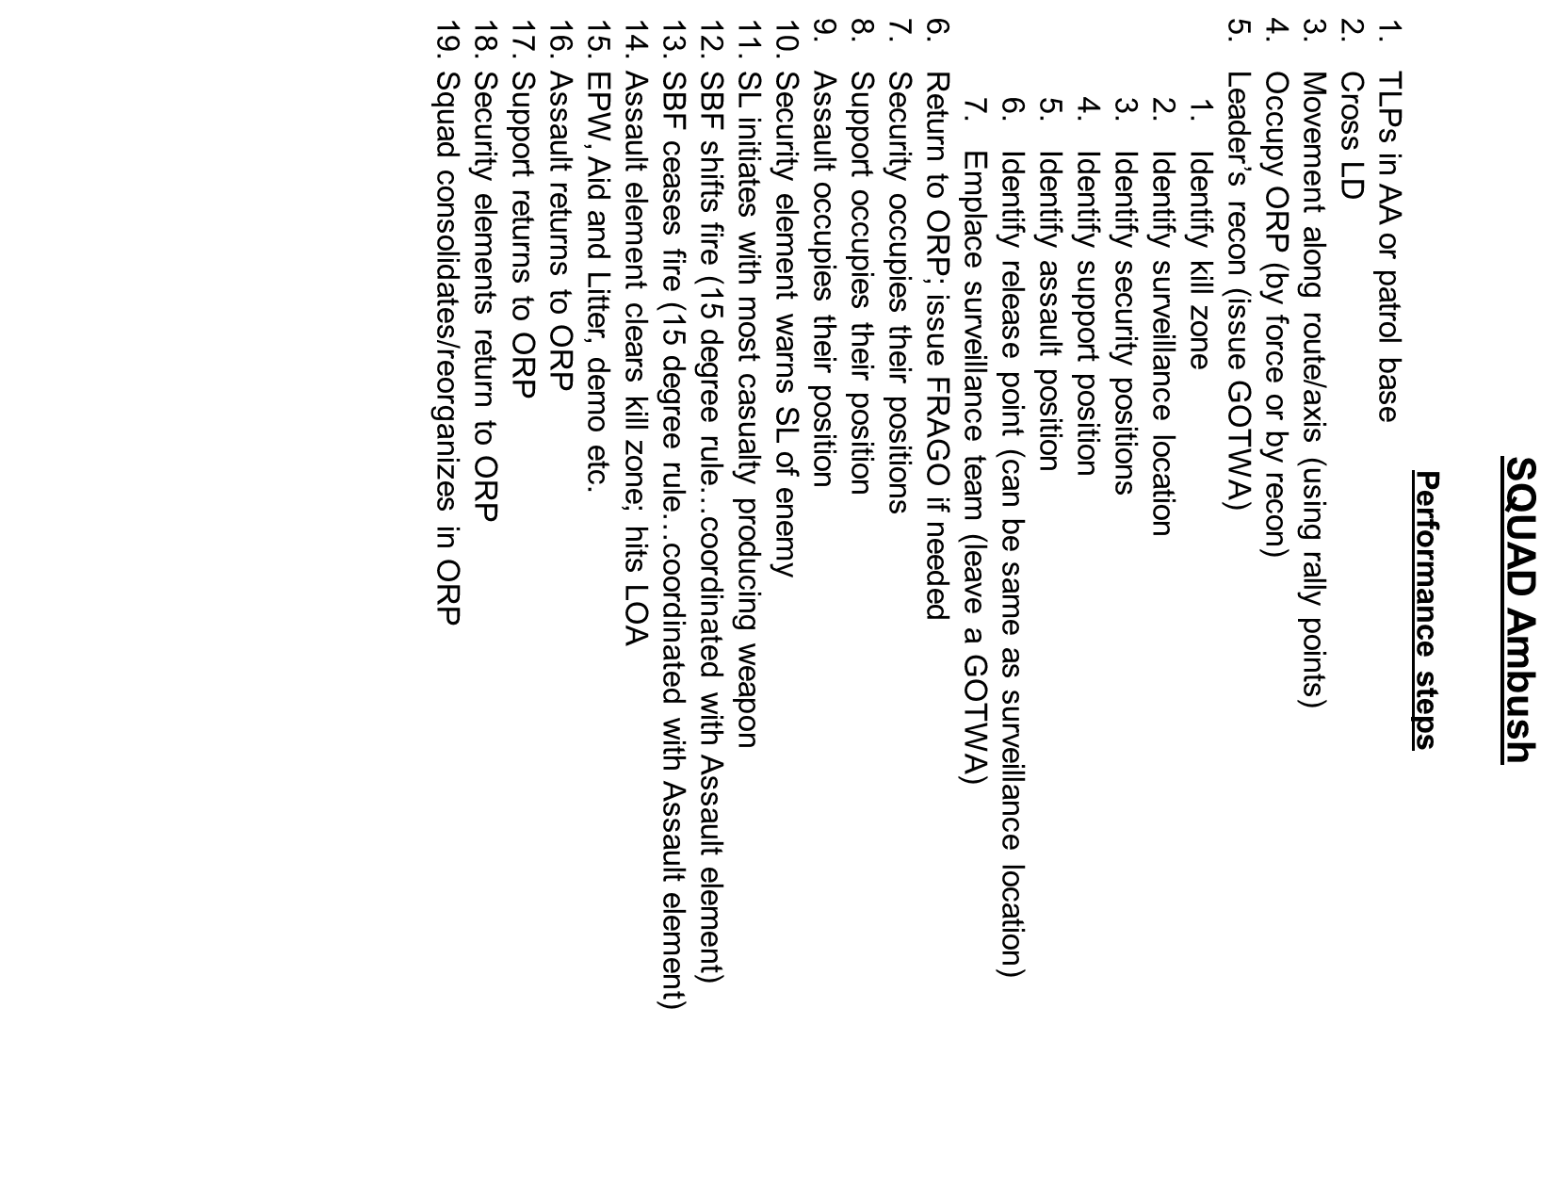
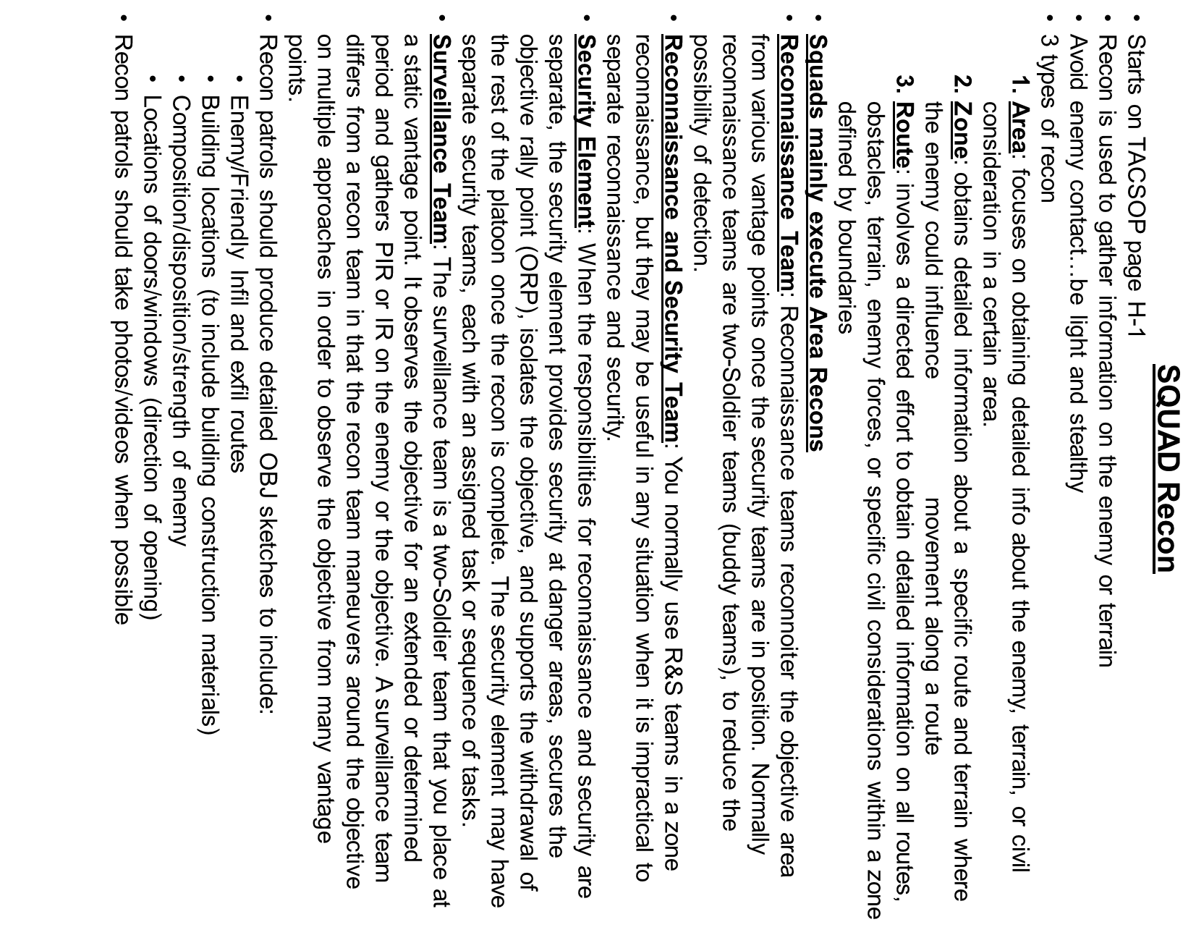

Slide 11
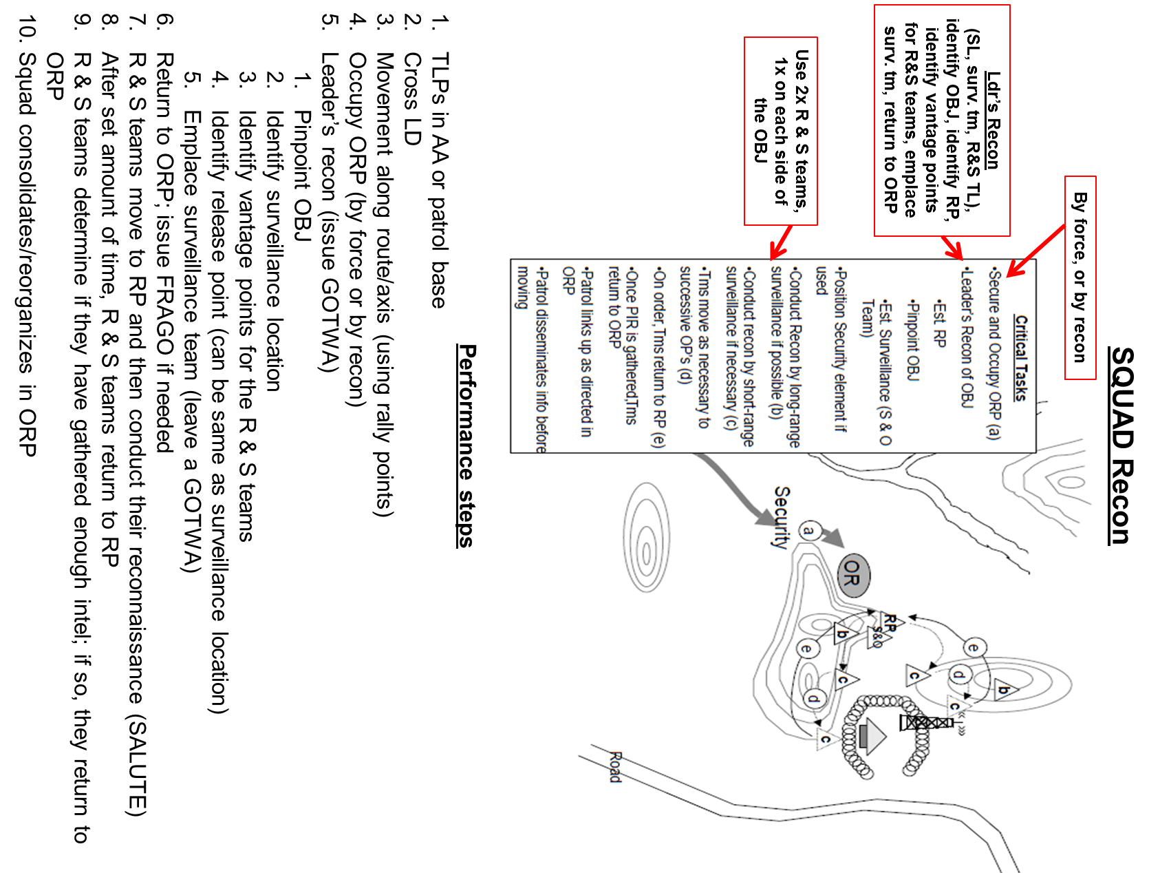

Slide 12
Print slide 13, flip over and print slide 14 (top of page is next to back wall)
Print slide 15, flip over and print slide 16 (top of page is next to back wall)

