Slide 1
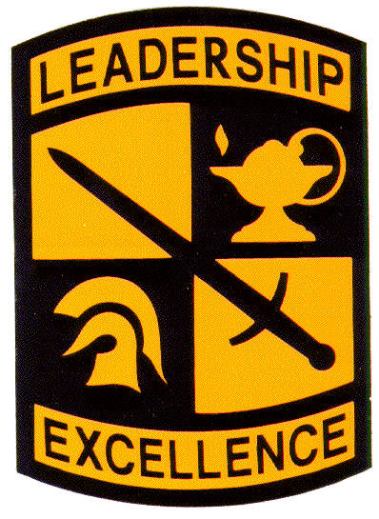

Fighting Eagles TACSOP
EWU ARMY ROTC
Front Cover (this is laminated)
As of 20 September 2016
References
ATP 3-21.8 “Infantry Platoon and Squad”
ADRP 3-90 “Offense and Defense”
The Ranger Handbook
ATP 3-20.98 “Reconnaissance Platoon”
TC 3-21.75 “The Warrior Ethos and Soldier Combat Skills”
EWU ARMY ROTC

Slide 2
Table of Contents
A. General
A-1 Army’s definition of leadership
A-1 Schofield’s definition of discipline
A-2 Rules of Thumb
A-3 Infantry Platoon Task Organization
B. Duties and Responsibilities
C. Unified Land Operations
C-1 Overview
C-2 Elements of Decisive Action
C-3 Warfighting Functions (WFFs)
D. Planning
D-1 Parallel Planning
D-2 TLPs
D-3 1/3-2/3 Rule & backwards planning
D-4 METT-TC
D-5 OAKOC
D-6 ASCOPE
D-7 WARNO
D-8 OPORD
D-9 FRAGO
D-9 Elements common to all patrols
D-10 Rehearsals
D-11 PCCs & PCIs
D-13 Tactical Mission Tasks
D-17 Fire Control Measures
E. Offense
E-1 Characteristics
E-3 Offensive Tasks
E-6 5 Forms of Maneuver
F. Defense
F-1 Characteristics
F-2 Defensive Tasks
F-7 Forms of the Defense
F-10 Battle Positions
F-11 Engagement Area Development
G. Patrolling
G-1 5 Principles of Patrolling
G-1 GOTWA
G-2 Security Halts
G-4 Objective Rally Point (ORP)
G-6 Patrol Base Operations
G-7 Patrol Base Occupation
G-8 Priorities of Work
G-10 Leader's Recon
G-11 Hand and Arm Signals
G-13 Signals and Passwords
G-14 Individual Movement Techniques
G-16 Movement Formations
G-26 Movement Techniques
G-32 Troop Movement Types
G-33 Range Cards
G-35 Sector Sketches
G-38 Danger Areas
H. Reconnaissance
H-1 Fundamentals of Recon
H-2 3 Types of Recon Patrols
H-3 Area Recon
H-6 Zone Recon
I. Combat Patrols
I-1 Combat Patrols
I-2 Combat Patrol Planning
I-3 Raid
I-7 Ambush Fundamentals
I-10 Deliberate Ambush
I-14 Hasty Ambush
J. Battle Drills
J-1 Battle Drills
J-2 Leader Decisions of Battle Drill Execution
J-4 Battle Drill #1: React to Direct Fire Contact
J-6 Battle Drill #2: Platoon Assault
J-10 Battle Drill #2A: Squad Assault
J-12 Battle Drill #3: Break Contact
J-14 Battle Drill #4: React to Ambush (near)
J-16 Battle Drill #5: Knock out a Bunker
J-18 Battle Drill #6: Enter and Clear a Room
J-20 Battle Drill #9: React to Indirect Fire
J-21 Battle Drill #11: React to IED
K. Medical
K-1 Tactical Combat Casualty Care (TC3)
K-3 Medical Evacuation Precedence Categories
L. Camouflage
M. Key Leader Engagements
N. Reports/Requests
N-1 Call for Fire Request
N-3 Close Combat Aviation Request
N-4 MEDEVAC request (w/ MIST)
N-5 UXO Report
N-6 SALUTE
N-7 LACE
O. Radio Operations (ASIP)
P. Miscellaneous
P-1 Escalation of Force
P-1 Classes of Supply
P-1 Weapons Data
P-2 Weapons Control Status
P-3 Weapons Clearing Procedures
EWU ARMY ROTC

Slide 3
Leadership Philosophies
Army leadership is “the process of influencing people by providing purpose, direction, and motivation to accomplish the mission and improve the organization.”
Schofield’s Definition of Discipline
The discipline which makes the soldiers of a free country reliable in battle is not to be gained by harsh or tyrannical treatment.
On the contrary, such treatment is far more likely to destroy than to make an army. It is possible to impart instructions and to give commands in such a manner and in such a tone of voice as to inspire in the soldier no feeling but and intense desire to obey, while the opposite manner and tone of voice cannot fail to excite strong resentment and a desire to disobey. The one mode or other of dealing with subordinates springs from a corresponding spirit in the breast of the commander. He who feels the respect which is due others cannot fail to inspire in them regard for himself; while he who feels, and hence manifests, disrespect toward other, especially his inferiors, cannot fail to inspire hatred against himself.
General
A - 1

Slide 4
Rules of Thumb
1. Squads and platoons fight through enemy contact at the lowest possible level.
2. Squads in contact must establish effective suppressive fire before they or other squads can maneuver. If the squad cannot move under its own fires, the platoon must attempt to gain suppressive fires and then maneuver against the enemy position.
3. Platoons and squads will fight as organized with fire teams and squads retaining their integrity. Even buddy teams stay the same. The team leader and the automatic rifleman form one buddy team, and the grenadier (M203) and a rifleman form the other buddy team.
4. Success depends upon all soldiers understanding what the platoon is trying to do and the specific steps necessary to accomplish the mission.
5. The platoon leader never waits for the squad in contact to develop the situation. Anytime a fire team makes contact, the platoon also begins taking action. That way the platoon can quickly provide additional support, maneuver to take up the assault, or follow-up on the success of the squad that made contact.
See the enemy; PID – shoot first, talk second.
Never use the same route in and out
TLs lead by example: “Do as I do, go where I go, fire at what I’m firing at”
SLs – your actions/decisions will win or lose the fight
Someone is always over-watching my movement
Shooting while moving is the exception rather than the rule (except in MOUT)
Never do anything for the first time – recon, rehearse, coordinate with replacing unit
Never get surprised, never get your flank rolled-up, always cover your sector
Make the enemy fight you in two directions
Fight from high ground to low ground
Don’t wait for anyone to train your PLT, SQD, TM
DOMINATE THE 15 SECOND FIGHT!!!
The first 15 seconds of any contact are critical. Fighting Eagles dominate the first 15 Second Fight. Leaders and soldiers who PID the threat and react quickly (within 15 seconds) placing effective fire on the enemy will gain the initiative and dictate the terms of the remainder of the battle.
General
A - 2

Slide 5
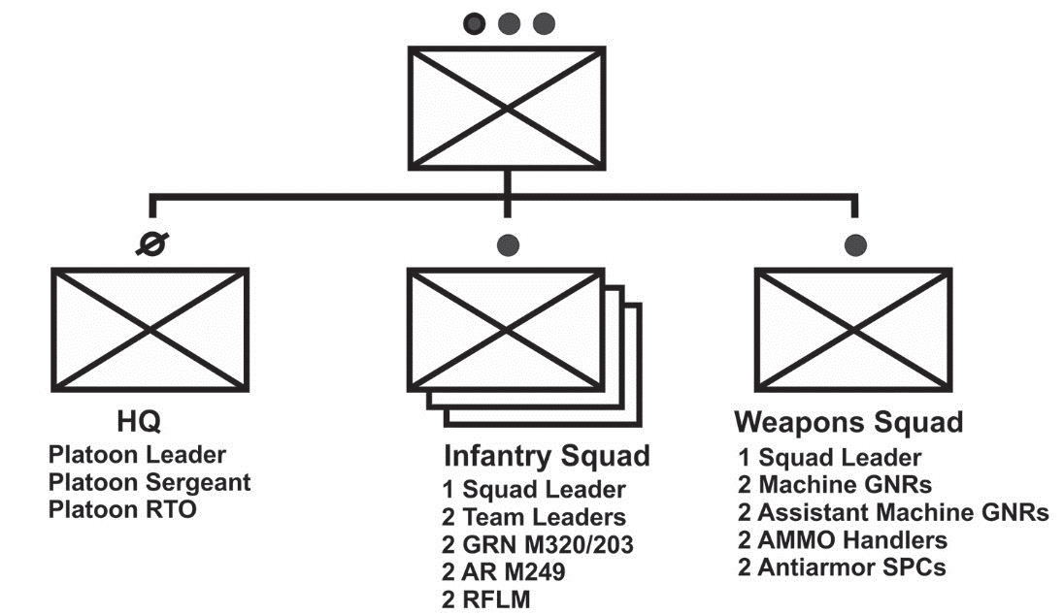
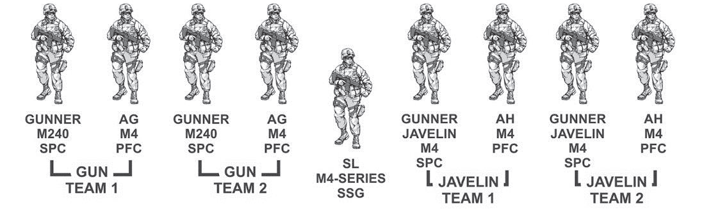
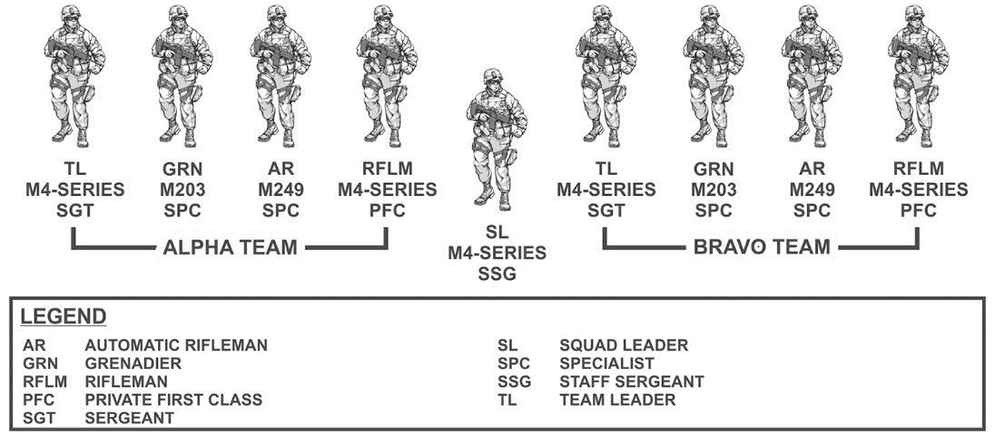
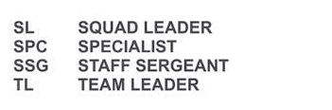

Infantry Platoon Task Organization
Weapons
Squad
Infantry
Squad
General
A - 3

Slide 6
Platoon Leader
The platoon leader leads his Soldiers by personal example and is responsible for all the platoon does or fails to do, having complete authority over his subordinates. This centralized authority enables him to maintain unit discipline, unity, and to act decisively. He must be prepared to exercise initiative within his company commander’s intent and without specific guidance for every situation. The platoon leader knows his Soldiers, how to employ the platoon, its weapons, and its systems. Relying on the expertise of the platoon sergeant, the platoon leader regularly consults with him on all platoon matters. During operations, the platoon leader—
Leads the platoon in supporting the higher headquarters missions. He bases his actions on his assigned mission and intent and concept of his higher commanders.
Conducts troop leading procedures.
Maneuvers squads and fighting elements.
Synchronizes the efforts of squads.
Looks ahead to the next “move” of the platoon.
Requests, controls, and synchronizes supporting assets.
Employs mission command systems available to the squads and platoon. Checks with squad leaders ensuring 360-degree, three-dimensional security is maintained.
Checks with weapons squad leader controlling the emplacement of key weapon systems.
Issues accurate and timely reports.
Places himself where he is most needed to accomplish the mission.
Assigns clear tasks and purposes to the squads.
Understands the mission and commander’s intent two levels up (company and battalion).
Receives on-hand status reports from the platoon sergeant and squad leaders during planning.
Coordinates and assists in the development of the obstacle plan.
Oversees and is responsible for property management.
The platoon leader works to develop and maintain situational understanding. This is a product of four elements. First, the platoon leader attempts to know what is happening in present terms of friendly, enemy, neutral, and terrain situations. Second, he knows the end state representing mission accomplishment. Third, he determines the critical actions and events occurring to move his unit from the present to the end state. Finally, he assesses the risk throughout.
Duties and Responsibilities
B - 1

Slide 7
Platoon Sergeant
The platoon sergeant is the platoon's most experienced NCO and second-in-charge, accountable to the platoon leader for leadership, discipline, training, and welfare of the platoon's Soldiers. He sets the example in everything. He assists the platoon leader by upholding standards and platoon discipline. His expertise includes tactical maneuver, employment of weapons and systems, sustainment, administration, security, accountability, protection warfighting functions, and Soldier care. As the second-in charge, the platoon sergeant assumes no formal duties except those prescribed by the platoon leader. However, the platoon sergeant traditionally—
Ensures the platoon is prepared to accomplish its mission, which includes supervising precombat checks and inspections.
Updates platoon leader on appropriate reports and forwards reports needed by higher headquarters.
Prepares to assume the role and responsibilities of the platoon leader.
Takes charge of task-organized elements in the platoon during tactical operations, which may include but is not limited to, quartering parties, support elements in raids or attacks, and security patrols.
Monitors the morale, discipline, and health of the platoon.
Positions where best needed to help the engagement (either in the base of fire or with the assault element).
Receives squad leaders’ administrative, logistical, and maintenance reports, and requests rations, water, fuel, and ammunition.
Requests logistical support from the higher headquarters, and usually coordinates
with the company’s first sergeant or executive officer.
Ensures Soldiers maintain all equipment.
Ensures ammunition and supplies are properly and evenly distributed after the platoon consolidates on the objective and while the platoon reorganizes.
Manages the unit’s combat load prior to operations, and monitors logistical status during operations.
Establishes and operates the unit’s casualty collection point (CCP). This includes directing the platoon medic and aid/litter teams in moving casualties, maintains platoon strength level information, consolidates and forwards the platoon’s casualty reports, and receives and orients replacements.
Employs the available digital mission command systems to the squads and platoon.
Ensures Soldiers distribute supplies according to the platoon leader’s guidance and direction.
Accounts for Soldiers, equipment, and supplies.
Coaches, counsels, and mentors Soldiers.
Upholds standards and platoon discipline.
Understands the mission and commander’s intent two levels up (company and battalion).
Duties and Responsibilities
B - 2

Slide 8
Weapons Squad Leader
The weapons squad leader leads his teams by personal example. He has complete authority over his subordinates and overall responsibility for those subordinates’ actions. This centralized authority enables him to act decisively while maintaining troop discipline and unity. Under the fluid conditions of modern warfare, he accomplishes assigned missions using disciplined initiative without needing constant guidance from higher headquarters.
The weapons squad leader is usually the senior squad leader, second only to the platoon sergeant, and performs all the duties of the rifle squad leader. In addition, the weapons squad leader—
Controls fires and establishes fire control measures.
Recommends medium machine gun employment to the platoon leader.
Coordinates directly with the platoon leader for medium machine gun base-of-fire effect, and plans accordingly.
Monitors ammunition expenditure.
Coordinates directly with the platoon leader in placement of the Javelin-CCMS to best cover armored avenues of approach in the defense and overwatch positions in the attack.
Employs mission command systems available to the squad and platoon.
Performs the role of the platoon sergeant as required.
Conducts troop leading procedures.
Understands the mission two levels up (platoon and company).
Duties and Responsibilities
B - 3

Slide 9
Squad Leader
The squad leader directs team leaders and leads by personal example. He has authority over his subordinates and overall responsibility of those subordinates’ actions. Centralized authority enables him to act decisively while maintaining troop discipline and unity. Under the fluid conditions of close combat, the squad leader accomplishes assigned
missions without constant guidance from higher headquarters.
The squad leader is the senior Infantry Soldier in the squad and is responsible for everything the squad does or fails to do. He is responsible for the care of the squad’s Soldiers, weapons, and equipment, and leads the squad through two team leaders. During operations, the squad leader—
Is the subject matter expert on all battle and individual drills.
Is the subject matter expert for the squad’s organic weapons employment, and employment of supporting assets.
Knows weapon effects, surface danger zones, and risk estimate distances for all munitions.
Uses control measures for direct fire, indirect fire, and tactical movement effectively.
Controls the movement of the squad and its rate and distribution of fire (including call for and adjust fire).
Fights the close fight by fire and movement with two fire teams and available supporting weapons.
Selects the fire team’s general location and temporary sector of fires in the defense.
Communicates timely and accurate situation reports (SITREPs) and status reports including—
Size, activity, location, unit, time, and equipment (SALUTE) spot reports (SPOTREPs).
Status to the platoon leader (including squad location and progress, enemy situation, enemy KIA and security posture).
Status of ammunition, casualties, and equipment to the platoon sergeant.
Employs digital mission command systems available to the squad and PLT.
Operates in all environments to include the urban environment.
Conducts troop leading procedures.
Assumes duties as the platoon sergeant or platoon leader as required
Understands the mission and commander’s intent two levels up (platoon and company).
Duties and Responsibilities
B - 4

Slide 10
Team Leader
The team leader leads his team members by personal example and has authority over his subordinates and overall responsibility of their actions. Centralized authority enables him to maintain troop discipline and unity and to act decisively. Under the fluid conditions of close combat, he accomplishes assigned missions using initiative without needing constant guidance from higher headquarters.
The team leader’s position on the battlefield requires immediacy and accuracy in all of his actions and is a fighting leader who leads by example. He is responsible for all his team does or fails to do, and is responsible for caring of the team’s Soldiers, weapons, and equipment. During operations, the team leader—
Is the subject matter expert for all the team’s weapons and duty positions and all squad battle drills.
Leads his team in fire and movement.
Controls the movement of his team and its rate and distribution of fire.
Employs digital mission command systems available to the squad and platoon.
Ensures security of the team’s area of operations.
Assists the squad leader as required.
Is prepared to assume the duties of squad leader and platoon sergeant.
Enforces field discipline and preventive medicine measures.
Determines his team’s combat load and manages its available classes of supply as required.
Understands the mission two levels up (squad and platoon).
When maneuvering the team, the team fights using one of three techniques. This includes:
Individual movement techniques. This is the lowest level of movement.
Buddy team fire and movement.
Fire team fire and movement (maneuver).
Determining a suitable technique is based on the effectiveness of the enemy’s fire and available cover and concealment. The more effective the enemy’s fire, the lower the level of movement. Because the team leader leads his team, he is able to make this assessment firsthand. Other leaders must be sensitive to his decision on movement.
Duties and Responsibilities
B - 5

Slide 11
Radio Telephone Operator
The platoon radiotelephone operator (RTO) primarily is responsible for communication with its controlling headquarters (usually the company). During operations, the RTO—
Has communications at all times. If communication with the platoon’s next higher element is lost, the radiotelephone operator immediately informs the platoon leader or platoon sergeant and reestablishes communication.
Conducts radio checks with higher according to unit standard operating procedures when in a static position. If radio contact cannot be made as required, he informs the platoon sergeant or platoon leader.
Is an expert in radio procedures and report formats such as close combat attack call for indirect fire, or medical evacuation. Plus is an expert on types of field expedient antennas.
Has the frequencies and call signs on his person in a location known to all Soldiers in the platoon.
Assists the platoon leader with information management.
Assists the platoon leader and platoon sergeant employing digital mission command systems with the squads and platoon.
Determines his combat load prior to operations and manages battery utilization during operations.
Duties and Responsibilities
B - 6

Slide 12
Machine Gun Teams
MACHINE GUNNER
The gunner is normally the senior member of the medium machine gun team. During operations, the gunner—
Is responsible for his assistant gunner and all the gun equipment.
Is responsible for putting the gun in and out of action.
Is the subject matter expert for information contained in FM 3-22.68.
When attached to a rifle squad, is the subject matter expert for employment of the medium machine gun, and advises the rifle squad leader of the best way to employ the medium machine gun.
Enforces field discipline while the gun team is employed tactically.
Knows the ballistic effects of the weapon on all types of targets.
Assists the weapons squad leader and is prepared to assume his responsibilities.
Understands the mission two levels up (squad and platoon).
ASSISTANT MACHINE GUNNER
The assistant gunner is the second member of the gun team. He is prepared to assume the gunner’s role in any situation. During operations, the assistant gunner—
Provides a supply of ammunition to the gun when employed.
Spots rounds and reports recommended corrections to the gunner.
Constantly updates the weapons squad leader on the round count and serviceability of the medium machine gun.
Watches for Soldiers to the flanks of the target area or between the gun and target.
Obtains ammunition from other Soldiers who are carrying 7.62-mm machine gun ammunition.
Immediately assumes the role of gunner if the gunner is unable to continue his duties.
Understands the mission two levels up (squad and platoon).
Duties and Responsibilities
B - 7

Slide 13
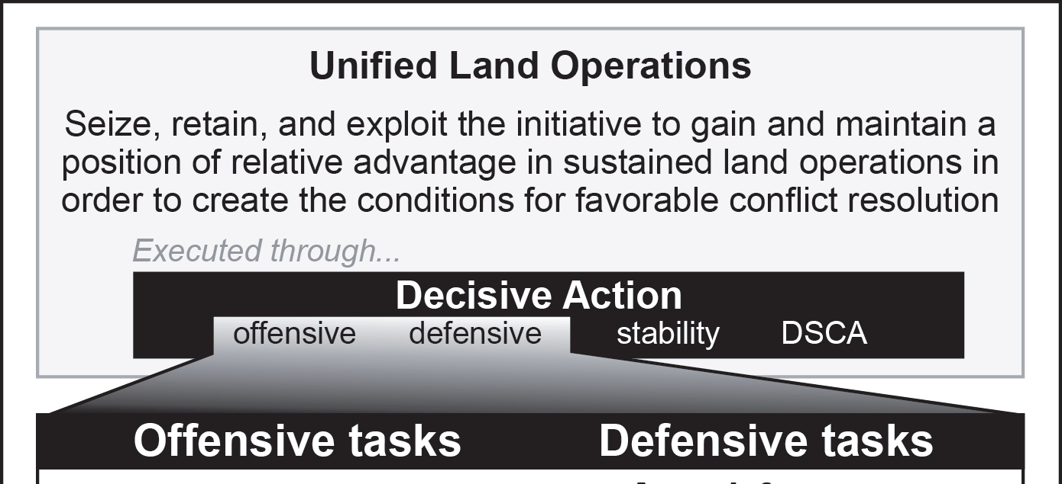
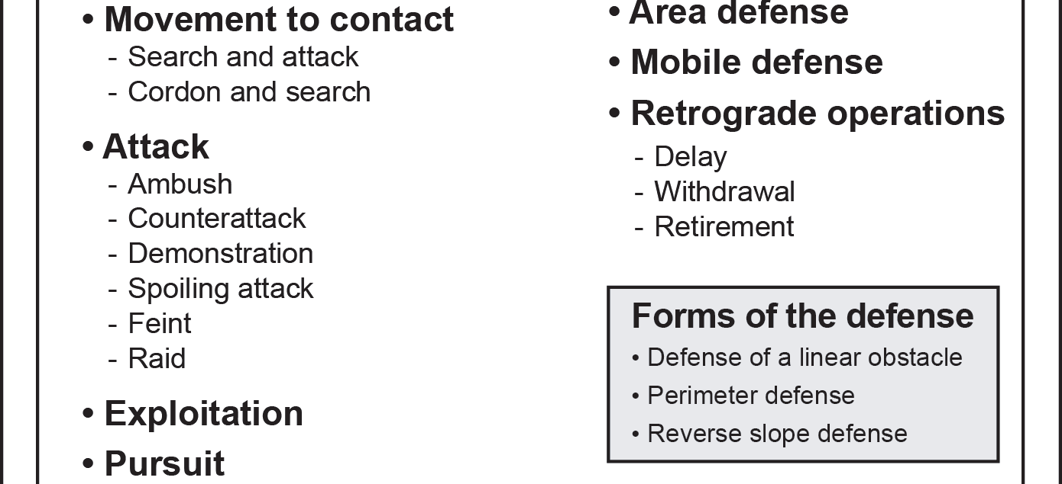
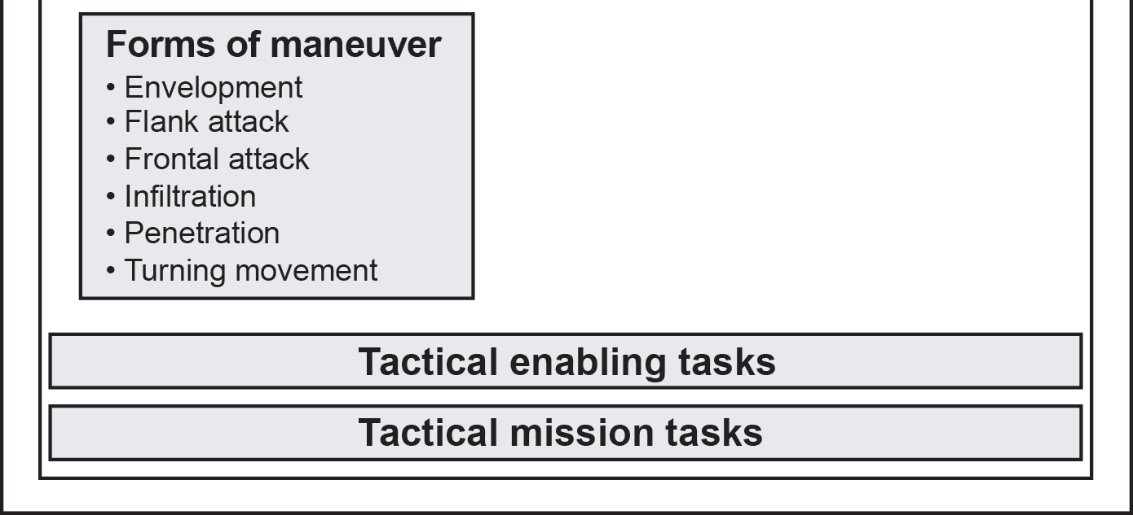
Unified Land Operations
Unified Land Operations
C - 1

Slide 14
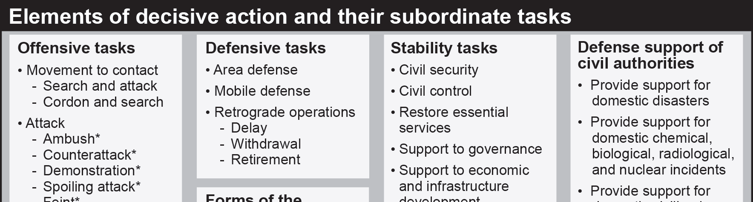
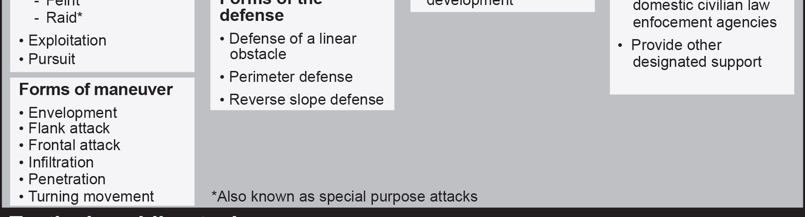
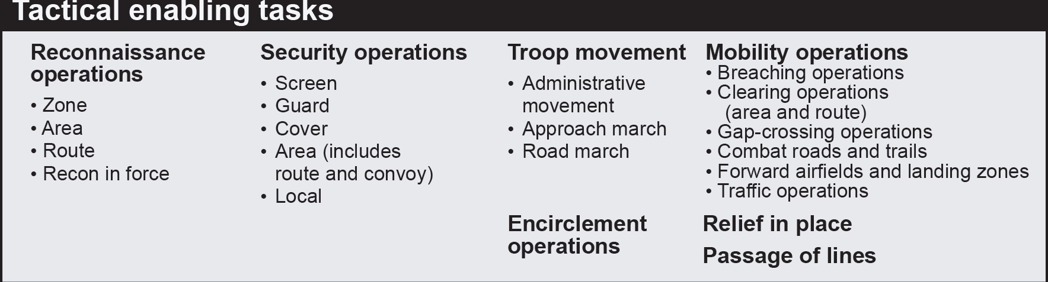
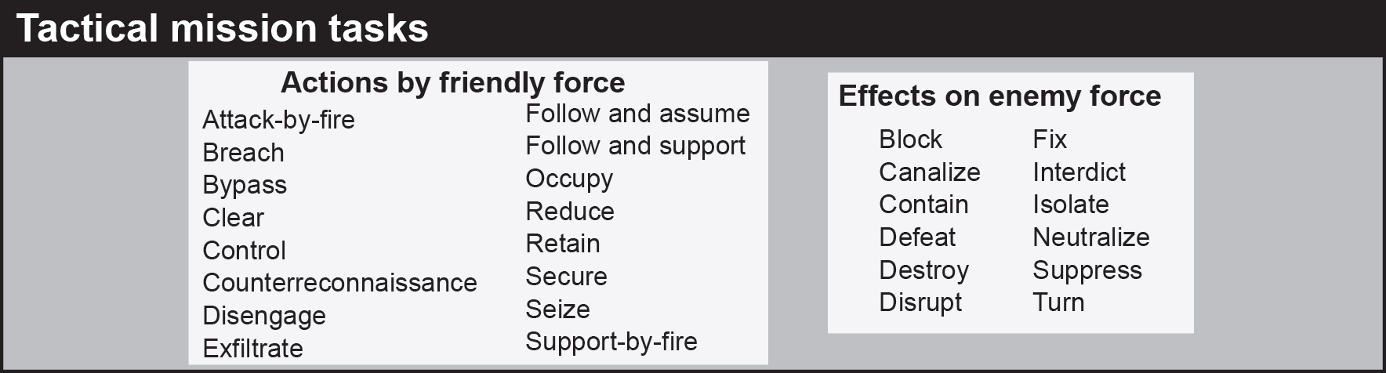
Unified Land Operations
Unified Land Operations
C - 2

Slide 15
6 Warfighting Functions (WFFs)
The mission command WFF is the related tasks and systems that develop and integrate those activities enabling a commander to balance the art of command and the science of control in order to integrate the other WFF
The movement and maneuver WFF is the related tasks and systems that move and employ forces to achieve a position of relative advantage over the enemy and other threats. Direct fire and close combat are inherent in maneuver.
The intelligence WFF is the related tasks and systems that facilitate understanding the enemy, terrain, and civil considerations.
The fires WFF is the related tasks and systems that provide collective and coordinated use of Army indirect fires, air and missile defense, and joint fires through the targeting process .
The sustainment WFF is the related tasks and systems that provide support and services to ensure freedom of action, extend operational reach, and prolong endurance.
The protection WFF is the related tasks and systems that preserve the force so the commander can apply maximum combat power to accomplish the mission.
Unified Land Operations
C - 3

Slide 16
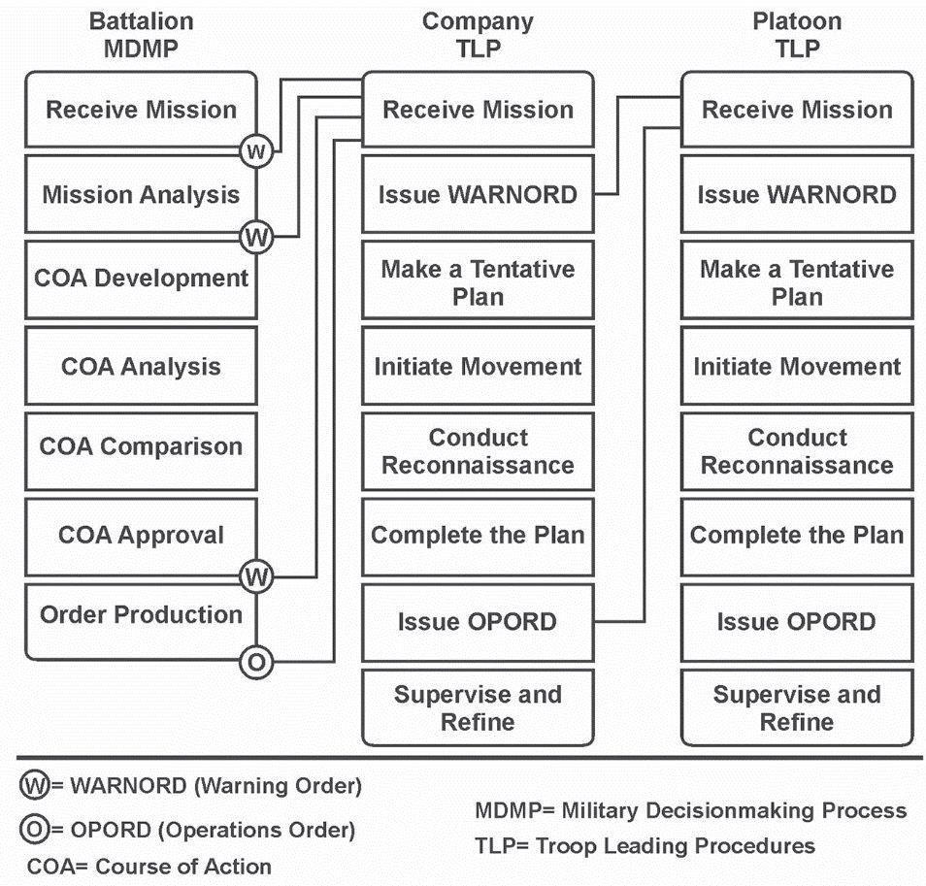
Parallel Planning
Planning
D - 1

Slide 17
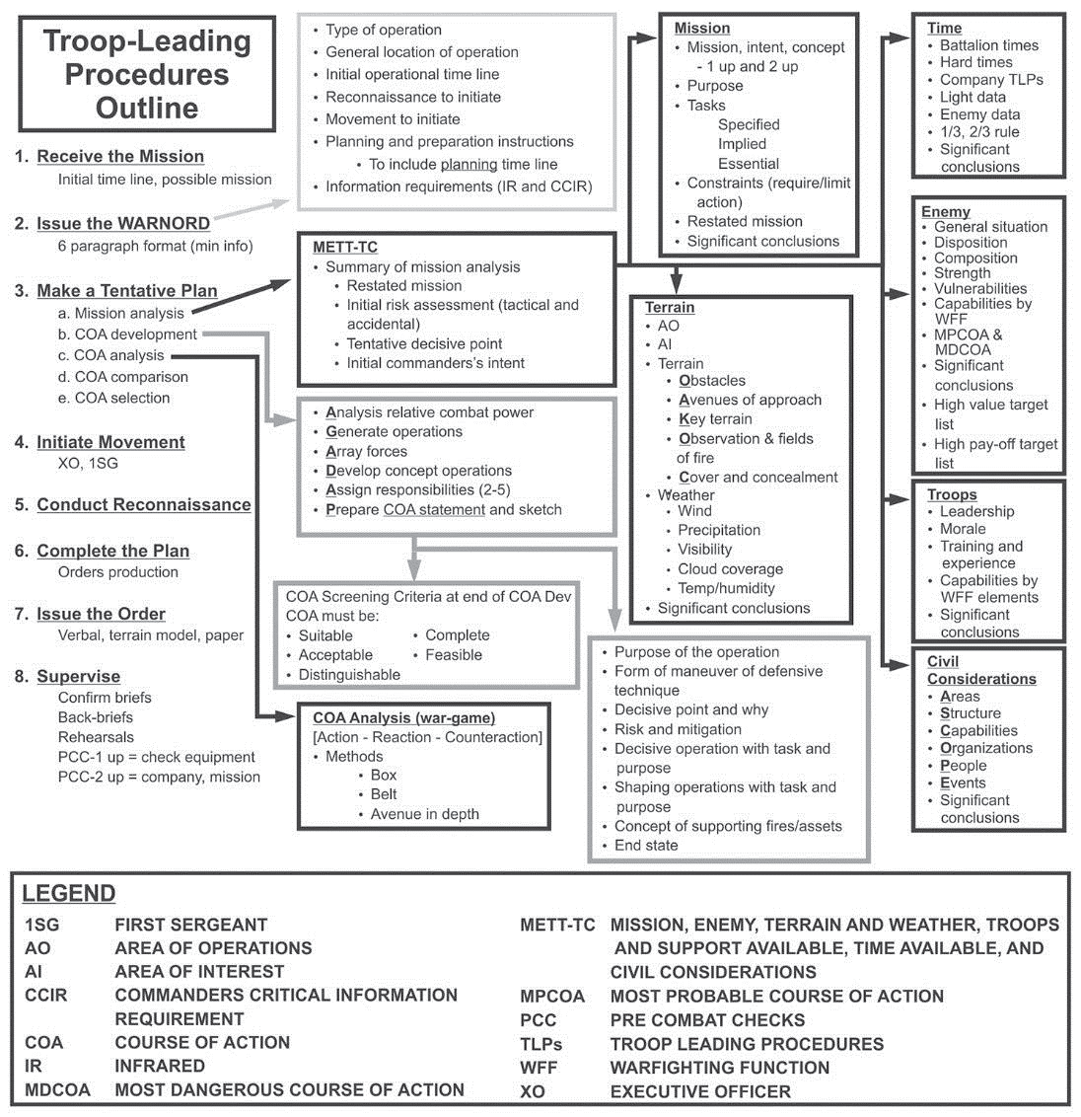
Troop Leading Procedures
Normally, the first three steps of TLP occur in order. However, the sequence of subsequent steps is based on the situation. The tasks involved in some steps example, initiate movement and conduct reconnaissance may occur several times. The last step, supervise and refine, occurs throughout.
Planning
D - 2

Slide 18
1/3 – 2/3 Rule
The “One Thirds Two Thirds” rule is an important rule for military leaders to follow for mission planning. The rule states that a military leader should not spend more than 1/3 of their available time for planning the mission. The remaining 2/3 of the time is for their subordinates to do their mission planning/preparation.
Determine SP time
  This is determined by conducting a hasty mission analysis (use METTTC) to determine how long it will take you to accomplish the mission after you SP (crossing LD)
Backwards plan from SP time to determine total time available
  1/3 of that time is for planning (Brief your OPORD NLT than the 1/3 mark)
  2/3 is for preparation
Planning
Preparation/Rehearsals/etc
Movement to OBJ
Now
OPORD
Brief
Cross LD (SP)
Actions on OBJ
Planning
D - 3

Slide 19
METT-TC
Mission. Commanders and staffs view all of the mission variables in terms of their impact on mission accomplishment. The mission is the task, together with the purpose, that clearly indicates the action to be taken and the reason for the action. It is always the first variable commanders consider during decision-making. A mission statement contains the, who, what, when, where, and why of the operation.
Enemy. The second variable to consider is the enemy dispositions (including organization, strength, location, and tactical mobility), doctrine, equipment, capabilities, vulnerabilities, and probable courses of action.
Terrain and weather. Terrain and weather analysis are inseparable and directly influence each other’s impact on military operations. Terrain includes natural features (such as rivers and mountains) and man-made features (such as cities, airfields, and bridges). Commanders analyze terrain using the five military aspects of terrain, observation and fields of fire, avenues of approach, key and decisive terrain, obstacles, cover and concealment (OAKOC). The military aspects of weather include visibility, wind, precipitation, cloud cover, temperature, and humidity.
Troops and support available. This variable includes the number, type, capabilities, and condition of available friendly troops and support. This includes supplies, services, and support available from joint, host nation and unified action partners. They also include support from civilians and contractors employed by military organizations, such as the Defense Logistics Agency and the Army Materiel Command.
Time available. Commanders assess the time available for planning, preparing, and executing tasks and operations. This includes the time required to assemble, deploy, and maneuver units in relationship to the enemy and conditions.
Civil considerations. Civil considerations are the influence of manmade infrastructure, civilian institutions, and activities of the civilian leaders, populations, and organizations within an area of operation on the conduct of military operations. Civil considerations comprise six characteristics, expressed as ASCOPE: areas, structures, capabilities, organizations, people, and events.
Planning
D - 4

Slide 20
OAKOC
Obstacles -Leaders identify existing (inherent to terrain and either natural or man-made) and reinforcing (tactical or protective) obstacles limiting mobility in his area of operation. Reinforcing obstacles are constructed, emplaced, or detonated by military force.
Avenues of Approach- An avenue of approach is an air or ground route of an attacking force leading to an objective or key terrain. Avenues of approach are classified by type (mounted, dismounted, air, or subterranean), formation, and speed of largest unit traveling on it.
Key Terrain- Key terrain is locations or areas whose seizure, retention, or control gives a marked advantage to either combatant. It is a conclusion, usually arrived at after enemy analysis and COA development, rather than an observation.
Observation and Fields of Fire- The leader identifies locations along each avenue of approach providing clear observation and fields of fire for both the attacker and defender. He analyzes the area surrounding key terrain, OBJs, engagement area, and obstacles. He locates intervisibility lines (ridges or horizons which can hide equipment or personnel from observation). He assesses the ability of the attacking force to overwatch or support movement (with direct fire). An intervisibility line analysis enables the leader to visualize the profile view of terrain when only a topographic product (map) is provided.
Cover and Concealment- Leaders look at the terrain, foliage, structures, and other features along avenues of approach (and on objectives or key terrain) to identify sites offering cover (protection from the effects of direct and indirect fire) and concealment (protection from observation). In the defense, weapon positions must be both lethal to the enemy and survivable to the Soldier. Cover and concealment is just as vital as clear fields of fire. Cover and concealment can be either part of the environment or something brought in by the unit to create the desired effect. Both offensive and defensive considerations must be made
Planning
D - 5

Slide 21
ASCOPE
Planning
D - 6

Slide 22
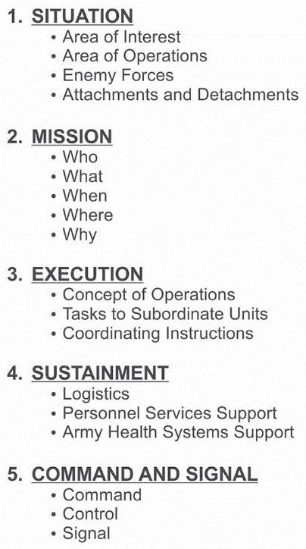
Warning Order (WARNO)
Timeline (apply 1/3 2/3 rule)
Planning
D - 7

Slide 23
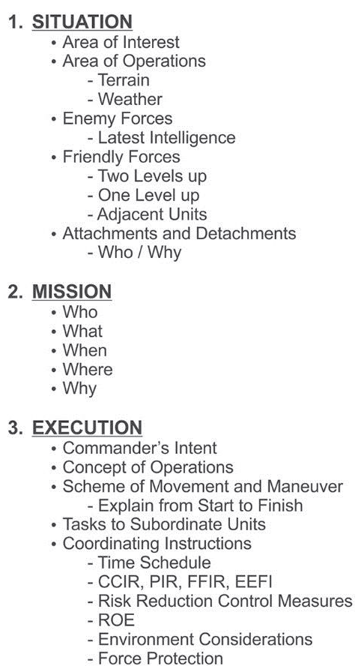
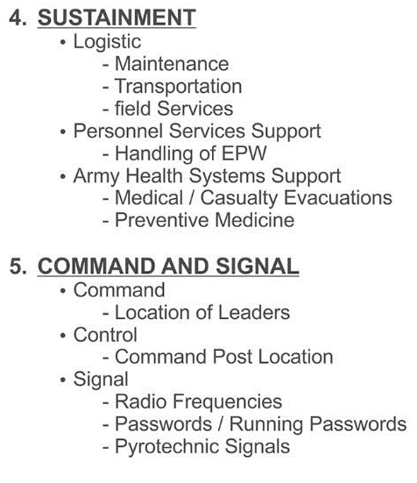
Operation Order/OPORD
Use a terrain model or sketch along with a map to explain the order. When possible, such as in the defense, give the order while observing the objective. The platoon/squad
Planning
D - 8

Slide 24
Fragmentary Order/FRAGO
FRAGMENTARY ORDERS (FRAGO). A FRAGO is an abbreviated form of an operations order, usually issued on a day-to-day basis that eliminates the need for restating information contained in a basic operations order. It is issued after an OPORD to change or modify that order or to execute a branch or sequel to that order. Only address elements that have changed.
Elements common to all patrols
Aid and Litter Teams: locate, treat, and evacuate casualties
Detainee Teams: process detainees using 5 Ss (search/silence/segregate/speed/safeguard)
Surveillance Teams: establish and maintain covert observation of an OBJ
En route Recorder: records all information collected during patrol
Compass and Pace Man: uses terrain-association, dead-reckoning, and/or GPS
Assault Teams: close with the enemy on the OBJ or clear the ambush kill zone
Support Teams: provide direct fire in support of the breach/assault teams.
Breach Teams: the assault team in getting to the objective.
Search Teams: conduct a cursory or detailed search of the objective area.
Planning
D - 9

Slide 25
Rehearsals
Leaders may use several types of rehearsals, which include:
Backbrief
Combined arms rehearsal
Support rehearsal
Battle drill or standard operating procedure rehearsal
METHODS OF REHEARSALS
Rehearsals should follow the crawl-walk-run training methodology whenever possible. This prepares the platoons and subordinate elements for increasingly difficult conditions. (Refer to FM 6-0 for more information).Units can conduct these forms of rehearsals if mission variables permit—
Full-dress rehearsal
Reduced-force rehearsal (key leader, squad leaders, etc.)
Terrain-model rehearsal
Digital terrain-model rehearsal
Sketch-map rehearsal
Map rehearsal
Network rehearsal
Planning
D - 10

Slide 26
PCCs and PCIs
PCCs and PCIs are critical to the success of missions. These checks and inspections are leader tasks and cannot be delegated below the team leader level. They ensure the Soldier is prepared to execute the required individual and collective tasks supporting the mission. Checks and inspections are part of the TLP protecting against shortfalls endangering Soldiers’ lives and jeopardize the execution of a mission.
PCCs and PCIs must be tailored to the specific unit and mission requirements. Each mission and each patrol may require a separate set of checklists. Each element will have its own established set of PCCs and PCIs, but each platoon within its element should have identical checklists. Weapons squads will have a different checklist than line squads, but each weapon squad within an organization should be the same.
One of the best ways to ensure PCCs and PCIs are complete and thorough is with full-dress rehearsals. These rehearsals, run at combat speed with communication and full battle-equipment, allow the leader to envision minute details, as they will occur in the area of operation. If the operation is to be conducted at night, Soldiers should conduct fulldress rehearsals at night as well. PCCs and PCIs should include back briefs on the mission, the task and purpose of the mission, and how the Soldiers’ role fits into the scheme of maneuver. The Soldiers should know the latest intelligence updates, ROE, be versed in medical and casualty evacuation procedures and sustainment requirements.
Table below lists sensitive items, high dollar value items, issued pieces of equipment, and supplies. This table should spur thought it’s not a final list.
Planning
D - 11

Slide 27
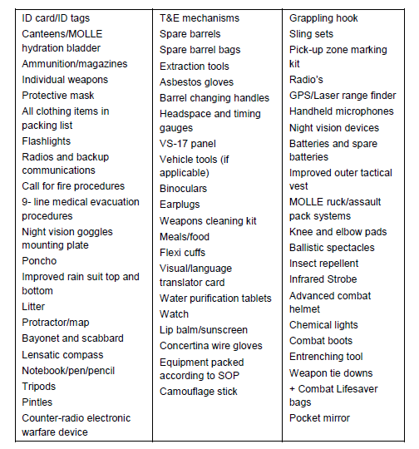
PCCs and PCIs
Planning
D - 12

Slide 28
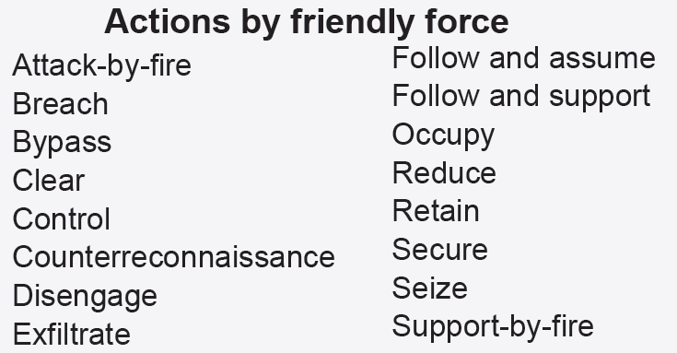
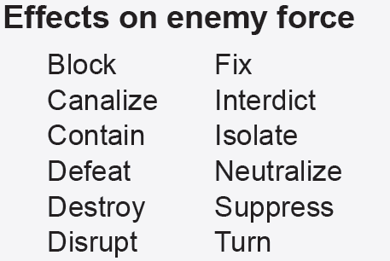
Tactical Mission Tasks
Tactical mission tasks: are the specific activity performed by a unit while executing a form of tactical operation or form of maneuver. It may be expressed in terms of either actions by a friendly force or effects on an enemy force. They describe the results or effects the commander wants to achieve- the what and why of a mission statement. The what is an effect that is normally measurable. The why of a mission statement provides the mission’s purpose.
Planning
D - 13

Slide 29
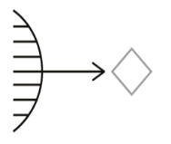
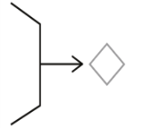
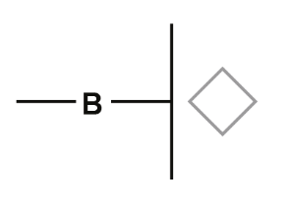
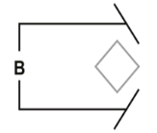
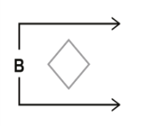
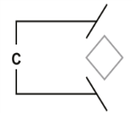
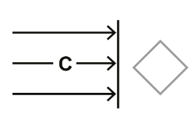

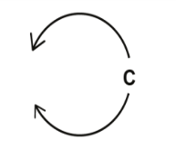
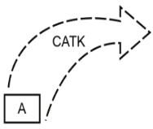
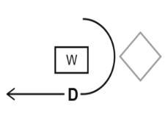
Tactical Mission Tasks
TASK | SYMBOL | DEFINITION
AMBUSH |  | An attack by fire or other destructive means from concealed positions on a moving or temporarily halted enemy.
ATTACK BY FIRE |  | A tactical mission task in which a commander uses direct fires, supported by indirect fires, to engage an enemy force without closing with the enemy to destroy, suppress, fix, or deceive that enemy
BLOCK |  | A tactical mission task that denies the enemy access to an area or prevents his advance in a direction or along an avenue of approach. Block is also an obstacle effect that integrates fire planning and obstacle effort to stop an attacker along a specific avenue of approach or to prevent the attacking force from passing through an engagement area.
BREACH |  | A tactical mission task in which the unit employs all available means to break through or establish a passage through an enemy defense, obstacle, minefield, or fortification.
BYPASS |  | A tactical mission task in which the commander directs his unit to maneuver around an obstacle, position, or enemy force to maintain the momentum of the operation while deliberately avoiding combat with an enemy force
CANALIZE |  | A tactical mission task in which the commander restricts enemy movement to a narrow zone by exploiting terrain coupled with the use of obstacles, fires, or friendly maneuver
CLEAR |  | A tactical mission task that requires the commander to remove all enemy forces and eliminate organized resistance within an assigned area
CONTAIN |  | A tactical mission task that requires the commander to stop, hold, or surround enemy forces or to cause them to center their activity on a given front and prevent them from withdrawing any part of their forces for use elsewhere
CONTROL |  | A tactical mission task that requires the commander to maintain physical influence over a specified area to prevent its use by an enemy or to create conditions necessary for successful friendly operations
COUNTER-ATTACK |  | Attack by part or all of a defending force against an enemy attacking force, for such specific purposes as regaining ground lost, or cutting off or destroying enemy advance units, and with the general objective of denying to the enemy the attainment of the enemy’s purpose in attacking. In sustained defensive operations, it is undertaken to restore the battle position and is directed at limited objectives
DELAY |  | A form of retrograde in which a force under pressure trades space for time by slowing the enemy’s momentum and inflicting maximum damage on the enemy without, in principle, becoming decisively engaged
Planning
D - 14

Slide 30
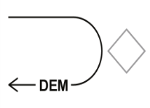
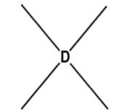
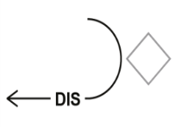
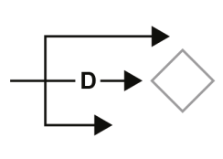
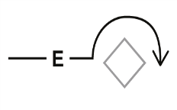
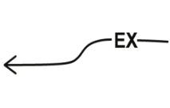
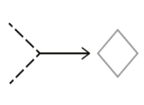
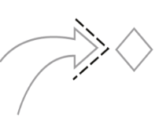

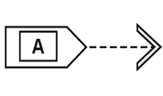
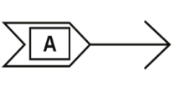
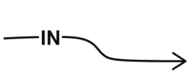
Tactical Mission Tasks
TASK | SYMBOL | DEFINITION
DEMONSTRATION |  | The demonstration is an attack to deceive the enemy about the location of the decisive operation or main attack. This purpose is very similar to that of a feint, but the friendly force does not seek to make contact with the enemy.
DESTROY |  | Destroy is a tactical mission task that occurs when an enemy force has temporarily or permanently lost the physical means or the will to fight. The defeated force's commander is unwilling or unable to pursue that individual's adopted course of action, thereby yielding to the friendly commander's will and can no longer interfere to a significant degree with the actions of friendly forces. Defeat can result from the use of force or the threat of its use.
DISENGAGE / DISENGEMENT |  | A tactical mission task where a commander has his unit break contact with the enemy to allow the conduct of another mission or to avoid decisive engagement.
DISRUPT |  | A tactical mission task in which a commander integrates direct and indirect fires, terrain, and obstacles to upset an enemy’s formation or tempo, interrupt his timetable, or cause his forces to commit prematurely or attack in piecemeal fashion. 2. An obstacle effect that focuses fire planning and obstacle effort to cause the enemy to break up his formation and tempo, interrupt his timetable, commit breaching assets prematurely, and attack in a piecemeal effort.
ENVELOPMENT |  | A form of maneuver in which an attacking force seeks to avoid the principal enemy defenses by seizing objectives behind those defenses that allow the targeted enemy force to be destroyed in their current positions
EXFILTRATE |  | A tactical mission task where a commander removes Soldiers or units from areas under enemy control by stealth, deception, surprise, or clandestine means
EXPLOIT |  | An offensive task—usually following a successful attack —designed to disorganize the enemy in depth. Conducted at BN level or higher.
FEINT |  | A feint is a form of attack used to deceive the enemy of the location or time of the actual decisive operations or main attack. Its purpose is to deceive the enemy and cause him to react in a particular way; such as by repositioning forces, committing its reserve, or shifting fires.
FIX |  | A tactical mission task where a commander prevents the enemy from moving any part of his force from a specific location for a specific period. Fix is also an obstacle effect that focuses fire planning and obstacle effort to slow an attacker’s movement within a specified area, normally an engagement area.
FOLLOW AND ASSUME |  | A tactical mission task in which a second committed force follows a force conducting an offensive operation and is prepared to continue the mission if the lead force is fixed, attrited, or unable to continue.
FOLLOW AND SUPPORT |  | A tactical mission task in which a committed force follows and supports a lead force conducting an offensive operation.
INFILTRATE |  | A form of maneuver in which an attacking force conducts undetected movement through or into an area occupied by enemy forces to occupy a position of advantage in the enemy rear while exposing only small elements to enemy defensive fires.
Planning
D - 15

Slide 31
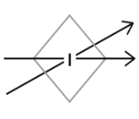

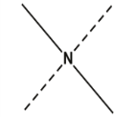

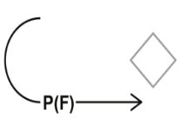
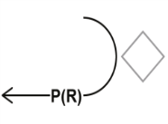
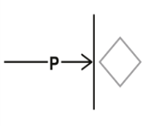
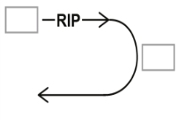

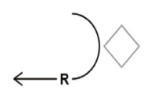
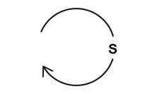

Tactical Mission Tasks
TASK | SYMBOL | DEFINITION
INTERDICT |  | A tactical mission task where the commander prevents, disrupts, or delays the enemy’s use of an area or route.
ISOLATE |  | A tactical mission task that requires a unit to seal off—both physically and psychologically—an enemy from his sources of support, deny an enemy freedom of movement, and prevent an enemy unit from having contact with other enemy forces.
NEUTRALIZE |  | A tactical mission task that results in rendering enemy personnel or materiel incapable of interfering with a particular operation.
OCCUPY |  | A tactical mission task that involves a force moving a friendly force into an area so that it can control that area. Both the force’s movement to and occupation of the area occur without enemy opposition.
PASSAGE OF LINES (FORWARD) |  | A tactical enabling operation in which one unit moves through another unit’s positions with the intent of moving into or out of enemy contact.
PASSAGE OF LINES (REAR) |  | A tactical enabling operation in which one unit moves through another unit’s positions with the intent of moving into or out of enemy contact.
PENETRATION / PENETRATE |  | A form of maneuver in which an attacking force seeks to rupture enemy defenses on a narrow front to disrupt the defensive system.
RELIEF IN PLACE |  | An operation in which, by direction of higher authority, all or part of a unit is replaced in an area by the incoming unit. The responsibilities of the replaced elements for the mission and the assigned area of operations are transferred to the incoming unit. The incoming unit continues the operation as ordered.
RETAIN |  | A tactical mission task in which the commander ensures that a terrain feature controlled by a friendly force remains free of enemy occupation or use.
RETIREMENT |  | A form of retrograde in which a force out of contact moves away from the enemy.
SECURE |  | A tactical mission task that involves preventing a unit, facility, or geographical location from being damaged or destroyed as a result of enemy action.
SECURITY S = SCREEN C = COVER G = GUARD |  | Security operations are those operations undertaken by a commander to provide early and accurate warning of enemy operations, to provide the force being protected with time and maneuver space within which to react to the enemy, and to develop the situation to allow the commander to effectively use the protected force.
s
s
Planning
D - 16

Slide 32
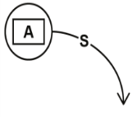






Tactical Mission Tasks & FCMs
TASK | SYMBOL | DEFINITION
SEIZE |  | A tactical mission task that involves taking possession of a designated area using overwhelming force.
SUPPORT BY FIRE |  | A tactical mission task in which a maneuver force moves to a position where it can engage the enemy by direct fire in support of another maneuvering force.
SUPPRESS |  | A tactical mission task that results in temporary degradation of the performance of a force or weapons system below the level needed to accomplish the mission.
TURN |  | 1. A tactical mission task that involves forcing an enemy force from one avenue of approach or mobility corridor to another. 2. A tactical obstacle effect that integrates fire planning and obstacle effort to divert an enemy formation from one avenue of approach to an adjacent avenue of approach or into an engagement area.
WITHDRAW |  | A planned retrograde operation in which a force in contact disengages from an enemy force and moves in a direction away from the enemy.
WITHDRAW UNDER PRESSURE
FIRE CONTROL MEASURES (FCMs)
Planning
D - 17

Slide 33
Offense
The leader seizes, retains, and exploits the initiative when conducting offensive tasks. Even when conducting primarily defensive tasks, taking the initiative from the enemy requires offensive tasks that are force- or terrain-oriented. Force-oriented tasks focus on the enemy. Terrain-oriented tasks focus on seizing and retaining control of terrain and facilities.
Characteristics of the Offense
The Infantry platoon and squad gains, maintains the initiative and keeps constant pressure on the enemy throughout its area of operation. Success in the offense greatly depends upon the proper application of the characteristics of the offense discussed in the following paragraphs.
1) Audacity is a simple plan of action, boldly executed. Audacity inspires Soldiers to overcome adversity and danger. It is a key component of all offensive actions, increasing the chance for surprise. Audacity depends upon the leader’s ability to see opportunities for action, decide in enough time to seize opportunities, and accept prudent risks. Leaders understand when and where to take risks, plan, and execute boldly.
2) Concentration is the massing of overwhelming effects of combat power to achieve a single purpose. Leaders balance the necessity for concentrating forces to mass effects against the need to disperse forces in order to avoid creating lucrative targets. Advances in ground, air mobility, target acquisition, and long-range precision fires enable attackers to concentrate effects. Mission command systems provide reliable, relevant information that assist commanders in determining when to concentrate forces to mass effects. The Infantry platoon and squad achieves concentration through—
Careful planning and coordination based on a thorough terrain and enemy analysis, plus accurate reconnaissance.
Designation of a main effort and allocation of resources to support it.
Continuous information flow.
Massing firepower using long-range precision fires and maneuver.
Offense
E - 1

Slide 34
Characteristics of the Offense
3) Surprise is achieved by attacking the enemy at a time or place they do not expect or in a manner for which they are unprepared. Estimating the enemy commander’s intent and denying the ability to gain thorough and timely situational understanding are necessary to achieve surprise. Unpredictability and boldness help gain surprise. The direction, timing, and force of attack also help achieve surprise. Surprise delays enemy reactions, overloads and confuse his command and control systems, induces psychological shock in enemy soldiers and leaders, and reduces the coherence of defensive missions. By diminishing enemy combat power, surprise enables the attackers to exploit enemy paralysis and hesitancy. The Infantry platoon and squad achieve surprise by—
Gaining and maintaining information dominance by conducting thorough information collection and counterreconnaissance efforts.
Striking the enemy from an unexpected direction, at an unexpected time, and by unique combinations of movement with units that cross all types of terrain.
Quickly changing the tempo of operations.
Being unpredictable.
4) Tempo is the relative speed and rhythm of military operations over time with respect to the enemy. Controlling or altering tempo is necessary to retain the initiative. A faster tempo allows attackers to quickly penetrate barriers and defenses, and destroy enemy forces in-depth before they can react. Leaders adjust tempo as tactical situations, sustainment necessity, or operational opportunities allow. This ensures synchronization and proper coordination, but not at the expense of losing opportunities, that defeats the enemy. Rapid tempo demands quick decisions. It denies the enemy the chance to rest while continually creating offensive opportunities.
Offense
E - 2

Slide 35
4 Offensive Tasks
The four offensive tasks are:
Movement to contact
Attack
Exploitation
Pursuit
1) Movement to contact is an offensive task designed to develop the situation and establish or regain contact. (Refer to FM 3-90-1 for more information.) It creates favorable conditions for subsequent tactical actions. The leader conducts a movement to contact when the enemy situation is vague or not specific enough to conduct an attack. Forces executing this task seek to make contact with the smallest friendly force possible. A movement to contact may result in a meeting engagement, which is a combat action occurring when a moving force engages an enemy at an unexpected time and place. Once making contact with an enemy force, the leader has five options: attack, defend, bypass, delay, or withdraw. Two movement to contact techniques are search and attack, and cordon and search.
1) Search and attack is a technique for conducting movement to contact sharing many of the same characteristics of an area security mission. (Refer to ADRP 3-90 for more information.) Conducted primarily by Infantry forces and often supported by armored forces, the leader employs this form of movement to contact when the enemy is operating as a small, dispersed element, or when the task is to deny the enemy the ability to move within a given area. Maneuver battalions and companies normally conduct search and attack.
2) Cordon and Search: The most common tactical task during stability is a cordon and search. This involves two potentially inflammatory processes: limiting freedom of movement and searching dwellings. These two actions have a clear potential for negative consequences. Therefore, organizing cordon and search elements requires extensive mission tailoring and Infantry leaders always are prepared for a civil disturbance. Cordon and search involves isolating the target area and searching suspected buildings to capture or destroy possible insurgents and contraband. It involves the emplacement of a cordon, or security perimeter, to prevent traffic in and out of the area. The cordon permits the search element to operate unimpeded within the secured area. The purpose of cordon and search is to obtain weapon caches, materiel or information, persons of interest, or a specific high-value target.
Offense
E - 3

Slide 36
4 Offensive Tasks
2) An attack destroys or defeats enemy forces, seizes and secures terrain, or both. (Refer to FM 3-90-1 for more information.) Attacks incorporate coordinated movement supported by direct and indirect fires. They may be decisive or shaping operations and hasty or deliberate, depending upon the time available for assessing the situation, planning, and preparing. However, based on METT-TC, the leader may decide to conduct an attack using only fires. An attack differs from a movement to contact because enemy main body dispositions are at least partially known, allowing the leader to achieve greater synchronization. This enables the massing effects of attacking forces combat power more effective in an attack than in a movement to contact.
Special Purpose Attacks are ambush, counterattack, demonstration, feint, raid, and spoiling attack. (Refer to ADRP 3-90 for more information.) The commander’s intent and METT-TC determine which special purpose attacks to employ. Each attack can be conducted as either a hasty or a deliberate operation. The commander’s intent and METT-TC determine the specific attack form. As subordinate attack tasks, they share many of the planning, preparation, and execution considerations of attack. Demonstrations and feints, while forms of attack, also are associated with military deception operations.
  Ambush: see ambush section of this TACSOP
  Counterattack: an attack by part or all of a defending force against an enemy attacking force, for such specific purposes as regaining ground lost or cutting off or destroying enemy advance units. The general objective is to deny the enemy his goal in attacking
  Demonstration: in military deception, a demonstration is a show of force in an area where a decision is not sought but made to deceive a threat. It is similar to a feint, but no actual contact with the threat is intended
  Feint: an attack used to deceive the enemy as to the location or time of the actual decisive operation. Forces conducting a feint seek direct fire contact with the enemy but avoid decisive engagement. As in the demonstration, leader use feints in conjunction with other military deception activities.
  Raid: see Raid section of this TACSOP
  Spoiling Attack: A spoiling attack is a tactical maneuver employed to impair a hostile attack while the enemy is forming/assembling for an attack.
Offense
E - 4

Slide 37
4 Offensive Tasks
3) Exploitation follows an attack and disorganizes the enemy in-depth (Refer to FM 3-90-1 for more information.) Exploitations seek to disintegrate enemy forces to the point where they have no alternative but surrender or retreat. Exploitation take advantage of tactical opportunities, foreseen or unforeseen. Division and higher headquarters normally plan site exploitations as branches or sequels plans. However, the Infantry platoon and squad may participate as part of the fixing force or striking force.
4) A pursuit is an offensive task designed to catch or cut off a hostile force attempting to escape, with the aim of destroying them. (Refer to FM 3-90-1 for more information.) A pursuit normally follows exploitation. Transition into a pursuit can occur if it is apparent enemy resistance has broken down entirely and the enemy is fleeing the area of operation. Pursuits entail rapid movement, decentralized control and clear commanders’ intent to facilitate control.
Offense
E - 5

Slide 38

5 Forms of Maneuver
Leaders select the form of maneuver based on METT-TC. The leader then synchronizes the contributions of all warfighting functions to the selected form of maneuver. An operation may contain several forms of offensive maneuver, such as frontal attack to clear enemy security forces, followed by a penetration to create a gap in enemy defenses, which in turn is followed by an envelopment to destroy a counterattacking force. While Infantry platoons and squads do not have the combat power to conduct all forms of maneuver on its own, they will participate as part of a larger organization. The six forms of maneuver are—Envelopment, Turning movement, Frontal attack, Penetration, Infiltration, and Flank attack.
Envelopment is a form of maneuver in which an attacking force seeks to avoid the principal enemy defenses by seizing objectives behind those defenses allowing the targeted enemy force to be destroyed in their current positions. BCTs and above normally plan and conduct envelopments. At the tactical level, envelopments focus on seizing terrain, destroying specific enemy forces, and interdicting enemy withdrawal routes. The leader’s decisive operation focuses on attacking an assailable flank. It avoids the enemy’s strength at the front where the effects of fires and obstacles are greatest. Generally, the leader prefers to conduct envelopment instead of a penetration or frontal attack because the attacking force tends to suffer fewer casualties while having the most opportunities to destroy the enemy. Envelopment also produces great psychological shock on the enemy. If no assailable flank is available, the attacking force creates one. The four varieties of envelopment are single envelopment, double envelopment, encirclement, and vertical envelopment.
Offense
E - 6

Slide 39

5 Forms of Maneuver
A turning movement is a form of maneuver in which the attacking force seeks to avoid the enemy’s principle defensive positions by seizing objectives behind the enemy’s current position. This causes the enemy forces to move out of their current positions or divert major forces to meet the threat. The leader uses this form of offensive maneuver to seize vital areas in the enemy’s support area before the main enemy force can withdraw or receive reinforcements. This form of offensive maneuver transitions from an attack into a site exploitation or pursuit. A turning movement seeks to make the enemy force displace from their current locations, whereas an enveloping force seeks to engage the enemy in their current locations from an unexpected direction. Divisions normally execute turning movements.
Offense
E - 7

Slide 40

5 Forms of Maneuver
A frontal attack is a form of maneuver where an attacking force seeks to destroy a weaker enemy force, or fix a larger enemy in place over a broad front. An attacking force can use a frontal attack to overrun a weak enemy force. The leader commonly uses a frontal attack as a shaping operation in conjunction with other forms of maneuver.
Offense
E - 8

Slide 41

5 Forms of Maneuver
A penetration is a form of maneuver where an attacking force seeks to rupture enemy defenses in a narrow front to disrupt the defensive system. Destroying the continuity of defense allows the enemy’s subsequent isolation and defeat in detail by exploiting friendly forces. The penetration extends from the enemy’s security area through main defensive positions into the enemy support area. The leader employs a penetration when there is no assailable flank, enemy defenses are overextended and weak spots are detected in the enemy’s positions, or time pressures do not permit envelopment.
Offense
E - 9

Slide 42

5 Forms of Maneuver
An infiltration is a form of maneuver where an attacking force conducts undetected movement through or into an area controlled by enemy forces. The goal is to occupy a position of advantage behind enemy positions while exposing only small friendly elements to their defensive fires. Infiltration occurs by land, water, air, or a combination of means. Moving and assembling forces covertly through enemy positions takes a considerable amount of time. To infiltrate, the force avoids detection and engagement. Since this requirement limits the size and strength of the infiltrating force, and infiltrated forces alone rarely can defeat an enemy, infiltration normally is used in conjunction with and in support for other forms of maneuver.
Offense
E - 10

Slide 43

5 Forms of Maneuver
A flanking attack is a form of offensive maneuver directed at the flank of an enemy force as illustrated in figure 2-6, page 2-10. A flank is the right or left side of a military formation and is not oriented toward the enemy. It is usually not as strong in terms of forces or fires as is the front of a military formation. A flank may be created by the attacker with fires or by a successful penetration. A flanking attack is similar to envelopment but generally conducted on a shallower axis. It is designed to defeat the enemy force while minimizing the effect of the enemy’s frontally-oriented combat power. Flanking attacks normally are conducted with the main effort directed at the flank of the enemy. Usually, a supporting effort engages the enemy’s front by fire and maneuver while the main effort maneuvers to attack the enemy‘s flank. This supporting effort diverts the enemy’s attention from the threatened flank. Corps and divisions are the most likely echelons to conduct turning movements. It often is used for a hasty operation or meeting engagement where speed and simplicity are paramount to maintaining battle tempo and, ultimately, the initiative.
Offense
E - 10

Slide 44
Defense
A defensive task is a task conducted to defeat an enemy attack, gain time, economize forces, and develop conditions favorable for offensive or stability tasks. (Refer to ADRP 3-90 for more information.) Normally, the defense alone cannot achieve a decision. However, it can set conditions for a counteroffensive or counterattack that enables Army forces to regain the initiative. Other reasons for conducting defensive tasks include, retain decisive terrain or deny a vital area to the enemy, attrition or fix the enemy as a prelude to the offense, counter surprise action by the enemy, or to increase the enemy’s vulnerability by forcing the enemy commander to concentrate subordinate forces. This chapter covers basics of the defense, common defensive planning considerations, forms of the defense engagement area development, and transitions.
Characteristics of the Defense
1) Preparation: The defense has inherent strengths. The defender arrives in the area of operation before the attacker and uses the available time to prepare. These preparations multiply the defense’s effectiveness. Preparations end only when the defenders retrograde or begin to fight. Until then, preparations are continuous. Preparations in-depth continues, even as the close fight begins
2) Security: Security helps deceive the enemy as to friendly locations, strengths, and weaknesses. It also inhibits or defeat enemy reconnaissance. Security measures provide early warning and disrupt enemy attacks early and continuously.
3) Disruption: Defenders disrupt attackers’ tempo and synchronization with actions designed to prevent them from massing combat power. Disruptive actions attempt to unhinge the enemy’s preparations and, ultimately, his attacks. Methods include defeating or misdirecting enemy reconnaissance forces, breaking up his formations, isolating his units, and attacking or disrupting his systems.
4) Mass and Concentration: Defenders seek to mass the effects of overwhelming combat power where they choose and shift it to support the decisive operation. To obtain an advantage at decisive points, defenders economize and accept risk in some areas; retain and, when necessary, reconstitute a reserve; and maneuver to gain local superiority at the point of decision. Unit leaders accept risk in some areas to mass effects elsewhere. Obstacles, security forces, and fires can assist in reducing risk.
5) Flexibility: The defense requires flexible plans. Planning focuses on preparation in-depth, use of reserves, and ability to shift the main effort. Leaders add flexibility by designating supplementary positions, designing counterattack plans, and preparing to counterattack.
6) Maneuver: Maneuver allows the defender to take full advantage of area of operation and to mass and concentrate when desirable. Maneuver, through movement in combination with fire, allows the defender to achieve a position of advantage over the enemy to accomplish the mission. It also encompasses defensive actions such as security and support area operations.
7) Operation in Depth: Simultaneous application of combat power throughout the area of operation improves the chances for success while minimizing friendly casualties. Quick, violent, and simultaneous action throughout the depth of the defender’s area of operation can hurt, confuse, and even paralyze an enemy force just as it is most exposed and vulnerable. Such actions weaken the enemy’s will and do not allow all early enemy successes to build the confidence of the enemy’s Soldiers and leaders. In-depth planning prevents the enemy from gaining momentum in the attack. Synchronization of decisive, shaping, and sustaining operations facilitates mission success.
Defense
F - 1

Slide 45
Defensive Tasks
There are three basic defensive tasks: area defense, mobile, and retrograde. Each contains elements of the others, and usually contains both static and dynamic aspects. Infantry platoons serve as the primary maneuver element, or terrain-controlling units for the Infantry company. They can defend area of operation, positions; serve as a security force or reserve as part of the Infantry company’s coordinated defense. (Refer to FM 3-90-1 for more information.)
As part of a defense, the Infantry platoon can defend, delay, withdraw, counterattack, and perform security tasks. The Infantry platoon usually defends, as part of the Infantry company’s defense in the main battle area. It conducts the defense to achieve one or more of the following:
Gain time.
Retain essential terrain.
Support other operations.
Preoccupy the enemy in one area while friendly forces attack in another.
Wear down enemy forces at a rapid rate while reinforcing friendly operations
Area Defense: An area defense concentrates on denying enemy forces access to designated terrain for a specific time rather than destroying the enemy outright. The focus is on retaining terrain where the bulk of the defending force positions itself in mutually supporting positions and controls the terrain between positions. The defeat mechanism is fires into engagement area, which reserve units can supplement. The leader uses the reserve force to reinforce fires, add depth, block penetrations, restore positions, counterattack to destroy enemy forces, and seize the initiative.
Defense
F - 2

Slide 46
Defensive Tasks
Mobile Defense: Mobile defense is a defensive task that concentrates on destruction or defeat of the enemy through a decisive attack by a striking force. Mobile defenses focus on defeating or destroying the enemy by allowing enemy forces to advance to a point where they are exposed to a decisive counterattack by the striking force. The leader uses the fixing force to hold attacking enemy in position, to help channel attacking enemy forces into ambush areas, to retain areas from which to launch the striking force. Mobile defenses require an area of operation of considerable depth. The leader must able to shape the battlefield, causing an enemy to overextend its lines of communication, expose its flanks, and dissipate its combat power. Likewise, the leader must be able to move friendly forces around and behind the enemy force targeted to cut off and destroyed. Divisions or larger formations normally execute mobile defenses. However, the platoon may participate as part of the fixing force or the striking force. (Note: units smaller than a division usually do not conduct a mobile defense)
Retrograde: Retrograde is a defensive task involving organized movement away from the enemy. The enemy may force a retrograde or the leader may execute it voluntarily. In either case, the higher commander of the force executing the operation must approve retrograding. There are three forms of retrograde:
Delay
Withdraw
Retire
1) Delay: allows units to trade space for time, avoiding decisive engagement and safeguard its forces. Ability of a force to trade space for time requires depth within the area of operation assigned to the delaying force. Delaying units may delay from either alternate or successive positions.
Defense
F - 3

Slide 47

Defensive Tasks
Delay from alternate positions: this is normally is preferred when adequate forces are available and areas of operation have sufficient depth. Delays from alternate positions, two or more units in a single area of operation occupy delaying positions in-depth. As the first unit engages the enemy, the second occupies the next position in-depth and prepares to assume responsibility for the operation. The first force disengages and passes around or through the second force. It then moves to the next position and prepares to re-engage the enemy while the second force takes up the fight.
Defense
F - 4

Slide 48

Defensive Tasks
Delay from subsequent positions: Delays from subsequent positions are used when assigned area of operation are so wide available forces cannot occupy more than a single tier of positions. Delays from subsequent positions must ensure all delaying units are committed to each of the series of battle positions or across the area of operation on the same phase line. Most of the delaying force is located well forward. Mission dictates the delay from one battle position or phase line to the next. Delaying unit movement is staggered so not all forces are moving at the same time.
Defense
F - 5

Slide 49

Defensive Tasks
2) Withdrawal: Withdrawal is a planned retrograde operation, which a force in contact disengages from an enemy force, and moves in a direction away from the enemy. Although the leader avoids withdrawing from action under enemy pressure, it is not always possible. Withdrawal is used to preserve the force or release it for a new mission. They are assisted or unassisted.
3) Retire: Retirement is a task employing to move a force not in contact to the rear. Retirement is a form of retrograde, which a force not in contact with the enemy moves away from the enemy. A retiring unit organizes for combat but does not anticipate interference by enemy ground forces. Typically, another unit’s security force covers the movement of one formation as the unit conducts a retirement. However, mobile enemy forces, unconventional forces, air strikes, air assaults, or long-range fires may attempt to interdict the retiring unit. The leader plans for enemy actions and organizes the unit to fight in self-defense. The leader usually conducts retirement to reposition his forces for future operations or to accommodate the current concept of the operation. Units conduct retirements such as tactical road marches where security and speed are the most important considerations.
Defense
F - 6

Slide 50

Forms of the Defense
Forms of the Defense
Defense of a linear obstacle
Perimeter defense
Reverse slope
Defense of a linear obstacle
Defense
F - 7

Slide 51

Forms of the Defense
Perimeter Defense
Defense
F - 8

Slide 52

Forms of the Defense
Defense on a reverse slope
Defense
F - 9

Slide 53

Battle Positions
Battle Positions: defensive location oriented on a likely enemy avenue of approach. Units as large as battalion task forces and as small as squads or sections use battle positions. They may occupy the topographical crest of a hill, a forward slope, a reverse slope, or a combination of all areas. The leader selects his positions based on terrain, enemy capabilities, and friendly capabilities. A leader can assign all or some subordinates battle positions within the area of operation. The types of battle positions are—
Primary: cover the enemy’s most likely avenue of approach
Alternate: for when primary positions become untenable or unsuitable
Supplementary: position that covers another possible enemy avenue of approach
Subsequent: position of which a unit expects to move during the course of the battle
Strongpoint: heavily fortified battle position tied to a natural or reinforcing obstacle to create an anchor for the defense
Defense
F - 10

Slide 54
Engagement Area Development
The engagement area is where the Infantry leader intends to engage and destroy an enemy force using the massed fires of all available weapons. Leaders combine natural and man-made obstacles to canalize the attacking force into engagement area. The success of engagements depends on how the leader can integrate the obstacle plan, indirect fire plan, and direct fire plan within the engagement area to achieve the Infantry platoon’s and squads’ tactical purposes.
At the platoon level, engagement area development is a complex function demanding parallel planning and preparation if the Infantry platoon and squad are to accomplish the myriad tasks for which it is responsible. Despite this complexity, engagement area development resembles a drill, and the platoon leader and his subordinate leaders use an orderly, standard set of procedures. The steps of engagement area development are not a rigid sequential process. Some steps may occur simultaneously to ensure the synergy of combined arms. Beginning with evaluation of METT-TC, the development process—
Identifies all likely enemy avenues of approach.
Determines likely enemy schemes of maneuver.
Determines where to kill the enemy.
Plans and integrates obstacles.
Emplaces weapon systems.
Plans and integrates indirect fires.
Rehearses the execution of operations in the engagement area.
Defense
F - 11

Slide 55

Patrolling
5 Principles of Patrolling
Planning: Quickly make a simple plan and effectively communicate it to the lowest level. A great plan that takes forever to complete and is poorly disseminated isn’t a great plan. Plan and prepare to a realistic standard, and rehearse everything.
Reconnaissance: Your responsibility as a leader is to confirm what you think you know, and to find out what you don’t.
Security: Preserve your force as a whole, and your recon assets in particular. Every Soldier and every rifle counts; anyone could be the difference between victory and defeat.
Control: Clear concept of the operation and commander’s intent, coupled with disciplined communications, to bring every man and weapon you have available to overwhelm your enemy at the decisive point.
Common Sense: Do what you’re supposed to do, without someone having to tell you, despite your own personal discomfort or fear.
5 Point Contingency Plan (GOTWA)
Patrolling
G - 1

Slide 56
Security Halts
Units conducting tactical movement frequently make temporary halts. These halts range from brief to extended periods. For short halts, platoons use a cigar-shaped perimeter intended to protect the force while maintaining the ability to continue movement. When the platoon leader decides not to immediately resume tactical movement, he transitions the platoon to a perimeter defense. The perimeter defense is used for longer halts or during lulls in combat.
Cigar–shaped Perimeter
When the unit halts, if terrain permits, Soldiers should move off the route and face out to cover the same sectors of fire they were assigned while moving, allowing passage through the center of the formation. This results in a cigar-shaped perimeter. Actions by subordinate leaders and their Soldiers occur without an order from the leader. Soldiers are repositioned as necessary to take advantage of the best cover, concealment, and fields of fire.
Perimeter Defense
When operating independently, the platoon uses a perimeter defense during extended halts, resupply, and issuing platoon orders or lulls in combat. Normally the unit first occupies a short halt formation. Then after conducting a leader’s reconnaissance of
the position and establishing security, the unit moves into the perimeter defense.
Soldier Actions at Halts
(these actions occur without leader prompting)
Moves to as much of a covered and concealed position as available.
Visually inspects and physically clears his immediate surroundings (a roughly 5- to 25-meter radius around his position).
Establishes a sector of fire for his assigned weapon (using 12 o’clock as the direction the Soldier is facing, the Soldier’s sector of fire ranges from 10 o’clock to 2 o’clock).
Determines his observation and field of fire. Identifies dead space in his field of fire.
Identifies obstacles and determines enemy avenues of approach (both mounted and
dismounted).
Identifies the dominant ground in his immediate surroundings.
Coordinates his actions with the Soldiers (or vehicles) on his left and right.
Patrolling
G - 2

Slide 57
Security Halts
Squad Leader Actions at Halts
Adjusts his perimeter:
If operating independently, the squad leader establishes 360-degree, three-dimensional security.
Attempts to find terrain that anchors his position.
If operating as part of a platoon, the squad leader arrays his teams to best fit into the platoon leader’s defensive scheme, based on the platoon leader’s guidance.
Visually inspects and physically clears (if required) the squad’s immediate surrounding (about 35 meters, the distance within hand grenade range).
Ensures his squad’s individual sectors of fire overlap with each other, creating a seamless perimeter with no gaps of fire coverage.
Identifies his dead space and adjusts his M203 grenadiers accordingly.
Identifies obstacles and the likely enemy avenue of approach (mounted and dismounted).
Identifies the dominant ground in his area of operation.
Coordinates responsibilities and sectors with the units on his left and right.
Platoon Leader Actions at Halts
Adjusts his perimeter:
If operating independently, he establishes 360-degree, three-dimensional security.
If operation as part of another organization, he arrays his squads to best fist into the controlling commander’s defensive scheme.
Supervises the emplacement of the weapons squad’s weapon systems.
Dispatches an element (usually a fire team) to visually inspect and physically clear the platoon’s immediate surrounding (an area out to small arms range, roughly 100-300 meters depending on terrain).
Ensures his squads’ sectors of fire overlap with each other, creating a seamless perimeter with no gaps of fire coverage.
Identifies his dead space not covered and requests indirect fire support to overwatch dead space in the area of operation.
Identifies obstacles and the likely enemy avenue of approach (mounted and dismounted).
Identifies the dominant ground in his area of operation.
Coordinates with the units on his left and right.
Patrolling
G - 3

Slide 58
ORP
The ORP is a point out of sight, sound, and small arms range of the objective area. It is normally located in the direction that the platoon plans to move after completion of actions on the objective. The ORP is tentative until the objective is pinpointed.
Occupation of the ORP
(1) The patrol halts beyond sight and sound of the tentative ORP (200-400m in good visibility, 100-200m in limited visibility).
(2) The patrol establishes a security halt IAW the unit SOP.
(3) After issuing a contingency plan to the PSG, the PL moves forward with a recon element to conduct a leader’s recon of the ORP.
(4) For a squad-sized patrol, the PL moves forward with a compass man and one member of each fire team to confirm the ORP.
(a) After physically clearing the ORP location, the PL leaves two men at the 6 o’clock position facing in opposite directions.
(b) The PL issues a contingency plan and returns with the compass man to guide the patrol forward.
(c) The PL guides the patrol forward into the ORP, with one team occupying from 3 o’clock through 12 o’clock to 9 o’clock, and the other occupying from 9 o’clock through 6 o’clock to 3 o’clock.
(1) For a platoon-sized patrol, the PL follows the same sequence, taking one ammo bearer or assistant gunner from each gun team forward and positioning them at 10, 2, and 6 o’clock.
(a) The first squad in the order of march is the base squad, occupying from 10 to 2 o’clock.
(b) The trail squads occupy from 2 to 6 o’clock and 6 to 10 o’clock respectively.
(c) The patrol headquarters element occupies the center of the triangle.
(2) Actions in the ORP. The unit prepares for the mission in the ORP. During the leader’s recon of the objective, once the objective is pinpointed, the PSG will generally line up rucks IAW unit SOP in the center of the ORP.
Patrolling
G - 4

Slide 59

ORP Occupation
Key Events
Halt beyond sight/sound of tentative ORP
Establish security halt (1)
PL moves forward with Recon Element (2)
Recon Element clears ORP (3)
PL leaves selected personnel at ORP, returns and brings patrol forward (4)
Patrol occupies ORP (5)
Patrolling
G - 5

Slide 60
Patrol Base Operations
A patrol base is a security perimeter that is set up for a platoon conducting a patrol and halts for an extended period. Patrol bases should not be occupied for more than a 24 hour period, and should never be used more than once. Patrol bases are used for hiding a unit, performing priorities of work, planning and issuing orders, and establishing a base from which to execute several consecutive or concurrent operations.
Selection Criteria:
  Undesirable terrain for the enemy
  Off tactical lines of drift, roads, and trails
  Select terrain with dense vegetation that would impede foot movement into the area
  Select terrain near a source of water
  Select terrain that can be defended for a short period of time and that offers good cover and concealment
  Avoid known or suspected enemy positions
  Avoid built up areas
  Avoid ridges and hilltops, unless needed for communication
The platoon will occupy the patrol base the same way it occupies the ORP.
The platoon will come to a security halt.
Once everyone is set in place, each team will send an R&S team into the center of the PB where the PL will give them specific guidance.
  The R&S teams will then kick out and clear their areas (they could possibly put the claymores out as well). When they return they will brief the PL on what they saw, and if the area is clear the PL will confirm the location and begin Priorities of Work.
The PSG will check the perimeter to ensure each team’s sectors are tied into each other.
Patrolling
G - 6

Slide 61



Patrol Base Occupation
10 o’clock
1st Squad
2 o’clock
Leaders Recon
PL, RTO, Lead TL, Compass, Trail TL & RM, WPNS SQD LDR and 3 AGs
3rd Squad
2nd Squad
6 o’clock
(1) A PB is reconned and occupied in the same manner as an ORP, with the exception that the platoon will typically plan to enter at a 90 degree turn (this is METT-TC dependent; if there is nothing to be gained by this step, the patrol does not do it). The PL leaves a two-man OP at the turn, and the patrol covers any tracks from the turn to the PB.
(2) The platoon moves into the PB. Squad-sized patrols will generally occupy a cigar-shaped perimeter; platoon-sized patrols will generally occupy a triangle-shaped perimeter.
(3) The PL and another designated leader start at 6 o’clock and move in a clockwise manner, inspecting and adjusting the perimeter as necessary.
(4) After the PL has checked each squad sector, each SL sends a two-man R&S team to the PL at the CP. The PL issues the three R&S teams a contingency plan, recon instructions, and detailed guidance on what to look for (enemy, water, built-up areas or human habitat, roads, trails, or possible rally points).
(5) Each R&S team departs at the left flank of its squad, moves a prescribed distance and direction, and reenters at the right flank of its own squad.
(a) Squad-sized patrols do not normally send out an R&S team at night.
(b) R&S teams will prepare a sketch of the area to the squad front if possible.
(c) The patrol remains at 100 % alert during this recon. (d) If the PL feels the patrol was tracked or followed, he may elect to wait in silence at 100 % alert before sending out R&S teams.
(e) The R&S teams may use methods such as the "I", the "Box", or the T". Regardless of the method chosen the R&S team must be able to provide the PL with the same information.
(6) Upon completion of R&S, the PL confirms or denies the patrol base location, and either moves the patrol or begins priorities of work.
Patrolling
G - 7

Slide 62



Priorities of Work
Patrolling
G - 8

Slide 63


Priorities of Work
Security is always 100%
Alert is the percentage of Soldiers on security (25-100%)
Patrolling
G - 9

Slide 64

Leader’s Recon
Patrolling
G - 10

Slide 65







Hand and Arm Signals
MOVE OUT
face the direction of movement make a 90 degree angle with your arm, in one motion bring it to the front straightening as you extend in the direction of travel
DOUBLE TIME
make a 90 degree angle with your arm and fist your hand. extend straight up rapidly to signify double time
ATTENTION
Make knife hand, palm facing away from you, extend arm in an in/out motion, pivoting at elbow
PACE COUNT
tap boot rapidly
LINEAR DANGER AREA
make a knife cutting edge with arm and motion across your chest rapidly
Security Halt
Face palm down towards ground and move hand in circular rotation
RALLY POINT
hold arm straight up with knife cutting edge and circle above head, then point to area on ground
Patrolling
G - 11

Slide 66









Hand and Arm Signals
CEASE FIRE
with palm facing out centered on chest, move palm up and down in front of your face
PLT/SQD WEDGE extend arm straight
out making the “hang loose symbol”
HEAD COUNT with flat palm tap the back of your head/kevlar
PLT/SQD FILE
form a knife cutting edge with hand and hold vertical in front of face.
ON LINE
extend both arms straight out
FREEZE
clench fist and make a 90 degree angle with arm
ENEMY SPOTTED extend non firing arm and for an upside down pistol in direction of enemy.
MAP CHECK- place open palm in center of chest, use other hand to point into your palm
HALT
Open hand and make a 90 degree angle with arm
Patrolling
G - 12

Slide 67
Signals and Passwords
Signals
The leader should consider the use of special signals. These include hand-and-arm signals, flares, pyrotechnics, voice, whistles, radios, and visible or non-visible lasers. All signals are rehearsed to ensure all patrol members understand what they mean. Signals are important for shifting/lifting fires during an assault
Challenge And Password
When a challenge and password are prescribed, the challenge is given by the guard after the person is advanced to be recognized. The password is given by the challenged person. The challenge and password are given in a low tone to prevent them from being overheard by others. For example, a guard at an ammunition dump observes a group approaching his post. While the group is far enough away (for the guard to take effective measures should the group rush him) he calls "Halt! Who is there?" After receiving an answer (such as "Sergeant Black, Delta Company") indicating the group is friendly and that it may be authorized to pass, the guard says, "Advance, Sergeant Black, to be recognized." When Sergeant Black reaches a point where the challenge, spoken in a low tone, can be heard only by Sergeant Black, the guard again says, "Halt!" Then he gives the challenge in a low tone (e. g. "Rainbow"). After receiving the correct password from Sergeant Black (e. g. "Archer") and otherwise satisfying himself that Sergeant Black is authorized to pass, the guard says, "Advance, Sergeant Black." The guard then tells Sergeant Black to bring up his men and identify them as they pass
Number Combination
If the OPORD states that the number combination is 9, then a guard would say “5” in a low tone to an approaching individual. The approaching individual would respond with “4.” 4+5 =9.
Running Password
This code word alerts a unit that friendly are approaching in a less than organized manner and possibly under pressure. The number of friendly approaching follows the running password. For example, if the running password is “eagle," and seven friendly are approaching, they would say “eagle seven."
Patrolling
G - 13

Slide 68
Individual Movement Techniques
Low Crawl
The low crawl gives you the lowest silhouette. Use it to cross places where the cover and/or concealment are very low and enemy fire or observation prevents you from getting up. Keep your body flat against the ground. With your firing hand, grasp your weapon sling at the upper sling swivel. Let the front hand guard rest on your forearm (keeping the muzzle off the ground), and let the weapon butt drag on the ground. To move, push your arms forward and pull your firing side leg forward. Then pull with your arms and push with your leg. Continue this throughout the move
High Crawl
The high crawl lets you move faster than the low crawl and still gives you a low silhouette. Use this crawl when there is good cover and concealment but enemy fire prevents you from getting up. Keep your body off the ground and resting on your forearms and lower legs. Cradle your weapon in your arms and keep its muzzle off the ground. Keep your knees well behind your buttocks so your body will stay low. To move, alternately advance your right elbow and left knee, then your left elbow and right knee .
3-5 Second Rush
The rush is the fastest way to move from one position to another . Each rush should last from 3 to 5 seconds. Rushes are kept short to prevent enemy machine gunners or riflemen from tracking you. However, do not stop and hit the ground in the open just, because 5 seconds have passed. Always try to hit the ground behind some cover. Before moving, pick out your next covered and concealed position and the best route to it. Make your move from the prone position as follows:
• Slowly raise your head and pick your next position and the route to it.
• Slowly lower your head.
• Draw your arms into your body (keeping your elbows in).
• Pull your right leg forward.
• Raise your body by straightening your arms.
• Get up quickly.
• Rush to the next position.
When you are ready to stop moving:
• Plant both of your feet.
• Drop to your knees (at the same time slide a hand to the butt of your rifle).
• Fall forward, breaking the fall with the butt of the rifle.
• Go to a prone firing position.
If you have been firing from one position for some time, the enemy may have spotted you and may be waiting for you to come up from behind cover. So, before rushing forward, roll or crawl a short distance from your position. By coming up from another spot, you may fool an enemy who is aiming at one spot and waiting for you to rise. When the route to your next position is through an open area, use the 3 to 5
second rush. When necessary, hit the ground, roll right or left, and then rush again.
Patrolling
G - 14

Slide 69


Individual Movement Techniques
3-5 Second Rush
Patrolling
G - 15

Slide 70





Team Movement Formations
Fire Team Wedge
Fire Team File
Patrolling
G - 17

Slide 71







Squad Movement Formations
Squad Line
Squad Column
Squad File
Patrolling
G - 18

Slide 72

Platoon Movement Formations
Patrolling
G - 19

Slide 73

Platoon Movement Formations
Patrolling
G - 20

Slide 74


Platoon Movement Formations
Platoon Column
Patrolling
G - 21

Slide 75


Platoon Movement Formations
Platoon Line, Squads on Line
Platoon Line, Squads in column
Patrolling
G - 22

Slide 76

Platoon Movement Formations
Platoon Vee
Patrolling
G - 23

Slide 77

Platoon Movement Formations
Platoon Wedge
Patrolling
G - 24

Slide 78

Platoon Movement Formations
Platoon File
Patrolling
G - 25

Slide 79

Movement Techniques
Movement techniques are not fixed formations. They refer to the distances between Soldiers, teams, and squads vary based on mission, enemy, terrain, visibility, and other factors affecting control. There are three movement techniques: traveling; traveling overwatch; and bounding overwatch. The selection of a movement technique is based on the likelihood of enemy contact and need for speed. Factors to consider for each technique are control, dispersion, speed, and security. Individual movement techniques include high and low crawl, and three to five second rushes from one covered position to another.
Patrolling
G - 26

Slide 80



Movement Techniques
Traveling
used when contact with the enemy is not likely and speed is needed
Platoon traveling
Squad traveling
Patrolling
G - 27

Slide 81




Movement Techniques
Platoon Traveling overwatch is an extended form of traveling in which the lead element moves continuously but trailing elements move at varying speeds, sometimes pausing to overwatch movement of the lead element. (See figure 2-29.) Traveling overwatch is used when enemy contact is possible but not expected. Caution is justified but speed is desirable.
Squad Traveling overwatch is used when contact is possible. Attached weapons move near and under the control of the squad leader so they can employ quickly. Rifle squads normally move in column or wedge formation. (See figure 2-25.) Ideally, the lead team moves at least 50 meters in front of the rest of the element.
Patrolling
G - 28

Slide 82

Movement Techniques
Squad Bounding overwatch is used when contact is expected, the squad leader feels the enemy is near (based upon movement, noise, reflection, trash, fresh tracks, or even a hunch), or a large open danger area must be crossed. The lead fire team overwatches first. Soldiers in the overwatch team scan for enemy positions. The squad leader usually stays with the overwatch team. The trail fire team bounds and signals the squad leader when his team completes its bound and is prepared to overwatch the movement of the other team.
Both team leaders must know with which team the squad leader will be. The overwatching team leader must know the route and destination of the bounding team. The bounding team leader must know his team's destination and route, possible enemy locations, and actions to take when he arrives there. He also must know where the overwatching team will be and how he will receive his instructions. The cover and concealment on the bounding team's route dictates how its Soldiers move.
Teams can bound successively or alternately. Successive bounds are easier to control; alternate bounds can be faster.
Patrolling
G - 29

Slide 83
Movement Techniques
Platoon Bounding overwatch is similar to fire and movement in which one unit overwatches the movement of another. The difference is there is no actual enemy contact. Bounding overwatch is used when the leader expects contact. The key to this technique is the proper use of terrain.
One Squad Bounding: One squad bounds forward to a chosen position; it then becomes the overwatching element unless contact is made en route. The bounding squad can use traveling overwatch, bounding overwatch, or individual movement techniques (low and high crawl, and three- to five-second rushes by the fire team or buddy teams). METT-TC dictates the length of the bounds. However, the bounding squads never should move beyond the range at which the base-of-fire squads can suppress known, likely, or suspected enemy positions. In severely restrictive terrain, the bounding squad’s makes shorter bounds than it would in more open areas.
One Squad Overwatching: One squad overwatches the bounding squad from covered positions and from where it can see and suppress likely enemy positions. The platoon leader remains with the overwatching squad. Normally, the platoon’s medium machine guns are located with the overwatching squad.
One Squad Awaiting Orders: Based on the situation, one squad is uncommitted and ready for employment as directed by the platoon leader. The platoon sergeant and leader of the squad awaiting orders position themselves close to the platoon leader. On contact, this unit should be prepared to support the overwatching element, move to assist the bounding squad, or move to another location based on the platoon leader’s assessment
Weapons Squad: Medium machine guns normally are employed in one of two ways— Attached to the overwatch squad or the weapons squad supporting the overwatching Element, or awaiting orders to move (with the platoon sergeant) or as part of a bounding element.
Patrolling
G - 30

Slide 84

Movement Techniques
Platoon bounding overwatch
Patrolling
G - 31

Slide 85
Troop Movement
Troop movement is the movement of troops from one place to another by any available means. The ability of a commander to posture friendly forces for a decisive or shaping operation depends on the commander’s ability to move that force. The essence of battlefield agility is the capability to conduct rapid and orderly movement to concentrate combat power at decisive points and times. Successful movement places troops and equipment at their destination at the proper time, ready for combat. The three types of troop movement are
Administrative movement
Tactical road march
Approach march
Administrative Movement
Administrative movement is a movement in which troops and vehicles are arranged to expedite their movement and conserve time and energy when no enemy ground interference is anticipated. The commander only conducts administrative movements in secure areas. Examples of administrative movements include rail and highway movement in the continental United States. Once units deploy into a theater of war, commanders normally do not employ administrative movements.
Tactical Road March
A tactical road march is a rapid movement used to relocate units within an area of operations to prepare for combat operations. Units maintain security against enemy air attack and prepare to take immediate action against an enemy ambush, although they do not expect contact with enemy ground forces. (If the moving unit anticipates making contact with significant enemy ground forces, it will use a mix of combat formations and movement techniques.) The primary consideration of the tactical road march is rapid movement. However, the moving force employs security measures, even when contact with enemy ground forces is not expected. Units conducting road marches may or may not be organized into a combined arms formation. During a tactical road march, the commander is always prepared to take immediate action if the enemy attacks.
Approach March
An approach march is the advance of a combat unit when direct contact with the enemy is intended. However, it emphasizes speed over tactical deployment. Armored, Stryker, and infantry forces conduct tactical road marches and approach marches
Patrolling
G - 32

Slide 86

Range Cards
.
Patrolling
G - 33

Slide 87

Range Cards
.
Patrolling
G - 34

Slide 88
Sector Sketches
Squad sector sketches - The squad leaders prepare an original and one copy of the sector sketch. The original remains in the squad CP, and the copy is turned in to the platoon leader. As a minimum, the squad sector sketch includes:
(1) Key terrain within the squad sector.
(2) Each individual fighting position and its primary and secondary sectors of fire.
(3) Key weapons positions and their primary sector of fire, secondary sector of fire, and any fire control measures.
(4) All CP and OP locations.
(5) All dead space within the squad sector.
(6) Any obstacles and mines within the squad sector.
Platoon sector sketches - The platoon leader prepares an original and one copy of the sector sketch. The original remains in the platoon CP, and the copy is turned in to the company commander. As a minimum, the platoon sector sketch includes:
(1) Squad positions and sectors of fire.
(2) Key weapons positions and their sectors of fire and fire control measures.
(3) CPs (Command Post), OPs (Observation Post), and patrol routes.
(4) Platoon maximum engagement lines.
(5) All dead space within the platoon sector.
(6) All mines and obstacles within the platoon sector.
(7) Any TRPs (Target Reference Point) or FPFs (Final Protective Fires) within he platoon sector.
Patrolling
G - 35

Slide 89




Squad Sector Sketches
Patrolling
G - 36

Slide 90

Platoon Sector Sketches
Patrolling
G - 37

Slide 91
Danger Areas
When analyzing the terrain through METT-TC during the TLP, the platoon leader may identify danger areas. When planning the route, he marks the danger areas on his overlay. The term danger area refers to areas on the route where the terrain could expose the platoon to enemy observation, fire, or both. If possible, the platoon leader plans to avoid danger areas, but sometimes he cannot. When the unit must cross a danger area, it does so as quickly and carefully as possible. During planning, the leader designates nearside and far-side rally points. If the platoon encounters an unexpected danger area, it uses the en route rally points closest to the danger area as far-side and near-side rally points. Examples of danger areas include: open areas, roads/trails, villages, enemy locations, streams, obstacles, etc.
Regardless of the type of danger area, when the platoon must cross one independently, or as the lead element of a larger force, it must perform the following:
When the lead team signals "danger area" (relayed throughout the platoon), the platoon halts.
The platoon leader moves forward, confirms the danger area, and determines what technique the platoon will use to cross. The platoon sergeant also moves forward to the platoon leader.
The platoon leader informs all squad leaders of the situation, the near-side and far side rally points.
The platoon sergeant directs positioning of the near-side security (usually conducted by the trail squad). These two security teams may follow him forward when the platoon halts and a danger area signal is passed back.
The platoon leader reconnoiters the danger area and selects the crossing point providing the best cover and concealment.
Near-side security observes to the flanks and overwatches the crossing.
When the near-side security is in place, the platoon leader directs the far-side security team to cross the danger area.
The far-side security team clears the far side.
The far-side security team leader establishes an observation post forward of the cleared area.
The far-side security team signals to the squad leader the area is clear. The squad leader relays the message to the platoon leader.
The platoon leader selects the method the platoon will use to cross the danger area.
The platoon quickly and quietly crosses the danger area.
Once across the danger area, the main body begins moving slowly on the required azimuth.
The near-side security element, controlled by the platoon sergeant, crosses the danger area where the platoon crossed. They may attempt to cover tracks left by the platoon.
The platoon sergeant ensures everyone crosses and sends up the report.
The platoon leader ensures accountability and resumes movement at normal speed.
**Note: Same principles stated above are used when crossing a squad across a danger area
The platoon leader or squad leader decides how the unit will cross based on the time he has, size of the unit, size of the danger area, fields of fire into the area, and amount of security he can post. An Infantry platoon or squad may cross all at once, in buddy teams, or one Soldier at a time. A large unit normally crosses its elements one at a time. As each element crosses, it moves to an overwatch position or to the far-side rally point until told to continue movement.
Patrolling
G - 38

Slide 92

Linear Danger Areas
A linear danger area is an area where the platoon’s flanks are exposed along a relatively narrow field of fire. Examples include streets, roads, trails, and streams. The platoon crosses a linear danger area in the formation and location specified by the platoon leader.
Patrolling
G - 39

Slide 93

Large Open Danger Areas
If the large open area is so large the platoon cannot bypass it due to the time needed to accomplish the mission, a combination of traveling overwatch and bounding overwatch is used to cross the large open area. The traveling overwatch technique is used to save time. The squad or platoon moves using the bounding overwatch technique any point in the open area where enemy contact may be expected. The technique also may be used once the squad or platoon comes within range of enemy small-arms fire from the far side (about 250 meters). Once beyond the open area, the squad or platoon re-forms and continues the mission.
Patrolling
G - 40

Slide 94

Small Open Danger Areas
Small open areas are small enough to bypass in the time allowed for the mission. Two techniques can be used.
Contouring Around the Open Area: The leader designates a rally point on the far side with the movement azimuth. He then decides which side of the open area to contour around (after considering the distance, terrain, cover and concealment), and moves around the open area. He uses the wood line and vegetation for cover and concealment. When the squad or platoon arrives at the rally point on the far side, the leader reassumes the azimuth to the objective area and continues the mission.
Detour Bypass Method: The squad or platoon turns 90 degrees to the right or left around the open area and moves in the direction of travel. Once the squad or platoon has passed the danger area, the unit completes the box with another 90-degree turn and arrives at the far-side rally point, then continues the mission. The pace counts of the offset and return legs is not added to the distance of the planned route.
Patrolling
G - 41

Slide 95
Reconnaissance
Fundamentals of Recon
Ensure continuous reconnaissance.
Do not keep reconnaissance assets in reserve.
Orient on the reconnaissance objective.
Report all information rapidly and accurately.
Retain freedom of maneuver.
Gain and maintain threat contact.
Develop the situation rapidly.
A reconnaissance patrol collects information or confirms or disproves the accuracy of information previously gained. The intent for this type of patrol is to avoid enemy contact and accomplish its tactical task without engaging in close combat. With one exception (reconnaissance in force patrol), reconnaissance patrols always try to accomplish their mission without being detected or observed. Because detection cannot always be avoided, a reconnaissance patrol carries the necessary arms and equipment to protect itself and break contact with the enemy.
A reconnaissance patrol normally travels light, with as few personnel and as little arms, ammunition, and equipment as possible. This increases stealth and cross-country mobility in close terrain. Regardless of how the patrol is armed and equipped, the leader always plans for direct-fire contact with a hostile force. Leaders must anticipate where they may possibly be observed and control the hazard by emplacing measures to lessen their risk. If detected or unanticipated opportunities arise, reconnaissance patrols must be able to rapidly transition to combat. The three types of reconnaissance patrols normally conducted by an Infantry platoon and squad are—
Area reconnaissance
Route reconnaissance
Zone reconnaissance
Reconnaissance
H - 1

Slide 96
Reconnaissance Patrols
Area reconnaissance patrols focus on obtaining detailed information about the enemy activity, terrain, or specific civil considerations within a prescribed area. This area may include a town, a neighborhood, a ridgeline, woods, an airhead, or any other feature critical to operations. The area may consist of a single point (such as a bridge or an installation). Areas are normally smaller than zones and not usually contiguous to other friendly areas targeted for reconnaissance. Because the area is smaller, units conduct an area reconnaissance quicker than a zone reconnaissance.
Route Reconnaissance Obtains detailed information about a specified route and terrain where the enemy could influence movement along a route. Route reconnaissance focuses along a specific line of communications (such as a road, railway, or cross-country mobility corridor). It provides new or updated information on route conditions (such as obstacles and bridge classifications, and enemy and civilian activity along the route). A route reconnaissance includes not only the route itself, but also all terrain along the route from which the enemy could influence the friendly force’s movement. The commander normally assigns this mission to use a specific route for friendly movement.
Zone reconnaissance involves a directed effort to obtain detailed information on all routes, obstacles, terrain, enemy forces, or specific civil considerations within a zone defined by boundaries. Obstacles include both existing and reinforcing, as well as areas CBRN contamination. Commanders assign zone reconnaissance missions when they need additional information on a zone before committing other forces in the zone. Zone reconnaissance missions are appropriate when the enemy situation is vague, existing knowledge of the terrain is limited, or combat operations have altered the terrain. A zone reconnaissance may include several route or area reconnaissance missions assigned to subordinate units.
Reconnaissance
H - 2

Slide 97
Area Recon
Performance Steps
(a) The element occupies the ORP as discussed in the section on occupation of the ORP. RTO calls in spare for occupation of ORP. The leader confirms his location on map while subordinate leaders make necessary perimeter adjustments.
(b) The PL organizes the platoon in one of two ways: separate recon and security elements, or combined recon and security elements.
(c) The PL takes subordinates leaders and key personnel on a leader’s recon to confirm the objective and plan.
(1) Issues a 5 point contingency plan before departure.
(2) Establishes a suitable release point. That is out of sight and sound distance from the objective (if possible), but (at a minimum) definitely out of sight of the objective, and should also possess good rally point characteristics.
(3) Allows all pax to familiarizewith the release point & surrounding area
(4) Identifies (pinpoints) the OBJ and emplaces surveillance. The surveillance team is positioned with one man facing the OBJ, and one facing back in the direction of the release point.
(5) Takes subordinate leaders forward to pinpoint the objective, establish a limit of advance, and choose vantage points.
(6) Maintains commo with the platoon throughout the leader’s recon.
(7) Designates a surveillance team to keep the objective under surveillance. Issues a contingency plan to the senior man remaining with the surveillance team.
(d) The PSG maintains security and supervises priorities of work in the ORP.
(1) Reestablishes security at the ORP.
(2) Disseminates the PLs contingency plan.
(3) Oversees preparation of recon personnel (Personnel recamouflaged, NODs and Binos prepared, weapons on safe with a round in the chamber).
(e) The PL and his recon party return to the ORP.
Confirms the plan or issues a FRAGO.
Allows subordinate leaders time to disseminate the plan.
(f) The patrol conducts the recon by long-range observation/surveillance if possible.
(1) R&S elements move to observation points that offer cover and concealment, and that are outside of small-arms range and range of local security measures.
(2) Establishes a series of OPs if information cannot be gathered from one location.
(3) Gathers all PIR using the acronym SALUTE.
Reconnaissance
H - 3

Slide 98
Area Recon
(g) If necessary, the patrol conducts its recon by short-range observation/surveillance.
(1) Moves to an OP near the objective.
(2) Passes close enough to the objective to gain information.
(3) Gathers all PIR using the acronym SALUTE.
(h) R&S teams move using a technique such as the cloverleaf method to move to successive OP’s. In this method, R&S teams avoid paralleling the objective site, maintain extreme stealth, do not cross the limit of advance, and Maximize the use of available cover and concealment.
(i) During the conduct of the recon, each R&S team will return to the release point when any of the following occurs:
(1) They have gathered all their PIR.
(2) They have reached the limit of advance.
(3) The allocated time to conduct the recon has elapsed.
(4) Contact has been made.
(j) At the release point, the leader will analyze what information has been gathered and determine if he has met the PIR requirements.
(k) If the leader determines that he has not gathered sufficient information to meet the PIR requirements, or if the information he and the subordinate leader gathered differs drastically, he may have to send R&S teams back up to the objective site. Before doing this, he will issue new five-point contingency plans all around and may even have to return to the ORP to alert the PSG of the change.
(l) The R&S element returns undetected to the ORP by the specified time.
(1) Disseminates information to all patrol members through key leaders at the ORP, or moves to a position at least one terrain feature or one kilometer away to disseminate. To disseminate, the leader has the RTO prepare three sketches of the objective site based on his (the leader's) sketch and provides the copies to the subordinate leaders to assist in dissemination.
(2) Reports any information requirements and/or any information requiring immediate attention to higher headquarters, and departs for the designated area.
Reconnaissance
H - 4

Slide 99

Area Recon
(m) If contact is made:
Moving to the release point: the recon element will attempt to break contact and return to the ORP, secure rucksacks, and quickly move out of the area. Once they have moved a safe distance away, the leader will inform higher HQ of the situation and take further instructions from them.
(2) While emplacing surveillance: These individuals will withdraw through the release point to the ORP and follow the same procedures as above.
(3) While conducting the recon: All personnel will fire a full magazine on to the objective site. Surveillance will fire a LAW on the biggest weapon on the objective. All elements will pull off the objective and move to the release point. The senior man will quickly account for all personnel and return to the ORP. Once in the ORP, the procedures as outlined in (1) above will be followed.
Reconnaissance
H - 5

Slide 100
Zone Recon
Performance Steps
(a) The element occupies the initial ORP as discussed in the section occupation of the ORP. RTO calls in spare for occupation of ORP. The leader confirms his location on map while subordinate leaders make necessary perimeter adjustments.
(b) The recon team leaders organize their recon elements.
Designate security and recon elements.
(2) Assign responsibilities (point man, pace man, enroute recorder, and rear security), if not already assigned.
(3) Designates easily recognizable rally points.
(4) Ensure local security at all halts.
(c) The patrol recons the zone.
(1) Moves tactically to the ORP’s.
(2) Occupies designated ORP’s.
(3) Follows the method designated by the PL:
a. Fan Method. Utilizes a series of ORP’s. The patrol establishes security at the first ORP. Each recon element moves from the ORP along a different fan-shaped route that overlaps with others to ensure recon of the entire area. The leader typically maintains a reserve at the ORP. When all recon elements have returned to the ORP, the PL collects and disseminates all information before moving to the next ORP.
b. Converging Routes Method. The PL selects routes from the ORP through the zone to a link-up point at the far side of the zone from the ORP. Each recon element moves and recons along a specified route, and all elements converge at one time and place to link-up.
c. Box Method. The PL sends his recon elements from the first ORP along routes that form a box. He sends other elements along routes through the area within the box. All teams link-up
at the far side of the box from the ORP.
(d) The recon teams perform reconnaissance.
(1) During movement the squad will gather all PIR specified by the order.
(2) Recon team leaders will ensure sketches are drawn of all enemy hardsites, roads, and trails.
(3) When the squad arrives at new rendezvous point or ORP, the recon team leaders report to the PL with all information gathered.
Reconnaissance
H - 6

Slide 101

Zone Recon
(4) Return to the ORP, or link up at the rendezvous point on time.
(e) The PL continues to control the recon elements.
(1) PL moves with the recon element that establishes the link-up point.
(2) PL changes recon methods as required.
(3) PL designates times for the elements to return to the ORP or to link-up.
(4) PL collects all information and disseminates it to the entire patrol. PL will brief all key subordinate leaders on information gathered by other squads, establishing one consolidated sketch if possible, and allow team leaders time to brief their teams.
(5) PL and PSG account for all personnel.
(f) The patrol continues the recon until all designated areas have been reconned, and returns undetected to friendly lines.
Box Method
Reconnaissance
H - 7

Slide 102


Zone Recon
Converging Routes Method
Fan Method
Reconnaissance
H - 8

Slide 103
Combat Patrols
A combat patrol provides security and harasses, destroys, or captures enemy troops, equipment, or installations. When the commander gives a unit the mission to send out a combat patrol, he intends the patrol to make contact with the enemy and engage in close combat. A combat patrol always tries to remain undetected while moving, but when it discloses its location to the enemy it is with a sudden and violent attack. For this reason, the patrol normally carries a significant amount of weapons and ammunition. It may carry specialized munitions. A combat patrol collects and reports information gathered during the mission, whether related to the combat task or not. The three types of combat patrols are raid, ambush, and security patrol.
Raids are surprise attacks against a position or installation for a specific purpose other than seizing and holding the terrain. It is conducted to destroy a position or installation, to destroy or capture enemy soldiers or equipment, or to free prisoners. A raid patrol retains terrain just long enough to accomplish the intent of the raid. A raid always ends with a planned withdrawal off the objective and a return to the main body.
An ambush is a surprise attack from a concealed position on a moving or temp. halted target. An ambush patrol does not need to seize or hold terrain. It can include an assault to close with and destroy the target, or an attack by fire only.
A security patrol is sent out from a unit location when the unit is stationary or during a halt to search the local area, detect enemy forces near the main body, and to engage and destroy the enemy within the capability of the patrol. This form of combat patrol normally is sent out by units operating in close terrain with limited fields of observation and fire. Although this form of combat patrol seeks to make direct enemy contact and to destroy enemy forces within its capability, it should try to avoid decisive engagement. A security patrol detects and disrupts enemy forces conducting reconnaissance of the main body or massing to conduct an attack. Security patrols normally are away from the main body of the unit for limited periods, returning frequently to coordinate and rest. They do not operate beyond the range of communications and supporting fires from the main body, especially mortar fires.
Combat Patrols
I - 1

Slide 104
Combat Patrol Planning
There are three essential elements for a combat patrol: security; support; and assault. Assault elements accomplish the mission during actions on the objective. Support elements suppress or destroy enemy on the objective in support of the assault element. Security elements assist in isolating the objective by preventing enemy from entering and leaving the objective area as well as by ensuring the patrol’s withdrawal route remains open. The size of each element is based on the situation and leader’s analysis of METT-TC.
Assault Element: The assault element is the combat patrol’s main effort. Its task is to conduct actions on the objective. In most cases, the assault element will accomplish the overall purpose. This element must be capable (through inherent capabilities or positioning relative to the enemy) of destroying or seizing the target of the combat patrol. Tasks typically associated with the assault element include:
Conduct of assault across the objective to destroy enemy equipment, capture or kill enemy, and clearing of key terrain and enemy positions.
Maneuver close enough to the objective to conduct an immediate assault if detected.
Being prepared to support itself if the support element cannot suppress the enemy.
Providing support to a breach element in reduction of obstacles, if required.
Planning detailed fire control and distribution.
Conducting controlled withdrawal from the objective.
Support Element: The support element suppresses the enemy on the objective using direct and indirect fires. The support element is a shaping effort setting conditions for mission’s main effort. This element must be capable of supporting the assault element. The support force can be divided up into two or more elements if required. The support element is organized to address a threat of enemy interference with the assault elements. The support force suppresses, fixes, or destroys elements on the objective. The support force’s primary responsibility is to suppress enemy to prevent reposition against main effort. They:
Initiates fires and gains fire superiority with crew-served weapons and indirect fires.
Controls rates and distribution of fires.
Shifts/ceases fire on signal.
Supports the withdrawal of the assault element.
Security Element: The security element is a shaping force having three roles. The first is to isolate the objective from enemy personnel and vehicles attempting to enter the objective area. These actions range from simply providing early warning, to blocking enemy movement This element may require several different forces located in various positions. The patrol leader is careful to consider enemy reserves or response forces that will be alerted once the engagement begins. The second role is to prevent enemy from escaping the objective area. The third role is to secure the patrol’s withdrawal route.
Combat Patrols
I - 2

Slide 105

Raid
Raids are characterized by the following:
Destruction of essential systems or facilities (command and control nodes, logistical areas, other high value areas).
Provide or deny critical information.
Securing of hostages or prisoners.
Confusing the enemy or disrupting his plans.
Detailed information collection (significant collection assets committed).
Mission command from the higher headquarters to synchronize the operation.
Creating a window of opportunity.
Raids normally are conducted in five phases—
1) Approach the objective.
2) Isolate the objective area.
3) Set conditions for the assault element.
4) Assault the objective.
5) Tactical movement away from the objective area.
Combat Patrols
I - 3

Slide 106
Raid
Performance Steps
(a) The patrol moves to and occupies the ORP IAW the patrol SOP. The patrol prepares for leader’s recon.
(b) The PL, squad leaders, and selected personnel conduct a leader’s recon.
PL leaves a contingency plan with the PSG.
(2) PL establishes the RP, pinpoints the objective, observes the objective, and verifies and updates intelligence information.
(3) Leader’s recon verifies location of and routes to security, support, and
(4) assault positions.
(5) Leader’s recon conducts the recon without compromising the patrol.
(6) Leader's recon normally recons support first, then assault.
(7) PL leaves a surveillance team to observe the objective.
(8) If the security teams were brought forward on the leader's reconnaissance, the security leader can begin moving security into position while the platoon leader and the remainder of the leaders reconnaissance party move back to the ORP.
(c) The PL updates his plan and issues instructions to his squad leaders.
(1) Assigns positions and withdrawal routes to all elements.
(2) Designates control measures on the objective (element objectives, lanes, limits of advance, and assault line).
(3) Allows SLs time to disseminate information, and confirm that their elements are ready.
(d) Security elements occupy designated positions, moving undetected into positions that provide early warning and can seal off the objective from outside support or reinforcement.
(e) The support element leader moves the support element to designated positions. The support element leader ensures his element can place well-aimed fire on the objective.
(f) The PL moves with the assault element into the assault position. The assault position is normally the last covered and concealed position before reaching the objective. As it passes through the assault position the platoon deploys into its assault formation; that is, its squads and fire teams deploy to place the bulk of their firepower to the front as they assault the objective.
(1) Makes contact with the surveillance team to confirm any enemy activity on the objective.
(2) Ensures that the assault position is close enough for immediate assault if the assault element is detected early.
(3) Moves into position undetected, and establish local security and fire control measures.
Combat Patrols
I - 4

Slide 107
Raid
(g) Element leaders inform the PL when their elements are in position and ready.
(h) The PL directs the support element to fire.
(i) Upon gaining fire superiority, the PL directs the assault element to move towards the objective.
(1) Assault element holds fire until engaged, or until ready to penetrate the objective.
(2) PL signals the support element to lift or shift fires. The support element lifts or shifts fires as directed, shifting fire to the flanks of targets or areas directed in the FRAGO.
(j) The assault element attacks and secures the objective. The assault element may be required to breech a wire obstacle. As the platoon or its assault element moves onto the objective, it must increase the volume and accuracy of fires. Squad leaders assign specific targets or objectives for their fire teams. Only when these direct fires keep the enemy suppressed can the rest of the unit maneuver. As the assault element gets closer to the enemy, there is more emphasis on suppression and less on maneuver. Ultimately, all but one fire team may be suppressing to allow that one fire team to break into the enemy position. Throughout the assault, soldiers use proper individual movement techniques, and fire teams retain their basic shallow wedge formation. The platoon does not get "on-line" to sweep across the objective.
(1) Assault element assaults all the way through the objective to the designated LOA.
(2) Assault element leaders establish local security along the LOA, and consolidate and reorganize as necessary, providing ACE reports to the PL and PSG. The platoon establishes security, mans key weapons, provides first aid and prepares wounded soldiers for MEDEVAC, redistributes ammunition and supplies, relocates selected weapons to alternate positions if leaders believe that the enemy may have pinpointed them during the attack, adjusts other positions to maintain mutual support and squad and team leader provide ammunition, casualty, and equipment (ACE) reports to the platoon leader. The PL/PSG reorganize the patrol based on the contact.
(a) On order, special teams accomplish all assigned tasks under the supervision of the PL, who positions himself where required to maintain control
(b) Special Team Leaders report to PL when assigned tasks are complete.
(k) On order or signal of the PL, the assault element withdraws from the objective. Using prearranged signals the assault line begins an organized withdrawal from the objective site maintaining control and security as the withdrawal is conducted. The assault element will bound back in the vicinity of the original assault line and will begin a single file withdrawal through the APLs choke point. It is critical for all men to move through the choke point to maintain an accurate count. Once the assault element is a safe distance from the objective and the headcount is confirmed, the platoon can withdraw the support
Combat Patrols
I - 5

Slide 108


Raid
element. If the support element were a part of the assault line they will withdraw together and the security would be given the signal to withdraw. Once the support is a safe distance off the objective they will notify the platoon leader and the platoon leader will contact the security element and give them the signal to withdraw. All security teams will link-up at the release point and notify the platoon leader prior to moving to the ORP. As personnel return to the ORP, they immediately secure their equip. and establish 360 security. Once the security element returns, the platoon will move out of the objective area as soon as possible, normally within 2 – 3 minutes.
(1) Prior to withdrawal, demo team activates demo devices and charges.
(2) Support element or designated personnel within the assault element maintain local security during withdrawal.
(3) Leaders report updated accountability and status (ACE report) to the PL and PSG.
(l) Squads withdraw from the objective in the order designated in the FRAGO to the ORP.
(1) Account for personnel and equipment.
(2) Disseminate information.
(3) Redistribute ammunition and equipment as required.
(m) The PL reports mission accomplishment to higher and continues the mission.
(1) Reports raid assessment to higher.
(2) Informs higher of any IR/PIR gathered.
Combat Patrols
I - 6

Slide 109

Ambush
The purpose of an ambush is to destroy or to harass enemy forces. The ambush combines the advantages of the defense with the advantages of the offense, allowing a smaller force with limited means the ability to destroy a much larger force. Ambushes are enemy-oriented. Terrain is held only long enough to conduct the ambush, and then the force withdraws. Ambushes range from simple to complex and synchronized; short duration of minutes to long duration of hours; and within hand grenade range, to maximum standoff. Ambushes employ direct fire systems as well as other destructive means, such as command-detonated mines and explosives, and indirect fires on the enemy force. The attack may include an assault to close with and destroy the enemy or may just be a harassing assault by fire. Ambushes may be conducted as independent operations or as part of a larger operation.
The three forms of ambushes are point, area, and antiarmor. In a point ambush, Soldiers deploy to attack a single kill zone. In an area ambush, Soldiers deploy as two or more related point ambushes. These ambushes at separate sites are related by their purpose. A unit smaller than a platoon normally does not conduct an area ambush. Antiarmor ambushes focus on moving or temporarily halted enemy armored vehicles
Combat Patrols
I - 7

Slide 110

Ambush
Based on the amount of time available to set an ambush, ambushes are hasty and deliberate. A hasty ambush is conducted based on an unanticipated opportunity. It is used when a patrol sees the enemy before the enemy sees it, and the patrol has time to act. The leader gives the prearranged signal to start the action and all Soldiers move to concealed firing positions, prepared to engage the enemy. Depending on the mission, the patrol may allow the enemy to pass if the enemy does not detect the patrol.
A deliberate ambush is conducted against a specific target at a location chosen based on intelligence. With a deliberate ambush, leaders plan and prepare based on detailed information allowing them to anticipate enemy actions and enemy locations. Detailed
information includes: type and size of target, organization or formation, routes and direction of movement, time the force will reach or pass certain points on its route, and weapons and equipment carried.
3 most common ambushes are linear, L-shaped, and V-shaped.
Linear Ambush
Combat Patrols
I - 8

Slide 111





Ambush
L-shaped Ambush
V-shaped Ambush
Combat Patrols
I - 9

Slide 112
Deliberate Ambush
Performance Steps
(a) The PL prepares the patrol for the ambush in the ORP.
(b) The PL prepares to conduct a leader’s recon.
(1) Designates the members of the leader’s recon party (typically includes squad leaders, surveillance team, RTO/FO, and possibly the security element.
(2) Issues a contingency plan to the PSG.
(c) The PL conducts his leader's recon.
(1) Ensures the leader’s recon party moves undetected.
(2) Confirms the objective location and suitability for the ambush.
(3) Selects a kill zone.
(4) Posts a surveillance team at the site and issues a contingency plan.
(5) Confirms suitability of assault and support positions and routes from them to the ORP.
(d) The PL adjusts his plan based on info from the recon.
(1) Assigns positions.
(2) Designates withdrawal routes.
(3) Designates necessary control measures.
(e) The PL confirms the ambush formation.
(f) The security team(s) occupy first, securing the flanks of the ambush site, and providing early warning. The security element must be in position before the support and assault elements move forward of the release point. A security team remains in the ORP if the patrol plans to return to the ORP after actions on the objective.
(g) Support element leader assigns sectors of fire.
(1) Emplaces mines and obstacles as designated.
(2) Identifies sectors of fire and emplaces limiting stakes to prevent friendly fires from hitting other elements.
(3) Overwatches the movement of the assault element into position.
(h) Once the support element is in position, or on the PLs order, the assault element departs the ORP and moves into position. Actions of the assault element should include:
(1) Identify individual sectors of fire as assigned by the PL. Emplace aiming stakes.
(2) Emplace claymores and other protective devices.
(3) Emplace claymores, mines, or other explosives in dead space within the kill zone.
(4) Camouflage positions.
(5) Move weapon selector switches to FIRE.
(i) The security element spots the enemy and notifies the PL, reporting the direction of movement, target size, and any special weapons or equipment carried. The security element must also keep the platoon leader informed if any enemy forces are following the lead force.
Combat Patrols
I - 10

Slide 113
Deliberate Ambush
(j) The PL alerts other elements, and determines if the enemy force is too large, or if his ambush can engage successfully.
(k) The PL initiates the ambush using the highest casualty-producing device. He may use a command-detonated claymore. He must also plan backup method for initiating the ambush should the primary means fail. This should also be a casualty-producing device such as his individual weapon. This information must be passed out to all soldiers and practiced during rehearsals.
(l) The PL ensures that the assault and support elements deliver fire with the heaviest, most accurate volume possible. The patrol must have a means of engaging the enemy in the kill zone during period of limited visibility if it becomes necessary to initiate the ambush under this situation. Use of tracers must be weighed against how it might help the enemy to identify friendly positions. The platoon leader may use handheld or indirect illumination flares to illuminate the kill zone.
(m) The PL gives the signal to lift or shift fires if the target is to be assaulted. The PL directs lift or shift prior to any assault.
(n) The assault element assaults before the remaining enemy can react.
(1) Kills or captures enemy in the kill zone.
(2) Uses individual movement techniques or bounds by fire teams to move.
(3) Establishes security for special teams along a designated limit of advance (LOA) and gives ACE reports to higher.
(o) The PL directs special teams (EPW search, aid and litter, demo) to accomplish their assigned task once the assault element has established its LOA.
(1) Once the kill zone has been cleared collect and secure all EPWs and move them out of the kill zone before searching bodies. Establish a location for EPWs and enemy wounded who will not be taken out that provides them cover, yet allows them to be found easily by their units.
(2) Search from one side to the other and mark bodies that have been searched to ensure the area is thoroughly covered. Search all dead enemy personnel using two-man search techniques. [As the search team approaches a dead enemy soldier, one man guards while the other man searches. First, he kicks the enemy weapon away. Second, he rolls the body over (if on the stomach) by lying on top and when given the go ahead by the guard (who is positioned at the enemy's head), the searcher rolls the body over on him. This is done for protection in case the enemy soldier has a grenade with the pin pulled underneath him. The searchers then conduct a systematic search of the dead soldier from head to toe removing all papers and anything new (different type rank, shoulder boards, different unit patch, pistol, weapon, or NVD). They note
Combat Patrols
I - 11

Slide 114
Deliberate Ambush
if the enemy has a fresh or shabby haircut and the condition of his uniform and boots. They take note of the radio frequency, SOI, and maps. Once the body has been thoroughly searched, the search team will continue in this manner until all enemy personnel in and near the kill zone have been searched.]
(3) Identify, collect, and prepare all equipment to be carried back or destroyed.
(4) The demolition team prepares dual-primed explosives (C4 with two M60 fuse lighters and time fuse) or incendiary grenades and awaits the signal to initiate. This is normally the last action performed before the unit departs the objective and may signal the security elements to return to the ORP.
(5) Evacuate and treat friendly wounded first, then enemy wounded, time permitting.
(6) Actions on the objective with stationary assault line; all actions are the same with the exception of the search teams. They must work in 3 men teams in order to provide security within the teams to the far side of the kill zone while the search is being conducted. All KIAs should be dragged to near side of the kill zone prior to the search.
(p) If a flank security team makes contact, it fights as long as possible without becoming decisively engaged. It uses a prearranged signal to let the platoon leader know it is breaking contact. The platoon leader may direct a portion of the support element to assist the security team in breaking contact.
(q) The platoon leader directs the unit’s withdrawal from the ambush site:
• Elements normally withdraw in the reverse order that they established their positions.
• The elements may return to the RP or directly to the ORP, depending on the distance between elements.
• The security element of the ORP must be alert to assist the platoon’s return to the ORP. It maintains security for the ORP while the rest of the platoon prepares to leave.
(r) The PL and PSG direct actions at the ORP, to include accountability of personnel and equipment and recovery of rucksacks and other equipment left at the ORP during the ambush.
(s) The platoon leader disseminates information, or moves the platoon to a safe location (no less than one kilometer or one terrain feature away from the OBJ) and disseminates info.
(t) As required, the PL and FO execute indirect fires to cover the platoon’s withdrawal.
Combat Patrols
I - 12

Slide 115

Deliberate Ambush
Combat Patrols
I - 13

Slide 116
Hasty Ambush
Performance Steps
(a) Using visual signals, any soldier alerts the unit that an enemy force is in sight. The soldier continues to monitor the location and activities of the enemy force until his team or squad leader relieves him, and gives the enemy location and direction of movement.
(b) The platoon or squad halts and remains motionless.
(c) The PL gives the signal to conduct a hasty ambush, taking care not to alert the enemy of the patrol’s presence.
(d) The leader determines the best nearby location for a hasty ambush. He uses arm-and-hand signals to direct unit members to covered/concealed positions.
(e) The leader designates the location and extent of the kill zone.
(f) Teams and squads move silently to covered and concealed positions, ensuring positions are undetected and have good observation and fields of fire into the kill zone.
(g) Security elements move out to cover each flank and the rear of the unit. The leader directs the security elements to move a given distance, set up, and rejoin the unit on order or, after the ambush (the sound of firing ceases). At squad level, the two outside buddy teams normally provide flank security as well as fires into the kill zone. At platoon level, fire teams make up the security elements. The PL assigns sectors of fire and issues any other commands necessary (control measures, etc.).
(i) The PL initiates the ambush, using the greatest casualty-producing weapon available, when the largest percentage of enemy is in the kill zone.
(1) Controls the rate and distribution of fire.
(2) Employs indirect fire to support the ambush.
(3) Orders cease-fire.
(h) The PL designates personnel to conduct a hasty search of enemy personnel and process enemy prisoners and equipment.
(i) The PL orders the platoon to withdraw from the ambush site along a covered and concealed route.
(j) The PL gains accountability, reorganizes as necessary, disseminates information, reports the situation, and continues the mission as directed.
Combat Patrols
I - 14

Slide 117

Hasty Ambush
Combat Patrols
I - 15

Slide 118
Battle Drills
Battle Drills are essential because they allow us to instinctively dominate these critical first seconds of the contact minimizing the amount of time and complex decision-making that needs to take place in order to place effective fire on the enemy, suppress him, and gain the initiative. This allows us as leaders to save complex thought-processes for exploitation and seize the initiative.
Infantry platoons and squads undergo extensive training to conduct combat operations in all operational environments. In preparation for these operations battle drills are used to train and establish procedures to perform their mission. Battle drills are standardized collective actions made in response to common battle occurrences. They are designed for rapid reaction situations without the application of a deliberate decision-making process.
Battle Drills
J - 1

Slide 119
Leader Decisions During Battle Drill Execution
The small unit executes actions on contact using a logical, well organized process of decision making and action entailing these five steps:
Deploy and report.
Evaluate and develop the situation.
Choose a course of action.
Execute the selected course of action.
Recommend a course of action to the higher commander
*** LEADER DECISIONS DRIVE THE BATTLE DRILL *** EXECUTION SEQUENCE
Fire Team Makes Contact
  Soldiers in the Fire Team instinctively do the following, immediately:
    Return fire
    Find cover
    Get on line (once they are on line their fire team is ready to assault/support)
    Call out 3 Ds (distance, direction, description)
  Fire Team Leader rapidly assesses situation using 3 Ds & METTTC to determine if its a:
    Fire Team Fight
      Informs Squad Leader it’s a Fire Team Fight and he is pushing through the enemy
      Frontal assault through the enemy
        Bound individually or by buddy team (alternate/successive bounds)
    Squad Fight
      Informs Squad Leader it’s a Squad Fight
      Recommends a COA to the SL
      Establishes a base of fire to support squad maneuver
    Larger than a Squad Fight
      Fire Team continues to engage enemy, on line, in preparation for:
        Break Contact
        Platoon Attack
          If platoon attack, the fire team will become part of a squad-sized support element to support the platoon assault
Fire Team Leader DECISION
Battle Drills
J - 2

Slide 120
Leader Decisions During Battle Drill Execution
Squad Leader rapidly assesses situation using Fire Team SITREP (3 Ds & any additional info) & METTTC to determine if its:
    Squad Fight
      Informs PL it’s a Squad Fight and he is executing a Squad Assault (Battle Drill #2A)
      Fire Team in contact becomes Support-by-Fire (uses 15 degree rule)
      Trail Fire Team executes bold flanking maneuver to destroy ENY
      SL requests additional assets (Indirect, CCA, etc.)
    Platoon Fight
      Informs PL it’s a Platoon Fight
      Recommends a COA to the PL
      Establishes a base of fire to support the platoon maneuver
    Larger than a Platoon Fight
      Fire Team continues to engage enemy, on line, in preparation for:
        Squad Break Contact
        Company Attack
          If company attack, the squad will become part of a platoon-sized support element to support the company assault
As soon as possible, Squad Leader sends SALUTE/SITREP to PL to paint the picture of the situation and receive additional support from higher
Tips when in contact:
Clear and concise communication
  “1-6, 1-1 Squad Fight, 0 casualties, assaulting Right to Left”
  “1-6, 1-1 Platoon Fight , 0 Casualties, Recommend support by fire my position and assault right to left”
Squad Leader DECISION
Battle Drills
J - 3

Slide 121
Battle Drill 1: React to Direct Fire Contact
1. The element in contact immediately returns well-aimed fire on known enemy position(s).
2. Soldiers and vehicles assume the nearest covered and concealed position.
3. Element leaders locate and engage known enemy positions with well-aimed fire or battlesight fire command, and pass information to the unit leader and Soldiers.
4. Element leaders control the fire of their Soldiers by using standard fire commands (initial and supplemental) containing the following elements:
a. Alert. f. Method.
b. Weapon or ammunition (optional). g. Control (optional).
c. Target description. h. Execution.
d. Direction. i. Termination.
e. Range.
5. Soldiers maintain contact (visual or oral) with their leader and other Soldiers
6. Soldiers maintain contact with TL and indicate the location of the enemy positions.
7. Unit leaders (visually or orally) check the status of their personnel.
8. Element leaders maintain visual contact with the unit leader.
9. The unit leader moves up to the element in contact and links up with its leader.
a. Unit leader brings the radio-telephone operator, forward observer, element leader of the nearest element, one crew-served weapon team (machine gun team if available).
b. Element leaders of the elements not in contact move to the front of their element.
c. The platoon sergeant moves forward with the remaining crew-served weapons and links up with the unit leader and assumes control of the support element.
10. The unit leader determines whether or not the unit must move out of engagement area.
11. The unit leader determines whether or not the unit can gain and maintain suppressive fires with the element already in contact (based on the volume and accuracy of enemy fires against the element in contact).
12. The unit leader makes an assessment of the situation identifies—
a. The location of the enemy position and obstacles.
b. The size of the enemy force engaging the unit in contact. (The number of enemy automatic weapons, the presence of any vehicles, and the employment of indirect fires are indicators of enemy strength.)
c. Vulnerable flanks.
d. Covered and concealed flanking routes to the enemy positions.
13. The unit leader decides whether to conduct an assault, bypass (if authorized by the company commander), or break contact.
14. The unit leader reports the situation to higher headquarters and begins to maneuver the unit.
Battle Drills
J - 4

Slide 122


Battle Drill 1: React to Direct Fire Contact
Battle Drills
J - 5

Slide 123
Battle Drill 2: Platoon Assault
1. The platoon conducts action on enemy contact. The squad or section in contact reacts to contact by immediately returning well-aimed fire on known enemy positions. Dismounted Soldiers assume the nearest covered positions. Vehicles move out of the beaten zone and Soldiers dismount the vehicle. The element in contact attempts to achieve suppressive fires. The element leader notifies the platoon leader of the action.
2. Platoon leader gives the command to dismount the vehicles. The platoon sergeant takes control of the vehicles.
3. The platoon leader, radio telephone operator, FO, squad leader of the next squad, and one machine gun team move forward to linkup with the squad leader of the squad in contact.
4. The squad leader of the trail squad moves to the front of the lead fire team.
5. The weapons squad leader and second machine gun team move forward and linkup with the platoon leader. If directed, the weapons squad leader assumes control of the base-of-fire element and positions the machine guns to add suppressive fires against the enemy.
6. Platoon sergeant repositions vehicles, as necessary, to provide observation and supporting fire against the enemy.
7. The platoon leader assesses the situation.
8. If the squad in contact cannot achieve suppressive fire, the squad leader reports to the platoon leader.
a. The squad in contact establishes a base of fire. The squad leader deploys the squad to provide effective, sustained fires on the enemy position. The squad leader reports the final position to the platoon leader.
b. The remaining squads (not in contact) take up covered and concealed positions in place, and observe to the flanks and rear of the platoon.
c. The platoon leader moves forward with the radio-telephone operator, the platoon forward observer, squad leader of the nearest squad, and one machine gun team.
9. Lead squad locates the enemy.
a. The squad leader of the squad in contact reports the enemy size and location, and any other information to the platoon leader. The platoon leader completes the squad leader's assessment of the situation.
b. The squad continues to engage the enemy's position.
c. The weapons squad leader moves forward with the second machine gun team and links up with the platoon leader.
d. The platoon sergeant repositions vehicles, as necessary, to provide observation and supporting fire against the enemy.
10. Lead squad suppresses the enemy:
a. The platoon leader determines if the squad in contact can gain suppressive fire
Battle Drills
J - 6

Slide 124
Battle Drill 2: Platoon Assault
against the enemy based on the volume and accuracy of the enemy's return fire.
(1) If the answer is YES, the platoon leader directs the squad (with one or both machine guns) and vehicle element in contact to continue suppressing the enemy:
(a) The squad in contact destroys or suppresses enemy weapons that are firing most effectively against it; normally crew-served weapons. (b) The vehicle section in contact destroys or suppresses enemy weapons that were firing most effectively against them, including vehicles and crew-served weapons.
(c) The squad in contact places screening smoke (M203/320) to prevent the
enemy from seeing the maneuver element.
(2) If the answer is NO, the platoon leader deploys another squad, second vehicle section, and the second machine gun team to suppress the enemy position. (The platoon leader may direct the trail leader to position this squad and vehicle section, and weapons squad leader to position one or both machine gun teams in a better support-by-fire position.)
b. The platoon leader again determines if the platoon can gain suppressive fires against the enemy.
(1) If the answer is YES, the platoon leader continues to suppress the enemy with the two squads, two machine guns, and vehicle-mounted weapons.
(a) The trail squad leader assumes control of the base-of-fire element (squad in contact, machine gun teams, and any other squads designated by the platoon leader).
(b) The platoon sergeant assumes control of the vehicle section and base-of fire element (squad in contact and machine gun teams designated by the platoon leader).
(c) The platoon FO calls for and adjusts fires based on the platoon leader's directions. (The platoon leader does not wait for indirect fires before continuing with his actions.)
(2) If the answer is still NO, the platoon leader deploys the last squad to provide flank and rear security; guide the rest of the company forward, as necessary; and report the situation to the company commander. Normally, the platoon becomes the base-of-fire element for the company and may deploy the last squad to add suppressive fires. The platoon continues to suppress or fix the enemy with direct and indirect fire, and responds to orders from the company Commander
11. Platoon assaults the enemy position. If the squad(s) in contact together with the machine gun(s) and vehicle element can suppress the enemy, the platoon leader determines if the remaining squad(s) that are not in contact can maneuver.
Battle Drills
J - 7

Slide 125
Battle Drill 2: Platoon Assault
a. The platoon leader makes the following assessment:
(1) Location of enemy positions and obstacles.
(2) Size of enemy force. (The number of enemy automatic weapons, the presence of any vehicles, and the employment of indirect fires are indicators of enemy strength.)
(3) Vulnerable flank.
(4) Covered and concealed flanking route to the enemy position.
b. If the answer is YES, the platoon leader maneuvers the squad(s) into the assault:
(1) Once the platoon leader has ensured that the base-of-fire element is in position and providing suppressive fires, he leads the assaulting squad(s) to the assault position.
(2) If the vehicle section can effectively suppress the enemy element, the platoon leader may reposition the weapons squad or machine gun to an intermediate or local support-by-fire position to provide additional suppression during the assault.
(3) Once in position, the platoon leader gives the prearranged signal for the base of-fire element to lift or shift direct fires to the opposite flank of the enemy position. (The assault element MUST pick up and maintain effective fires throughout the assault. Handover of responsibility for direct fires from the base-of-fire element to the assault element is critical.)
(4) The platoon forward observer shifts indirect fires to isolate the enemy position.
(5) The assaulting squad(s) fight through enemy positions using fire and maneuver. The platoon leader controls the movement of the squads, assigns specific objectives for each squad, and designates the main effort or base maneuver element. The base-of-fire element must be able to identify the near flank of the assaulting squad(s).
(6) In the assault, the squad leader determines the way in which to move the elements of the squad based on the volume and accuracy of enemy fire against the squad and the amount of cover afforded by the terrain. In all cases, each Soldier uses individual movement techniques, as appropriate.
(a) The squad leader designates one fire team to support the movement of the other team by fires.
(b) The squad leader designates a distance or direction for the team to move and accompanies one of the fire teams.
(c) Soldiers must maintain contact with team members and leaders.
(d) Soldiers time their firing and reloading in order to sustain their rate of fire.
Battle Drills
J - 8

Slide 126
Battle Drill 2: Platoon Assault
(e) The moving fire team proceeds to the next covered position. Teams use the wedge formation when assaulting. Soldiers move in rushes or by crawling.
(f) The squad leader directs the next team to move.
(g) If necessary, the team leader directs Soldiers to bound forward as individuals within buddy teams. Soldiers coordinate their movement and fires with each other within the buddy team, and maintain contact with their team leader.
(h) Soldiers fire from covered positions. They select the next covered position before moving and rush forward (no more than five seconds), or use high or low crawl techniques based on terrain and enemy fires.
c. If the answer is NO, or the assaulting squad(s) cannot continue to move, the platoon leader deploys the squad(s) to suppress the enemy and reports to the company commander. The platoon continues suppressing enemy positions and responds to the orders of the company commander.
12. The platoon consolidates on the objective once the assaulting squad(s) has seized the enemy position.
a. Establishes local security.
b. The platoon leader signals for the base-of-fire element to move up into designated positions.
c. The platoon leader assigns sectors of fire for each squad and vehicle.
d. The platoon leader positions key weapons and vehicles to cover the most dangerous avenue(s) of approach.
e. The platoon sergeant begins coordination for ammunition resupply.
f. Soldiers take up hasty defensive positions.
g. The platoon leader and FO develop a quick fire plan.
h. The squads place out observation points to warn of enemy counterattacks.
13. Platoon organizes by:
a. Reestablishing the chain of command.
b. Redistributing and resupplying ammunition.
c. Manning crew-served weapons first.
d. Redistributing critical equipment such as radios; CBRN; and night vision devices.
e. Treating casualties and evacuating wounded.
f. Filling vacancies in key positions.
g. Searching, silencing, segregating, safeguarding, and speeding EPWs to collection points.
h. Collecting and reporting enemy information and materiel.
14. Platoon sends SITREP to the company commander.
Battle Drills
J - 9

Slide 127
Battle Drill 2A: Squad Assault
1. The team in contact immediately returns well-aimed fire on known enemy position(s) and assumes the nearest covered positions. Soldiers receiving fire take up nearest positions that afford protection from enemy fire (cover) and observation (concealment).
2. Soldiers in contact assume the nearest position that provides cover and concealment.
a. Fire team Soldiers in contact move to positions (bound or crawl) where they can fire their weapons, position themselves to ensure that they have observation, fields of fire, cover, and concealment. They continue to fire and report known/suspected enemy to the fire team leader
b. The team leader directs fires using tracers or standard fire commands.
c. The fire team not in contact takes covered and concealed positions in place, and observes to the flanks and rear of the squad.
d. The SL reports contact to the platoon leader and moves toward the fire team in contact.
3. Lead team locates the enemy:
a. Using sight and sound, the fire team in contact acquires known/suspected enemy positions.
b. The fire team in contact begins to place well-aimed fire on suspected enemy positions.
c. The squad leader moves to a position to observe the enemy and assess the situation.
d. The squad leader requests, through the platoon leader, immediate suppression indirect fires.
e. The squad leader reports the enemy size and location, and any other information to the platoon leader. (As the platoon leader comes forward, he completes the squad leader's assessment of the situation.)
4. Team in contact suppresses the enemy.
a. The squad leader determines if the fire team in contact can gain suppressive fire based on the volume and accuracy of the enemy fire.
b. If the answer is YES, the fire team leader continues to suppress the enemy:
(1) The fire team destroys or suppresses enemy crew-served weapons first.
(2) The fire team places smoke (M203/320) on the enemy position to obscure it.
(3) The fire team leader continues to control fires using tracers or standard fire commands. Fires must be well-aimed and continue at a sustained rate with no lulls.
(4) Buddy teams fire their weapons so both aren‘t reloading their weapons at the same time.
c. If the answer is NO, the squad leader then deploys the fire team not in contact to establish a support-by-fire position. The squad leader reports the situation to the platoon leader. Normally, the squad becomes the base-of-fire element for the platoon. The squad continues to suppress the enemy and responds to orders from the platoon leader. (The platoon leader, RTO, FO, one machine gun team, SL of the next squad, platoon sergeant, and the other machine gun team are already moving forward according to Battle Drill 2, Platoon Assault.)
5. The unit leader maneuvers the assault elements into the assault.
a. Squad leader adjusts fires (both direct and indirect) based on the rate of the assault element movement and the minimum safe distances of weapons systems.
b. Once in position, the squad leader gives the prearranged signal for the supporting fire team to shift direct fires to the opposite flank of the enemy position.
Battle Drills
J - 10

Slide 128
Battle Drill 2A: Squad Assault
c. The assaulting fire team assumes and maintains effective fires throughout the assault. Handover of responsibility for direct fires from support element to the assault element is critical to prevent fratricide.
d. If available, unit leader directs the forward observer to shift indirect fire (including smoke) to isolate the enemy position.
6. The assaulting element(s) fight through enemy position(s) using fire and movement.
a. TL controls the movement of the team.
b. TL assigns specific objectives for each buddy team and designates a base maneuver element.
c. Base-of-fire elements maintain visual contact of the near flank of the assaulting element.
d. The assault element conducts fire and movement based on volume and accuracy of enemy fires against his element and the amount of cover afforded by the terrain.
(1) Assault element leader designates a distance and direction for the assault element and moves with that element.
(2) Soldiers maintain contact with team members and leaders.
(3) Team leaders direct Soldiers to move as individuals or teams.
(4) Soldiers fire from covered positions. Soldiers move using 3- to 5-second rushes or the low or high crawl techniques, taking advantage of available cover and concealment.
(5) Soldiers time their firing and reloading in order to sustain their rate of fire.
(6) Team leaders maintain contact with the unit leader and pass signals to element members.
(7) If the assault element cannot continue to move, the unit leader deploys the element(s) to suppress the enemy and reports to higher headquarters.
7. The squad consolidates and reorganizes.
a. Squad leaders establish local security.
b. The squad leader signals for the base-of-fire element to move up into designated positions.
c. The squad leader assigns sectors of fire for each element.
d. The squad leader positions key weapons to cover the most dangerous avenue of approach.
e. The squad leader begins coordination for ammunition resupply.
f. Soldiers establish hasty fighting positions.
g. Squad leader develops a quick fire plan.
h. Squad leader place out observation posts to warn of enemy counterattacks.
i. Reestablishes the chain of command.
j. Redistributes and resupplies ammunition.
k. Mans crew-served weapons, first.
l. Redistributes critical equipment such as radios; CBRN; and night vision devices.
m. Treats and evaluates wounded.
n. Fills vacancies in key positions.
o. Searches, silences, segregates, safeguards, speeds, and tags detainees.
p. The unit leader consolidates ammunition, casualties’ and equipment reports.
8. Squad leader reports situation to platoon leader.
Battle Drills
J - 11

Slide 129

Battle Drill 3: Break Contact
1. The unit leader directs an element to suppress the enemy.
2. The unit leader directs the vehicles to support the disengagement of the dismounted element. (If the vehicles cannot support the disengagement of the dismounted element, the PL directs one squad or team to suppress by fire to support the disengagement of the remainder of the element.)
3. The unit leader orders a distance and direction, terrain feature, or last rally point of the movement of the element in contact.
4. The unit leader employs indirect fires to suppress enemy position(s).
5. The bounding element moves to occupy the overwatch position, employs smoke (M203, grenade launchers, indirect fires, and other options) to screen movement. If necessary, employs fragmentation and concussion grenades to facilitate breaking contact.
6. The base-of-fire element continues to suppress the enemy.
7. The moving element occupies their overwatch position and engages enemy position(s).
8. The unit leader directs the base-of-fire element to move to its next covered and concealed position. Based on the terrain, and volume and accuracy of the enemy's fire, the moving element may need to use fire and movement techniques.
9. The unit continues to bound away from the enemy until:
a. It breaks contact (the unit must continue to suppress the enemy as it breaks contact).
b. It passes through a higher-level support-by-fire position.
c. Its elements are in the assigned positions to conduct the next mission.
10. The leader should consider changing the unit's direction of movement once contact is broken. This reduces the ability of the enemy to place effective indirect fire on the unit.
11. Elements and Soldiers that become disrupted stay together and move to the last designated RP.
12. Unit leaders account for Soldiers, reports the situation to higher leadership, reorganize as necessary, and continue the mission.
Battle Drills
J - 12

Slide 130


Battle Drill 3: Break Contact
Battle Drills
J - 13

Slide 131

Battle Drill 4: React to Ambush (near)
1. Dismounted unit takes the following actions:
a. Soldiers in the kill zone execute one of the following two actions:
(1) Return fire immediately. If cover is not available, immediately and without order or signal, assault through the kill zone.
(2) Return fire immediately. If cover is not available, without order or signal, occupy the nearest covered position and throw smoke grenades.
b. Soldiers in the kill zone assault through the ambush using fire and movement.
c. Soldiers not in the kill zone identify the enemy location, place “well-aimed” suppressive fire on the enemy's position and shift fire as Soldiers assault the objective.
d. Soldiers assault through and destroy the enemy position.
e. The unit leader reports the contact to higher headquarters.
2. Mounted unit takes the following actions:
a. Vehicle gunners in the kill zone immediately return fire and deploy vehicle smoke, while moving out of the kill zone.
b. Soldiers in disabled vehicles in the kill zone immediately obscure themselves from the enemy with smoke, dismount if possible, seek covered positions, and return fire.
c. Vehicle gunners and Soldiers outside of the kill zone identify the enemy positions, place "well-aimed" suppressive fire on the enemy, and shift fire as Soldiers assault the objective.
d. The unit leader calls for and adjusts indirect fire and request CAS according to METT-TC.
e. Soldiers in the kill zone assault through the ambush and destroy the enemy.
f. The unit leader reports the contact to higher headquarters.
Battle Drills
J - 14

Slide 132


Battle Drill 4: React to Ambush (near)
Battle Drills
J - 15

Slide 133
Battle Drill 5: Knock Out a Bunker
1. The unit deploys:
a. The squad/team in contact establishes a base of fire. If mounted, the squad dismounts, establishes local security, and adds suppressive fires against the enemy. The platoon leader, radio telephone operator, and platoon FO dismount, and if not with the lead section, moves forward with the other squad leader and linkup with the squad leader of the lead squad.
b. Weapons squad leader positions machine guns to reinforce rifle squad in contact.
c. Platoon sergeant moves to support-by-fire position and assumes control of the position's fires and repositions vehicles if necessary, to provide additional observation and base of fire. The weapons squad leader repositions another machine gun, as needed, based on METT-TC.
d. The squad in contact gains and maintains fire superiority by—
(1) Destroying or suppressing enemy crew-served weapons.
(2) Continuing suppressive fires at the lowest possible level.
(3) Suppressing the bunker and supporting positions.
(4) The squad employs SLMs, as required.
e. The platoon FO calls for and adjusts indirect fires as directed by the platoon leader, including the use of smoke.
f. Establishes security to rear and flanks of SBF position.
2. The unit reports:
a. Submits contact reports.
b. SALUTE report to commander.
c. Submits SITREP, as needed.
3. Unit personnel evaluate and develop the situation:
a. The platoon leader, radio telephone operator, and platoon FO move forward to linkup with the squad leader of the squad in contact.
b. The platoon + leader evaluates the situation by identifying the enemy's composition, disposition, and capabilities:
(1) Identifies ENY disposition: number/location of enemy bunkers, level of mutual support and overlapping fires between positions, and connecting trenches and protective obstacles.
(2) Identifies enemy composition and strength: the number of enemy automatic weapons, the presence of vehicles, and employment of indirect fires are indicators of enemy strength.
(3) Identifies enemy capability: to defend, reinforce, attack, and withdraw.
c. Platoon leader develops the situation by determining where he can move to a position of advantage. These include—
(1) A vulnerable flank or blind spot to at least one bunker.
(2) A covered and concealed flanking route to the flank of the bunker.
4. Unit personnel develop a COA:
The platoon + leader determines—
(1) Which bunker poses the greatest threat.
Battle Drills
J - 16

Slide 134
Battle Drill 5: Knock Out a Bunker
(2) Where the adjoining bunkers are located.
(3) Requirement to breach protective obstacles.
b. Platoon leader determines where support positions will be placed.
c. Platoon leader determines size and make up of assault squad.
5. Unit personnel execute COA:
a. Platoon leader directs the supporting element to suppress bunker:
(1) Platoon sergeant repositions a squad, fire team, machine gun team, and mounted element to isolate the bunker and continue suppressive fires, as necessary.
(2) FO shifts fires, as needed.
b. Platoon leader directs the assault squad to attack the bunker:
(1) The assaulting squad, platoon leader, and radio-telephone operator move along the covered and concealed route to an assault position and do not mask the fires of the support-by-fire element.
(2) Soldiers constantly watch for other bunkers or enemy positions in support of bunkers.
(3) On the platoon leader’s signal, the supporting element shifts or ceases fire (direct fire and indirect fire).
(4) Upon reaching the last covered and concealed position—
(a) Buddy team #1 (team leader and automatic rifleman) remain where they can cover buddy team #2 grenadier and rifleman.
(b) The squad leader positions himself where best to control the teams. On the squad leader’s signal, the base-of-fire element lifts or shifts fires to the opposite side of the bunker from the assaulting fire team’s approach.
(5) Buddy team #2 moves to a blind spot near the bunker.
(a) One Soldier takes up a covered position near the exit.
(b) The other Soldier cooks off a grenade (two seconds, maximum), announces, "FRAG OUT," and throws it through an aperture.
(c) After the grenade detonates, the Soldier covering the exit enters first and the team clears the bunker.
(6) Buddy team #1 moves to join buddy team #2.
(7) The team leader—
(a) Inspects the bunker.
(b) Marks the bunker according to unit SOP.
(c) Signals the squad leader that the bunker is clear.
6. The platoon leader:
a. Directs the supporting squad to move up and knock out the next bunker. OR directs the assaulting squad to continue and knock out the next bunker.
b. Rotates squads, as necessary.
7. Unit leaders account for Soldiers, provide a SITREP to higher headquarters, consolidate and reorganize as necessary, and continue the mission.
Battle Drills
J - 17

Slide 135


Battle Drill 6: Enter and Clear a Room
1. The unit leader occupies a position to best control the security and clearing teams.
a. Unit leader directs a clearing team to secure corridors or hallways outside the room with appropriate firepower.
b. The team leader (normally, the number two Soldier) takes a position to best control the clearing team outside the room.
c. The unit leader gives the signal to clear the room.
2. The clearing team enters and clears the room.
a. The first two Soldiers enter the room almost simultaneously.
b. The first Soldier enters the room, moves left or right along the path of least resistance to one of two corners, and assumes a position of domination facing into the room. During movement, the Soldier scans the sector and eliminates all immediate threats.
c. The second Soldier (normally the clearing team leader) enters the room immediately after the first Soldier and moves in the opposite direction of the first Soldier to his point of domination. During movement the Soldier eliminates all immediate threats in the sector.
d. The third Soldier moves in the opposite direction of the second Soldier while scanning and clearing the sector and assuming the point of domination.
Battle Drills
J - 18

Slide 136

Battle Drill 6: Enter and Clear a Room
e. The fourth Soldier moves opposite of the third Soldier to a position dominating his sector.
f. All Soldiers engage enemy combatants with precision aimed fire and identify noncombatants to avoid collateral damage.
g. The clearing team leader announces to the unit leader when the room is CLEAR.
3. Marks the entry point according to unit SOP.
a. Makes a quick assessment of room and threat.
b. Determines if unit has fire power to continue clearing their assigned sector.
c. Reports to the higher unit leader the first room is clear.
d. Requests needed sustainment to continue clearing his sector.
e. Marks entry point according to unit SOP.
4. The unit consolidates and reorganizes, as needed.
Battle Drills
J - 19

Slide 137
Battle Drill 9: React to Indirect Fire
1. Dismounted. Unit personnel take the following actions:
a. Any Soldier announces, “INCOMING!”
b. Soldiers immediately assume the prone position or move to immediate available cover during initial impacts.
c. The unit leader orders the unit to move to a rally point by giving a direction and distance.
d. Soldiers move rapidly in the direction and distance to the designated rally point, after the impacts.
e. The unit leaders report the contact to higher headquarters.
Battle Drills
J - 20

Slide 138
Battle Drill 11: React to IED
1. The first Soldier to realize there is a possible IED communicates the 3-Ds:
a. Distance: the distance from the Soldier(s) that initially found the possible IED.
b. Direction: the direction to which the possible IED is located from the Soldier(s) who initially found it.
c. Description: the initial description of the possible IED. Soldiers should not move closer to the possible IED to retrieve a better description.
2. The element performs the 5-Cs.
a. Check: all personnel should check their immediate area for secondary/tertiary devices by conducting 5/25/200 meter checks from their positions. If Soldiers suspect an IED while performing the 5/25/200 meter checks, they should assume it could detonate at any moment, even if the suspected IED turns out to be a false alarm.
b. Confirm: the unit MUST confirm the existence of a suspected IED from a safe distance using any available standoff means (robot, Buffalo, optics, or other means). Once confirmed, the unit calls in an EOD 9-line explosive hazard spot report.
(1) Line 1, date-time group: complete this line with the date and time the item was discovered.
(2) Line 2, reporting activity and location: complete this line with the unit and the 8-digit grid location of the explosive hazard.
(3) Line 3, contact method: enter the radio frequency, call sign, point of contact, and telephone number.
(4) Line 4, type of ordnance: document whether it was dropped, projected, placed, or thrown; or whether it was a possible IED. Give the number of items, if more than one. Include as detailed of a description as possible of the item in question, to include the size, shape, and physical condition.
(5) Line 5, CBRN contaminations: Be as specific as possible.
(6) Line 6, resources threatened: document equipment, facilities, or other assets that were threatened.
(7) Line 7, impact on mission: provide a short description of the current tactical situation and how the explosive hazard affected the status of the mission.
(8) Line 8, protective measures: document any measures taken to protect personnel and equipment.
(9) Line 9, recommended priority. indicate whether it was immediate, indirect, minor, or no threat:
(a) Immediate: stops the unit maneuver and mission capability, or threatens critical assets vital to the mission.
(b) Indirect: stops the unit maneuver and mission capability, or threatens critical assets important to the mission.
(c) Minor: reduces the unit maneuver and mission capability, or threatens noncritical assets.
Battle Drills
J - 21

Slide 139
Battle Drill 11: React to IED
(d) No threat: has little or no effect on the capabilities or assets of the unit. c. Clear: the unit clears the area around the device of all personnel, working from the device outwards. If an IED has been confirmed, the unit must clear the area. The safe distance is determined by several factors: the tactical situation, avoiding predictability, and moving several hundred meters away from the IED.
c. Clear: the unit clears the area around the device of all personnel, working from the device outwards. If an IED has been confirmed, the unit must clear the area. The safe distance is determined by several factors: the tactical situation, avoiding predictability, and moving several hundred meters away from the IED.
d. Cordon: establish a security cordon around the danger area by setting up blocking positions to prevent foot and vehicle traffic from approaching the IED. An effective cordon will deny the enemy observation of friendly TTPs, along with denying them IED effectiveness. Continue to check for secondary/tertiary IEDs, make use of available cover, and establish an incident command post.
e. Control: the unit must control the area inside the cordon to ensure authorized access. Since the distance of all personnel from the IED directly affects their safety, Soldiers should control the site to prevent someone from straying dangerously close until the threat has been neutralized.
(1) 5-meter check: identify a position to halt. Search five meters out from your vehicle through the window before opening the door. Conduct a systematic visual check using binoculars or other optics. Check for abnormalities such as disturbed earth, suspicious objects, or loose bricks in walls and security ties. Work from the ground up and continue above head height. Take your time, search methodically, and use a white flashlight during hours of reduced visibility.
(2) 25-Meter check: once a 5-meter check is completed and if deemed necessary by the patrol leader; exit the vehicle and close the door in order to protect occupants from the potential blast and sniper threats. Immediately perform a visual search under the vehicle and continue visually clear the area out to 25 meters, while simultaneously checking for potential IED indicators or anything out of the ordinary. During the 5/25/200 meter checks, the patrol (including Soldiers remaining inside the vehicle), must remain outwardly focused while searching from far-to-near looking for suspected enemy activity such as a triggerman, cameraman, or sniper.
(3) The driver and the gunner should remain inside the vehicle for security purposes.
Battle Drills
J - 22

Slide 140
Medical
Tactical Combat Casualty Care
Tactical Combat Casualty Care (TCCC) is the prehospital care rendered to a casualty in a tactical, combat environment. The principles of TCCC are fundamentally different from those of traditional civilian trauma care, which is practiced by most medical providers and medics. These differences are based on both the unique patterns and types of wounds that are suffered in combat and the tactical environment medical personnel face in combat. Unique combat wounds and tactical environments make it difficult to determine which intervention to perform at what time. Besides addressing a casualty’s medical condition, responding medical personnel must also address the tactical situation faced while providing casualty care in combat. A medically correct intervention performed at the wrong time may lead to further casualties. Stated another way, “good medicine may be bad tactics,” which can get the rescuer and casualty killed. To successfully navigate these issues, medical providers must have skills and training focused on combat trauma care, as opposed to civilian trauma care.
Casualties and Wounds
On the battlefield, the prehospital period is the most important time to care for any combat casualty. In previous wars, up to 90 percent of combat deaths occurred before a casualty reached a medical treatment facility. This highlights the primary importance of treating battlefield casualties at the point of injury, prior to tactical evacuation care and arrival at a treatment facility.
On the battlefield, casualties will fall into three general categories:
• Casualties who will live, regardless of receiving any medical aid.
• Casualties who will die, regardless of receiving any medical aid.
• Casualties who will die if they do not receive timely and appropriate medical aid.
TCCC addresses the third category of casualties — those who require the most attention of the medical provider during combat.
Medical
K - 1

Slide 141
TCCC
TCCC Goals
TCCC presents a system to manage combat casualties that takes the issues discussed above into consideration. The guiding principle of TCCC is performing the correct intervention at the correct time in the continuum of field care. TCCC is ultimately structured to meet three important goals:
• Treat the casualty.
• Prevent additional casualties.
• Complete the mission.
Stages of Care
In thinking about the management of combat casualties, it is helpful to divide care into three distinct phases, each with its own characteristics and limitations:
• Care under fire is the care rendered at the point of injury while both the medic and the casualty are under effective hostile fire. The risk of additional injuries from hostile fire at any moment is extremely high for both the casualty and the medic. Available medical equipment is limited to that carried by the medic and the casualty.
• Tactical field care is the care rendered by the medic once he and the casualty are no longer under effective hostile fire. It also applies to situations in which an injury has occurred on a mission but there has been no hostile fire. Available medical equipment is still limited to that carried into the field by mission personnel. Time to evacuation may vary from minutes to hours.
Tactical evacuation care is the care rendered once the casualty has been picked up by an aircraft, vehicle, or boat. Additional medical personnel and equipment that has been pre-staged in these assets should be available during this phase of casualty management.
Medical
K - 2

Slide 142
Medical Evacuation Precedence Categories
Priority I, URGENT is assigned to emergency cases that should be evacuated as soon as possible and within a maximum of 1 hour to save life, limb, or eyesight and to prevent complications of serious illness and to avoid permanent disability.
• Priority IA, URGENT-SURGICAL is assigned to patients who must receive far forward surgical intervention to save life and stabilize for further evacuation.
• Priority II, PRIORITY is assigned to sick and wounded personnel requiring prompt medical care. This precedence is used when the individual should be evacuated within 4 hours. Additionally, if his medical condition could deteriorate to such a degree that he will become an URGENT precedence or whose requirements for special treatment are not available locally, or who will suffer unnecessary pain or disability, the precedence is assigned as a PRIORITY.
• Priority III, ROUTINE is assigned to sick and wounded personnel requiring evacuation but whose condition is not expected to deteriorate significantly. The sick and wounded in this category should be evacuated within 24 hours.
• Priority IV, CONVENIENCE is assigned to patients for whom evacuation by medical vehicle is a matter of medical convenience rather than necessity.
Medical
K - 3

Slide 143
Camouflage
Paint shiny areas (forehead, cheekbones, nose, ears, and chin) with a dark color. Paint shadow areas (around the eyes, under the nose, and under the chin) with a light color. In addition to the face, paint the exposed skin on the back of the neck, arms, and hands. Palms of hands are not normally camouflaged if arm-and-hand signals are to be used. Remove all jewelry to further reduce shine or reflection. When camouflage sticks/compacts are not issued, use burnt cork, bark, charcoal, lamp black, or light-colored mud.
Camouflage
L - 1

Slide 144
Key Leader Engagements
A Key Leader Engagement is a method for building relationships with people and entities of influence in your area of operation. KLE occurs at all levels. Coalition Forces best achieve desired KLE effects through deliberate and focused face-to-face meetings with local leaders. Effective KLE fosters and expands rapport and builds a willingness to cooperate between Coalition Forces and influential people within host nation communities.
Successful TTPS:
Develop an agenda (endstate, questions, talking points, etc.) for each KLE
Be prepared for impromptu KLEs (ie you run into a local during your recon patrol)
View KLE more like a negotiation or a meeting of 2 friends, rather than an intelligence gathering or business meeting
Do not expect to address your goals immediately (building rapport takes time)
Use a majority of the time focusing on the goals and interests of the locals
Never make a promise that you cannot keep
Do not say “I cannot,” simply say “I don’t know if that’s possible, but I’ll try/check.”
Casual conversation is a must at the beginning of every encounter
Look at the host, not the interpreter. However, periodically make eye-contact with the interpreter.
Accept offerings of food or tea (if you must decline, do so gracefully)
Try to compliment the leader and avoid negatively affecting his honor
Try not to openly disagree with their goals in public; instead, suggest further discussion may be needed
Do not openly express anger or shout, as such behavior is viewed as disrespectful and shows a lack of self control
Start & end of meetings in local language
In negotiations, allow your counterpart to ask about your agenda, but only allow for small pieces to be revealed (enough for your counterpart to feel comfortable and build his trust in you)
Conclude the meeting by clarifying & repeating agreements
Don’t go to only listen, be an active listener without dominating the conversation.
Prior to the KLE, conduct rehearsals when time permits and establish a translation rhythm with the interpreter.
Repeat yourself or rephrase yourself when stressing complicated issues to bridge the language barrier & increase understanding
Be mindful of your body language & the local’s as well.
For expecting long KLEs, have a back-up interpreter.
Key Leader Engagements
M - 1

Slide 145
Call For Fire
OBSERVER IDENTIFICATION
WARNING ORDER
TARGET LOCATION
  Methods:
    Grid mission: observer sends enemy target location as a 6-8 digit grid
    Polar mission: observer sends direction and distance from his location to the enemy location
    Shift from a Known Point: the enemy target will be located in relation to a pre-existing known point or pre-planned recorded target
TARGET DESCRIPTION
  The target description helps the FDC to select the type and amount of ammunition to best defeat the enemy target….remember SNAP
  S: Size and Shape….”one enemy Soldier” “platoon of enemy Soldiers”
  N: Nature and Nomenclature….”T72 tank” “sniper team” “machine gunner”
  A: Activity: “stationary” “moving”
  P: Protection and Posture “in the open” “dug in” “on a rooftop”
METHOD OF ENGAGEMENT
  If within 600m…..say danger close in transmission
METHOD OF FIRE AND CONTROL
  Fire when ready, at my command, etc…
Example Fire Mission
Observer identification and warning order
  “FDC this is Cobra 26, adjust fire, over”
Target Location
  Grid 12345678, over
Target description, method of engagement, and method of fire and control
Platoon of Soldiers in the open, danger close, fire when ready, over
****After the FDC receives the CFF, it determines how the target will be attacked. Once they figure it out, they will send a “Message to Observer” which includes details about the fire mission (ie Target #)
Cobra 26, this FDC, you will 6x rounds of HE, target number AB2005
Shot over, Shot out
Splash over, splash out (this is to keep your head down)
Left/Right 100m, over
Add/drop 100m, over
Fire for Effect (once corrections/bracketing is complete)
2x enemy tanks destroyed, End of Mission, over
Reports/Requests
N - 1

Slide 146

Call For Fire
Reports/Requests
N - 2

Slide 147

Close Combat Aviation Request
Reports/Requests
N - 3

Slide 148
9 Line MEDEVAC Request
1. Location of Pickup Site.
Encrypt grid coordinates. When using DRYAD Numeral Cipher, the same SET line will be used to encrypt grid zone letters and coordinates. To preclude misunderstanding, a statement is made that grid zone letters are included in the message (unless unit SOP specifies its use at all times).
2. Radio Frequency, Call Sign, Suffix.
Encrypt the frequency of the radio at the pickup site, not a relay frequency. The call sign (and suffix if used) of person to be contacted at the pickup site may be transmitted in the clear.
3. No. of Patients by Precedence.
Report only applicable info & encrypt brevity codes. A = Urgent, B = Urgent-Surg, C = Priority, D = Routine, E = Convenience. (If 2 or more categories reported in same request, insert the word “break” btwn. each category.)
4. Spec Equipment.
Encrypt applicable brevity codes. A = None, B = Hoist, C = Extraction equipment, D = Ventilator.
5. No. of Patients by Type.
Report only applicable information and encrypt brevity code. If requesting MEDEVAC for both types, insert the word “break ” between the litter entry and ambulatory entry: L + # of Pnt -Litter; A + # of Pnt - Ambul (sitting).
6. Security Pickup Site (Wartime).
N = No enemy troops in area, P = Possibly enemy troops in area (approach with caution), E = Enemy troops in area (approach with caution), X = Enemy troops in area (armed escort required).
6. Number and type of Wound, Injury, Illness (Peacetime).
Specific information regarding patient wounds by type (gunshot or shrapnel). Report serious bleeding, along with patient blood type, if known.
7. Method of Marking Pickup Site.
Encrypt the brevity codes. A = Panels, B = Pyrotechnic signal, C = Smoke Signal, D = None, E = Other.
8. Patient Nationality and Status.
Number of patients in each category need not be transmitted. Encrypt only applicable brevity codes. A = US military, B = US civilian, C = Non-US mil, D = Non-US civilian, E = EPW.
9. NBC Contamination, (Wartime).
Include this line only when applicable. Encrypt the applicable brevity codes. N = nuclear, B = biological, C = chemical.
9. Terrain Description (Peacetime).
Include details of terrain features in and around proposed landing site. If possible, describe the relationship of site to a prominent terrain feature ( lake, mountain, tower).
M.I.S.T.
Mechanism of Injury.
Type of Injury
3. Signs (Vitals):
Pulse (heart beats per minute):
Respiratory Rate (breaths per minute):
Blood Pressure:
4. Treatment Given
Type (Morphine, tourniquet, etc.)
Time treatment given
Reports/Requests
N - 4

Slide 149

9 Line UXO Report
Reports/Requests
N - 5

Slide 150

SALUTE REPORT
Reports/Requests
N - 6

Slide 151
LACE Report
LIQUID
  Fuel / H2O
AMMUNITION
  Crew Served Weapons / Individual
CASUALTIES
  CF/Interpreter/ISAF/LN
  Casualties will be reported as Green if no casualties are taken. If casualties are taken they will be reported as Amber followed with a by name listing of Battle Roster Number and injury.
EQUIPMENT
  Status of CREW systems and serviceability
  Equipment will be reported as Green if no equipment is lost. If equipment is lost it will be reported as Amber followed by a list of the missing equipment and serial number if applicable.
M4 (30rd Mags)
249 (100rd belts)
G
6 Mags
G
10 Belts
A
5 Mags
A
8 Belts
R
4 Mags
R
6 Belts
B
3 Mags
B
5 Belts
240B (100rd belts)
Water (qts)
G
10 Belts
G
4
A
8 Belts
A
3
R
6 Belts
R
2
B
5 Belts
B
1
Reports/Requests
N - 7

Slide 152




Radio Operations (ASIP)
1. Install battery.
2. Screw antenna base into "RT ANT" connector, hand tight!
3. Connect handset connector to "AUD/DATA" connector.
4. Set "FCTN" to "TST," should read "GOOD."
5. Set “FNCT” switch to “LD”
6. Set “VOLUME” to “7” via the “MENU” key with “CHG” key.
7. Set "CHAN" to desired channel via "MENU" key using number pad.
8. Set “POWER” to “HI” using “CHG” key.
9. Set “MODE” to “SC” via “MENU” with “CHG” key.
10. Set “COMSEC” to “PT” via “MENU” with “CHG” key.
11. Press “FREQ” key then “CLR” key.
12. Enter frequency given then press “STO” key
13. Set “FUNC” switch to “SQ ON”
Hand Set
Whip Antenna
Radio
BB-590/U Battery
Battery Cover
Radio Operations
O - 1

Slide 153
Miscellaneous
Escalation of Force
SHOUT - verbal warning to halt.
SHOVE - nonlethal physical force.
SHOW - intent to use weapon.
SHOOT - deliberately aimed shots until threat no longer exists.
Classes of Supply
CLASS | DESCRIPTION
I | Subsistence
II | Clothing, individual equipment, tentage, organizational tool sets
III | POL (JP-8, DIESEL, MOGAS, OIL, HYDRALIC FLUID)
IV | Construction
V | Ammunition
VI | Personal demand
VII | Major end items
VIII | Medical material
IX | Repair parts
X | Material to support nonmilitary programs
Weapons Data
M4 500m pt / 600m area
M203 150m pt / 350m area
M249 600m pt / 800m area
M240B
- Bipod 600m pt / 800m area
- Tripod 800m pt / 1100m area
M2 1830m area 700m grazing
Mk-19 1500m pt / 2200m area
M136 300m
Mortar (HE/WP/ILLUM)
- 60mm 70m – 3500m
- 81mm 70m – 5600m
- 120mm, 180m – 7200m
105mm tank 2-2.5 km
25mm BFV 2,200m
AK47 & Variants 350m
AK74 5.45mm 500m
RPK 7.62X39mm 800m
RPD 7.62x39mm 800m
PK 7.62X54mm 800m
GP-25/30 40mm 250-300m
AGS-17 30mm 1700m
DSHK 12.7mm 1500-2000m
RPG-7 85mm 300m
Mortar
- 82mm 100m – 2600m
- 120mm 460m – 5700m
Miscellaneous
P - 1

Slide 154
Miscellaneous
Weapons Control Status
Engagement Criteria | Definition
Weapons Free | Engage any targets that are not positively identified as friendly
Weapons Tight | Engage only targets that are positively identified as enemy
Weapons Hold | Engage only if engaged or ordered to engage
Check Fire | Cease fire of all weapons systems both direct and indirect. Possible safety concern or incident has occurred
Weapon |  | Red | Amber | Green
CLOSED BOLT | M4/M16 | round chambered, weapon on safe | Magazine in weapon, no round chambered, weapon on safe | Weapon cleared, no rounds/magazines in weapon, weapon on safe
 | M203/320 | round chambered only when engaging | no round in tube, weapon on safe
OPEN BOLT | M249 | ammo in feed tray, bolt to rear, weapon on safe | ammo in feed tray, bolt forward, weapon off safe | weapon cleared, no rounds/belt in weapon, bolt forward, weapon on safe
 | M240
Miscellaneous
P - 2

Slide 155
Miscellaneous
Weapons Clearing Procedures
M16 / M4
Point weapon into clearing barrel for all steps.
1.) Orient weapon in a safe direction (Clearing container if available).
2.) Remove the magazine from the weapon.
3.) Attempt to place weapon selector lever on SAFE.
4.) Lock bolt / slide to rear (ensure weapon is on SAFE).
5.) Inspect the receiver and chamber to ensure no ammunition is present (Leader verified)
6.) With NO ammunition in chamber or receiver, allow the bolt / slide to go forward
7.) Aim weapon into clearing container, rotate selector lever to SEMI/place safety on fire, and squeeze the trigger.
For M16 / M4 / M14
8.) Charge weapon once
9.) Place selector lever on SAFE.
10.) Close ejection port cover (M16/M4).
11.) Pick up any ejected rounds.
M249 Squad Automatic Weapon
Point weapon into clearing barrel for all steps
1.) Place the weapon on “fire”.
2.) Lock the bolt to the rear.
3.) Place the weapon on “safe”.
4.) Return and lock the coking handle to the forward position.
5.) Raise the cover and feed mechanism assembly and conduct 5-point ammo check:
a. Check feed pawl assembly under the feed cover.
b. Check the feed tray assembly.
c. Lift feed tray assembly and check the chamber.
d. Check the space between the bolt assembly and the chamber.
e. Insert 2 fingers of left hand into magazine well to extract ammo.
6.) Close the cover and feed mechanism.
7.) Place the weapon on “fire”.
8.) Return the cocking handle to the rear position.
9.) Pull the trigger, ease the bolt forward.
M240B Machine Gun
Point weapon into clearing barrel for all steps.
1.) Place the weapon on “fire”.
2.) Lock the bolt to the rear.
3.) Return the cocking lever to the forward position.
4.) Place the weapon on “safe”.
5.) Raise the cover assembly and conduct 4-point check for ammo:
  a. Check the feed pawl assembly under the cover.
  b. Check the feed tray.
  c. Lift the feed tray and inspect the chamber.
  d. Check between the face of the bolt and the chamber (including under the bolt and operating rod assembly).
6.) Close the feed tray and cover assembly.
7.) Place the weapon on “fire”.
8.) Pull the coking handle to the rear and hold it.
9.) Pull the trigger, ease the bolt forward.
10.) Close the ejection port cover.
Miscellaneous
P - 3

Slide 156

x

