Slide 1
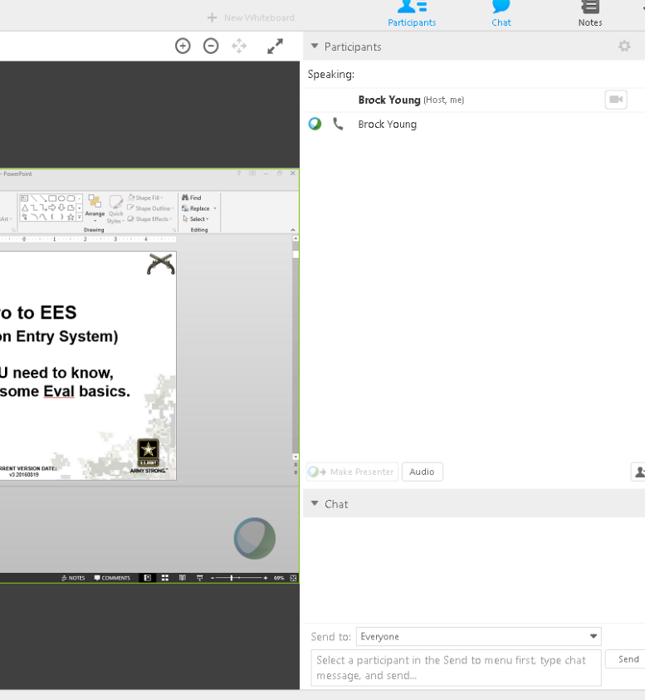
GROUND RULES
1) Keep your phone on MUTE.
2) Type in what unit/state/ component you’re with in the Chat box below (I’m interested in seeing where everyone is from).
3) Time will be given during each session to ask questions; please hold questions until then. (though may be limited due to number of participants)
4) Feel free to type a question (at appropriate time) in the WEBEX Chat box located here:
Notes:
Before we begin, due to the larger number of attendees, please ask all questions, unless I indicate other wise, in the chat text box in WebEx indicated by the red arrow.
A brief period will be given for those who are only calling into the class to ask questions.

Slide 2
Intro to EES
(Evaluation Entry System)
What YOU need to know,
Mixed with some Eval basics.
Notes:
INTRODUCTION: Self
Name, Position, Background – Infantry/MP NCO, MP Officer, Aide, PL, Full time S3 now Full Time ALOC OIC/S1.
OPENING COMMENTS:
Thank You to 40 MP CO (primary) for requesting this class, and everyone else on the line.
Did not expect invite to go out in S1Net Blast, so thank you to those calling from out of state; from locations in Virginia, Louisiana, Texas, Oregon, Florida, and Illinois.
Points on my instructing method:
-Designed so everyone can get it.
-As “right” and as it can be, with some tricks and TTPs learned over career.
-Slides may be “wordy,” designed so people don’t need “instructor” to get the info.

Slide 3
EES NOTE
Use of EES is MANDATORY for all NCOERs with a “THRU” date of 1 JAN 16 or later.
  NCOERs with a “THRU” date before 1 JAN 16, will be submitted through the proper S1 channels using the applicable form for that date.
Use of EES for OER submission has been mandatory for several years.
https://evaluations.hrc.army.mil/
This class will not cover the art of writing evaluations. For information on how to create and compile evaluations, see S1Net at;
www.milsuite.mil
Notes:
Slide.
Class on the Basics of and the “Art” of Bullet Writing will follow this class after a short break.
All classes are available on MilSuite.
-Eval submitted in EES with THRU prior to 1 JAN 16; has to be removed and replaced.
-Even HQDA Makes mistakes,
NOTE ON MILSUITE:
-Products include bullet guides, duty descriptions, profile tracking tools, etc.

Slide 4
Agenda
References
Navigating EES
Responsibilities
Creating an OER/NCOER Support Form
Creating an OER/NCOER
Evaluation Process
Assigning Delegates
“Profiling” and Rater/SR Profile
Types of Evaluations
Major Issues (and issues with 185 evals)
Questions
10 Minute Break.

Slide 5
References
EES Webstie: https://evaluations.hrc.army.mil/index.html
ADP 1, The Army
ADRP 1, The Army Profession
ADRP 6-22, Army Leadership
ADRP 7-0, Training Units and Developing Leaders
AR 27-10, Military Justice
AR 350-1, Army Training and Leader Development
AR 600-9, The Army Body Composition Program
AR 600-20, Army Command Policy
AR 623-3, Evaluation Reporting System
ATP 6-22.1, The Counseling Process
DA Pam 611-21, Military Occupational Classification and Structure
DA Pam 623-3, Evaluation Reporting System
FM 6-22, Army Leadership; Competent, Confident, and Agile
TC 7-22.7, Noncommissioned Officer Guide
Notes:
QUESTIONS?

Slide 6
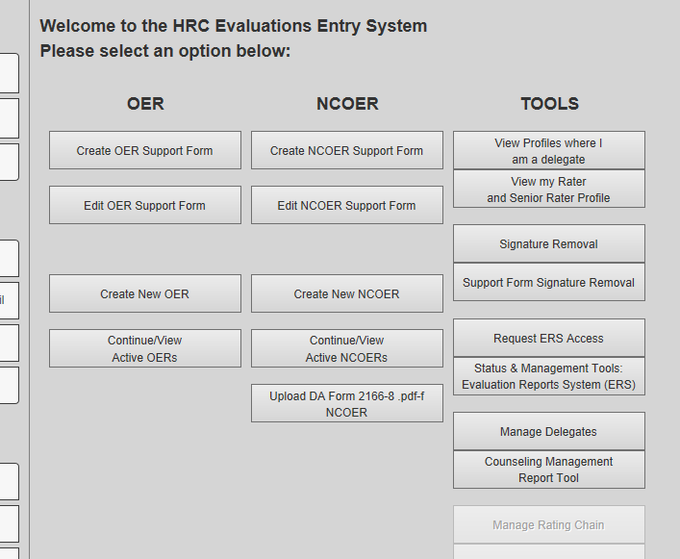
Navigating EES
Create / Continue Support Form:
Rated, Rater, SR or Delegates can create and edit support forms.
Create / Continue Evaluation:
ANYONE can create, but only Rater, SR or delegate can view or edit once saved.
Manage Delegates:
Go here to assign delegates.
Notes:
Home Screen of EES.
These are the buttons most used and will be covered here.
QUESTIONS?

Slide 7
Responsibilities
Commanders: Commander’s are ultimately responsible for the evaluations within their units.
Rater: Assesses PERFORMANCE. (AR 623-3, 2-12)
  Counsel Soldier. Initial face-to-face discussion of duties, responsibilities, and objectives
  Quarterly/semi-annually to assess a Soldier’s performance against the standards - the Army Leadership Requirements Model, the org’s mission, duties, responsibilities, tasks, and objectives
  Inform NCOs where they stand in comparison to peers, and what they can do IOT improve
  NOTE: Rater commenting on potential will result in in the evaluation being returned from HQDA
Senior Rater: Assesses POTENTIAL. (AR 623-3, 2-14)
  Accurately assess POTENTIAL for greater responsibility measured against the above standards. Must be 2 grades higher (min) than Rated NCO
  REVIEWS FOR ACCURACY
Notes:
Rater: Assesses PERFORMANCE.
-Raters, make sure you comment accordingly for the bullet points.
-Do not be afraid the put “MET STANDARD” if that’s all they did. Do not feel you need to inflate a rating to protect a poor performer, even if you failed to counsel.
-Raters are continuing to talk about POTENTIAL! STOP!
EXAMPLES RIGHT:
-performed according to standard, with minimal supervision.
-outstanding performance in all respects; clearly performed above already high expectations.
-top performing SSG in a company with 23 SSGs.
-performs at a level above his current rank
- continue to utilize as squad leader to increase exposure to leadership challenges
EXAMPLES WRONG:
-ready for promotion now
-assign immediately as MP company 1SG.
-has the potential to excel in the company.
Senior Rater: Assesses POTENTIAL, not performance.
QUESTIONS?

Slide 8
Responsibilities, cont.
Rated Soldier: (AR 623-3, 2-10)
  Make sure your evaluation gets done, when it needs to be done (Annual vs. Change of Rater vs. Change of Duty, etc.)!
  IT’S YOUR CAREER!!
  Push for counseling and updates on performance.
  Update Support Form with accomplishments, even those accomplishments in civilian education, training, etc.
Supplementary Reviewer (NCOERs only):
  Ensures Rater and Senior Rater meet minimum requirements and bullets/ narrative comments meet the standards.
  NCOERs do not need a Supplementary Reviewer if the Senior Rater is SGM/CSM, CW3-CW5, or CPT/higher
  Qualifications: Must be SGM/CSM, CW3-CW5, or CPT/ higher, and be senior to the Senior Rater in TIG/rank
Notes:
RATED SOLDIERS:
-In 185 MP BN, at the beginning of August 2016, there were 41 SGTs that were without an evaluation for over 480 days since promotion.
-There were 3 SSGs!
-Issue due to promo date not being entered into SIDPERs, therefore RMT didn’t track.
REVIEWER:
-Companies that do not have a CPT for a company commander, will need BN assistance in order to review NCOERs.
-185 MP BN has sent out a memo designating the BN reviewer as part of the BN Evaluation SOP.
-No, 1LT(P) does not count.
-Order that an NCOER has to be signed in: Rater, SR, Rated NCO, Reviewer (if applicable).
QUESTIONS?

Slide 9
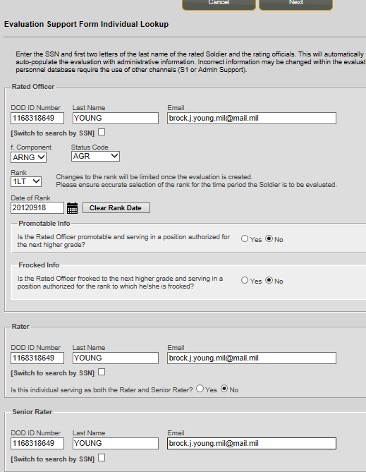
Creating a Support Form
Create Support Form:
Click on applicable button.
Enter applicable information for:
Rated NCO/OFFICER,
Senior Rater,
Reviewer (if applicable on NCOERs only)
Notes:
WHAT YOU WILL NEED:
DODID #s: Rated, Rater, SR, and Reviewer if applicable.
Names, last and first: Rated, Rater, SR, and Reviewer if applicable.
“Dot MIL” email addresses: Rated, Rater, SR, and Reviewer if applicable.
Rater/Senior Rater Support Forms and Initial Counseling (see NCOER Support Form Class).

Slide 10
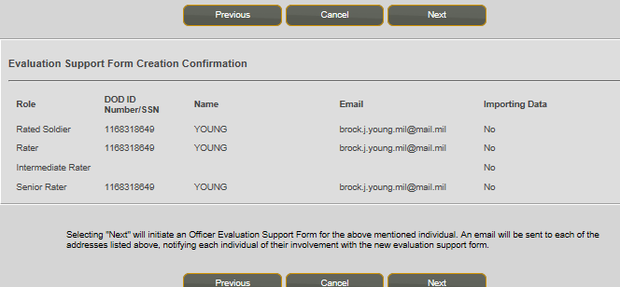
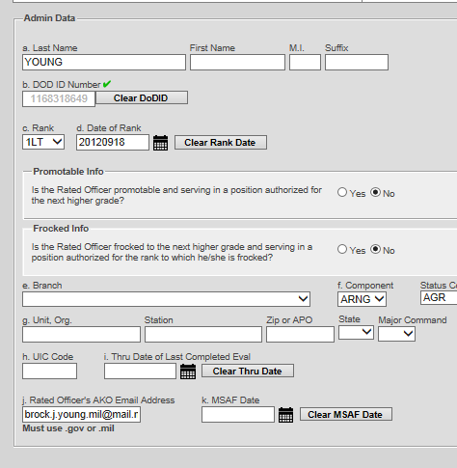
Creating a Support Form
Confirm applicable information is correct.
Click “NEXT”
Complete filling out the Section I Admin data.
Click “NEXT,” and complete Section II Authentication
(Rater/ Senior Rater/ Reviewer Info)

Slide 11
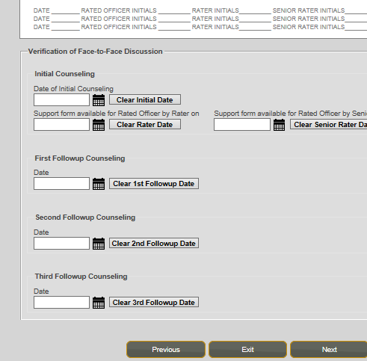
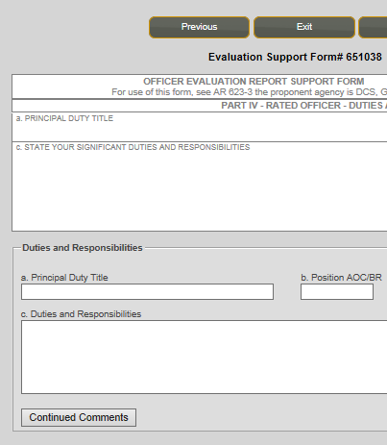
Creating a Support Form
Enter any applicable Counseling Dates.
Click “NEXT”
Begin filling out applicable sections.
How to fill out this information can be found in the PowerPoint class entitled “NCOER Support Form Class - v4 20150516”
Notes:
-This class will not dig into how to develop all of the parts of the NCOER Support Form however I put together a class available on Milbook with can be used if you’re interested in how to develop duty descriptions, goals, etc (can be used for OER Spt Frm as well).
TTPs for support forms:
-Rater or Rated NCO/Officer can initiate
-Recommend any time Rated NCO/Officer does something, it’s added to the SPT Frm.
-Little known/understood things to add:
--Civilian schooling grades, semester hours completed, degree’s earned etc.
--Completed college credits and or maintained high GPA
--Completed/competed in a marathon or some physical competition
--Volunteered in community
--Recognized/awarded something in civilian job
-QUESTIONS?

Slide 12
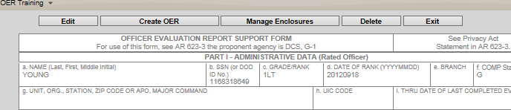
Create an Evaluation
2 ways to create an Evaluation:
1) Create an Evaluation From an active Support Form:
Click on “Create OER (or NCOER)” button. This way is PREFERRED because it will import all of the admin data (NOT BULLETS) from the Support Form.
NOTE: If you are the Rated Soldier, once you create the evaluation you will not have access to view it until it is ready for your signature.
2) Create an Evaluation From Scratch (no Support Form used):
Click on applicable button and begin form. You will need to enter all administrative data as well as duties, responsibilities, MOS/AOC, etc.
NOTE: If you are the Rated Soldier, you can create and input your own evaluation information, however once you EXIT the evaluation, you will not have access to view it again until it is ready for your signature.
Notes:
- If created this way, Rated NCO/Officer won’t be able to access. Only part 1 information transfers.
- If created this way, Rated NCO/Officer can access until the eval times out, or the individual closes it.
If rated NCO/Officer choses to initiate eval and give rater/SR draft bullets, recommend complete eval on PDF form and then cut and paste into EES.

Slide 13
Create an Evaluation
Once created, the Rater and Senior Rater will input the applicable information, bullets/narratives into the form.
OERs: Every box will be in narrative format
NCOERs: Rater boxes will be in bullet format on SGT and SSG/MSG-1SG NCOERs(no change to old formatting); SGM/CSM NCOERs will be all narrative. Senior Rater comments will be in a narrative format.
  TTP: SR SHOULD comment on (at a minimum); observed performance (optional); promotion potential (command, positons, assignments etc.); school potential (both Mil and Civ); performance potential; and retention potential (optional)
Once everything is good and someone (the Enlisted Advisor in “perfect world; see section on Assigning Delegates) has reviewed the evaluation, the evaluation must be signed in order:
  Rater
  Senior Rater
  Rated Soldier
  Reviewer (if applicable)
Notes:
QUESTIONS?

Slide 14
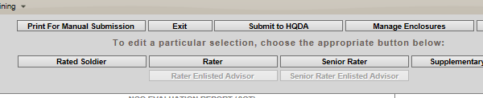
Completing an Evaluation
Once the evaluation is signed by the Rated Soldier, the Senior Rater submits the evaluation to HQDA for submission:
NOTE FOR 49 MP BDE ONLY. SR WILL NOT submit evaluations.
OERs: SR will informed the BN S1 that the OER is complete and ready for submission. The BN S1 will inform the 49 MP BDE S1, who will review and code OERs
NCOERs: SR will informed the BN S1 that the NCOER is complete and ready for submission. The BN S1 will review, submit and code NCOERs
Notes:
NOTE FOR SUBMISSION. This is a 49th MP BDE requirement only. Any other elements on the line will need to contact their BN/BDE S1s to see if there are any similar requirements for their organizations.
NCOERs specifically, currently have a less than 2% error rate with this process. Previously near 40%.
QUESTIONS?

Slide 15
Evaluation Process
Initial Counseling. Following this, the Rated Soldier should create their NCOER/OER Support Form if their Rater hasn’t done so already
Follow-up Counseling: Quarterly (AC and AGR); semi-annually for ARNG/USAR M-Day/TPU NCOs. Counseling should also take place after periods of extended duty, e.g. AT, ODT, etc. Update Support form/4856
Evaluation Creation. Any time; suggested complete draft 30 days from the “THRU” date
Signing the Evaluation. Can be signed up to 14 days before the “THRU”
Submission to HQDA. Submit on or after the “THRU” date once signed by the Rated Soldier. SR forwards evaluation to HQDA (except 49 MP BDE)
Coding/PERMing. OERs take 5 weeks, NCOERs take 8 weeks to process to your file. The difference comes from the volume of NCOERs and the number of errors on the forms. OER error rate – 12-16%, NCOER error rate – 27-33%. HRC's goal is 4-6 weeks for all. Any faster and you can't fix errors without doing an Appeal
Notes:
COUNSELING is part of the evaluation process and is typically where the process breaks down.
You will need:
-Delegate name, rank, DoD ID # and “.mil” email address (NOT AKO).

Slide 16
BREAK
5 min
Notes:
COUNSELING is part of the evaluation process and is typically where the process breaks down.
You will need:
-Delegate name, rank, DoD ID # and “.mil” email address (NOT AKO).

Slide 17
Assigning Delegates
Assigning delegates allows visibility of evaluations and support form by Soldiers out side of the rating chain.
Mandatory delegates (for 185 MP BN):
  All Officers: Assign BN S1 Officer and BDE S1 Warrant as delegates with the following permissions:
    View Rating Profile
    Edit Evaluations
    Submit Evaluations/ Remove Signatures
  All NCOs: Assign Company 1SG or DET SGT (at a minimum) as delegate with the “Enlisted Advisor” permissions.
  NCOs with BC as Senior Rater or Reviewer: Assign BN CSM as delegate with the “Enlisted Advisor” permissions.
Other delegates can be assigned at the unit level as appropriate. Suggested delegates include company XO, Platoon Sergeants, Training or Readiness NCOs, etc.
Notes:
Additionally, every Senior Rater within the 185 MP BN has the BN S1 as delegate with review/submit permissions.

Slide 18
Assigning Delegates
How to assign a delegate:
1) Select “Manage Delegates”
2) If adding your first delegate your screen will look like this. Use the drop down to select
“Rater” or “Senior Rater” depending on what role you would like to assign.

Slide 19
Assigning Delegates
How to assign a delegate:
3) Enter the delegate’s DOD ID number or SSN and Last Name
4) When information populates, ensure delegate’s information is correct.
5) Select roles; an “Enlisted Advisor” will only be a delegate for Rater or Senior Rater.

Slide 20
Assigning Delegates
How to assign a delegate:
6) Check the applicable delegate permissions. Unless granting additional permissions, only select the “Enlisted Advisor” permission for the Enlisted Advisor.
7) Select “Update Permissions” to save work;
8) Use drop down to change the role you would like your delegate to have permissions (Note: only a delegate with “Submit Evaluations” permission in the Senior Rater role can submit completed evaluations).
9) Add any additional delegates you need to add. When complete, return to the HOME screen.
Notes:
Permissions include
MANAGE DELEGATES
VIEW RATING PROFILE
EDIT EVALUATIONS
SUBMIT EVALUATIONS/Remove signatures
ENLISTED ADVISOR
-Can set for a time limit, e.g. 1 yr, 6 mo, etc.
QUESTIONS?

Slide 21
Profiling
What is a “Profile” with regards to evaluations?
A “Profile” is a management technique used to prevent Senior Raters/Raters from placing everyone in the top box.
  (if everyone is AWESOME, then no one is awesome)
It is designed to force Raters and Senior Raters to give better, more accurate assessments of their subordinates.
Profiling doesn’t mean good NCOs/Officers are harmed by the rating check, it just requires more succinct narrative and bullet comments.
OERs: BOTH the Rater and Senior Rater Profiles are CONSTRAINED, meaning EES/HQDA will not allow a Far Exceeds or Most Qualified if your profile doesn’t allow it (AR 623-3, ch 3-11).
NCOERs: Only Senior Rater Profiles are constrained, but
Rater profiles are tracked to check “tendency,” which will
effect how boards treat Rater bullets.

Slide 22
Profiling, cont.
What are the constraints?
NCOERs: Raters must maintain a credible RATER PROFILE. Your Rater Profile is UN-CONSTRAINED, meaning you can give as many “FAR EXCEEDS” ratings as you like. However, your “Rater Tendency,” or rating history for each grade they rate, is maintained within the EES. It follows a rater through their career and while not constrained, will affect how an evaluation is looked at; e.g. if a Rater only gives “FAR EXCEEDS” to certain grades (from SSG-CSM/SGM), it will give less weight to their comments on a particular evaluation.
NCOERs: Senior Rater Profile. Senior Rater Profile is CONSTRAINED, meaning you are limited to marking 24% of SSGs-CSM/SGM, “MOST QUALIFIED.” There is a “Silver Bullet Exception,” meaning with immature profiles (under 5
evaluations) 1 of the first 4 NCOERs can be given the “MOST QUALIFIED” ranking. This is a ONE TIME USE per rank.

Slide 23
Profiling, cont.
OERs: Rater and Senior Rater Profiles are CONSTRAINED, meaning Officers are only allowed to grant 49% of each rank they rate with either an “EXCELS” (as Rater) or “MOST QUALIFIED” (as Senior Rater). HOWEVER, if you have an immature profile, and have only just begun rating/senior rating Officers of a certain rank, you are allowed a ONE TIME option of giving one of the first 4 evaluations you make at a particular grade, an “EXCELS” (as Rater) or “MOST QUALIFIED” (as Senior Rater).
Managing your Profile.
You can keep track of your profile through EES.
Managing profiles for the good of your subordinates requires forethought and planning.
Get a tracker. Here are two:
  https://www.milsuite.mil/book/message/574677
  https://www.milsuite.mil/book/docs/DOC-278659
Notes:
-Resist the urge to “leap-frog” subordinate evaluation ratings, or give a subordinate a “top block” simply because they are going to board or need it for promotion.
-Only give EXCELS/MOST QUALIFIED ratings to those that deserve it.
QUESTIONS?

Slide 24
Types of Evals
When is YOUR evaluation due?
(These are only the “typical” types of evaluations, see AR 623-3 for a complete list)
Annual: 365 rated days from last THRU or promotion to SGT; NO unrated time.
Extended Annual: 365 rated days with additional unrated time from last THRU or promotion to SGT/Commission. Typically, 1st time OERs for 2LTs will be Extended Annual.
Change of Rater: Mandatory when Rater changes but has been Rater for over 90 days.
Change of Duty: Changes duty while under same Rater (to include going into the ING).
Complete the Record (OERs only): Used to close out a rating period before an HQDA Board.
Relief for Cause: is required when an NCO or Officer is
relieved for cause. Must include counseling (or other
applicable documentation).
Notes:
ANNUAL Reports: 365 (366 in leap year); reports are getting kicked back if they have less/more than 1 year rated time. If less/more will be another type; COR, COD, Ext-ANN, etc. Typically 2LTs will NOT have an Annual for their first eval due to BOLC being nonrated time.
Extended annual: 365 (to 455) rated days; should have nonrated time. Can ALSO include ratings OVER 365 days; e.g. SM PCS or ETS within 90 days after annual; SM is pending administrative or legal actions that will conclude within 90 days after annual; SM will complete a project/process that was worked on throughout rating period; etc.
See AR 623-3, sections VIII, IX, X for additional reports.

Slide 25
Major Issues
Major Issues that cause evaluations to be returned:
Formatting issues in Rater and Senior Rater’s comment sections on NCOERs
  DA PAM 623-3 para 3-6b, 3-11b - Raters of MSG and below will use bullet(s) for all blocks in Part IV
  DA PAM 623-3 para 3-16b - Raters of SGMs / CSMs will use narrative comments for Part IV blocks c, d and f
  DA PAM 623-3 para 3-7c, 3-12e, 3-17e - Senior Raters of all NCOs will use narrative comments
Raters comment on performance, NOT potential.
Senior Raters comment on potential, NOT performance.
Missing SHARP statement in Part IV block c (Character).
Unqualified Senior Rater (must be two pay grades above rated NCO)
Missing Required Supplementary Reviewer, e.g. NCOERs with Senior Raters in ranks of SFC–MSG, WO1–CW2, 2LT–1LT.
Reviewer must be SGM/CSM, CW3 or higher, CPT or higher.
Improper use of “Extended Annual” report (wrong type of eval).
Senior Rater now uses NARRATIVE on NCOER, not bullets.
ARNG NCOs; “P” on rated SM rank (not allowed on ARNG NCOs)
Notes:
Seeing a lot of SR comments as bullets.
NCOERs with missing SHARP comment.
1LT(P) SR require a reviewer.
Rated NCOs who are ARNG having the “P” identifier; not allowed per AR 623-3, para 2-11, d. “For ARNG NCOs, the “P” identifier in part I, block c for the rated NCO is not applicable.”

Slide 26
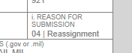
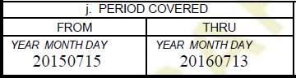
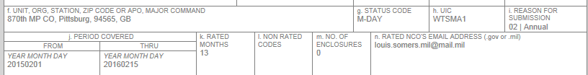
Issues Seen in the 185th
From 185th MP evaluations:
o Reason for submission incorrect: “Reassignment” is not a valid evaluation for ANY ARNG NCO/Officer.
o Selecting an “ANNUAL” evaluation has a default THRU date that is 365 days from the FROM date; 2016 is a leap year with 366 days. Raters must manually change the date. This one should be “20160714.”
o “ANNUAL” reports must be 365/366 days EXACTLY, with no unrated time.

Slide 27
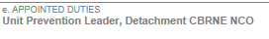
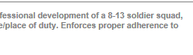
Issues Seen in the 185th
From 185th MP evaluations:
o “Daily Duties and Scope,” “Areas of Special Emphasis,” and “Appointed Duties” need to be separated by a SEMICOLON
o REVIEWERS for NCOERs must be SGM/CSM, CW3-CW5, or CPT/higher. 1LT(P) cannot be reviewers, and evaluations with 1LT(P) senior raters, require review.
o Using old AKO emails opposed to the “mail.mil” email.

Slide 28
Issues Seen in the 185th
Comments from evaluations that have been kicked back from HQDA:
o Bullets must be preceded by a small “o,” begin with a lower case letter and start with his/her or action words/NOT Soldiers Name and rank.
o Rater Overall Performance - Rater comments are limited to performance only; comments on potential such as future military schooling, promotion or assignments are not authorized.
o Senior rater comments must be in narrative format.
o Rater is an ARNG NCO, the P identifier is not authorized.

Slide 29
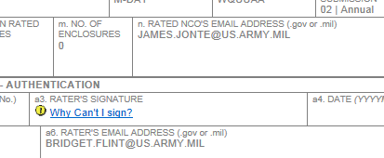




Issues Seen in the 185th
-DO NOT use the old @US.ARMY.MIL
-Leap year has 366 days (20161029)
-These sections don’t use bullets.

Slide 30
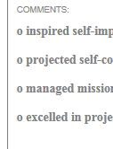
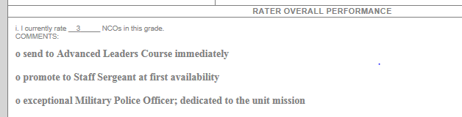


Issues Seen in the 185th
-Maximum of 3 bullet comments per box.
-Rater CANNOT comment on potential of future schools
-Missing SHARP Bullet
-Bullet comment makes no sense.

Slide 31
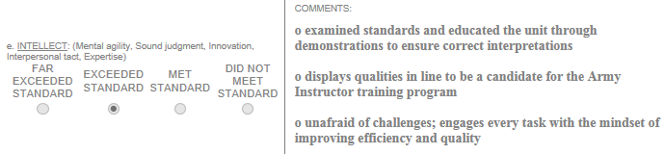

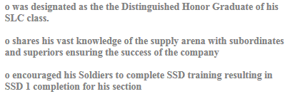
Issues Seen in the 185th
-Check doesn’t match comments.
-SHARP Bullet in the Wrong Box.
-1059 producing school comments not allowed.
-Periods on ALL bullets, or NO bullets; CONSISTENCY!

Slide 32


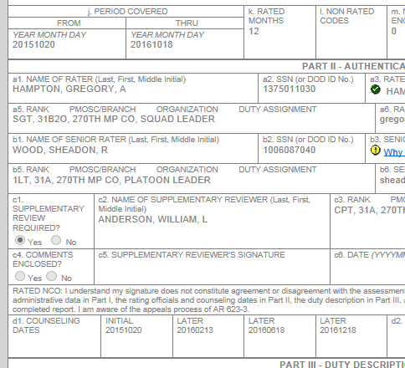
Issues Seen in the 185th
-Raters cannot use the NCO’s name in bullets.
-Choosing incorrect REASON for submission.
-Counseling dates outside of rating period.

Slide 33
QUESTIONS?
For additional personal growth and development,
visit:
Milsuite and MilBook;
www.milsuite.mil
NCOER Bullet Guide;
https://www.milsuite.mil/book/docs/DOC-263142
NCOER (OER) Support Form Class;
https://www.milsuite.mil/book/docs/DOC-202566
FEEDBACK/CRITIQUE:
Brock.j.young.mil@mail.mil
Notes:
QUESTIONS?
Anyone who would like a copy of this class, please email me at my “.mil” email and I will send you a copy.
Also available is a quick introduction to Milsuite class.
For feedback, comments, or thoughts on how how to make this class better, please feel free to email me at>

Slide 34
10 MIN BREAK

