Slide 1

PHANTOM Troop
Small Unit TACSOP

Slide 2
PHANTOM 6
TRUST
THINK
COMMUNICATE
WIN!

Slide 3
PHANTOM TROOP’S STANDING ORDERS
Know your job and the job of everyone beside you. There is no substitute for accurate knowledge. Knowledge is power; Never fake it.
Never lie to an NCO or Officer. Admit your mistakes quickly and learn from them.
Stand ready to execute any task with intensity. Aggressively confront problems.
Seize the initiative. Acquire first, shoot first, hit first.
Your weapon is your life-line. Keep it on safe, clean, and off the ground. Your neatness of dress and Care of equipment will sets standard for others to follow.
Be nimble. Move quickly and without detection. A CIVILIAN ON THE BATTLEFIELD MAY RESULT IN A HARD COMPROMISE. Compromise is failure.
Fight behind cover. Do not funnel onto the objective; utilize individual movement techniques and micro-terrain for protection.
Spread out! Make contact with the smallest element possible.
Accept and mitigate tactical risk. Exercise tactical patience.
Remain calm under fire - your stoic presence in any stressful situation will have a calming effect on THOSE AROUND YOU.
If separated from your unit, survival depends on your ability to successfully evade enemy forces and be recovered by friendly forces. Know the evasion plan of action.
Maintain security at all times. Never drop security below 33% when executing priorities of work. Ensure all priorities of work are completed before chow. Never eat on the line and ensure security is in place.
Conduct stand-to and maintain 100% security at BMNT. Dawn is when the enemy attacks.
Move tactically. Adjust your movement formations to the terrain AND THE enemy.
Never return on the same route. Plan routes for infiltration, exfiltration, and contingencies.
When crossing linear danger areas, emplace security to provide early warning and use the terrain to your advantage.
Counter-track your movement to disrupt the enemy. If someone is following you, execute a hasty ambush.
Surprise the enemy and overwhelm them with integrated fires. violence of action is decisive to a small unit’s survival.
Possess physical vitality and endurance. Be able to withstand the hardships to which you are subjected, and a dauntless spirit that enables you not only to accept them cheerfully but to minimize their magnitude. Be positive in the worst situations – your attitude is contagious.

Slide 4
TABLE OF CONTENTS
1. Task Organization
  1a. DUTIES & RESPONSIBILITIES
2. Movement
  2a. Formations
  2b. techniques
  2c. DELIBERATE LDA
  2d. FISH-HOOK
  2e. SHORT HALT POSTURE
  2f. 5-POINT CONTINGENCY PLAN (GOTWA)
3. OBJECTIVE RALLY POINT
  3a. Clearing the TENTATIVE orp
  3b. ORP / LONG HALT POSTURE
  3c. Leader’s Reconnaissance OF OBJECTIVE
4. ACTIONS ON OBJECTIVE
  4a. OCCUPY SURVEILLANCE SITE
  4b. SURVEILLANCE SITE PRIORITIES OF WORK
  4c. OCCUPY HIDE SITE
  4d. HIDE SITE PRIORITIES OF WORK
  4e. DISPLACEMENT CRITERIA (RED, WHITE, BLUE)
  4f. BREAK CONTACT
5. Collection & reporting
  5a. Pax / vehicle identification
  5b. Building identification
6. REPORTS
  6a. ANGUS (INITIAL ENTRY)
  6b. BORRIS (INTELLIGENCE)
  6c. CRACK (BATTLE DAMAGE ASSESSMENT)
  6d. CYRIL (SITUATION REPORT)
  6e. EAGLE (FIRST EYES ON OBJECTIVE)
  6f. UNDER (CACHE)
  6g. ENTER / LEAVE (INFIL / EXFIL)
  6h. SALUTE REPORT
7. medical
  7a. Casevac plan
  7b. CCP / HLZ OPERATIONS
8. EVASION AND RECOVERY
  8a. DAR LINK-UP ACCOUNTABILITY
9. AREA RECONNAISSANCE
10. LINK-UP
11. OCCUPY Hide site (PRI / ALT)
12. 9-LINE MEDEVAC / MIST
13. CALL FOR FIRE
  13a. CLOSE AIR SUPPORT / CLOSE COMBAT ATTACK
  13b. RISK ESTIMATE DISTANCES / MAX RANGES
14. PRE-COMBAT INSPECTION
Fries operations
  15a. Ropers actions
  15b. Safety
  15c. Preflight + inflight
  15d. Medical
  15e. Adverse weather conditions
Pathfinder operations
16a. Phases of lz/pz operations
16b. Technical factors in pz selection
16c. Hlz marking
16d. Flying/landing formations
Boat operations
17a. inflation
17b. deflating
Command post operations
REPORTS

Slide 5
1. TASK ORGANIZATION
8 MAN ELEMENT
SSO
ATL
A
SAW
A
GR
RTO
TL
B
GR
B
SAW

Slide 6
1A. DUTIES & RESPONSIBILITIES
ALPHA TEAM
SENIOR SCOUT OBSERVER (SSO)
Front Security
Leaders Recon for ORP, OBJ, PB
SSO
ASSISTANT TEAM LEADER (ATL)
Controls Navigation and Pace
Conducts Leaders Recon
Left Side Security
Primary Compass
Ensures Rally Points are designated
Responsible for command and control of Alpha Team
Responsible for Surveillance Log
ATL
A
SAW
Alpha team saw (ASAW)
Responsible for providing immediate suppression to the front
Controlled by the ATL
Conducts Leaders Recon
Right Side Security
A
GR
ALPHA TEAM GRENADIER (AGR)
Left Side Security during patrol and LDA crossing
Primary Pace
Leaders Recon for ORP, OBJ, PB

Slide 7
1A. DUTIES & RESPONSIBILITIES
BRAVO TEAM
TEAM LEADER (TL)
Responsible for accomplishment of the mission
Leaders Recon for ORP, OBJ, PB
Responsible for command and control of Bravo Team
Ensures Route and Pace are correct
Responsible for accountability
Controls CCP designated in the Release Point
Controls Flank Security elements at LDAs
TL
Radio telephone operator (rto)
Calls in all Sit-Reps, Code Words when applicable
Maintains Radio Communications
Records all information transmitted on Net
RTO
A
GR
BRAVO TEAM GRENADIER (BGR)
Right Side Security during patrol and LDA crossing
Alternate Pace
Leaders Recon for ORP, OBJ, PB
B
SAW
BRAVO team saw (BSAW)
REAR SECURITY

Slide 8
2A. MOVEMENT FORMATIONS
WEDGE
FILE
ATL
ATL
A
SAW
SSO
SSO
A
SAW
A
GR
A
GR
TL
RTO
RTO
B
SAW
B
GR
TL
B
GR
B
SAW
LINE
DIAMOND
A
SAW
ATL
ATL
SSO
A
GR
SSO
A
GR
A
SAW
RTO
B
GR
TL
B
GR
RTO
TL
B
SAW
B
SAW

Slide 9
2B. MOVEMENT TECHNIQUES
TRAVELING
TRAVELING OVERWATCH
LEAD SQUAD IN TRAVELING
OVERWATCH FORMATION
LEAD SQUAD IN TRAVELING
OVERWATCH FORMATION
± 20 METERS
50 TO 100 METERS
PLATOON HQ
PLATOON HQ
± 20 METERS
DIRECTION
OF TRAVEL
± 20 METERS
DIRECTION
OF TRAVEL
± 20 METERS
± 20 METERS
PLATOON SERGEANT, MEDIC
PLATOON SERGEANT, MEDIC
± 20 METERS
± 20 METERS
BOUNDING OVERWATCH
SQUAD AWAITING
ORDERS
OVERWATCHING
SQUAD
BOUNDING SQUAD
DIRECTION
OF TRAVEL

Slide 10
2C. DELIBERATE LDA
4
SSO
ATL
5
B
SAW
B
GR
A
SAW
A
GR
3
TL
RTO
8
LDA is identified // Pass H&A signal back
short halt // lay guns on far-side target // identifies crossing point
Establish near-side security (Left: ASAW / RIGHT: Agr)
Sso, atl, bgr cross LDA at 45 degree angle
BGR establishes left far-side security
Far-side clears (ATL, SSO)
BSAW move to far side, establishes right side
ASAW, RTO, AGR, TL move to far side
TL breaks down far side security (BSAW, BGR)
Patrol continues mission

Slide 11
2D. FISH-HOOK
PASS FISH-HOOK H&S BACK
SQUADS MOVE INTO A FILE AT FIRST 90° TURN
EXECUTE 90° TURNS TO PREVENT TRACKING
SHORT HALT POSTURE
SLLS / PINPOINT ON MAP
INPLACE CLAYMORE COVERING 6 ‘O CLOCK
PLATOON:
- PLACE TWO SOLDIERS AT CHOKE-POINT TO CONTROL THE FLOW OF ENTRY
- 2B-GRENADIER CONTROLS CLAYMORE
200 M
90°
100 M
50 M
100 M
DIRECTION
OF TRAVEL

Slide 12
2E. SHORT HALT POSTURE
SQUAD
360° SECURITY
SLLS
TL PINPOINTS ON MAP
ATL MOVES TO CENTER
ATL DISSEMINATES:
  LOCATION ON MAP
  REASON FOR HALT
  NEXT ACTION
ATL PLACES CLAYMORE
(IF NECCESARY)
SSO
ATL
A
SAW
A
GR
TL
RTO
B
GR
B
SAW
1A
PLATOON
360° SECURITY
SLLS
PL PINPOINTS ON MAP
PSG / SLs MOVE TO CENTER
ATLs DISSEMINATE:
  LOCATION ON MAP
  REASON FOR HALT
  NEXT ACTION
3atl PLACES CLAYMORE
(IF NECCESARY)
1 SQD
2 SQD
1B
3 SQD / HQ
2B
2A

Slide 13
2F. FIVE-POINT CONTINGENCY PLAN
(GOTWA)
WHERE YOU ARE GOING
  DISTANCE
  DIRECTION (MAGNETIC)
  DESCRIPTION
  GRID POINT
  BRIEFED WHILE VIEWING MAP
OTHERS YOU WILL BE TAKING WITH YOU
  NUMBER OF TOTAL PEOPLE
  NAME / POSITION
  SOLDIERS WILL BE COUNTED OUT AND IN
  RECOMMENDED PARTY: PL / FO / M249 / M320
TIME YOU WILL BE GONE
  EXACT ZULU TIME YOU WILL RETURN
  DO NOT BRIEF A TIME LENGTH (E.G. 60 MINUTES)
    AFTER FULL DISEMINATION THE LAST MAN WILL HAVE A DIFFERENT TIME THAN THE FIRST
  RECOMMENDED YOU GIVE YOURSELF DOUBLE THE TIME YOU THINK YOU WILL NEED
WHAT TO DO IF WE DO NOT RETURN
  SEND SEARCH PARTY TOWARDS DISTANCE / DIRECTION GIVEN
  LINK-UP AT DESIGNATED AREA OF RECOVERY
  NO “WAIT 10 MORE MINUTES”
  NO “CALL HIGHER”
ACTIONS ON CONTACT
  WHAT YOU DO IF I MAKE CONTACT
  WHAT I DO IF I MAKE CONTACT
  WHAT YOU DO IF YOU MAKE CONTACT
  WHAT I DO IF YOU MAKE CONTACT
SPECIAL INSTRUCTIONS
  WHAT TASKS ARE TO BE ACCOMPLISHED IN THE ORP IN YOUR ABSENCE
Notes:
Paper size is 4in x 6in and can be printed on a notecard.

Slide 14
3. LEADER’S RECONNAISSANCE
OF OBJECTIVE RALLY POINT
SHORT HALT / SLLS / PINPOINT
GOTWA TO ATL (BACKBREIF)
ATL COUNTS OUT (DOGLEG)
SHORT HALT AT RP / PINPOINT
TL ISSUES GOTWA TO SSO
LEADER’S RECONNAISSANCE PARTY
CLEARS TENTATIVE ORP
12
TENTATIVE
ORP
9
3
ORP CHARACTERISTICS
6
SSO
EASILY DEFENDABLE
AWAY FROM NATURAL LINES OF DRIFT
AWAY FROM HIGH-SPEED AVENUES OF APPROACH
PROVIDES NO VALUE TO ENEMY
PROVIDES COVER & CONCEALMENT FROM GROUND & AIR
A
GR
RP
TL
A
SAW
LEADER’S RECON
SH
SSO
: CLEARS TENTATIVE
ORP
A
GR
: CLEARS TENTATIVE
ORP
ATL
B
GR
B
SAW
TL
: ISSUES 2 GOTWAS
OVERWATCH AT RP
RTO
A
SAW
: OVERWATCH AT RP
REAR SECURITY

Slide 15
3A. CLEARING THE TENTATIVE OBJECTIVE RALLY POINT
HALT AT RELEASE POINT / SLLS
SSO ISSUES GOTWA TO TL
SSO & AGR Recon TENTATIVE ORP
  TL & ASAW PROVIDE OVERWATCH
  SSO & AGR CLEAR TENTATIVE ORP (6 -> 9 -> 3 -> 12)
  * LOOK FOR RECET HUMAN ACTIVITY (BRASS / TRASH)
SSO & AGR RETURN TO RP // TL DETERMAINS SUITABILITY
TL PINPOINTS ORP // TL LEAVES RADIO WITH SSO //
CONFIRMS NEAR & FAR RECOGNITION SIGNAL // ISSUES GOTWA TO SSO
TL & ASAW MOVE BACK TO SECURITY HALT AND GATHER THE REMAINDER OF THE ELEMENT AND BRINGS THEM TO THE ORP.
100 meters from the center in the direction of movement or an advantage point to see beyond 100 meters
12
TENTATIVE
ORP
50 meters from the center or to an advantage points to see beyond 50 meters
50 meters from the center or to an advantage points to see beyond 50 meters
SSO
3
9
A
GR
6
Once the tentative ORP is cleared the S&O will be placed at the 6 o’clock position
TL
A
SAW

Slide 16
3B. ORP / LONG HALT POSTURE
Patrol dog legs into the long halt/ORP formation
Long halt can turn into a HASTY ORP BY FORCE
Patrol stays on a knee until each man is IN PLACE.
Each member sits down with their rucksack on, one at a time starting with SSO
Conduct SLLS
Pin point position on map
RTO establishes communications with Higher HQ
place claymore
TL issues GOTWA to ATL
TL conducts Leader’s Recon OF OBJECTIVE
ATL disseminates GOTWA
SSO
ATL
A
SAW
A
GR
TL
RTO
B
GR
B
SAW
PREPARE MWE
MEN
CAMOUFLAGE FACE
FOLEAGE AROUND HELMATE, NECK, FLC
FLC SILENCED FOR NOISE AND SHINE
FULL MAGAZINES
1QT WATER
SKETCH PAD & PENCIL
KNOWLEDGE OF PIR / SIR
WEAPONS
WEAPONS ON SAFE
ROUNDCHAMBERED / FUNCTIONAL
320: CORRECT ROUND / TUBE CLEAN
249: ROUND SEATED PROPERLY
EQUIPMENT
PROPERLY TIED DOWN
NODs PREPARED / FUNCTIONAL
RADIOS (EXTRA BATTERIES / WORKS)
SPECIAL EQUIPMENT
ALL SOLDIERS ARE INSPECTED BEFORE AOO

Slide 17
3C. LEADER’S RECONNAISSANCE
OF OBJECTIVE
PREPARE MWE IN ORP
GOTWA TO ATL (BACKBREIF)
ATL COUNTS OUT (DOGLEG)
SHORT HALT AT RP / PINPOINT /
RECAMOUFLAGE
TL / SSO CLOVERLEAF AND
IDENTIFY SURVEILLANCE SITE
* AGR / ASAW PROVIDE OVERWATCH
IDENIFY SURVEILLANCE SITE
ENPLACE S&O (ASAW / AGR)
* GOTWA TO AGR (BACKBREIF)
* ENGAGEMENT CRITERIA
* DISENGAGEMENT CRITERIA
* RADIO / SPOTTING SCOPE
TL / SSO RADIOS TO ORP AND MOVES
THROUGH RELEASE POINT
NEAR-RECOGNITION SIGNAL /
ENTER ORP / MEETS WITH ATL
FINAL COORDINATION (TL & ATL)
* DESIGNATED AREA OF RECOVERY
* NO COMMO PLAN
OBJ
SS
SSO
TL
A
GR
RP
A
SAW
LEADER’S RECON
SSO
: LAND NAVIGATION
ORP
TL
: GOTWA (ATL / AGR)
ATL
A
GR
B
GR
B
SAW
: S&O (REAR)
RTO
A
SAW
: S&O (FRONT)

Slide 18
4A. OCCUPY SUVEILLANCE SITE
ATL BACKBRIEFS TL
* DAR / NO COMMO PLAN
SSO LEADS ATL TO SS
* ATL RADIOS TO SS
* TL COUNTS OUT (DOGLEG)
FUNNEL THROUGH RP /
NEAR-RECOGNITION SIGNAL / MOVE TO SS
IMPROVE POSITION
* SET CLAYMORE (ATL)
* SET SMOKE (OBS @ 12 / SAW @ 6)
TEAM SETS IN POSITION
* IDENTIFY NEAREST COVERED POSITION (ALL)
* ESTABLISH RFA (FST/ ATL)
* CAS / 9-LINE PREP (FST/ATL)
* HASTY / DETAILED SEARCH (SSO/OBS)
ATL SENDS EXCHECK THAT SS IS IN POSITION
OBJ
RFA
A
SAW
A
GR
RP
RUCK / REST PLAN
SSO
OBJ
12
ATL
OBS
LOG
ORP
TL
ATL
RST
SAW
B
GR
B
SAW
GR
SSO
RTO
SAW

Slide 19
4B. SURVEILLANCE SITE
PRIORITIES OF WORK
Detailed and accurate reporting is critical to the success of a reconnaissance or surveillance mission. The information you provide feeds into your supported unit’s decision making process. your reports Should be able to “paint an accurate picture” with your words. You never know what minute piece of information may prove to be vital to the analysts. Report EVERYTHING you can of tactical significance.
IDENTIFY NEAREST INDIVIDUAL COVER FOR EACH SOLDIER
ATL DISSEMINATES INFORMATION FROM TL:
- DAR // ENGAGEMENT / DISPLACEMENT CRITERIA (RED, WHITE, BLUE)
SETUP CLAYMORE (ATL) / SETUP SMOKE (SSO)
CONTACT FSO AND ESTABLISH A RESTRICTED FIRES AREA (RFA) OVER THE SURVEILLANCE SITE
CONDUCT HASTY SEARCH OF OBJECTIVE
- IDENTIFY OBSERVER-TARGET DIRECTION (MILS / DEGREES & CARDINAL)
- BUILD RANGE ESTIMATION BT IDENTIFYING KNOWN DISTANCES ON MAP
IDENTIFY IDF TRARGETS
- SEND UP SURVEILLANCE SITE LOCATION TO FDC
- PLOT GRIDS FOR TARGETS
- PLAN TARGETS ON BUILDINGS, SUPPLY ROUTES, PAST / ON OBJ, EGRESS
FILL-OUT CAS / CCA / MEDEVAC SMART CARDS
CONDUCT DETAILED SEARCH
- DIVIDE OBJECTIVE INTO SECTIONS IF NECCESARY
- SCAN SYSTEMATICLY FROM NAKED EYE THROUGH HIGHEST LEVEL OPTIC
- OBSERVER GIVES DETAILS TO THE RECORDER
MAINTAIL CONSTANT OBSERVATION ON AREAS THAT ARE LIKELY TO CHANGE
OBSERVER (OBS)
STAYS ON GLASS AND GIVES DETAILS TO RECORDER
SURVEILLANCE LOG RECORDER (LOG)
RECORDS AND MAINTAINS SURVEILLANCE LOG
SQUAD AUTOMATIC WEAPON (SAW)
provides immediate suppression
REAR SECURITY
RESTING (RST)
EXECUTE THE FINAL PRIORITY OF WORK
OBS
LOG
SAW
RST

Slide 20
4C. OCCUPY HIDE SITE
TL COUNTS OUT ATL
CHECK MWE (TL)
360° SWEEP OF ORP
TL/RTO/BSAW/BGR
MOVE TO HIDE SITE (DOGLEG)
STOP / SLLS
RECON / CLEAR HIDE SITE (BGR/BSAW)
360° SECURITY / SLLS
SETUP CLAYMORE
ESTABLISH COMMUNICATION WITH
HIGHER UNIT
SEND EXCHECK THAT HIDE SITE IS ESTABLISHED
MAINTAIN COMMUNICATION WITH SURV. SITE
OBJ
RFA
SS
RP
RUCK / REST PLAN
OBJ
12
RFA
B
SAW
2
SAW
HS
1
GR
B
GR
RTO
ORP
TL
1
RTO
2
TL
1s / 2s REST
SAW @ 12
CM @ 6
DAR

Slide 21
4D. HIDE SITE
PRIORITIES OF WORK
Detailed and accurate reporting is critical to the success of a reconnaissance or surveillance mission. The information you provide feeds into your supported unit’s decision making process. your reports Should be able to “paint an accurate picture” with your words. You never know what minute piece of information may prove to be vital to the analysts. Report EVERYTHING you can of tactical significance.
SECURITY HALT // SLLS // PINPOINT LOCATION ON MAP // CLAYMORE
TL DISSEMINATES INFORMATION:
- DAR // ENGAGEMENT / DISENGAGEMENT CRITERIA // RED, WHITE, BLUE
IDENTIFY NEAREST INDIVIDUAL COVER FOR EACH SOLDIER
ESTABLISH A RESTRICTED FIRE AREA (RFA) AROUND THE HIDE SITE
RTO ESTABLISHES COMMUNICATION WITH HIGHER UNIT
- MAINTAINS COMMUNICATION WITH SURVEILLANCE SITE
INPLACE CLAYMORE
PLAN FIRES ON EGRESS ROUTE
FILL-OUT CAS / CCA / MEDEVAC SMART CARDS
TL SENDS REPORT TO HIGHER THAT HIDE & SURVEILLANCE SITE ARE ESTABLISHED
CONSOLIDATE AND ORGANIZE REPORTS FROM SURV. SITE TO HIGHER
TL
TEAM LEADER (TL)
REVIEWS AND EDITS ALL REPORTS BEFORE THEY ARE SENT HIGHER
RADIO TELEPHONE OPERATOR (RTO)
RECORDS AND MAINTAINS COMMUNICATION LOG
SQUAD AUTOMATIC WEAPON (SAW)
provides immediate suppression
REAR SECURITY
RESTING (RST)
EXECUTE THE FINAL PRIORITY OF WORK
RTO
SAW
RST

Slide 22
4E. DISPLACEMENT CRITERIA
RED, WHITE, BLUE PLAN
RED: ENEMY ON THE OBJECTIVE
  EVERYONE IS AWAKE
WHITE: ENEMY APPROACHING SURVEILLANCE SITE
  PACK EVERYTHING AND BE READY TO MOVE
  LAY GUNS ON, BUT DO NOT LOAD
  REQUEST CAS/CCA ON STATION
BLUE: SURVEILLANCE SITE COMPROMISED
  EXECUTE BREAKOUT DRILL
    DETONATE CLAYMORE
    CALL IN IDF / CAS / CCA
    BREAK CONTACT
    MOVE TO DESIGNATED AREA OF RECOVERY (DAR)
RED
WHITE
BLUE
OBJ
SS
DAR
RED
WHITE
BLUE
HS

Slide 23
4F. BREAK CONTACT
TL ORDERS TO BREAK CONTACT
TL DESIGNATED SUPPORT ELEMENT AND MANEUVER ELEMENT
TL ISSUES DISTANCE & DIRECTION FOR THE MANEUVER ELEMENT
SBF SUPRESSES ENEMY POSITION
MANEUVER ELEMENT USES SMOKE TO MASK MOVEMENT
- TAKES UP OVERWATCH POSITION
- BEGINS TO SUPPRESS ENEMY
TL DIRECTS SBF TO BREAK CONTACT
TL USES SMOKE TO SCREEN MOVEMENT
- TAKES UP OVERWATCH POSITION
TL CONTINUES TO BOUND AWAY UNTIL CONTACT IS BROKEN
CONSOLIDATE / REORGANIZE
B
GR
A
SAW
A
GR
SSO
RTO
B
SAW
ATL
TL

Slide 24
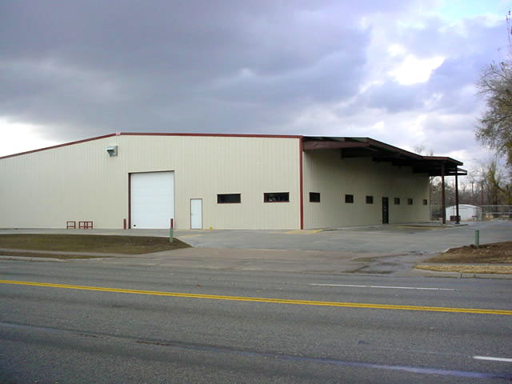
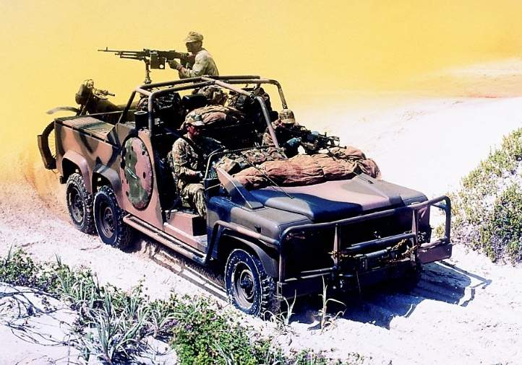
5A. PAX / VEHICLE IDENTIFICATION
The purpose of pre-operational surveillance is to determine the target’s vulnerabilities. Surveillance helps to quantify the target, note possible weaknesses and even to begin to identify potential attack methods. When the target is a person, perhaps targeted for assassination or capture, teams will look for patterns of behavior such as the time the target leaves the objective, the transportation method and the route taken. They also will take note of the type of security, if any, the target uses.
** ENSURE CROSS-COMMUNICATION WITH SISTER ELEMENTS WHEN NAMING PAX **
NAME PERSONNEL ALPHABETICALY
A = ADAM / B = BOB / C = CHRIS / ETC.
HIGH-VALUE TARGETS
SPECIAL ITEMS OF EQUIPMENT
DTG
LOCATION
CLOTHING
WEAPONS
ACTIVITY
TRANSPORTATION METHOD
ROUTE TAKEN
DEFENSIVE POSTURE
MARKINGS ON VEHICLES / WEAPONS / EQUIPMENT
OBSERVATIONAL CONSIDERATIONS
- Put yourself in the mindset of the supported Commander
- He may be looking for actionable intelligence on an HVT
- He may be asking for targeting data for a CFF mission
- He may be looking to send his troops to hit this particular OBJ
** What do you think is tactically relevant? **

Slide 25
5B. BUILDING IDENTIFICATION
The purpose of pre-operational surveillance in an urban environment is to determine the target’s vulnerabilities. Surveillance helps to quantify the target, note possible weaknesses and even to begin to identify potential attack methods. For fixed targets such as buildings, the surveillance will be used to determine physical security measures as well as patterns of behavior within the guard force, if guards are employed. For example, teams will identify the best possible entry points into buildings, doors, windows, fences, gates, but also will look for times when fewer guards are present or when the guards are about to come on or off their shifts. All of this information will then be used to select the best time and location for the attack, the type of attack and the resources needed to execute it.
BUILDING NUMBER FROM HIGHER UNIT GRG
FACES OF BUILDINGS ARE COLORS
- NORTH = RED
- SOUTH = BLUE
- EAST = BLACK
- WEST = WHITE
FLOORS ARE LETTERS
- A = FLOOR 1
- AA = FLOOR 27
WINDOWS ARE NUMBERS
- NUMBERED FROM LEFT TO RIGHT
IE: IF THERE IS ACTIVITY IN BUILDING #15, ON THE SOUTH FACE, ON THE 3RD FLOOR, IN THE SECOND WINDOW FROM THE LEFT…. THE TANSMITION WOULD READ: #15, BLUE, CHARLIE, 2
NORTH: RED
GRG #
1
2
3
E
EAST: BLACK
D
1
2
3
WEST: WHITE
C
1
2
3
B
1
2
3
A
1
2
3
N
SOUTH: BLUE

Slide 26
6A. ANGUS
(INITIAL ENTRY REPORT)
CURRENT DTG
TEAM STATUS (CODE WORDS: GREEN, AMBER, RED)
TEAM CURRENT LOCATION (6 DIGIT WITH IDENTIFIER)
TEAM LEADER’S NARRATIVE WITH DEVIATIONS FROM BRIEFED PLAN
TEAM LEADER’S REMARKS
THE RTO NORMALLY SENDS THE ANGUS REPORT AS SOON AFTER THE INSERTION AS THE TACTICAL SITUATION ALLOWS. THIS IS USUALLY COMPLETED WITHIN FOUR HOURS OF INSERTION. IF THE ANGUS IS NOT SENT WITHIN THIS WINDOW THE COB MAY ASSUME THE MISSION IS COMPROMISED AND INITIATE EMERGENCY PROCEDURES. THIS MESSAGE ALERTS THE COB OF THE STATUS OF THE INSERTION, THE TEAMS INITIAL SITUATION, AND POSSIBLE DEVIATIONS FROM THE INFILTRATION PLAN DUE TO PREVIOUSLY UNKNOWN CONDITIIONS ON THE GROUND.
6B. BORRIS
(INTELLIGENCE REPORT)
CURRENT DTG
DTG ACTIVITY OBSERVED
LOCATION OF ACTIVITY OBSERVED
OBSERVED ACTIVITY
DESCRIPTION OF VEHICLES / EQUIPMENT / PERSONNEL / WEAPONS
TEAM LEADER’S ASSESSMENT
WHEN ANY PIR IS OBSERVED ON THE OBJECTIVE, THE RTO WILL SEND A BORIS REPORT TO THE COB DURING PRESCRIBED COMMUNICATIONS WINDOWS. WHEN ICT IS MET, THE SURVEILLANCE SITE HAS 3 MINUTES TO SEND THE REQUIRED INFORMATION TO THE HIDE SITE. THE HIDE SITE HAS 15 MINUTES TO COMPILE THE INFORMATION INTO THE REPORT AND SEND IT TO THE COB. A FLASH BORIS MUST BE FOLLOWED WITH A DETAILED BORIS WITHIN 30 MINUTES.

Slide 27
6C. CRACK
(BATTLE DAMAGE ASSESSMENT)
CURRENT DTG
LOCATION OF TARGET ( 8 DIGIT WITH IDENTIFIER)
TYPE OF TARGET (VEHICLE, BRIDGE, BUILDING, ECT….)
DESCRIPTION OF TARGET
- PHYSICAL DAMAGE ASSESSMENT
- FUNCTIONAL DAMAGE ASSESSMENT
ANALYSIS (THE LEVEL OF CONFIDENCE INI THE ACCURACY OF THE ASSESSMENT, AND WHETHER THE REATTACK IS NECESSARY)
- CONFIRMED
- PROBABLE (AT LEAST 50% CONFIDENCE)
- POSSIBLE (AT MOST 50% CONFIDENCE)
TEAM LEADER’S REMARKS
THE CRACK REPORT IS USED TO PROVIDE A TIMELY AND ACCURATE ESTIMATE OF DAMAGE RESULTING FROM THE APPLICATION OF MILITARY FORCE, EITHER LETHAL OR NONLETHAL, AGAINST A PREDETERMINED OBJECTIVE.
6D. CYRIL
(SITUATION REPORT)
CURRENT DTG
TEAM’S CURRENT LOCATION (8 DIGIT WITH IDENTIFIER)
MEDICAL STATUS OF TEAM (CODE WORDS: GREEN, AMBER, RED)
STATUS OF TEAM EQUIPMENT (CODE WORDS: GREEN, AMBER, RED)
STATUS OF FOOD WATER AND BATTERIES (PER PERSON)
TEAM ACTIVITY SINCE LAST COMMUNICATIONS WINDOW
TEAM ACTIVITY UNTIL NEXT COMMUNICATIONS WINDOW
TEAM LEADER’S REMARKS
THE RTO MUST SEND THE CYRIL REPORT DURING, AND ONLY DURING, SCHEDULED COMMUNICATIONS WINDOWS. THE CYRIL REPORTS THE TEAM’S SITUATION, STATUS (MEDICAL, TEAM EQUIPMENT, FOOD, WATER, BATTERIES), PAST, CURRENT, AND PLANNED ACTIVITIES. THE TEAM MUST SEND A CYRIL REPORT DURING EVERY COMMUNICATIONS WINDOW.

Slide 28
6E. EAGLE
(FIRST EYES ON OBJECTIVE)
CURRENT DTG
OBSERVATION DTG
GA0588385875 GRID LOCATION IS APROX 100M SOUTH OF THE OBJ.
CHANGE IN FIRE TARGETS / RESTRICTED FIRE AREAS
INFORMATION OF TACTICAL VALUE (OBJ AND SURROUNDING AREA)
- TERRAIN: OAKOC
- STRUCTURES: LOCATION, ORIENTATION, DIMENSIONS, CONSTRUCTION, NUMBER
OF FLOORS, POINTS OF ENTRY, WINDOWS, ROOF, UTILITIES, SECURITY
- EQUIPMENT
- WEAPONS
- VEHICLES
- PERSONNEL
TEAM LEADER’S REMARKS
THE RTO MUST SEND AN EAGLE REPORT IN THE FIRST COMMUNICATIONS WINDOW AFTER EYES ON THE OBJECTIVE HAS BEEN ESTABLISHED. THIS REPORT CONTAINS CRITICAL INFORMATION TO INCLUDE THE LOCATIONS OF THE SURVEILLANCE AND HIDE SITES, AS WELL AS TRP AND NFA ADJUSTMENTS. THIS REPORT MUST BE EXTREMELY DETAILED AND PAINT A CLEAR PICTURE OF THE OBJECTIVE WITH THE SURROUNDING TERRAIN, STRUCTURES EQUIPMENT, ANY WEAPONS IDENTIFIED, VEHICLES AND PERSONNEL.
6F. UNDER
(CACHE)
TYPE OF CACHE
CONTENTS
NUMBER OF CONTAINERS
REFERENCE POINT & GRID LOCATION
LOCATION FROM REFERENCE POINT
DEPTH
ADDITIONAL INFORMATION
THE UNDER REPORT IS USED BY HIGHER HEADQUATERS FOR RESUPPLY OF EQUIPMENT, RATIONS, OR UPDATES ON MISSION CRITICAL INFORMATION. IT IS ALSO USED THE RECONNAISSANCE TEAM WHEN LEAVING EQUIPMENT THAT IS NO LONGER NEEDED OR FOR THE DROP OF PIR / SIR.

Slide 29
6G. ENTER / LEAVE
(INFIL / EXFIL)
CURRENT DTG
LOCATION
ROUTE TAKEN (DISTANCE AND DIRECTION)
DURATION (ENTER: INSERT TO ORP – LEAVE: TEAM INTERNAL LU TO EXTRACTION POINT)
INFORMATION OF TACTICAL VALUE
TERRAIN: DESCRIPTION OF TERRAIN TO INCLUDE KEY TERRAIN….
VEGITATION: RESTRICTIVE, UNRESTRICTIVE, EFFECTS ON TEAM….
ROADS/TRAILS: SIZE: TRAFFICABILITY, SIGNS OF RECENT ACTIVITY….
RIVERS/STREAMS: WIDTH, DEPTH, FORDING POINTS, NAVIGABLE?....
STRUCTURES: LOCATION, SIZE, CONSTRUCTION, ORIENTATION, USE….
OBSTACLES: LOCATION, TYPE, ORIENTATION, PURPOSE….
CIVILIANS: LOCATION, NUMBER, ACTIVITY OR SIGNS OF ACTIVITY….
ENEMY: LOCATION, NUMBER, PERSONNEL OR VEHICULAR ACTIVITY….
CONTACT: DTG, LOCATION, TYPE, CASUALITIES, ACTIONS, ACE….
TEAM LEADER’S REMARKS
THE RTO SENDS THE ENTER REPORT IN THE FIRST COMMUNICATIONS WINDOW AFTER EYES ON HAS BEEN ESTABLISHED. THE ENTER REPORT WILL COVER FROM INSERTION UNTIL THE TEAM HAS ESTABLISHED THE ORP. INFORMATION INCLUDED IN THE ENTER REPORTS INCLUDES THE ROUTE TAKEN FROM INSERTION TO ORP WITH DISTANCE AND DIRECTION. THE DURATION FROM INSERTION TO ORP. THE INFORMATION OF TACTICAL VALUE MUST BE VERY DETAILED AND PAINT A CLEAR PICTURE DESCRIBING THE TERRAIN, VEGITATION, ROADS/TRAILS, RIVERS/STREAMS, STRUCTURES, OBSTACLES, CIVILIANS, ENEMY AND ANY CONTACT TAKEN.
THE RTO SENDS THE LEAVE REPORT IN THE FIRST COMMUNICATIONS WINDOW AFTER THE TEAM HAS REACHED THE EXTRACTION SITE. THE FORMAT OF THE MESSAGE REMAINS THE SAME AS THE ENTER REPORT OTHER THAN THE REPORT TITLE IN THE MESSAGE HEADER.
6H. SALUTE
S : SIZE
L : LOCATION
A : ACTIVITY
U : UNIFORM
T : TIME
E : EQUIPMENT
THE SALUTE REPORT IS A QUICK SUMMARY OF THE CURRENT ENEMY SITUATION. ALL REPORTS MUST BE QUICKLY, COMPLETELY, AND ACCURATELY REPORTED

Slide 30
7A. CASEVAC PLAN
EXPECTANT
TIAGE TRIANGLE
* MEDIC / PSG AT CHOKE-POINT
URGENT (RED CHEM-LIGHT)
PRIORITY (YELLOW CHEM-LIGHT)
MINIMAL (GREEN CHEM-LIGHT)
EXPECTANT (BLUE CHEM-LIGHT)
MINIMAL
10
2
URGENT / IMMIDIATE
PRIORITY / DELAYED
6
TACTICAL EVACUATION CARE (3)
MEDIC CONTINUES TREATMENT
PREPARE CASUALTY FOR TRANSPORT
TRANSPORT TO HLZ / AXP
DAR
TACTICAL FIELD CARE (2)
RE-ASSESS CASUALTY (HABC)
H: HEMORAGE
* CONTROL MASSIVE HEMORAGE
- HEAD TO TOE BLOOD SWEEP
- TURNIQUET
- EMERGENCY TRAMA BANDAGE
- COMBAT GUAZE
A: AIRWAY
*HEAD-TILT, CHIN-LIFT
- ENSURE AIRWAY IS CLEAR
B: BREATHING
*LOOK – LISTEN – FEEL
- LOOK FOR EVEN CHEST RISE AND FALL
- FEEL BY PLACING HANDS ON CHEST
- LISTEN FOR BREATH SOUNDS
C: CIRCULATION
*CHECK FOR RADIAL PULSE
- SECONDARY HEMORAGE CONTROL
- SHOCK CONTROL
HAND-OVER TO MEDIC
HS
CARE UNDER FIRE (1)
VISUAL BLOOD SWEEP
HASTY TOURNIQUET
SS

Slide 31
7B. CCP / HLZ OPERATIONS
CCP OPERATIONS
SECURITY
AID & LITTER TEAMS
TIAGE TRIANGLE:
* MEDIC / PSG AT CHOKE-POINT (6 ‘O CLOCK)
  URGENT (RED CHEM-LIGHT)
  PRIORITY (YELLOW CHEM-LIGHT)
  MINIMAL (GREEN CHEM-LIGHT)
  EXPECTANT (BLUE CHEM-LIGHT)
PATIENT TRACKING & ACCOUNTABILITY BY BATTLE ROSTER NUMBER
MARKINGS FOR: CCP // VEHICLE ROUTE IN/OUT // LANDING ZONE
TRIAGE TRIANGLE
**BLUE**
EXPECTANT
**GREEN**
MINIMAL
10
2
URGENT / IMMIDIATE
PRIORITY / DELAYED
**RED**
*YELLOW*
6
[PSG]
[MEDIC]
HLZ OPERATIONS
HLZ CLEAR OF OBSTACLES 18 INCHES IN HIGHTH NEED TO BE CLEARED OR MARKED
LAND HEADING INTO THE WIND
VS-17 / LIGHTS ARE SECURED
CLEAR A DIAMETER:
- UH-60 REQUIRES 50m
- CH-47 REQUIRES 80m
AVOID LANDING DOWNSLOPE
HLZ MARKING
DAY:
(P) VS-17 PANEL
(A) SMOKE
NIGHT:
(P) IR CHEM-LIGHT
(A) IR STROBE
(C) BUZZ-SAW
ENGINEER TAPE [OBSTACLES]
SSO
TL
CLEARANCE DIAMETER
UH-60: 50m
CH-47: 80m
SSO
TL
7m
DIRECTION OF FLIGHT
14m
7m
7m
DIRECTION OF WIND

Slide 32
8. EVASION AND RECOVERY
As a member of a reconnaissance team operating away from a Forward Operating Base with the possibility of becoming separated from your unit or team. Your ability to successfully evade to, or be recovered by, friendly forces will greatly improve your chances of survival on the battlefield. Ultimate responsibility for proper evasion preparation and planning rests with the potential evaders.
EVASION PLAN OF ACTION (EPA):
NO-COMMO PLAN
DESIGNATED AREA OF RECOVERY (DAR)
RECOVERY ACTIVATION SIGNAL (RAS)
NO-COMMO PLAN
IF COMMO IS LOST THEN MOVE TO THE LAST REPORTED FRONT LINE TRACE (PHASE LINE, CHECKPOINT, ETC.)
IF FILL IS LOST THEN THE PLATOON WILL CONDUCT LINK-UP WITH TROOP AT PREDESIGNATED LINK-UP RALLY POINT
IF CONTACT WITH TROOP IS LOST THEN CONTACT ADJACENT UNITS
IF ALL PLANS FAIL THEN MOVE TO DAR. MAINTAIN UNIT INTEGRITY.
DESIGNATED AREA OF RECOVERY (DAR):
SPECIFIC LOCATION(S) OR CORRIDOR THAT IS PRE-PLANNED, EASILY RECOGNIZED, AND UNDERSTOOD BY EVERY SOLDIER.
SOLDIERS WILL MOVE TO THE DAR IF DISPLACEMENT CRITERIA OR THE NO-COMMO PLAN IS MET.
THERE WILL BE MULTIPLE DESIGNATED AREAS OF RECOVERY TIED TO A TIME. IF YOU MISS THE FIRST TIME, MOVE TO THE NEXT DAR.
  DAR1 = 2 HOURS // DAR2 = 4 HOURS // DAR3 = 8 HOURS
RECOVERY ACTIVATION SIGNAL (RAS)
PURPOSE: IDENTIFICATION FOR COMBAT SEARCH AND RESCURE TEAM
ENPLACED BY EVADER when EXECUTING THE evasion PLAN OF ACTION
Can be letter of the day, number of the day, etc.
RAS can be made of either manmade or natural materials
  VS17 panels, stepped down vegetation, logs, debris, etc.
  RAS should be 1m high // legs 1m // wide 4m

Slide 33
8A. DAR LINK-UP ACCOUNTABILITY
EVADER WILL MOVE TO DESIGNATED AREA OF RECOVERY
MARK YOUR STATUS IN THE APPROPRIATE CIRCLE
IF MOVEMENT AWAY FROM THE DAR IS NECESSARY WITHOUT FULL ACOUNTABILITY, THIS MARKING WILL SERVE AS A PERSONNAL STATUS MESSAGE TO INCOMING PERSONNEL UPON REACHING THE VACANT DAR
ENGINEER TAPE
SSO
NOT PRESENT
ATL
PRESENT
(NO INJURY)
A
SAW
PRESENT
(WITH INJURY)
A
GR
KIA
RTO
CAPTURED
TL
B
GR
B
SAW

Slide 34
9. AREA RECONNAISSANCE
PREPARE MWE OF RECON TEAM IN ORP
CONFIRM ROUTE
INSPECT RECON TEAM
GOTWA TO ATL (BACKBREIF)
ATL COUNTS OUT (DOGLEG)
SHORT HALT AT RP / SLLS / RECAMOUFLAGE
PINPOINT OBJECTIVE:
CONFIRM / CHANGE / ABORT MSN
ENPLACE S&O / GOTWA
TL / SSO CLOVERLEAF AND
BEGIN TO GATHER PIR
CONFIRM PIR AT RP
WITHDRAWL / EXTRACT S&O
NEAR / FAR RECOGNITION SIGNAL
WITH ORP
DISSEMINATE PIR AT ORP
OBJECTIVE
RS
2
RS
1
S&O
RP
RECONNAISSANCE & SECURITY
ORP
SSO
: CONDUCTS
RECONNAISSANCE
TL
: PROVIDES LOCAL
SECURITY
PREPARE MWE
*PRIORITY TO RECON TEAM *
MEN
CAMOUFLAGE
SKETCH PAD & PENCIL
KNOWLEDGE OF PIR / SIR
WEAPONS
CHAMBERED / FUNCTIONAL
EQUIPMENT
SUBDUE SHINY PARTS
SILENCE NOISE
RADIOS (EXTRA BATTERIES)
SPECIAL EQUIPMENT
TL INSPECTS ALL SOLDIERS
SURVEILLANCE & OVERWATCH
A
GR
: S&O (REAR)
A
SAW
: S&O (FRONT)

Slide 35
10. LINK-UP
SHORT HALT POSTURE
SLLS / PINPOINT LOCATION
TRANSITION INTO LONG-HALT POSTURE
TL ISSUES GOTWA TO ATL
MOVING ELEMENT MOVES TO LINK-UP SITE & HALTS
STATIONARY ELEMENT HALTS / RECONS / CLEARS / OCCUPIES LINK-UP RALLY POINT (LURP)
TL CONTACS STATIONARY ELEMENT & REQUESTS PERMISSION TO MOVE TO LURP
MOVING element continues to move forward halting approximately every 50-100 meters and conducting SLLS until they have made visual contact with the Link-up point
MOVING ELEMENT ESTABLISHES OVERWATCH OF LINK-UP POINT
ALTERT STATIONARY ELEMENT THEY HAVE VISUAL CONTACT WITH LP / GIVES DISTANCE & DIRECTION
LINK-UP TEAM PROVIDES NEAR RECOGNITION SIGNAL WITH SE
LINK-UP TEAM CONDUCTS FACE-TO-FACE WITH SE
TL CALLS UP OVERWATCH AND LINKS THEM
IN WITH THE SE / ISSUE GOTWA TO SSO
FAR RECOGNITION TO SECURITY HALT
NEAR RECOGNITION TO SH / MOVES BACK
TO GATHER REMAINDER OF SQUAD
TL MOVES SQUAD UP TO LINK-UP POINT
- EXCHANGE FAR / NEAR RECOGNITION SIGNAL
WITH LINK-UP POINT
STATIONARY ELEMENT WILL GUIDE SQUAD TO THE
LINK-UP RALLY POINT AND INTEGRATE IN THE SECURITY
HALT OR BE LOADED ONTO TRUCKS
TL will identify himself
TL will ask them how long the stationary element will stay there
TL will tell him the number of personnel that he will return with
How long until it will take to bring the remainder of the squad up from the SH
From what general direction the squad will be coming from
LINK-UP
SITE
ME
LP
LU
RP
SE
KEY TERMS
Moving Element (ME) is the squad or squads that are moving up to the link-up point.
Stationary Element (SE) is the first element at the link-up point, they established the link-up point, marked it, and have a security team observing the link-up point from a cover and concealed position.
LINK-UP POINT (LP) This is the actual point on the ground that the elements conducting the Link-up operation are looking for. This is nothing more than an easily identifiable feature on the ground.
LINK-UP RALLY POINT (LURP) This is the point that all of the elements that are conducting the Link-up will occupy once the Link-up is complete. This rally point needs to have the same characteristics as an ORP, and be large enough for the size of the element that is linking up to establish a security perimeter.
LINK-UP SITE (LUS) THIS IS THE ENTIRE AREA SURROUNDING THE LINK-UP RALLY POINT, THIS AREA INCLUDES ALL OF THE ELEMENTS SECURITY HALTS, THE LINK-UP RALLY POINT, EVERYTHING. THE LINK-UP SITE CAN EXTEND TO A 1KM RADIUS FROM THE ACTUAL LINK-UP POINT ITSELF. THE STATIONARY ELEMENT MUST CONTROL AND SYNCRONIZE THE MOVEMENT OF ALL THE FRIENDLY ELEMENTS OPERATING IN THE LINK-UP SITE AREA.
SSO
TL

Slide 36
11. OCCUPY HIDE SITE
(PRIMARY)
Unit FOOM (Terrain dependent)
Security Halt (SH/LH)
LDRS recon of tentative CP (Personnel_)
ID/clear/establish S&O/5 point (vulnerable points; 5 characteristics)
CP occupation (Personnel__;90/90; SLLS)
R&S, confirm/change/abort (5 characteristics; OACOK)
CP establishment (commo/camo/info protection)
CP defensive measures (early warning/op/routes)
Fires/withdrawal/alert plans (SOF/ Black&Gold/APB)
Black/Gold/Alternate CP(distance; direction; terrain feature
Compromise Plan- procedures; direction; authentication; LU
1
M
F
X
R
R
(6) C/C/O ; R&S
(7) Establishment
(8) Defensive Meas.
(9) Plans/APB
(10/11) COMP PLAN
R
F
X
C
M
R
F
F
C
R
R
1
N
N
GV: 200m - 400m
LV: 100m - 200m
F
R
1
N

Slide 37
11. OCCUPY HIDE SITE
(ALTERNATE)
Unit FOOM (Terrain dependent)
Security Halt (SH/LH)
LDRS recon of tentative CP (Personnel_)
ID/clear/establish S&O/5 point (vulnerable points; 5 characteristics)
CP occupation (Personnel__;90/90; SLLS)
R&S, confirm/change/abort (5 characteristics; OACOK)
CP establishment (commo/camo/info protection)
CP defensive measures (early warning/op/routes)
Fires/withdrawal/alert plans (SOF/ Black&Gold/APB)
Black/Gold/Alternate CP(distance; direction; terrain feature
Compromise Plan- procedures; direction; authentication; LU
R
1
F
X
F
R
C
R
M
M
R
X
C
F
R
R
1
F
N
N
GV: 200m - 400m
LV: 100m - 200m
F
R
1
N

Slide 38
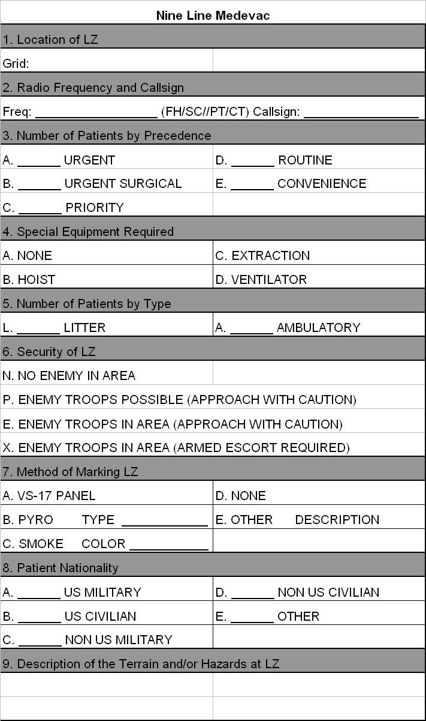
12. 9-LINE MEDEVAC
MIST REPORT
MIST
Method of Injury
Injury Sustained
Symptoms
Treatment

Slide 39
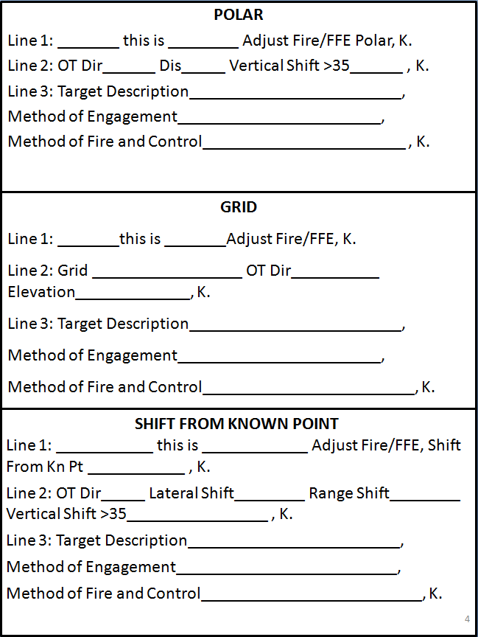
13. CALL FOR FIRE

Slide 40
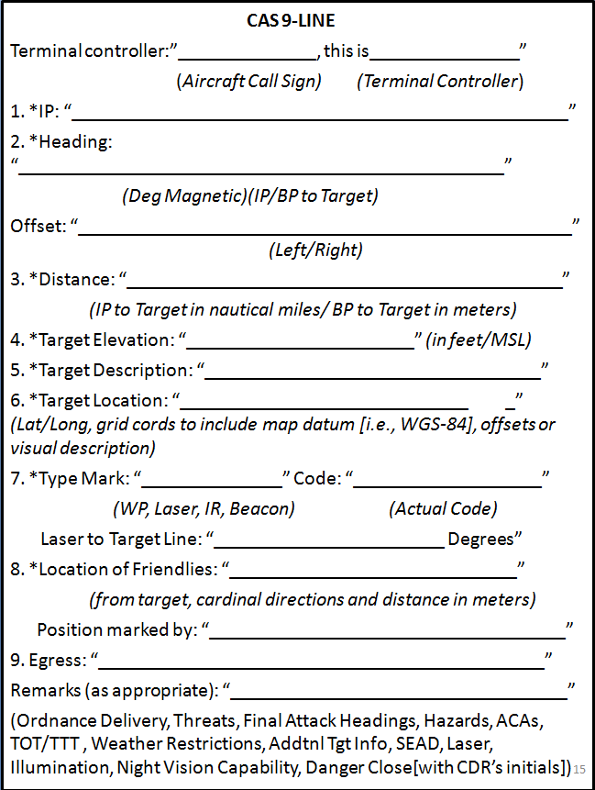
13A. CAS 9-LINE

Slide 41
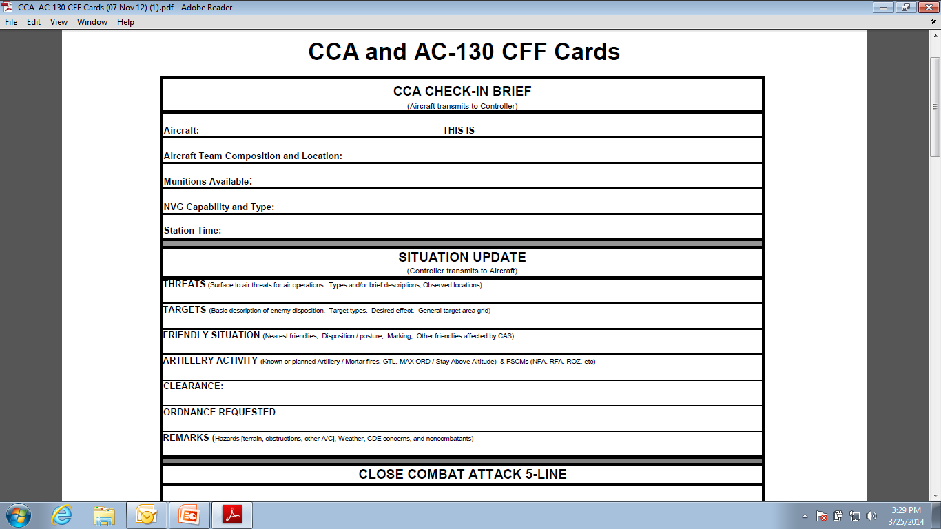
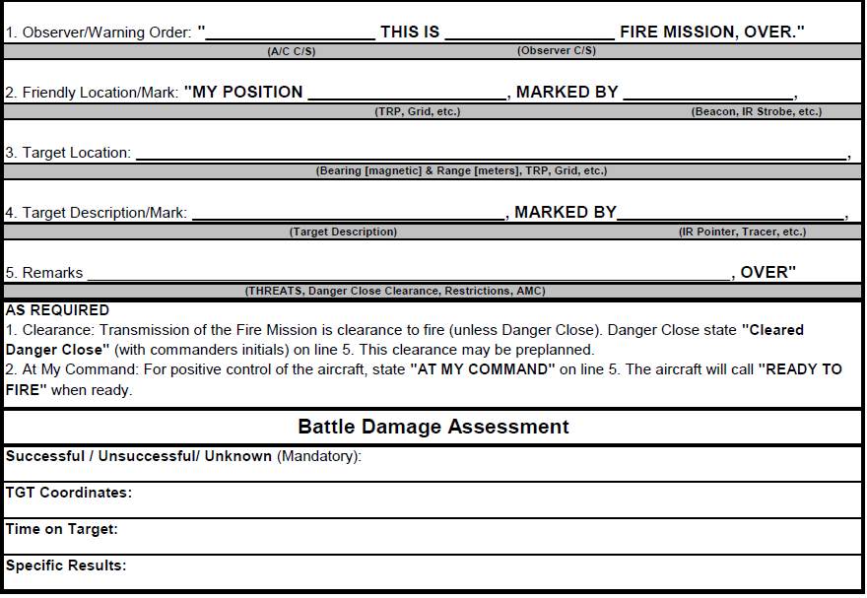
13A. CCA CHECK-IN BRIEF
13A. CCA 5-LINE / BDA

Slide 42
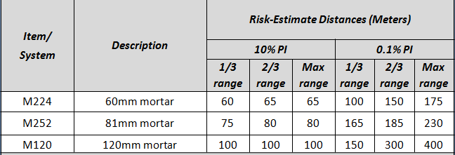
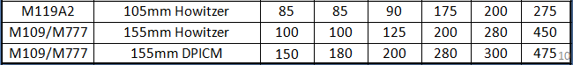
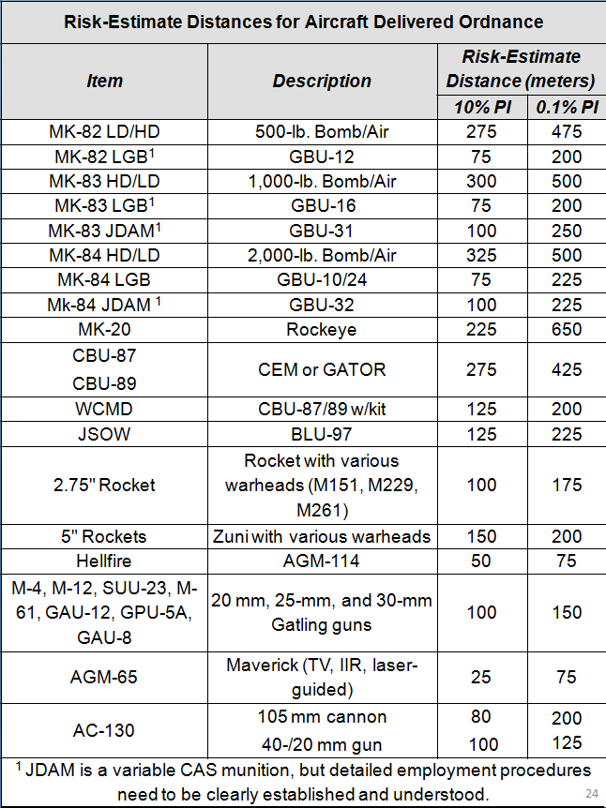
13B. REDs / MAX RANGE
DANGER CLOSE:
>600m
ARTILLARY
105mm: 11,500
155mm: 22,200
MORTARS
60mm: 3,500
81mm: 5,800
120mm: 7,200

Slide 43
14. PCI CHECKLIST
Uniform - ACUs (serviceable)
Name tape, US Army, rank, Unit patch, IR Flag (right)
Dog tags (2 x each – on chain around neck); ID Card (left breast pocket)
Shooting gloves
Boots (serviceable); w/trousers properly bloused IAW AR 670-1
Eye pro w/clear lenses (minimum)
Ear pro
Knee Pads (on knees)/or pad inserts
Pen (black) and paper
Tan Belt
Watch
Knife (accessible)
Flashlight with red lens
Mission graphics; Knowledge of mission and CDR’s intent (LOWEST LEVEL)
CFF/9-line cheater card (laminated)
PCI Checklist (laminated)
MAL (TLs, SLs, PSGs only) (laminated)
2nd Tourniquet in lower left leg pocket
ACH w/ACU cover
NODs Mount firmly attached
Cammo Band w/Name on Left Side (as worn)
Pads present and cover all 4 x Buckles
Screws tight w/no rust
Goggle retainer straps present
Firefly ir beacon in back of ach pouch
Armor/FLC
Proper size/fit
Name tape and rank visible
Front and back plates present
7 x Magazines (full); rounds facing down; empty facing up
IFAK Pouch – farthest left pouch on left side and accessible by the Soldier
  IFAK insert w/cord, Tourniquet, Elastic Bandage, 4.5” Gauze, Airway, 2” Surgical Tape, Rubber Gloves, DA Form 7656, TC3
Compass (tied down)
Camelback (topped off) – 2 x quarts minimum
1 x black marker
Munitions properly rigged and stored
Extra batteries (NODs, Lasers, Optics)
NVGs
Tied down to kit or helmet
Swing arm present and serviceable
Soldier familiar with points of adjustment and how to focus
Weapon
Clean; functions check completed
Optics/Lasers functional and tied down with wire
Commo
Tied down
Batteries fully charged; spare battery present
COMSEC filled and current
Radio check completed with headset attached
Proper antenna attached
Necessary accessories present
Commo Card (TL & RTO only)
KNOWLEDGE OF MISSION
TASK
PURPOSE
COMMANDER’S INTENT
ENEMY SITUATION
  COMPOSITION
  DISPOSITION
  STRENGTH
FRIENDLY SITUATION
  ADJACENT UNITS
  LEFT/RIGHT/FRONT/REAR
GRIDS
  CROSSINGS / LINK-UP
  ORP / OBJ
  HLZ
PIR / SIR
CONTINGENCIES
ACTIONS ON CONTACT
  MOVEMENT
  ORP / LDR RECON
  HIDE / SURVE SITE
EVASION PLAN OF ACTION
  DESIGNATED AREA OF RECOVERY
  NO-COMMO PLAN
  BONA FIDES
  RECOVERY ACTIVATION SIGNAL
SCHEME OF MANEUVER
ORDER OF MARCH
ROUTE (PRI / ALT)
ACTIONS ON OBJ
SPECIAL TEAMS
CASEVAC PLAN
EPW PLAN
SPECIAL ITEMS OF EQUIPMENT
RULES OF ENGAGEMENT
ENGAMENT CRITERIA
DISPLACEMENT CRITERIA

Slide 44
15. FRIES
Individual Equipment Required: Each Soldier participating in FRIES training or operations will have the following required minimum personal equipment as specified in FM 3-05 210, paragraph 10-13.
Heavy leather gloves (the cowhide black or tan issued work gloves with inserts).
A helmet with a chin strap (each Soldier will wear their Army issued ACH).
Protective goggles (must be APEL approved).
Hearing protection and identification tags for helicopter operations.
Unit FRIES Equipment: The following required equipment as per FM 3-05 210, paragraph 10-15 is required in order to conduct FRIES and will be provided to Charlie Troop from Light Fighter School on Fort Drum. Light Fighter School is responsible for inspecting the following equipment for serviceability during all FRIES training.
Insertion Fast Rope. The fast rope is a polyester rope, consisting of three 1 ¾-inch strands, olive drab in color, that comes in 20-. 40-. 60-, 90-, and 120-foot lengths. The top of the main rope has an 8-inch eye splice to allow the rope to be attached to specially equipped helicopters.

Slide 45
15. FRIES
Training Altitude Maximums
Charlie Troop will mitigate risk while conducting FRIES training by performing the training at the lowest altitude possible. The training is not dependent on higher altitudes. Charlie Troops training altitudes are as follows:
  Tower Training: 15 to 40 Feet
  Helicopter: Initial Training-not to exceed 10 feet on the first decent with two additional descents at 20 feet.
Initial FRIES Training (as required by FM 3-05 210, paragraph 10-31)
All personnel will successfully complete initial FRIES training before they are considered FRIES qualified. Before participating in FRIES operations, personnel must meet the following requirements:
  Must have completed initial qualification training and be authorized by an O5 level commander to conduct FRIES training.
  Must demonstrate ability to use hands and feet to hold a Lock-in position on the rope until FRIES Master says Recover without difficulty. Must demonstrate ability to execute 4 controlled descent from a height of 40 feet: Hollywood, Hollywood Lock-in, Combat Equipment, Combat Equipment Lock-in.
  Have passed the Army Personnel Fitness Test.
  Have a current medical examination and be free of any injury or physical condition that could cause a potential safety hazard during FRIES training.
The Chain of Command for Charlie Troop will ensure that all Soldiers participating in FRIES training has the capability and upper body strength in order to perform the full scope of roping duties.
The maximum Soldier weight will not exceed 60 pounds. This weight includes helmet, weapon, vest, web gear, and rucksack. Rucksack weight will not exceed 35 pounds. If using the IBA, this supplements the rucksack.

Slide 46
15. FRIES
Sustainment Training (as required by FM 3-05 210, paragraph 10-37 and appendix G)
The Commander will make sure Soldiers participating in FRIES operations receive sustainment training on equipment and procedures within 24 hours before the FRIES operation. Soldiers who do not attend FRIES sustainment training will not participate in FRIES operations. At a minimum, training will include a review of the following:
  Hand-arm-signals.
  Individual equipment riggings.
  Aircraft familiarization.
  Actions in the aircraft
  Safety procedures and emergency procedures.
  Any rehearsals the FRM or commander deems necessary.
  1 hollywood and 1 combat load fast-rope repel off of the 40ft tower.

Slide 47
15. FRIES
Ropers notify the FRM, AFRM, safety, or pilot if they observe any unsafe act or condition. Ropers may halt or call for a halt of roping for safety at any time. During FRIES insertion training, the number of ropers on the fast rope at one time is limited to six. During extraction training, the total weight per extraction bar and rope must not exceed a total of 1,500 pounds. Total roper equipment weight will not exceed 60 pounds. Ropers will—
  Maintain hands at head level.
  Maintain visual contact with lower ropers during their descent.
  Maintain a minimum 1-second interval on exit to avoid collisions.
  Keep at least two points of contact on the rope (both hands) at all times.
  Use their feet for additional breaking anytime needed.
  Execute descents at a safe speed.
  Slow the rate of descent halfway down the rope to avoid landing on each other.
  Move quickly away from the rope upon arrival on the surface.
  Know correct wear of extraction (SPIES) harness and extraction procedures.
The FRM, AFRM, and safety must make sure all personnel are on the surface and have moved clear of the ropes before aircraft fly away or ropes are jettisoned.

Slide 48
15.COMMANDS AND SIGNALS
(FRIES)
Commands and Signals
Ground-to-aircraft hand-and-arm signals are military standard as found in FM 3-21.38. The following standardized hand-and-arm signals are provided for FRIES operations:
  Time Warnings (10-, 6-, and 1-minute). The FRM gives these time warnings by holding up the appropriate number of fingers and verbally sounding off.
  Get Ready. FRM extends arms horizontally, with fingers extended vertically and joined.
  Stand By. FRM extends arms downward at a 45-degree angle from the body, with hands closed except for index fingers, which are extended, pointing to the floor.
  Deploy Ropes. FRM or safety form both hands into fists at mid-thigh level and sweeps arms horizontally outward. At full extension, he opens his hands as if dropping the ropes out of the helicopter, and sounds off with DEPLOY ROPES.
  Go. FRM raises arms to horizontal, hands closed with index fingers extended pointing to the ropes.
  Stop or Abort. FRM closes hands into fists, with arms raised across the forehead.
  Sit Down and Don Seat Belts. FRM points to the floor, followed by moving both fists around waist, as if donning a belt.
  Okay. FRM raises hands to eye level, with index finger and thumb forming a circle, and other fingers extended.

Slide 49
15A. ROPERS ACTIONS
(FRIES)
Ropers perform the following actions:
  At the command STAND BY (given at 1-minute warning), ropers make final check of themselves and prepare to exit position.
  At the command GO, the first roper exits the aircraft, rotates his body 90 to 180 degrees to make sure his equipment clears the aircraft, places the fast rope between the arches of his feet, and commences descent. The roper uses his hands and feet to slow his descent about two-thirds of the way down.
  Subsequent ropers exit at 1-second intervals using the same procedure but begin slow descent about halfway down to avoid landing on each other.
  During descent, ropers keep a lookout and break as necessary to avoid landing on obstructions or on fellow ropers.
  Ropers prepare to land just before reaching the ground by spreading their legs about shoulder- width apart with their knees slightly bent.
  At landing, ropers quickly move clear of the ropes to avoid collisions with descending ropers.

Slide 50
15A. ROPERS ACTIONS
(FRIES)
Emergency Actions
Procedures for correcting an emergency condition that personnel could reasonably encounter are as follows. Multiple emergencies, adverse weather, or other unusual conditions may require modification of these procedures. The nature and severity of the emergency dictate the response necessary; therefore, personnel must use sound judgment in determining the correct action to take.
Emergencies Before Roping Starts
All personnel sit down, don their seat belts, and take further instructions from the pilot or crew chief. If a crash occurs, all personnel follow emergency procedures the FRM or pilot briefed before the operation.
Emergencies After Roping Starts
In an emergency, personnel follow specific procedures. The following paragraphs explain these procedures.
Unsafe Drift or Premature Liftoff
Anyone who detects the aircraft having drifted off the site must immediately stop training and inform the FRM, AFRM, safety, or pilot in command. The procedures for unsafe drift or premature liftoff are as follows:
  FRM, AFRM, safety, or roper stops stick.
  Ropers stop descent and lock in.
  FRM or crewman informs the pilot in command and guides him in moving the aircraft back on target.
  Unit continues operations.
Rope Hung or Snagged
Anyone who detects the rope being snagged or hung up must immediately stop training and inform the FRM, AFRM, safety, crew chief, or pilot in command. The procedures for a snagged or hung rope are as follows:
  Safety makes sure ropers are off the rope and are clear. 􀀀 Aircraft descends or lands, as needed.
  Ground personnel free the rope.
  Unit resumes the operation.
Premature or Unintentional Deployment of the Fast Rope
If the fast rope is released prematurely or accidentally falls from the helicopter, the FRM—
  Notifies the pilot in command.
  Follows the aircrew’s instructions.
Lost Communication
All training and operations must include the use of the intercom between the pilot in command or crewmen and the FRM. If the intercom fails, the following hand-and-arm signals can be used until the rope can be cleared and the intercom is restored:
  Stop stick: A clenched fist touching the chest.
  Ropes: Open palm toward the door in a horizontal motion.
  Aircraft movement: An open palm moving and facing in the direction required.
  Stop aircraft movement: A clenched fist.

Slide 51
15B. SAFETY
(FRIES)
Safety
Safety is everyone’s responsibility. All personnel involved in FRIES operations are responsible for identifying hazardous situations and preventing injuries of personnel. Anyone who observes an unsafe condition or act is authorized to halt the operation and inform the FRM or the pilot in command. Refer to USSOCOM M 350-6 for the most current safety requiremnts.
Briefing
The FRM or AFRM present a safety briefing before conducting FRIES training or operations. The safety briefing must cover (as a minimum) the following:
  The planned event (day or night, tower or helicopter, high or low hover, insertion or extraction).
  Actions on the aircraft (or tower).
  General tower or aircraft safety.
  Operation (or training) location and any hazards within 500 meters.
  Identification of key personnel, their location, and their duties and responsibilities.
  FRIES equipment and its characteristics.
  FRIES equipment rigging or inspection.
  Personnel preparation (shirttails tucked in, chin strap fastened, loose straps taped, and gloves and goggles on).
  Hand-and-arm signals.
  Emergencies and emergency procedures.
  Medical coverage (medic with aid bags, backboards, litters, and vehicle driver on site).
  Communications requirements (frequencies, call signs, required reports).
  If chemlights are used for limited visibility, they are attached at Top, Middle, and Bottom of rope
  Any other information essential to safety.

Slide 52
15C. PREFLIGHT AND IN-FLIGHT
(FRIES)
Anyone who detects an in-flight emergency will immediately notify the pilot in command, crew chief, or safety and follow aircrew instructions. Below are preflight and in-flight procedures for FRIES:
  Before a FRIES operation, the FRM will coordinate both routine and emergency procedures as well as any unique conditions or potential problems with the pilot in command. He also discusses the procedures used during flight, during roping, and before aircraft departure from the roping site. The FRM then discusses the information with all the assistant fast-rope masters (AFRMs), safeties, and crew chiefs. He reviews the time warnings (including hand-and-arm signals) and appropriate actions—such as who will deploy ropes, verify rope status, and perform rope-clearing procedures.
  The FRM gives a mission prebrief discussing any aircraft equipment that, if disturbed, could cause an aircraft or fast-rope problem. The FRM should make all problem areas known to all personnel concerned and preventive measures taken to neutralize or eliminate them where possible.
  The FRM gives the crew chief the final position adjustment over the target, using hand signals.
  The crew chief securely stows all safety straps and communications cords that are not in use. All safety straps and communication cords in use should be positioned so they do not present a hazard to personnel movement in the aircraft.
  After the pilot in command gives the command DEPLOY ROPES, the FRM deploys the rope and ensures it is in contact with the surface before ropers exit.

Slide 53
15C. PREFLIGHT AND IN-FLIGHT
(FRIES)
During Roping
The following safety precautions apply during roping:
  During descent, ropers must watch for obstructions and for lower ropers, and must break as necessary.
  Individual ropers will lock-in during emergencies by wrapping one leg around the rope once or twice and standing on the fast rope with the other foot.
  Ropers must maintain sufficient intervals on the rope to prevent contact with lower ropers. Individual ropers exit when the head of the Soldier in front of them disappears below the ramp.
  Ropers execute descents at speeds commensurate with their experience and proficiency in FRIES infiltration operations. For example, less-experienced ropers should descend slowly until they become more proficient.
  The number of ropers on each rope at one time must not exceed the safe limit of the rope mount point in use, as follows:
    MH/UH-60: Do not exceed 1,500 pounds per rope.
    MH-47: Do not exceed 1,500 pounds per rope for extractions, regardless of the mount used. The aft mounts may go up to 2,250 pounds for insertions.
    MH/HH-53: Do not exceed 1,500 pounds per rope.
    MH-60G: Do not exceed 1,300 pounds per rope.
Operational Requirements and Limitations
FRIES operations require medical and communications support, including during adverse weather conditions and night operations. Personnel must use sound judgment to determine what action to take depending on the nature and severity of the condition.

Slide 54
15D. MEDICAL COVERAGE
A qualified and equipped 18D, 91B medic, or a Service-qualified EMT will be at all training sites. Medics must know CASEVAC procedures and have coordinated requirements necessary to expedite evacuation and treatment of personnel on and off military installations. All medics will have as a minimum an M-5 aid bag or equivalent packed IAW unit standards as well as Backboard and neckbrace. Medical transportation must also be available. The vehicle must be covered and large enough to carry an open stretcher. Units cannot conduct training without a medic, medical equipment, and transportation. If the situation warrants and the installation cannot support a MEDEVAC mission, the installation may use a FRIES aircraft as a last-resort CASEVAC. The medics will develop an evacuation plan. This plan should include, but not be limited to, the following:
  Medical facilities—location and capabilities.
  Emergency telephone numbers.
  Routes to medical facilities.
Adverse Weather and Terrain Conditions
During the risk assessment for FRIES training, the S-3 considers the following conditions:
  Wind chill factors caused by the rotor wash of the helicopter or extraction cruise air speeds that could cause cold weather injuries.
  Water or ice on the fast rope, inhibiting the ability of the ropers to control their descent.
  The rope is exposed to the elements long enough for it to freeze, thereby reducing its tensile strength.
  Blowing particles produced by rotor downwash cause the aircrew or the AFRM to lose visual contact with the ground.
15E. ADVERSE WEATHER AND TERRAIN CONDITIONS

Slide 55
Landing Zone Sizes
16. PATHFINDER OPS
SIZE | TYPE OF A/C | DIAMETER
1 | OH-6, OH-58, MH/AH-6, UH-72A | 25 METERS
2 | AH-1W/Z, UH-1Y/N | 35 METERS
3 | AH-64, UH-60A/L/M, SH-60 | 50 METERS
4 | ALL CH A/C, to include MV/CV-22B | 80 METERS
Technical Considerations for choosing HLZ:
1. Size of Helicopter Landing Point (based on size/type of aircraft, pilot/unit proficiency, day or night operation and atmospheric conditions)
2. Landing Formations
3. Surface Conditions
4. Obstacles
5. Approach and Departure Routes
6. Atmospheric Conditions
7. Type of Load

Slide 56
16. LANDING ZONE SIZES CONT’D:
Obstacle ratio of 10:1, or 100m, on the trail and lead edge of the HLZ will be followed unless prior coordination with aircrew has been made and the ratio can be dropped to 5:1
    Example: If there are trees that are 15m tall, then the obstacle stand off distance must be 150m (15x10).
10m standoff will be used on the left and right side of the HLZ
Always attempt to land the aircraft into the wind

Slide 57
16A. PHASES OF LZ/PZ OPERATIONS
REFERENCES:
FM 3-21.38 (FM 57-38) Pathfinder Operations
FM 10-450-3, April 1997, Multi Service Helicopter Sling Load: Basic Operations and Equipment
FM 90-4, March 1987, Air Assault Operations
a. DEFINITION: To provide navigational assistance and air traffic advisories to army aircraft that encompass selecting, improving, marking, and controlling PZ/LZ that supports any phase of an air assault or ground operation.
b. PHASES OF LZ/PZ OPERATIONS: Selection, marking, and controlling.
c. SELECTION PHASE
(1) LANDING POINT:
(a) Cleared circular area, can support one aircraft
(b) LANDING POINT SIZES (CLEARED DIAMETER DISTANCES):
SIZE 1: 25 meters OH-58D
SIZE 2: 35 meters UH-1H, AH-1
SIZE 3: 50 meters UH-60, AH-64
SIZE 4: 80 meters CH-47
SIZE 5: 100 meters All slingload aircraft and aircraft of unknown origin
(2) LANDING SITE: One or more landing points (must have control facilities)
(3) LANDING ZONE: One or more landing sites (may or may not have control facilities)

Slide 58
16A. PHASES OF LZ/PZ OPERATIONS
d. REQUIREMENTS OF LZ: Must consider the following:
(1) NUMBER OF AIRCRAFT: PZ/LZ must support both number and type of aircraft
(2) FLYING/ LANDING FORMATIONS: 9 standard formations:
(a) Trail
(b) Echelon Left/Right
(c) Heavy Left/Right
(d) Staggered Trail Left/Right
(e) Vee
(f) Diamond
(3) SURFACE CONDITIONS: Must support the weight of the aircraft and be free from debris. Clear to ground level.
(4) GROUND SLOPE: Land on an up-slope whenever possible. Avoid down slope. If slope exceeds 7 degree‘s Aircraft with skids cannot land. No aircraft can land if the slope exceeds 15 degrees, terminate at hover.
(5) APPROACH AND DEPARTURE ROUTES:
(a) Into the wind
(b) Over lowest obstacles
(c) Along the long axis of the PZ / LZ
(6) PREVAILING WINDS: Head Wind, Cross Wind, Tail Wind
(a) 0-5 knots: Aircraft can land in any direction
(b) 6-9 knots: Must land head or cross wind
(c) 10 knots and above: head wind only
(7) DENSITY ALTITUDE: As these factors increase, the A/C performance decreases
(a) Humidity
(b) Altitude above sea level
(c) Temperature
(8) LOADS: Considerations
(a) Weight of load
(b) Personnel and/or equipment
(c) Internal or external
(d) Insertion or extraction

Slide 59
16A. PHASES OF LZ/PZ OPERATIONS:
(9) OBSTACLES: An obstacle is anything that is 18 inches (or greater) high, wide or deep
(a) Obstacle ratio- 10:1
(b) Obstacles- four ―R’s
1 Remove
2 Reduce
3 Red (mark it)
4 Radio (advise pilot)
e. MARKING PHASE
(1) Marking the Landing Zone: Use minimum identifiable means, mark as tactically as possible.
(2) Basic Equipment:
(a) Anemometer; wind-measuring device
(b) Goggles
(c) FM Communications
(d) Map and compass
(e) Daytime marking; VS-17 panel
(f) Night time marking; Lights, chem-lites, strobe light
(3) Markings:
(a) Obstacle ratio- 10:1
(b) Mark obstacles - red
(c) inverted ―Y: 7m x 14m x 14m. Directional light, base light, left and right stem lights, used to mark #1 TDP at night. NO RED
(e) Additional TDP‘s:
1 Size 3: 5m x 5m- for observation and utility A/C
2 Size 4: 10m x 10m- used for sling load A/C and cargo A/C
3 Separate A/C that require a different landing point size by 100m
f. CONTROLLING PHASE: Types of control:
(1) Visual
(2) Electronic
(3) Verbal
:

Slide 60
16A. PHASES OF LZ/PZ OPERATIONS:
g. WHEN ESTABLISHING AN LZ:
(1) Establish control facilities:
(a) Must have Ground To Air communications (GTA)
(b) Must be able to observe the entire PZ/LZ
(2) Determine length and width of LZ/PZ: Pace both and make a record of it.
(3) Determine area of unusable:
(a) 10:1 ratio, straight edge method
(b) #1 TDP at edge of unusable
(4) Obstacles: Four R’s (Remove, Reduce, mark in Red, Radio the pilot).
(5) Mark and clear TDP’s:
(a) VS 17 panel during daylight
(b) Inverted ―Y at night
(c) clear the PZ/LZ using ―zig-zag method in each cardinal direction.
(6) TECHNICAL FACTORS IN PZ AND LZ SELECTION
:

Slide 61
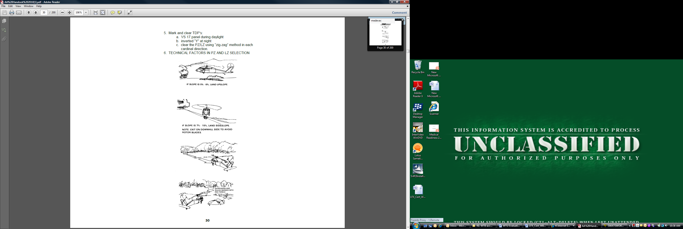
16B. TECHNICAL FACTORS IN PZ SELECTION:
LZ Selection and Marking

Slide 62
16B. TECHNICAL FACTORS IN PZ SELECTION:
Ground Slope considerations for LZs

Slide 63
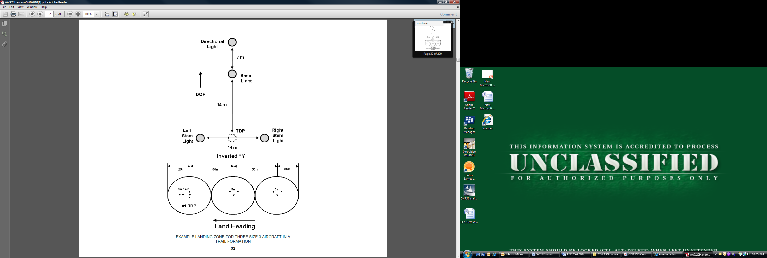
16B. TECHNICAL FACTORS IN PZ SELECTION:
Example landing zone for three Size 3 aircraft in a trail formation.

Slide 64
16C. HLZ MARKING
Per Fort Drum regulations the use of the NATO “T” is mandatory for marking of HLZ’s on post
Spacing for the NATO “T” is 10m between each light
When using the NATO “T” you must add 20m to the overall length of the site
10m
10m
10m
Direction of Flight
10m
Light

Slide 65
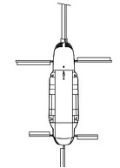
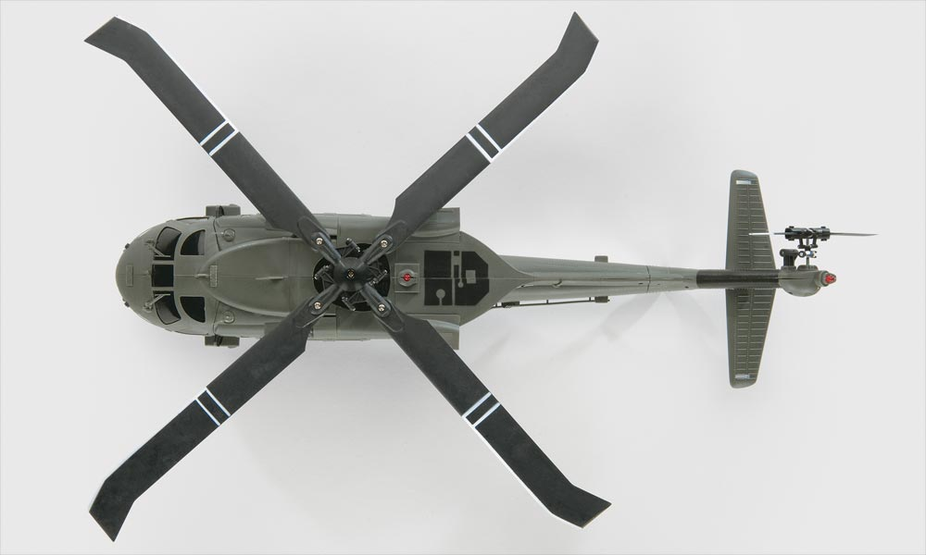
16C. HLZ MARKING:
Follow on aircraft do not require the use of the NATO “T”
For Utility, Observation & Attack helicopters two lights are spaced 5m apart and 5m to the right of the touchdown point of the aircraft
For Cargo helicopters two lights are spaced 10m apart and 10m to the right of the touchdown point
5m
10m

Slide 66
16C. HLZ MARKING:
During day time operations the use of a signal man, a VS-17 panel or by other identifiable means
    Follow on aircraft do not need markings for daytime
When placing the GTA (Ground to Air) consider the following:
  Good 360 degree observation of the site
  Not placed in a cleared area
  Opposite of the CCP

Slide 67
16C. HLZ MARKING:
#1 TDP Marking Methods
Additional TDP lights

Slide 68
16C. HLZ MARKING:
Emergency Lighting

Slide 69
16D. FLYING/LANDING FORMATIONS:
Aircraft formations; aircraft are spaced according to landing point size

Slide 70
17. BOAT OPS
WATERCRAFT. Use of inland and coastal waterways may add flexibility, surprise, and speed to tactical operations. Use of these waterways will also increase the load-carrying capacity of normal dismounted units. Watercraft are employed in reconnaissance and assault operations.
a. Inflation Method. Inflate watercraft using foot pumps. There are four separate valves inside the buoyancy tubes. There are eight separate airtight compartments. To pump air into the boat, turn all valves into the “orange” or "inflate” section of the valve. Once the assault boat is filled with air, turn all valves onto the "green" or "navigation" section. This will section the assault boat into eight separate compartments.
b. Characteristics.
• Maximum payload: 2,756 pounds.
• Crew: 1 coxswain + either 10 paddlers or a 65 HP short shaft outboard motor.
• Overall length: 15 feet, 5 inches.
• Overall width: 6 feet, 3 inches.
• Weight: 265 pounds.
c. Preparation.
(1) Rubber Boat.
• Each rubber boat will have a 12-foot bow line secured to the front starboard D ring. This rope will be tied with an anchor line bow line, and the knot will be covered with 100 MPH tape.
• Each rubber boat will have a 15-foot center line tied to the rear floor D ring. The same procedure for securing the bow line will be used for the centerline.
• Each rubber boat will be filled to 240 millibars of air, and checked to ensure that all valve caps are tight, and set in the NAVIGATE position.
• Each rubber boat will have one foot pump, which will be placed in the boat’s front pouch or, if no pouches are present, the foot pumps will be placed on the floor.
• Each rubber boat must be inspected using the maintenance chart.

Slide 71
(2) Personnel and Equipment.
• All personnel will wear work vest or kapok (or another suitable positive flotation device).
• FLC is worn over the work vest, unbuckled at the waist.
• Individual weapon is slung across the back, muzzle pointed down and facing toward the inside of the boat.
• Crew-served weapons, radios, ammunition, and other bulky equipment are lashed securely to the boat to prevent loss if the boat should overturn. Machine guns with hot barrels are cooled prior to being lashed inside the boats.
• Radios and batteries are waterproofed.
• Pointed objects are padded to prevent puncturing the boat.
d. Positions. Assign each Ranger a specific boat position (Figure 1).
e. Duties.
• Designate a commander for each boat, (normally coxswain)
• Designate a navigator (normally a leader within the platoon)—observer team as necessary.
• Position crew as shown in Figure 2.
• Duties of the coxswain.
– Responsible for control of the boat and actions of the crew.
– Supervises the loading, lashing, and distribution of equipment.
– Maintains the course and speed of the boat.¬
– Gives all commands.
• Paddler #2 (Long Count) is responsible for setting the pace.
• Paddler #1 is the Observer, stowing and using the bow line unless another observer is assigned.
f. Embarkation and Debarkation Procedures.
(1) When launching, the crew will maintain a firm grip on the boat until they are inside it: similarly, when beaching or debarking, they hold on to the boat until it is completely out of the water. Loading and unloading is done using the bow as the entrance and exit point.
(2) Keep a low center of mass when entering and exiting the boat to avoid capsizing. Maintain 3 points of contact at all times.
(3) The long count is a method of loading and unloading by which the boat crew embarks or debarks individually over the bow of the boat. It is used at river banks, on loading ramps, and when deep water prohibits the use of the short count method.
(4) The short count is a method of loading or unloading by which the boat crew embarks or debarks in pairs over the sides of boat while the boat is in the water. It is used in shallow water allowing the boat to be quickly carried out of the water. The short count method of organization is primarily used during surf operations.
(5) Beaching the boat is a method of debarking the entire crew at once into shallow water and quickly carrying the boat out of the water.

Slide 72
DUTIES AND RESPONSIBILITIES PER POSITION
Observer
Forward Security (SAW)
Handles towline & quick release line
2
1
Navigator
Sets stroke rate
Scout Swimmer 2
Equipment Handler (Forward)
Asst Navigator/Compass Man
Scout swimmer
Equipment Handler (Forward)
4
3
Equipment Handler (Back)
6
5
Equipment Handler (Back)
Coxswain
Boat LDR
8
7
RTO

Slide 73
g. Commands. Commands are issued by the coxswain to ensure the boat is transported over land and controlled in the water. All crew members learn and react immediately to all commands issued by the coxswain. The various commands are as follows:
(1) "Short count...count off," Crew counts off their position by pairs, such as 1, 2, 3, 4, 5 (Passenger #1, #2, if applicable), coxswain.
(2) “Long count…count off,” Crew counts off the position by individual, such as 1, 2, 3, 4, 5, 6, 7, 8, 9, 10, (Passenger #1, #2, if applicable), coxswain.
(3) “Boat stations," Crew takes positions alongside the boat.
(4) “High carry…move" (used for long distance move overland).
(a) On the preparatory command of “High carry," the crew faces the rear of the boat and squats down, grasping carrying handles with the inboard hand.
(b) On the command “Move," the crew swivels around, lifting the boat to their shoulders so that the crew is standing and facing to the front with the boat on their inboard shoulders.
(c) Coxswain guides the crew during movement.
(5) “Low carry…move," (used for short distance moves overland).
(a) On preparatory command of “Low carry," the crew faces the front of the boat, bent at the waist, and grasps the carrying handles with their inboard hands.
(b) On the command of “Move," the crew stands up straight raising the boat about 6 to 8 inches off the ground.
(c) Coxswain guides the crew during movement.
(6) “Lower the boat move," Crew lowers the boat gently to the ground using the carrying handles.
(7) “Give way together," Crew paddles to front with #2 setting the pace.
(8) “Hold," Entire crew keeps paddles straight downward motionless in the water stopping the boat.
(9) “Left side hold" (right), Left crew holds, right continues with previous command.
(10) "Back paddle," Entire crew paddles backward propelling the boat to the rear.
(11) ''Back paddle left" (right), left crew back paddles causing the boat to turn left, right crew continues with previous command.
(12) "Rest paddles," crewmembers place paddles on their laps with blades outboard. This command may be given in pairs such as "#1s, rest paddles").
h. Securing of Landing Site.
(1) If the patrol is going into an unsecured landing site, it can have a security boat land and reconnoiter the landing site, and then signal to the remaining boats to land. This is the best way.
(2) If the landing site cannot be secured prior to the waterborne force landing, some form of early warning, such as scout swimmers, should be considered. These Rangers swim to shore from the assault boats and signal the boats to land. All signals and actions are rehearsed prior to the actual operation.
(3) The landing site can be secured by force with all the assault boats landing simultaneously in a line formation. While this is the least desirable method of securing a landing site, it is rehearsed in the event the tactical situation requires its use.
(4) Arrival at the debarkation point.
(a) Unit members disembark according to leaders order (Figure 3).
(b) Local security is established.
(c) Leaders account for personnel and equipment.
(d) Unit continues movement.

Slide 74
• Rangers pull security initially with work vest on.
• Coxswains and two men unlash and de rig rucksacks.
• Rangers return in buddy teams to secure rucksack and drop off work vest.
• Boats are camouflaged/ cached if necessary prior to movement.
Figure 3: Landing Site
i. Capsize Drill. The following commands and procedures are used for capsize drills or to right an overturned boat:
(1) Prepare to Capsize. This command alerts the crew and they raise paddles above their heads, with the blades pointed outward. Before capsizing, the coxswain will conduct a long count.
(2) Pass Paddles. All paddles are passed back and collected by Rangers #9/ 10.
(3) Capsize the Boat. All personnel slide into the water except Rangers #3/ 5/ 7. Ranger #1 secures the bow line. The three men in the water grasp the capsize lines (ensuring the lines are routed under the safety lines) and stand on the buoyancy tubes opposite the capsize lines anchor points. The boat is then turned over by Rangers #3/ 5/ 7 men, who lean back and straighten their legs while pulling back on the capsize lines. As the boat lifts off the water, Ranger #4 grasps the center carrying handle and rides the boat over. Once the boat is over, Ranger #4 helps Rangers #3/ 7 men back onto the boat. Ranger #5 holds onto the center carrying handle and turns the boat over the same way. Ranger #5 rides the boat back over and helps the rest of the crew into the boat. As soon as the boat is capsized, the coxswain commands a long count to ensure that no one sank or was trapped under the boat. Every time the boat is turned over, he conducts another long count.
j. River Movement.
(1) Characteristics of River.
(a) Know local conditions prior to embarking on river movement.
(b) A bend is a turn in the river course.
(c) A reach is a straight portion of river between two curves.
(d) A slough (pronounced “sloo”) is a dead end branch from a river. They are normally quite deep and can be distinguished from the true river by their lack of current.
(e) Dead water is a part of the river, due to erosion and changes in the river course that has no current. Dead water is characterized by excessive snags and debris.
(f) An island is usually a pear shaped mass of land in the main current of the river. Upstream portions of islands usually catch debris and are avoided.
(g) The current in a narrow part of a reach is normally greater than in the wide portion. The current is greatest on the outside of a curve; sandbars and shallow water are found on the inside of the curve.
(h) Sandbars are located at those points where a tributary feeds into the main body of a river or stream.
(j) Because Rangers #1 and #2 are sitting on the front left and right sides of the boat, they observe for obstacles as the boat moves downriver. If either notices an obstacle on either side of the boat, he notifies the coxswain. The coxswain then adjusts steering to avoid the obstacle.

Slide 75
(2) Navigation. The patrol leader is responsible for navigation. The three acceptable methods of river navigation are
(a) Checkpoint and General Route. These methods are used when the drop site is marked by a well defined checkpoint and the waterway is not confused by a lot of branches and tributaries. They are best used during daylight hours and for short distances.
(b) Navigator Observer Method. This method is the most accurate means of river navigation and is used effectively in all light conditions.
(c) Equipment Needed.
• Compass
• GPS
• Photo map (1st choice)
• Topographical map (2nd choice)
• Poncho (for night use)
• Pencil/ Grease pencil
• Flashlight (for night use)
(d) Procedure. Navigator is positioned in center of boat and does not paddle. During hours of darkness, he uses his flashlight under the poncho to check his map. The observer (or Ranger #1) is at the front of the boat.
• The navigator keeps his map and compass oriented at all time.
• The navigator keeps the observer informed of the configuration of the river by announcing bends, sloughs, reaches, and stream junctions as shown on his map.
• The observer compares this information with the bends, sloughs, reaches, and stream junctions he actually sees. When these are confirmed, the navigator confirms the boat’s location on his map.
• The navigator also keeps the observer informed of the general azimuths of reaches as shown on his map and the observer confirms these with actual compass readings of the river.
• The navigator announces only one configuration at a time to the observer and does not announce another until it is confirmed and completed.
• A strip map drawn on clear acetate backed by luminous tape may be used. The drawing is to scale or a schematic. It should show all curves and the azimuth and distance of all reaches. It may also show terrain features, stream junctions, and sloughs.
k. Formations. Various boat formations are used (day and night) for control, speed, and security (Figure 13-4). The choice of which is used depends on the tactical situation and the discretion of the patrol leader. He should use hand and arm signals to control his assault boats. The formations are:
• Wedge
• Line
• File
• Echelon
• Vee
Figure 13-4: Formations

Slide 76
Inflation
17A. INFLATION
Open all of the inflatable boat's valves before you begin inflating it.
Fill up each air chamber in the boat. Try to get the air pressure as uniform as you can. Pick a valve, and then work your way around the boat in a clockwise motion as you fill each air chamber.
In a counterclockwise direction, check that each air chamber has the same air pressure. Generally, each chamber should be filled to about 2.5 PSI, but no more than that.
Inflate the thwarts after you have filled the main air chambers. Continue to inflate until it takes shape.
Use oars to row the boat whichever direction you need to go, or just let the inflatable boat float along with the current.
Tips & Warnings
Clean boats thoroughly before storing.
Use a cotton swab and 303 Aerospace Protectant to keep the valves clean.
Changes in temperature can affect how well your boat is inflated, so you should check it regularly throughout the day.

Slide 77
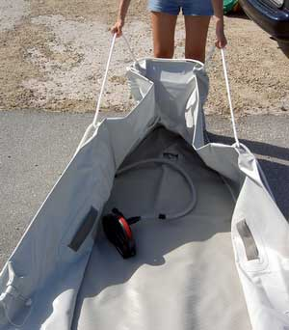
Deflating and Folding
17B. DEFLATING AND FOLDING
Your boat has several separate air chambers and valves. First of all open all of valves by depressing them and turning a half turn till arrow points into the orange area. The vessels end caps are to be removed to allow all the air to escape the boat. Your boat is equipped with an Aluminum Floor, it is now time to remove it. Remove the stringers from either edge first. Now, lift the floor about 10 inches at the rear most seam (between the last and second last floor pieces). Carefully lift the pieces out and place them in their carrying case. The valves should be in their "open" position for disassembly. They are open when they are in the down position. They can be alternately placed in their up (closed) and down (open) positions by pushing them down and turning one quarter to a half turn. Make sure that each chamber in your boat has a very small amount of air in it to prevent severe scrunching of the fabric so that damage doesn't occur while your boat is being stored.
Next, deflate the front section of the boat. As it is deflating pull up on the bow ropes. This will make it easier to fold later. Close the valve.

Slide 78
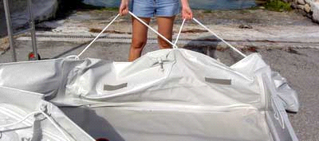
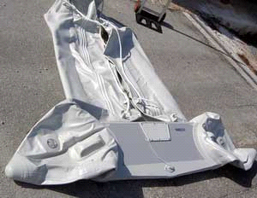
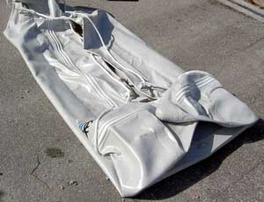
Deflate the main pontoons. As they are deflating pull up on the side ropes so that the boat will fold in
properly. You want the pontoons to
fold in so the entire package is not wider than the transom. If the
pontoons are not folding in properly then put a bit of air back into them and repeat the deflation
procedure until you achieve the desired result.
Fold the pontoons in so that they are
laying flat and are no wider that the transom.
Fold the cones in.

Slide 79
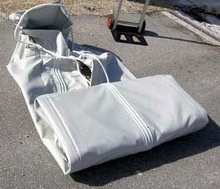
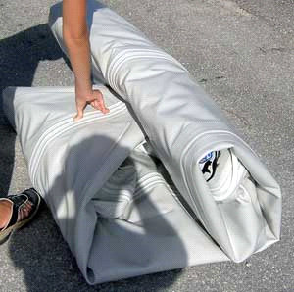
Begin rolling up the boat from the transom.
Fold the nose of the boat in.

Slide 80
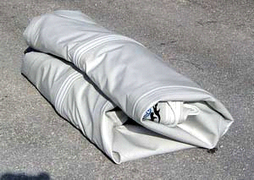
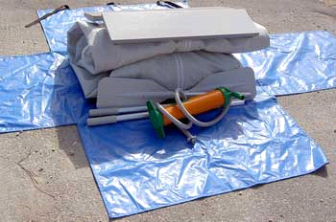
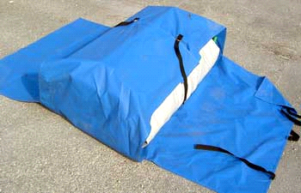
Finish rolling up the boat.
Place folded boat and accessories over carry bag.
Fold and
faster narrow flaps of the carry bag.

Slide 81
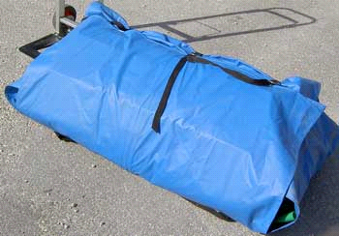
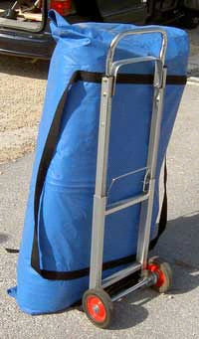
C/1
-
71 CAV Waterborne Operations SOP
Source: Ranger Handbook
Fold and fasten wide flaps of the carry bag.
Now boat compactly folded into carry bag and ready to be stowed away.

Slide 82
18. COMMAND POST TASK STEPS
Command Post Task Steps
Plan- XO gain and/or maintain situational understanding using available communications equipment, maps, intelligence, summaries, situation reports (SITREP’s), and other available information sources. Intelligence sources include troop intelligence support team (TRIST) human intelligence (HUMINT), signal intelligence (SIGINT), and imagery intelligence (IMINT) to include unmanned aircraft systems (UAS) and unattended ground sensors (UGSs).
XO receives an OPORD or FRAGORD requiring operations of a Command Post, and issues warning order (WARNORD) to the unit using FBCB2, FM, or other tactical means and begins conducting troop leading procedures.
  Plans security requirements.
  Plans communications requirements.
  Plans for continuous operations.
  Addresses actions on chance contact with the enemy, while moving.
  Considers the enemy’s capabilities, likely courses of actions (COAs), and specific weapons capabilities.
  Coordinates and synchronizes activates within each warfighting function.
Conducts a digital and or conventional reconnaissance.
  Identifies primary and alternate command post (CP) locations.
  Identifies likely enemy avenues of approach, as appropriate.
  Marks tentative dismount points on digital and conventional maps as appropriate.
PREPARE- Unit leader and reconnaissance element conducts the reconnaissance based on factors of mission, enemy, terrain and weather, troops and support available, time available, civil considerations (METT-TC)
  Enters way points into position navigation (POSNAV) equipment to aid navigation.
  Pinpoints the primary and alternate CP locations.
  Establishes security.
  Verifies and updates intelligence information.
  Leaves surveillance team to observe the location, if necessary.
  Returns to the unit position.

Slide 83
18. COMMAND POST TASK STEPS
Command Post Task Steps
5. EXECUTE- XO positions CP.
  Moves on covered and concealed routes to the rear of unit combat elements.
  Completes all communications checks.
  Positions the CP in a static position (assembly area, battle position, and so forth).
    Positions the CP away from natural lines of drift and key terrain features.
    Collocates the unit CP with an element CP, if added security is required.
    Camouflages CP to prevent detection from ground and air.
  Moves CP.
    Designates where the CP will move.
    Halts in concealed, terrain-masked positions with or to the rear of unit overwatch or support by fire element.
    Maintains radio communications with higher headquarters' CP and subordinate elements throughout the operations.
    Conducts reconnaissance of terrain forward, to the rear, and to the flanks of the unit’s position, as required.

Slide 84
18. COMMAND POST TASK STEPS
Command Post Task Steps
6. CP establishes security and conducts operations.
  Establishes security before main element arrives.
  Operates as the net control station (NCS) for the unit command net.
  Provide all-round protection for the CP main element at the site.
  Monitors unit and higher headquarters radio nets and fire direction net as needed
  Manages the flow of information between unit and higher headquarters.
  Positions observation post (OP’s) on likely avenues of approach and verify OP’s are as far forward as possible while still being within small-arms support range.
  Maintains an operations log and operations map, continuously tracks operations.
  Updates and maintains the locations of subordinate and adjacent units.
  Provides commander and subordinate leaders with periodic updates of friendly/enemy units to the front, flanks, and rear, and information on civilian personnel and activities.
  Reports the unit location in a secure manner (FM voice or digital) when required.
  Records and plots all spot reports and forwards them to higher headquarters.
  Processes information, prepares and submits all reports (FM voice and or digital) IAW the SOP to higher headquarters.
  Forwards higher headquarters orders and other critical information to the unit leader.
  Distributes air attack warnings to all elements.
  Maintains accurate status reports for all subordinate elements (for example, combat power and maintenance status, classes of supply, pre-combat inspection [PCI] completion, and so forth).
  Performs unit Chemical, Biological, Radiological, and Nuclear (CBRN) defense activates.
  Emplaces CBRN alarms upwind.
  Supervises radiological monitoring, chemical detection, and decontamination operations.
  Upgrades security measures to include booby traps, trip wires, listening devices, and patrols.
  Plans and coordinates sustainment for the unit, assisted by the 1SG/PSG.
  Facilitate bottom-up refinement of planning and preparation.
  Conduct required coordination with adjacent and flank unit.
  Conducts continuous operations.
    Cross-trains personnel
    Establishes CP work schedule and sleep plan
    Ensures key decision-markers get sleep.

Slide 85
18. COMMAND POST LAYOUT
COMMAND POST
(STATIC)
EQUIPMENT
COMMAND POST TENT
2 TACTICAL TABLES (q)
COMMO
  2x STACK (a)
  4 x ASIPS (b)
  4 x SPEAKER BOXES (c)
  2 x POWER CONVERTER (d)
  2 x Comp 201 (e)
  OSRVT (If applicable) (f)
  Platoon Radio Charger (t)
Maps
  2x 1/25,000 laminated on foam board (g)
  2x laminated 1/50,000 map on table (r)
6 Tactical Chairs (h)
CP Book (I)
LOG Book (j)
Laminated Report Cards (k)
Sustainment (left in Vehicle)
  Trash Bags (l)
  Chem. Lights
  MRE’s
1x Tube Light Set (m)
2x 50ft extension cord (n)
2x surge protectors (o)
1x Generator (p)
1 x white board 2.5ft x 3.5ft (s)
TRIST work Station (u)
Empty Tuff Boxes (v)
p
8ft
q
m
V
Trist
Trist
V
r
q
c
h
h
q
Radio
b
a
j
h
XO
b
h
I
c
m
d
m
12ft
f
r
h
d
c
Fires
b
h
C
a
t
b
Charge STAT.
c
s
g

Slide 86
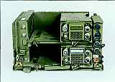
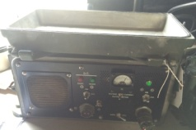
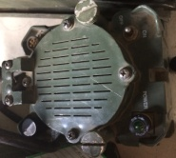
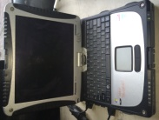

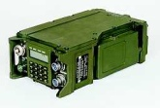
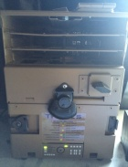
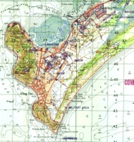

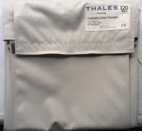

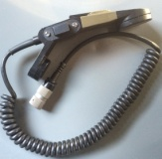
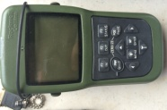
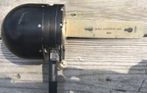
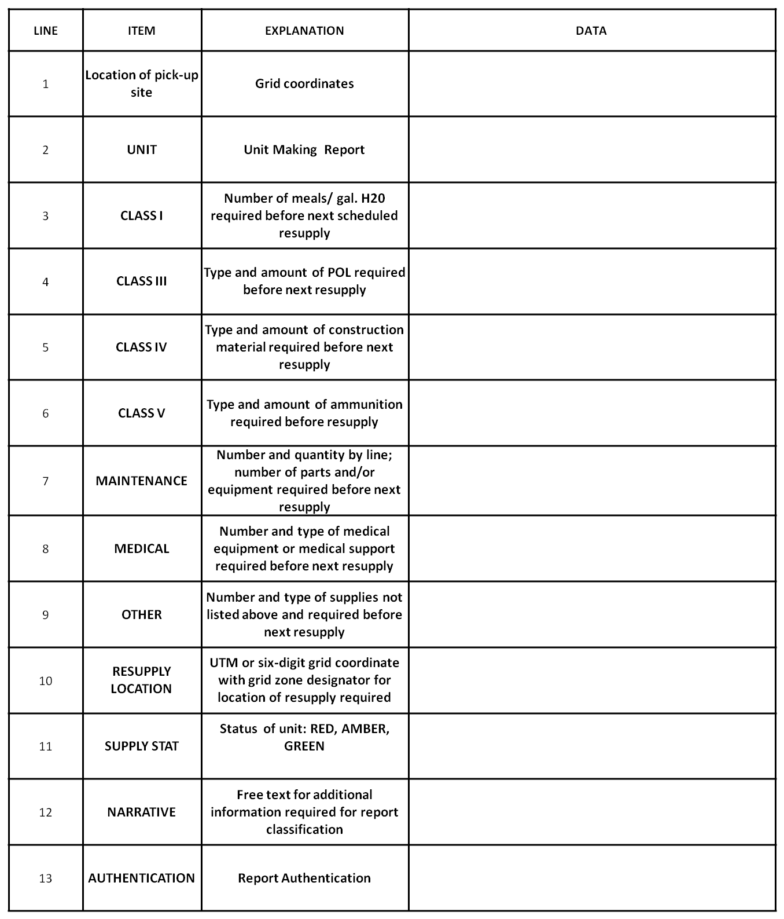

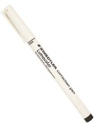
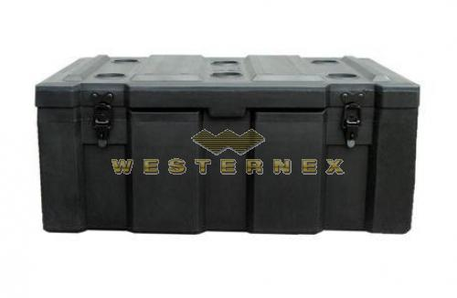
18. STATIC COMMAND POST TEARDOWN AND DISPLACEMENT
Commo Box #1
Commo Box #2 (Fires)
OSRVT (If Applicable)
AN/VRC-89/91 LR/SR
Power Convertor
4x
AN/VRC-89/91 LR/SR
Power Convertor
2x
Tough Book
ASIP Speaker
ASIP Speaker
Wireless
Transceiver
ASIP
AN-PRC-119 SR
2x
ASIP
AN-PRC-119 SR
2x
MUBC
1/50,000 Map
Protractor
2x
Dagger
Foldable Solar
Charger/w Cable
Hand Mics
3x
Antenna
Hand Mics
3x
Report Cards
(Taped on table in front of radio)
Report Cards
(Taped on table in front of radio)
Lumocolor Correction
Pen
2x
Lumocolor Pen
Permanent
2x

Slide 87

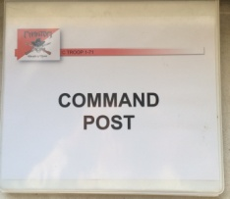

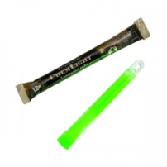
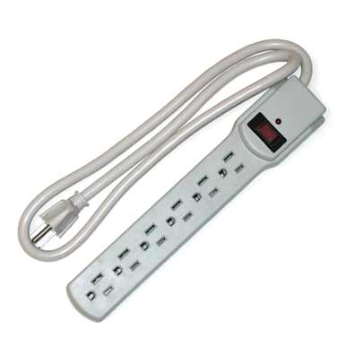
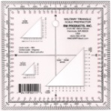
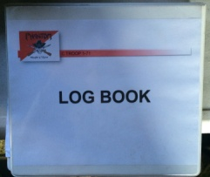
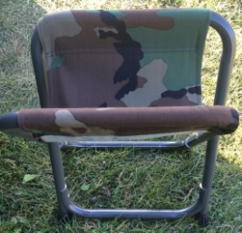
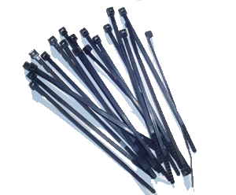
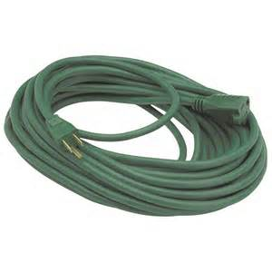
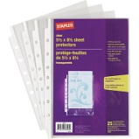
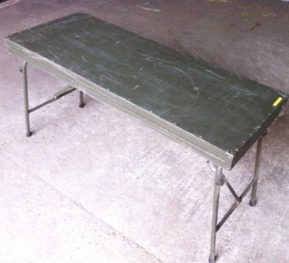
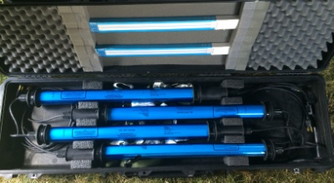
18. STATIC COMMAND POST TEARDOWN AND DISPLACEMENT
Static Command Post Teardown and Displacement
Lumocolor Correction
Pen
2x
Lumocolor Pen
Permanent
2x
Pens
1 box
TENT
Chem. Lights
IR/Regular
2 Boxes Each
Command Post
SI /Supply Tracker
Note Pad
2x
Protractor
5x
Radio Log
Book
Surge Protector
3x
Folding Chairs
4x
Page Protectors
100x
Zip Ties
50x
50 ft
Extension Cord
2x
Folding CP Table
3x
Light Set
(Keep a spare in the Vics)
1/25,000 Laminated Map on Foam Board

Slide 88











18. DISMOUNTED COMMAND POST TEARDOWN AND DISPLACEMENT
Dismounted
Command Post Teardown and Displacement
Lumocolor
Correction
Pen
Lumocolor Pens
Permanent
Protractor
2x
Aid
Bag
Lumocolor
Correction
Pen
Lumocolor Pens
Permanent
Command Post
SI /Supply Tracker +
LOG SHEETS
Inciderary
Grenade
2x
ASIP Long
Whip
Claymore
2X
Laminated
1/50,000 Map
Protractor
2x
ASIP Long
Whip
Inciderary
Grenade
2x
ASIP Battery
Laminated
1/50,000 Map
Laminated
1/50,000 Map
Protractor
2x
Claymore Wire
550 Cord
50ft
ASIP Long
Whip
Claymore
2X
Bungi
Cords
4x
Hand Mics
2x
Hand Mics
2x
Hand Mics
2x
Bug Net
Dagger
Dagger
ASIP Battery
2x
Bungi
Cords
4x
Anti-Intrusi
on Kit
2X
ASIP Battery
2X
ASIP
AN-PRC-119 SR
ASIP
AN-PRC-119 SR
ASIP Battery
ASIP
AN-PRC-119 SR
ASIP Battery
XO
FSNCO
COMMO
NBC NCO
OPS

Slide 89

18. EXPEDITIONARY SUSTAINMENT TTPs
Detailed analysis, foresight, and planning
Thorough Adjacent Unit coordination with all supported elements and supporting elements (Line Troops, BSB, Aviation Assets)
Delivery Methods
  Speedballs (Body bags/A Bags)
    CL I: Field striped and broken down MREs, 5 gallon collapsible water jugs, thermal ice bags
    CL II: Prepackaged MCLs
    CL III: Belly banded 5 gal fuel cans
    CL V: Belly banded and padded ammo crates
    CL VIII: MCL padded and taped
    CL VI: Padded and taped repair parts
  Cache
  Sling Loads
  CDS/HD, Aerial Delivery Methods
  Mounted Troop throughput
  Utilization of Logistical Resupply Points (LRPs)
  Tactical Convoy Operations (TCO)
    Minimize target signature, use only LMTVs for fuel/water jugs, No HEMTT variants
Unit Supply Representatives located with the FSC
Squadron S1 and S4 rep located with the FSC
Aerial Delivery Team located at ISB and BSA

Slide 90
19. Reports
Green 2 (Sensitive Items Report/GREEN 2)
To send this report, state “GREEN 2,” followed by pertinent information on these lines:
Line ALPHA: Reporting unit (use call sign).
Line CHARLIE: Results of sensitive items check. Use the term “UP” for on-hand/functional items. For missing items, report the line description and serial number and provide an explanation. Use additional lines from the Yellow 1 report.
Line ECHO: Initials of person sending report.

Slide 91
LOGISTICS RESUPPLY REQUEST (LOGRESREP)

