Slide 1

Berserker Maintenance
Training Series
GCSS-A
5988E
POC: 1LT Michael Brodka

Slide 2
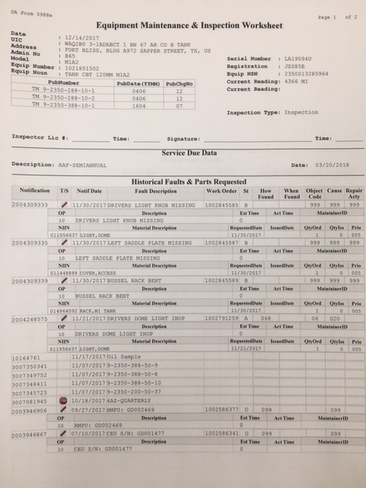
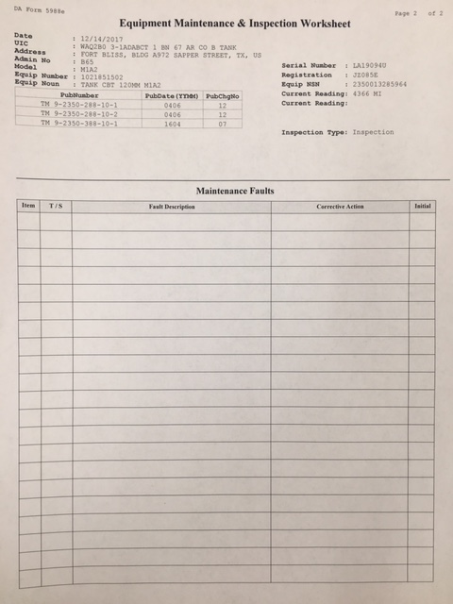
GCSS-A 5988E Overview
Front
Back

Slide 3
Date: Reflects the date 5988E was printed
Force Element: 8 digit number that replaces UIC in GCSS-A its followed by Unit information
Admin No: Actual UIC and followed by the bumper number of vehicle (C4)
Model: Type of vehicle (M1A2SEP, M1151, M2A3)
Equip Number: This number is assigned by the GCSS-A system
Equip Noun: Description of vehicle (TANK CBT FT 120MM, TRUCK UTILITY, etc)
Service Due Data: Description of service type (e.g. Annual and Bi-Annual for vehicles, Quarterly for weapons)
and next date due.

Slide 4
Serial Number: This number will reflect what is on the vehicles data plate.
Registration Number: This number will also reflect what is on the vehicles data plate (Not all vehicles have one)
Equipment NSN: National Stock Number for the equipment
Current Reading: Depending of equipment you will either have (M: Miles, KM: Kilometers, H: Hours)
Inspector Lic# / Time: Operator will annotate their License number and the time they started their PMCS
Signature: When a deficiency or shortcoming is found, the signature and time of operator or supervisor are
required. This signature keeps the form from being used past current dispatch. The commander or the
commander’s designated representative signsname and enters rank when making a status symbol change, or
when changing from an X to a CIRCLED X (E) status symbol for a onetime operation.

Slide 5
Notification:
This replaces your item number
and is generated by GCSS-A
Notification Date:
Date notification was logged
In GCSS-A
Notes:
WK #15
5

Slide 6
Fault Description:
Describes fault. Needs to be
specific when describing fault.
Work Order:
Document Number
for part ordered
Work Req Codes:
0- Begin NMC Time
1- Awaiting deadlining NMC parts
5- Scheduled services
6- Re-inspection
8- Rework, return to shop
9- Begin in-transit time
System Condition Codes:
A- Awaiting initial inspection
B- In shop
C- Awaiting shop
I- In shop awaiting Non-NMC parts
J- In Shop awaiting NMC parts
K- Awaiting NMC parts
R- Awaiting pickup
S- Closed-completed by the
maintenance activity
U- Picked up (must be closed first)

Slide 7
NIIN:
National Stock Number
for the part ordered
Material Description:
When NIIN is input into GCSS-A
It automatically populates off of FEDLOG.
This is the Army's description of the part
Requested Date:
Date parts were requested
Issued Date:
Date parts were received and
issued to the unit

Slide 8
This lets the mechanics/operators know
That this part is recoverable and to turn
It back into the Shop Office or Supply
QTY ORD/ QTY ISS:
The QTY of material that was ordered
and once it is received the QTY ISS will
reflect of many were received
Priority Code:
02- 5 Day Turn Around for Parts
05- 8 Day Turn Around for Parts
12- 30 Day Turn Around for Parts

Slide 9
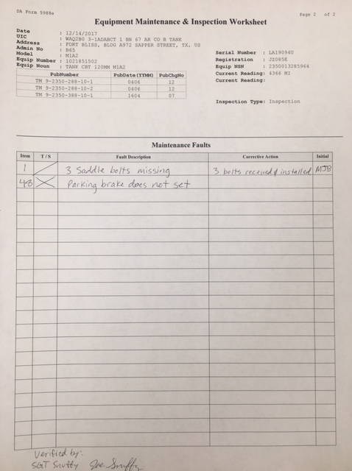
Item Number:
This will match your
numbers in your -10
manuals. If deficiency
is found the number
of check will be put in
this block.
Technical Status:
Does the technical
manual say “Not Fully
Mission Capable”? If so,
then an X would be
placed in this column.
Put a / for faults that do
not effect mission capability.
Fault Description:
This will be a brief in depth
description of the fault.
Corrective Action:
Either an NSN, part installed,
bolt tightened, or oil filled. A
corrective action will be put here
after verification of fault. Soldier
completing action will initial in the
corresponding box.

Slide 10
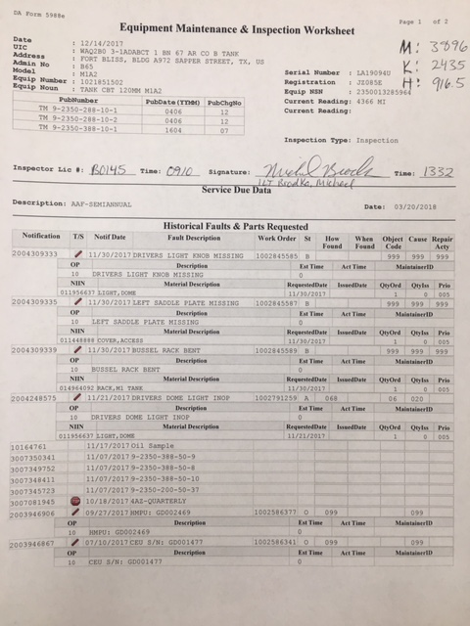
5988E Standard (Front)
Current miles, kilometers,
and hours will be annotated
in the top right corner of the
form.
Operator conducting PMCS
will annotate their license
number, time started,
signature, printed full name,
and time complete.

Slide 11
5988E Standard (Back)
Supervisor will scrub 5988E
for accuracy and correct any
mistakes. They will place
“Verified By” in the lower left
corner, and print/sign their
name.
Once this is completed, the
5988E will be turned in to the
mechanics for fault verification,
open work orders, and part
ordering.

Slide 12
QUESTIONS?

