Slide 1
INFORMATION BRIEF
JUNIOR OFFICER FORUM
ARMY PROFESSIONAL FORUM FOR THE DEVELOPMENT OF COMPANY GRADE OFFICERS
https://juniorofficer.army.mil

Slide 2
JUNIOR OFFICER FORUM
BRIEFING AUTHOR: Brock J. Young, CPT, CA ARNG
Date: 20180306
Information Brief: Junior Officer Forum
Classification: UNCLASSIFIED

Slide 3
JUNIOR OFFICER FORUM
BLUF:
  What Junior Officer Forum Is and Is Not
HISTORY:
  Creation and previous versions
PARTICIPANTS
  Who is Junior Officer For
  Registration and joining Junior Officer
SO WHAT?
  What Junior Officer offers to Junior Officers
  What Junior Officer offers to leaders
CLOSE

Slide 4
JUNIOR OFFICER FORUM
BOTTOM LINE UP FRONT
What Junior Officer IS:
  A non-CAC accessible, professional military forum directed at developing and improving the practice of current and future company and platoon-level leadership across the Army
  Improve the effectiveness of junior officers by connecting them with each other—across space and time—in conversations about leading, personal and professional development, and loving Soldiers
  Advancing the profession by connecting leaders and mentors in conversation, about content in context, in order to improve their individual and collective effectiveness

Slide 5
JUNIOR OFFICER FORUM
BOTTOM LINE UP FRONT
What Junior Officer IS NOT:
  A place to simply air grievances about or takes shots at “higher”
    The forum is to assist with solving problems, not just complain about them
  A place to engage in unprofessional, or disrespectful conversations
    While “rank” is left at the door, all members of the forum are expected to act in a professional manner
  A place for field grade officers to monitor their subordinates’ activities

Slide 6
JUNIOR OFFICER FORUM
HISTORY
2000, Spring: Launched of www.CompanyCommand.com as a means of connecting past, present, and future company commanders
2001: www.platoonleader.org launched; published Taking the Guidon: Exceptional leadership at the company level
2003: Became a “one-stop shop” for deployment information, conversation; Combat-Leader Interviews begin
2006: PL Forum moved to AKO login
2007: CC staff traveled to Afghanistan and Iraq to interview leaders in 3/10 MTN (published Afghan Commander AAR Book (OEF-7)); and to interview leaders; first video- based Leader Challenge LPD conducted at USMA
2008: CC staff deployed to Iraq and interviews leaders in 25th ID; published Iraq Commander AAR Book 2/25; MCCC yearbook project
2009: Published A Platoon Leader’s Tour; Pete deployed to Afghanistan (Paktika, Herat) and conducted interviews; published Afghan CDR AAR Book, Currahee Edition; CC, PL, Leader Challenge, and Professional Reading forums come together as Milspace; Leadercast video library is developed; 1st Leader2Leader LPD at Mission Command Conference at USMA
2010: Staff interviewed 2-12 IN (4/4 ID) leaders in Afghanistan (Kunar); published Iraq Commander AAR Book 1/1 CAV

Slide 7
JUNIOR OFFICER FORUM
HISTORY
2011: Leader Challenge LPDs became a core element of USMA’s character development program; Staff interviewed 3/1 ID leaders in Afghanistan; published Afghan Commander AAR Book (Duke BDE); Leader Challenge online developed; “Read to Lead” developed in ProReading forum
2012: Published Iraq and Kuwait AAR Book, 1st ABCT, 1st CAV; provided PCC support to PA & NY ARNG
2013: Milspace transitioned to milSuite platform, online access became CAC-only; introduced Leader Challenge methodology to Maneuver Center of Excellence
2014: PlatoonLeader.net, a WordPress-based open- source platform that is non-CAC, launched on military server
2015: Last Army Magazine column published; published The Army Officer’s Guide to Mentoring
2016: First cadet-focused and high-school focused Leader Challenges launched; Leaders Huddle Podcast debuted, became #10 training/education podcast on iTunes
2017: Juniorofficer.army.mil, an open-source platform, goes live after 18 months of development. 1-16 IN takes the Pro-Reading

Slide 8
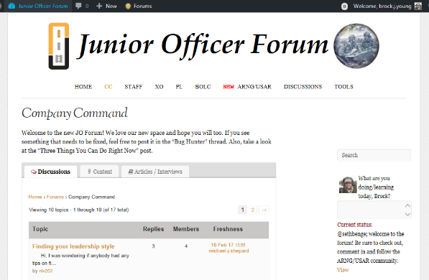
JUNIOR OFFICER FORUM
HISTORY

Slide 9
JUNIOR OFFICER FORUM
WHO IS JUNIOR OFFICER FOR
Intended audience (automatic approval):
  Current Junior/Company Grade officers (2LTs, 1LTs, and CPTs)
  Future officers; USMA/ROTC Cadets and OCS Candidates
Field Grade Officers (limited approval):
  Field Grade officers are permitted to join on a case by case basis
  Must be willing to engage with forum members on a peer/near-peer basis

Slide 10
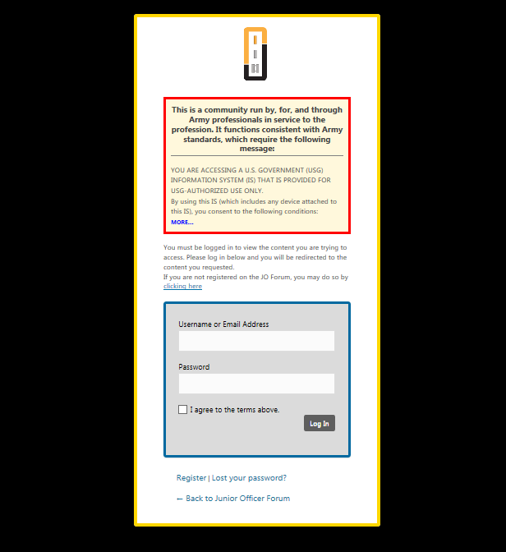
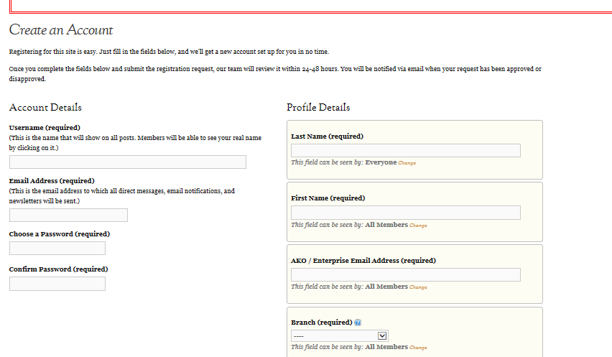
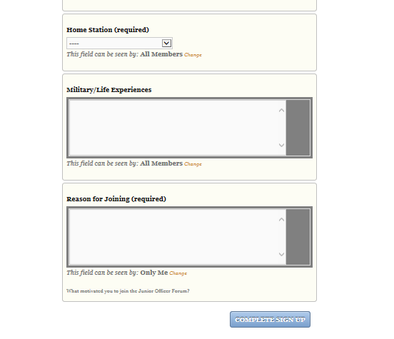
JUNIOR OFFICER FORUM
REGISTRATION
https://juniorofficer.army.mil
  Once submitted, anticipate approval within 72 hours

Slide 11
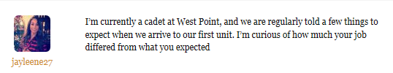
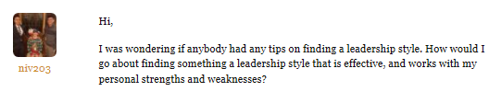
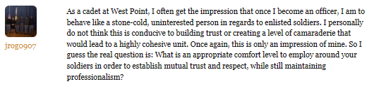
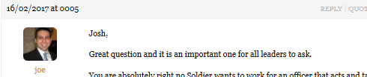
JUNIOR OFFICER FORUM
What Junior Officer, Offers
To Junior Officers:
Judgement free place to ask questions and get honest, pertinent feedback

Slide 12
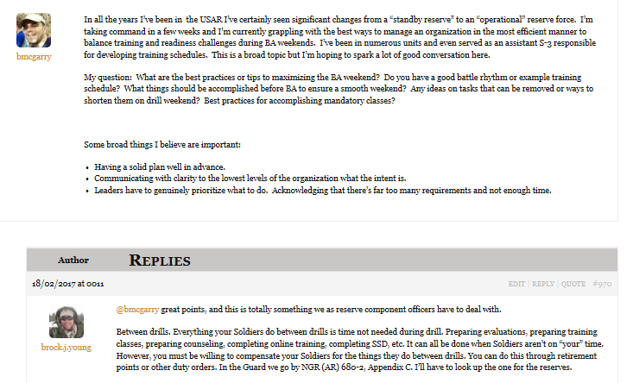
JUNIOR OFFICER FORUM
What Junior Officer, Offers
To Junior Officers:
Judgement free place to ask questions and get honest, pertinent feedback

Slide 13

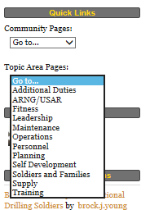
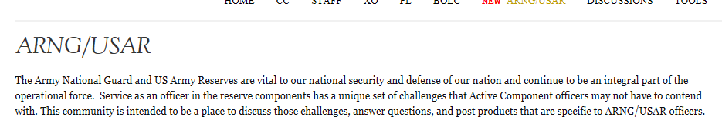
JUNIOR OFFICER FORUM
What Junior Officer, Offers
To Junior Officers:
Communities and topic areas specific to position, function or component that officers might have questions about
(Upper level communities)

Slide 14
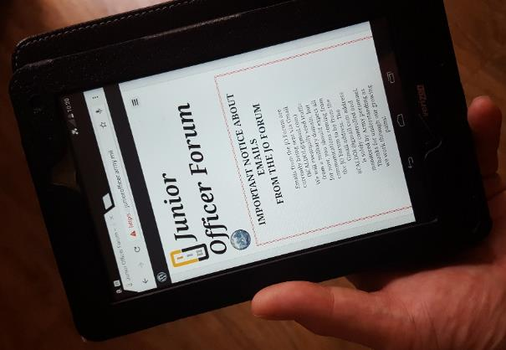
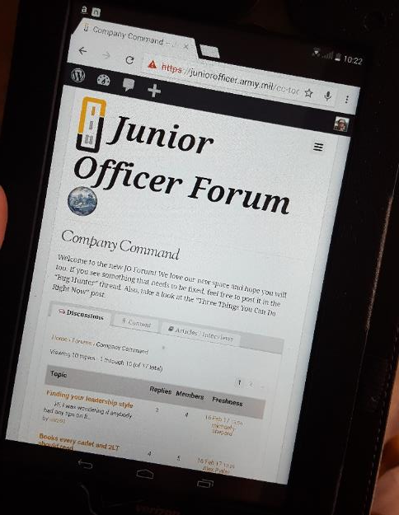
JUNIOR OFFICER FORUM
What Junior Officer, Offers
To Junior Officers:
Accessibility (mentorship!) anywhere, without the need for a CAC reader
Accessible by phone
Tablet
Laptop
Or PC

Slide 15
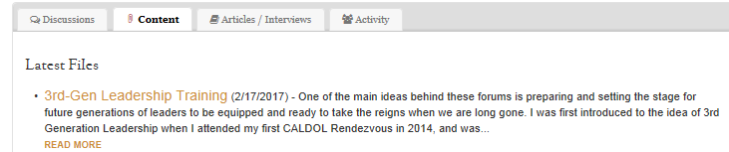
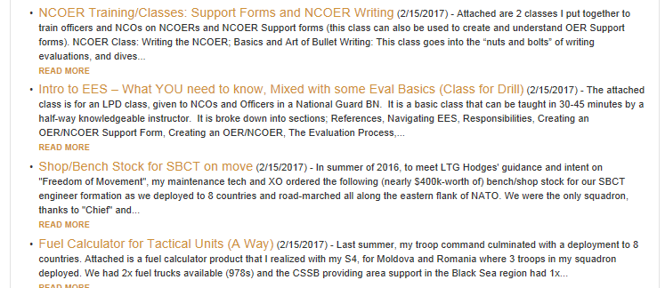
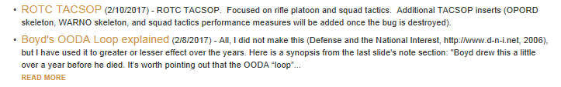
JUNIOR OFFICER FORUM
What Junior Officer, Offers
To Junior Officers:
Share and find products to help them be more efficient

Slide 16
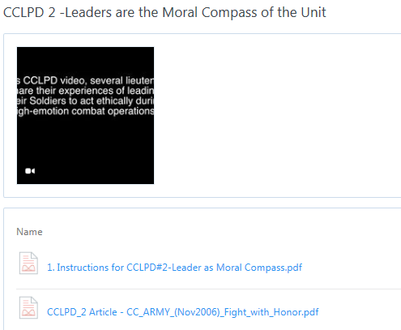
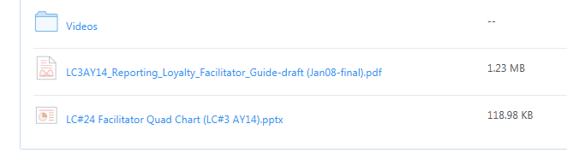
JUNIOR OFFICER FORUM
What Junior Officer, Offers
To Junior Officers:
Packaged, ready to use LPD training; Leader Challenges, CCLPD; etc.

Slide 17
JUNIOR OFFICER FORUM
What Junior Officer, Offers
To Junior Officers:
The opportunity to be published and grow
Oct-Nov 2013, 1LT Young commented in a discussion forum about “What Not to Do as a Platoon Leader”
Was asked by Company Command facilitators to contribute more in depth
Published in December 2013 issue of the Army Magazine
Since, was published again in Army Magazine in March 2016 and twice in Task and Purpose (November 2015 and June 2016).
Notes:
-In addition to assisting young leaders grow and develop, participating in professional writing offers them the opportunity to go beyond what they thought they were capable of.
-Being published helps build confidence as well as the ability to write and communicate effectively.

Slide 18
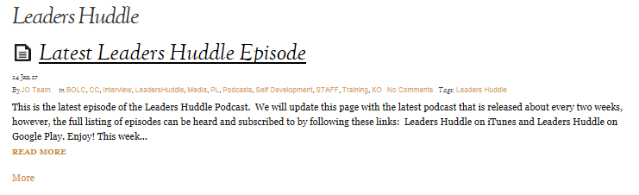
JUNIOR OFFICER FORUM
What Junior Officer, Offers
To Junior Officers:
PODCASTS, talking about various issues, challenges, and items of concern to Junior Officers (also available on iTUNES and Google Play)
NOTE: Upcoming episode will feature National Guard information and resources. It will be a collaborative effort between two ARNG officers (one in CA and one in KY), is due to be recorded in March 2017

Slide 19
JUNIOR OFFICER FORUM
What Junior Officer, Offers
To Leaders:
Junior Officer gives leaders the opportunity to mentor officers across the Army as an organization
Junior Officer increases the effectiveness of Junior Officers within units across the Army, AC and Reserve Components
Junior Officer gives subordinate leaders an outlet to grow and develop themselves professionally
Junior Officer gives Field Grade officers the ability to continue to learn and develop professionally, by offering them all of the training that the Junior Officers have access to

Slide 20
JUNIOR OFFICER FORUM
I am an expert, and I am a professional...
–from The Soldier’s Creed
The Army is a Profession; we are members of that Army Profession. As professionals, we:
  Share common values,
  Share common commitment to being competent as individuals and group,
  Share a desire to give back and make a difference to our fellow professionals, no matter the rank

Slide 21
JUNIOR OFFICER FORUM
CLOSING
Junior Officers (current and future) should be encouraged, NOT directed, to join
  Mentorship per FM 6-22; the voluntary developmental relationship that exists between a person of greater experience and a person of lesser experience that is characterized by mutual trust and respect
Junior Officer builds the professional community

Slide 22
QUESTIONS?
https://juniorofficer.army.mil

