Slide 1


“Résumé Development LPD”
“War Winning Talent”
LTC Greg Lockhart
Army Talent Management Task Force

Slide 2
AGENDA
21st Century Talent Management - Overview
ATAP
Knowledge, Skills, & Behaviors (KSBs)
The AIM 2.0 Résumé & Officer Baseball Card
---------------------------------------------------------------------------------
Take Home LPD
How to Build Your Résumé

Slide 3

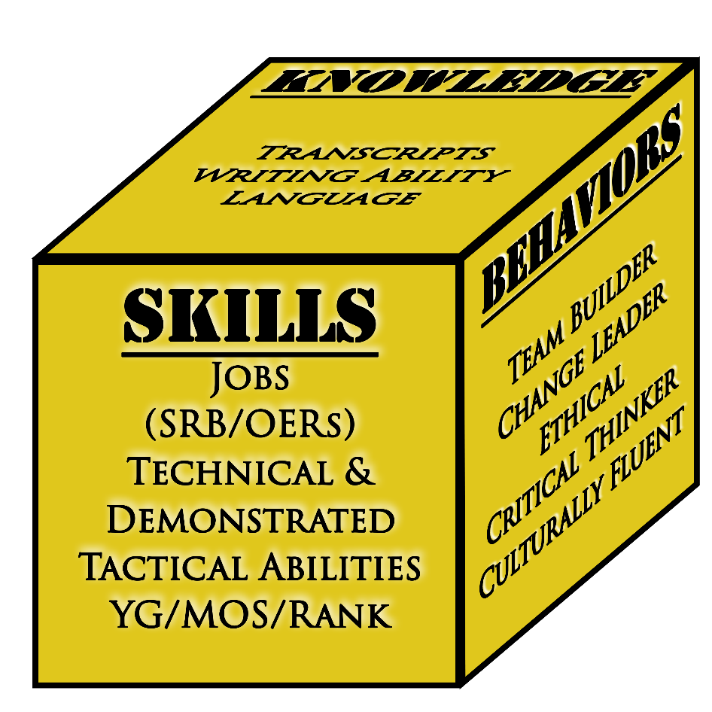
Why Talent Management?
Industrial Age Strength Management
21st Century Talent Management
10x change vs 10% change
Skills:
SRB
OER/NCOER
APFT
YG/MOS/Rank
1
Data Driven Approach
2
Flexible Career Paths
Two dimensional view of people (Infantry CPT)
Mass production of personnel - interchangeable parts
187 disparate personnel systems based on 90’s IT
Data Poor
Inflexible
No predictive capability
3
Force Shaping
Three Dimensional: Screens, identifies, and leverages talent (KSB-P)
Data Rich: Multiple vectors of information leads to better decisions over time
Accurate: puts the right individual in the right job at the right time (over time)
Make a new system, not make the system better
4
Promotions & Selections
5
Career Assessments

Slide 4

The Army Talent Alignment Process
ATAP is a decentralized regulated market-style hiring system that aligns officers with jobs based on preferences. These Preferences are shaped by the unique Knowledge, Skills, and Behaviors (KSBs) of each officer and the KSBs desired by commanders for their available assignments.
Set the Conditions for the Market
Execute the Market
Clear the Market
Officers
Clearing the Market
Regulated Marketplace
Assignments
Vacancies
Readiness Determines the officers and vacancies that enter the market
***ATAP does not change this process***
Officers and units interact and submit preference information
Based on officer and unit preferences, Officers are matched to vacancies
Unit Submitted Vacancies
HRC Validated Vacancies
Officer
Preferences
ASL Adjustments
3
MER
DRL
Market
Interaction
Locked
Preferences
AIM
Proposed Slate
Final Slate
Assignments
Unit
Preferences
1
ACMG & other ASL guidance
2
4
Army Talent Alignment Algorithm
Corrections
This process gives units ownership of who goes to their formations. It is not tenable without a substantial increase in unit participation.
Role of HRC
Based on the needs of the Army: Identify moving officers, validate unit vacancies, and identify all markets for which officers are eligible
Identify and publish market timelines
Role of the Unit
Identify desired KSBs
Interview candidates
Rank officers in order of preference
Be mindful of performance distribution
Be aware of nepotism
Role of the Officer
Create résumé
Identify KSBs
Contact units/incumbents
Rank vacancies in order of preference
Role of HRC
Brief market outcomes to ASL
Identify potential issues, or need to re-slate (special circumstances, Performance Distribution Guidance, or market failure)
Publish final slate based on ASL guidance
Role of Unit
Make assignment considerations earlier
Advertise vacancies accurately and robustly
Officer Identification
(JUN-AUG)
MER
(AUG)
(OPEN) Market (CLOSE)
(01OCT) (01DEC)
Market Processing
(JAN-FEB)
Slate Adjustments
(FEB)
RFO
(FEB-MAR)
REPORT
(APR-SEP)
~ 15 month movement cycle timeline (20-02)

Slide 5
Résumé and Interview Impacts in ATAP
84% of officers in the 21-02 market had at least a 70% strength rating or higher on their résumé prior to market opening.
70% of officers agreed their résumé was useful in interacting with units in the marketplace
78% of units found that officer résumés were helpful in making their preferences.
Officer Resumes were the second (2nd) most important factor for unit preferencing of officers in the market. Interviews were number one (1).
Bottom Line: Officer résumés do impact unit preferencing in ATAP markets.
CUI
5

Slide 6
Army Talent Attribute Framework
Updated definitions of Talent, KSB-P within the ATAF.
Structure
Consolidation of:
1. 21 Talents
2. ADP 6-22
3. ATMTF Attribute List
7 Talent Domains
42 Talents
199
Measurable KSBs
Example
Tier 1: Talent Domain (7)
Tier 2: Talents (42)
Tier 3: Measurable KSBs (199)
Physical
Cognitive
Interpersonal
Communication
Leadership & Management
Disposition
Expertise & Personal Competence
Leadership
Management
Performance Management
Sustains Climate and Morale
Training and Developing Others
Assesses Developmental Needs Of Others
Mentoring
Creates a Learning Environment
Instructing
Training and Developing Others
Providing a tiered structure makes the information more digestible at the user level as well as easier to navigate in an application setting (e.g. AIM2, IPPS-A).

Slide 7

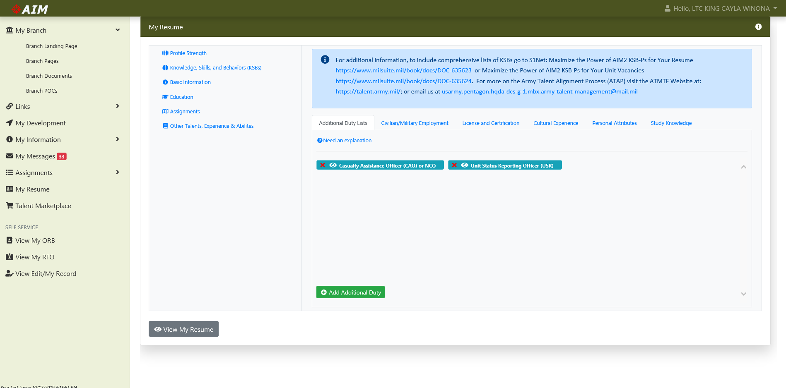
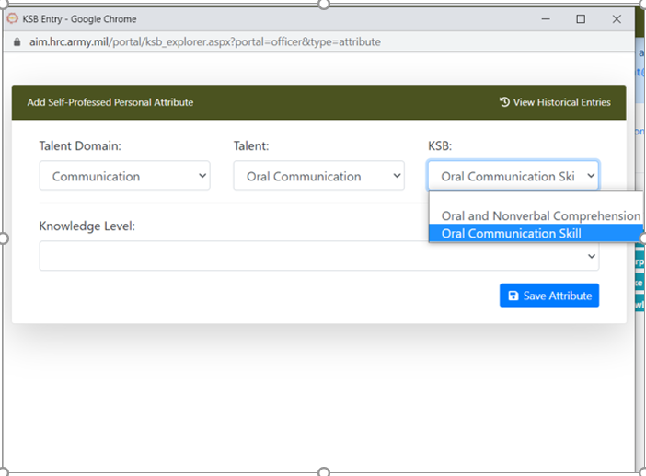

AIM 2.0 Résumé – KSBs
2
3
4
1
5
Don’t forget to save your work!!!.

Slide 8
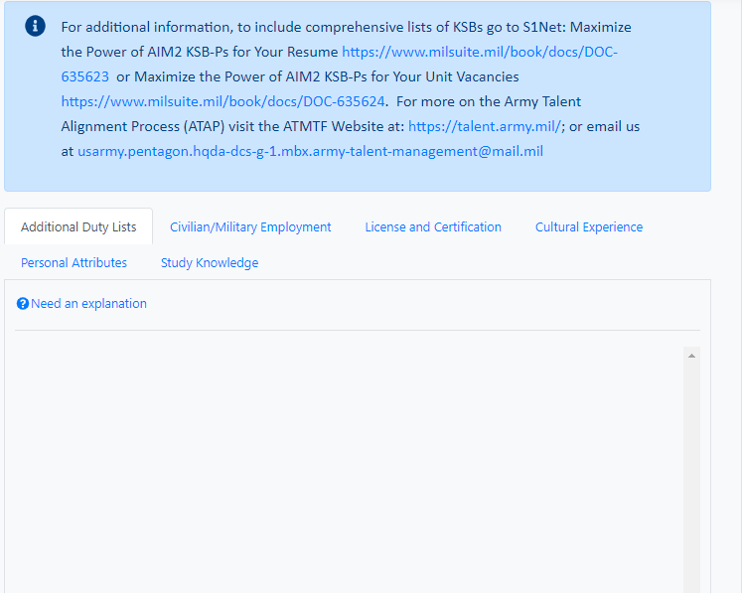
TTPs for KSBs
Maximize the Power of KSB-Ps for Your Résumé
https://www.milsuite.mil/book/docs/DOC-635623
TTPs:
Officers should start with the Personal Attribute List. For Active Duty Officers, this list is the most relevant.
If you profess a KSB, use page two (2) of your résumé to further explain how you attained it.
Only profess KSBs you feel confident you have attained through experience or training. You should not select all 199 KSBs.
Officers are not required to profess KSBs or experiences from every list. Only select what applies to your experiences and training. (e.g. Civilian Experience or Additional Duties may not apply to your experiences).
If a KSB or experience is not listed, you can include it on page two (2) of your résumé in the appropriate section. This works well for non-DOD certifications or credentials (e.g. Medical Training & Certifications).
KSBs are not displayed on page two (2) of your résumé. They are displayed on your Officer Baseball Card.
CAC Approved Branch Storyboards with KSBs have been added to the milsuite link. Use only as a guide to assist with résumé development.
Start early, KSBs require thought and time.

Slide 9


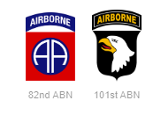



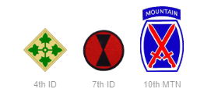
KSB Development Across Talent Management
Officers
Professed KSBs
Problem Solver
Innovative
Tactical/ Technical Competence
Post- Marketplace
Analysis
How big is the gap?
Officers in the current market lack cultural fluency.
DEVELOP:
- Changes to PME
- Recommend Officer Self-Development on IDPs
RETAIN:
- Incentivize Officers with this talent to stay in the Army
ACQUIRE:
- Direct Talent Hiring
AIM2
How and do we need to rectify this talent gap?
ATAP Marketplace
Units
Units requested officers with cultural fluency.
How important is the skill?
Desired KSBs
Problem Solver
Innovative
Cultural Fluency
Tactical/ Technical Competence
Pre-Decisional// Unclassified

Slide 10
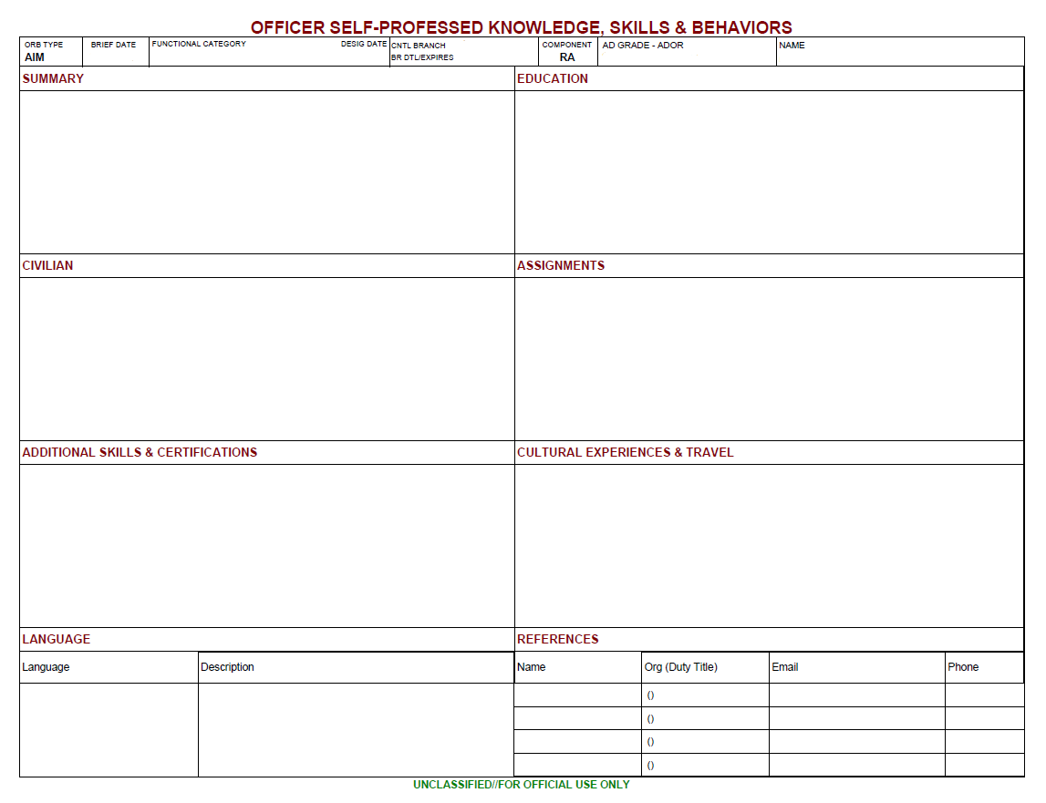
AIM Resume – “A Way”
1
What sets you apart from your peers? Summarize your overall skills, desires, career goals.
Include information that makes people want to read more.
What kind of job are you looking for next?
What opportunities do you want to be considered for? (i.e. KD, command, aide de camp, speechwriter, WIAS, etc.)
What are your career aspirations 5-10 years out?
2
Include civilian and military education that is not listed on your ORB (i.e. 30 credits in graduate program, cyber courses, etc.).
Describe any significant educational information that goes beyond your degree title (i.e. thesis topic, area of specification; internships; etc.).
How have you used your education opportunities to improve the Army, your branch, or your unit?
3
What work have you done to better the community? How did you solve a problem? What were the results?
How have you improved civilian-military relationships?
Have you organized or participated in unit events that served the community?
Do you have a leadership position in any civilian organization? (i.e. schools, sports, etc.)
4
What key experiences/accomplishments do you want to convey from your past assignments? Review your OERs for potential input.
What did you accomplish, how did you make an impact in key assignments?
Highlight assignments that prepared you for the future jobs you want.
5
6
List any articles/writings you have published.
List any military or civilian certifications that are not listed on your ORB.
Include certifications you are working toward.
Do you have a unique skill you have used to improve the Army, your branch, or your unit?
How have you used your experiences/travel to improve the Army, your branch, or your unit?
What have you done or experienced that sets you apart from your peers?
Do you have any unique experiences that makes you better suited for the jobs you want?
7
8
List all languages you have studied and/or languages in which you are proficient, that are not listed on your ORB.
Ensure your references know they are listed – if someone contacts them and they do not remember you or do not respond, it may not reflect well on you.
https://aim.hrc.army.mil/portal/index.aspx
Slide Courtesy of Human Resources Command

Slide 11
20200301
OPERATIONS
AR
CPT 20150301
SNUFFY, JOSEPH P.
ARIAL 8.5 PT FONT BOLD
ARIAL 8.5 PT FONT BOLD
ARIAL 8.5 PT FONT BOLD
ARIAL 8.5 PT FONT BOLD
ARIAL 8.5 PT FONT BOLD
ARIAL 8.5 PT FONT BOLD
ARIAL 8.5 PT FONT BOLD
ARIAL 8.5 PT FONT BOLD
COL Joseph Smith
3CR (Commander)
joseph.smith.mil@mail.mil
706-555-6465
COL Joseph Smith
3CR (Commander)
joseph.smith.mil@mail.mil
706-555-6465
COL Joseph Smith
3CR (Commander)
joseph.smith.mil@mail.mil
706-555-6465
COL Joseph Smith
3CR (Commander)
joseph.smith.mil@mail.mil
706-555-6465

Slide 12
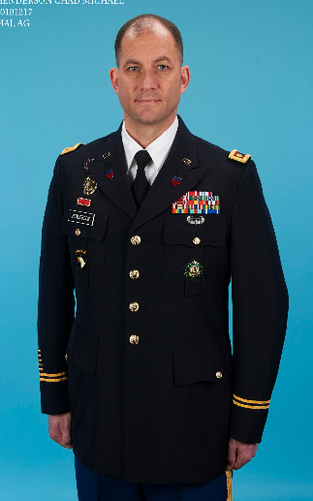
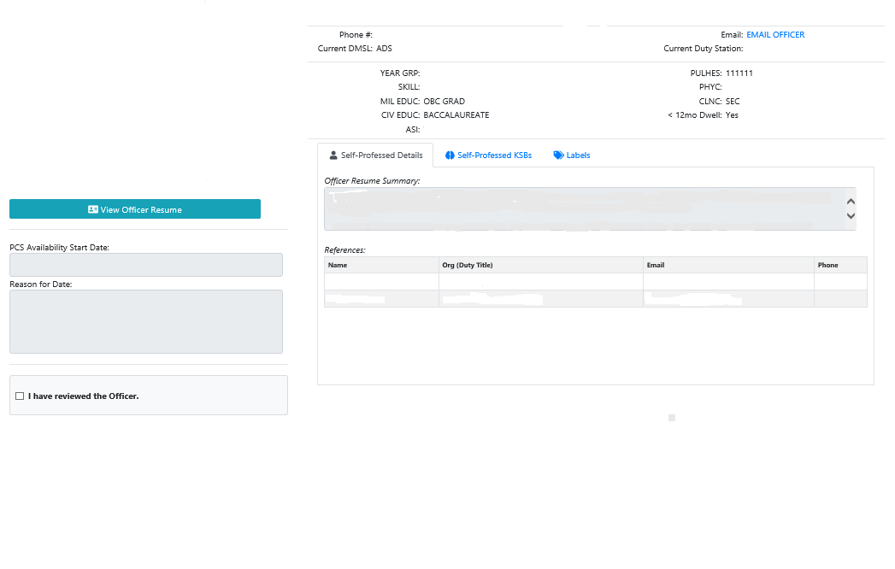


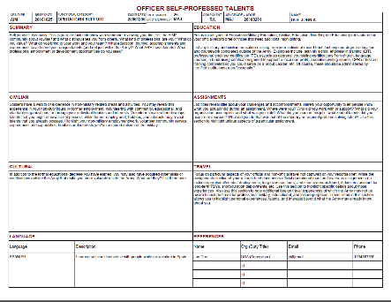
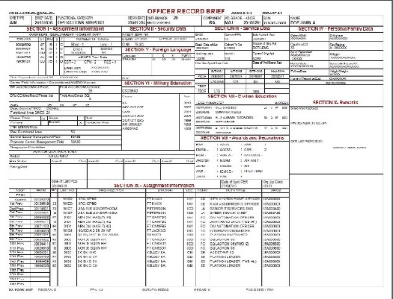
Officer Baseball Card
Photo No Longer Visible
CPT DOE JOHN M
CURRENT DUTY POSITION
6
Dwell information to assist deploying units in the process of ranking officers.
5
4
Labels applied to the officer.
The Officer ORB/Resume
Officer Self-professed KSBs.
Self-professed details provides the unit with the officer’s Resume summary and references from their AIM Resume.
2
Unit S1s update ORBs. Officers should not request updates
through the AIM Help Desk.
Units can select “I have reviewed the officer” on the officers baseball card to identify officers whose files have been reviewed. Once checked, the officer will be highlighted in green in the unit’s marketplace.

Slide 13
Résumé How-to Guide LPD

Slide 14
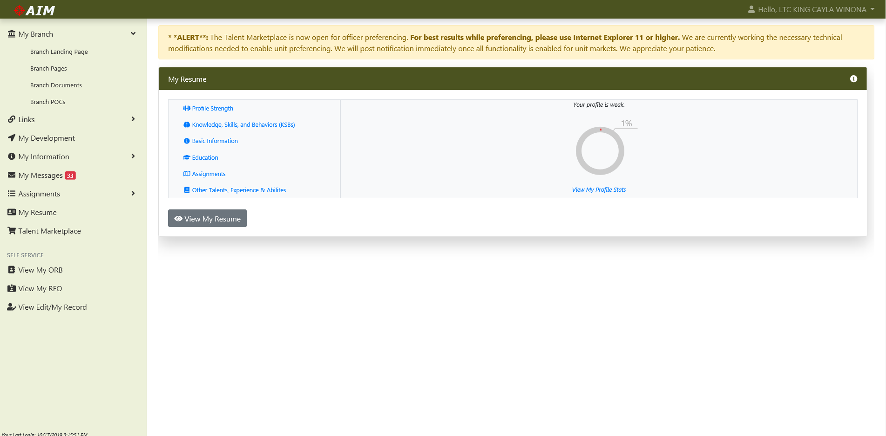

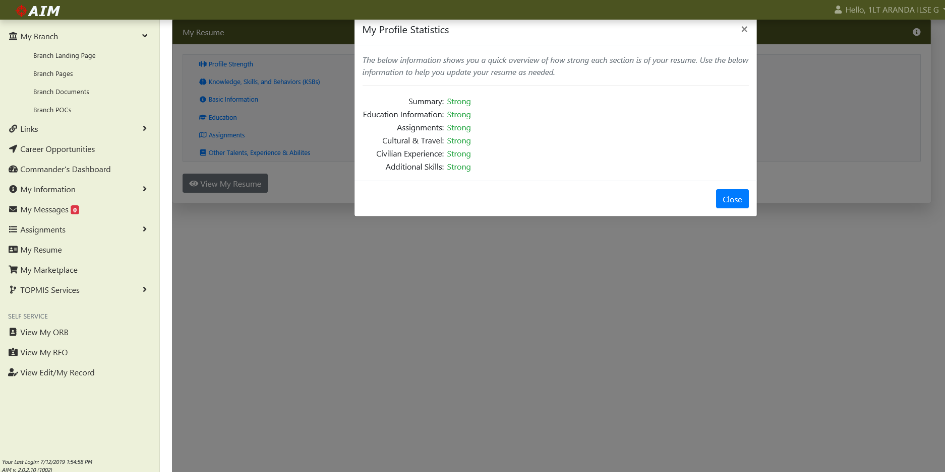
AIM 2.0 Résumé – My Résumé
Upon clicking the “My RÉSUMÉ” tab in AIM 2.0, the officer is defaulted to the “Profile Strength” tab. The Profile Strength section shows which areas of your resume you need to potentially add information to. It is based solely on character length, not quality of content. This gauge is ONLY visible to the officer and Career Manager, NOT to units.
2
3
The Profile Strength Gauge is only visible to the officer and career manager, not units.
1
There is no one “right” way
Some units prefer short and concise
Some units prefer long and detailed
Craft your resume to illustrate your experiences / skills
“A Way” Guide”: https://www.milsuite.mil/book/docs/DOC-635623
In the “My Resume” tab, officers can add information about themselves that is not always available in the ORB.

Slide 15
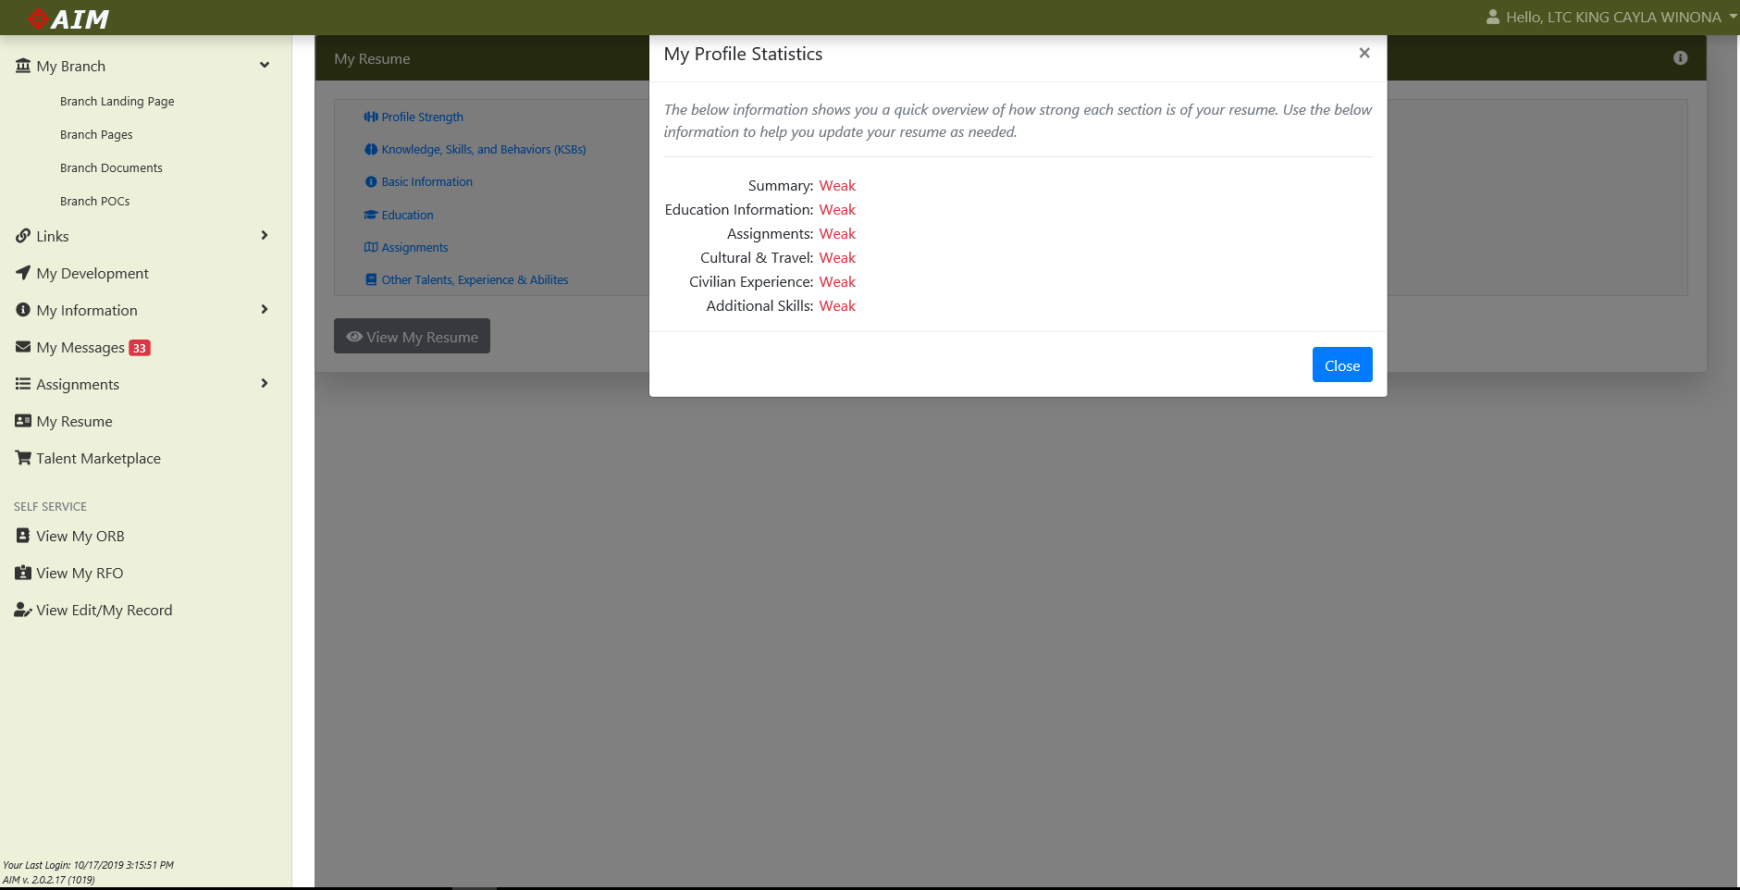
AIM 2.0 Résumé – Profile Strength
1
A click on the “View my Profile Stats” will present a screen and provide recommendations on areas an officer needs to potentially add additional information.

Slide 16
AIM 2.0 Résumé – KSBs
The “Knowledge, Skills and Behaviors (KSBs)” tab is immediately below the “Profile Strength” tab. Clicking on this tab will present the officer with the ability to add information to the following fields: Additional Duties, Civilian and Military Employment, Licenses and Certifications, Cultural Experience, Personal Attributes, Study Knowledge.
1
2
To add information, click on the specific tab you want to amend. At the bottom left of the tab’s page, click add. This will present a search bar. Officers can type a keyword to search the list of available items. Officers will be asked to provide dates or years of experience and level of knowledge for some tabs.
3

Slide 17
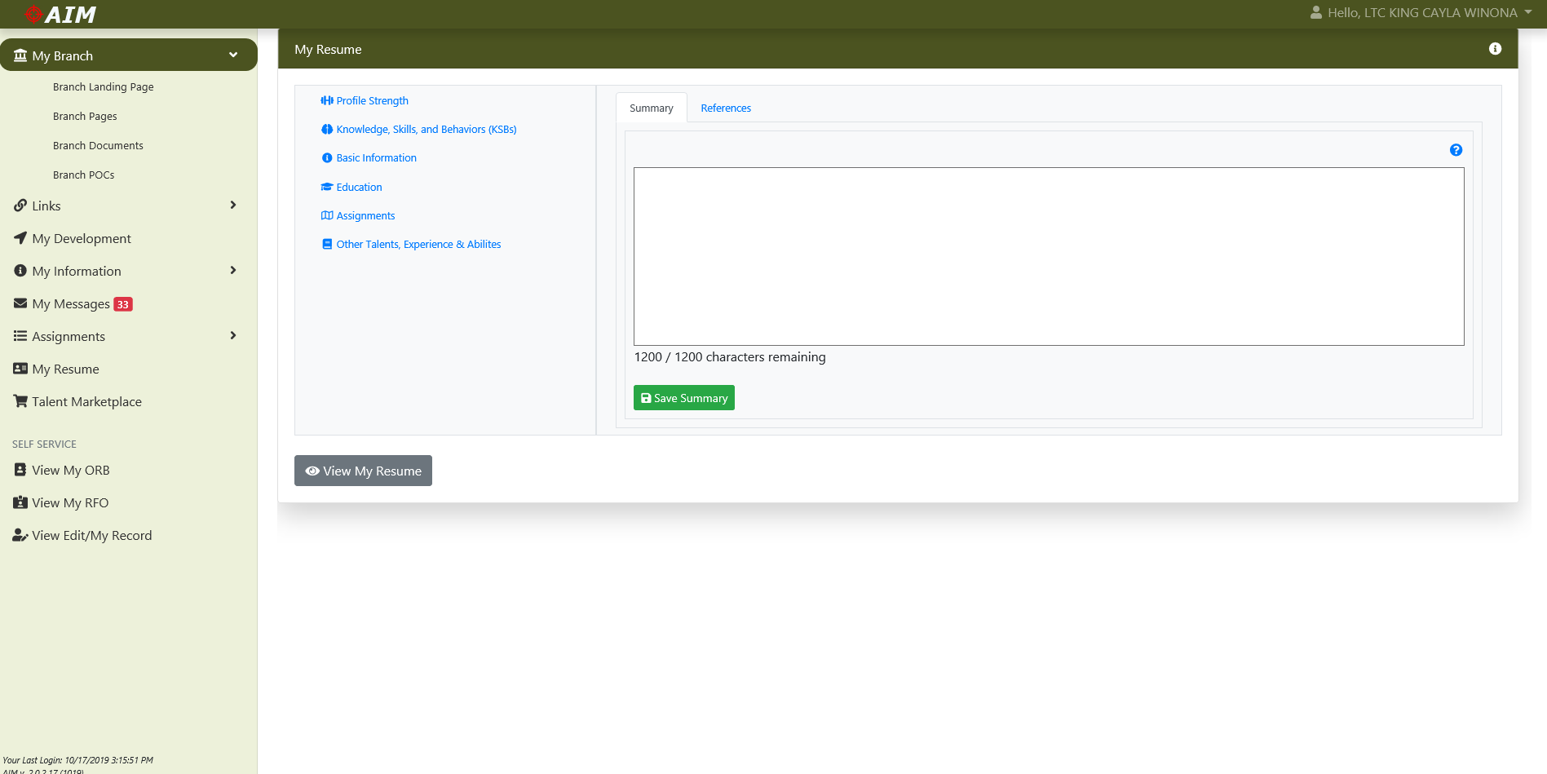
AIM 2.0 Résumé – Basic Information “Summary”
1
The “Summary Tab” provides a 1200 character field for an officer to highlight and summarize their overall skills, desires and goals. This is reflected on page two (2) of an officer’s résumé in the top left corner. Many units consider this paragraph as the most helpful and influential during a marketplace.

Slide 18
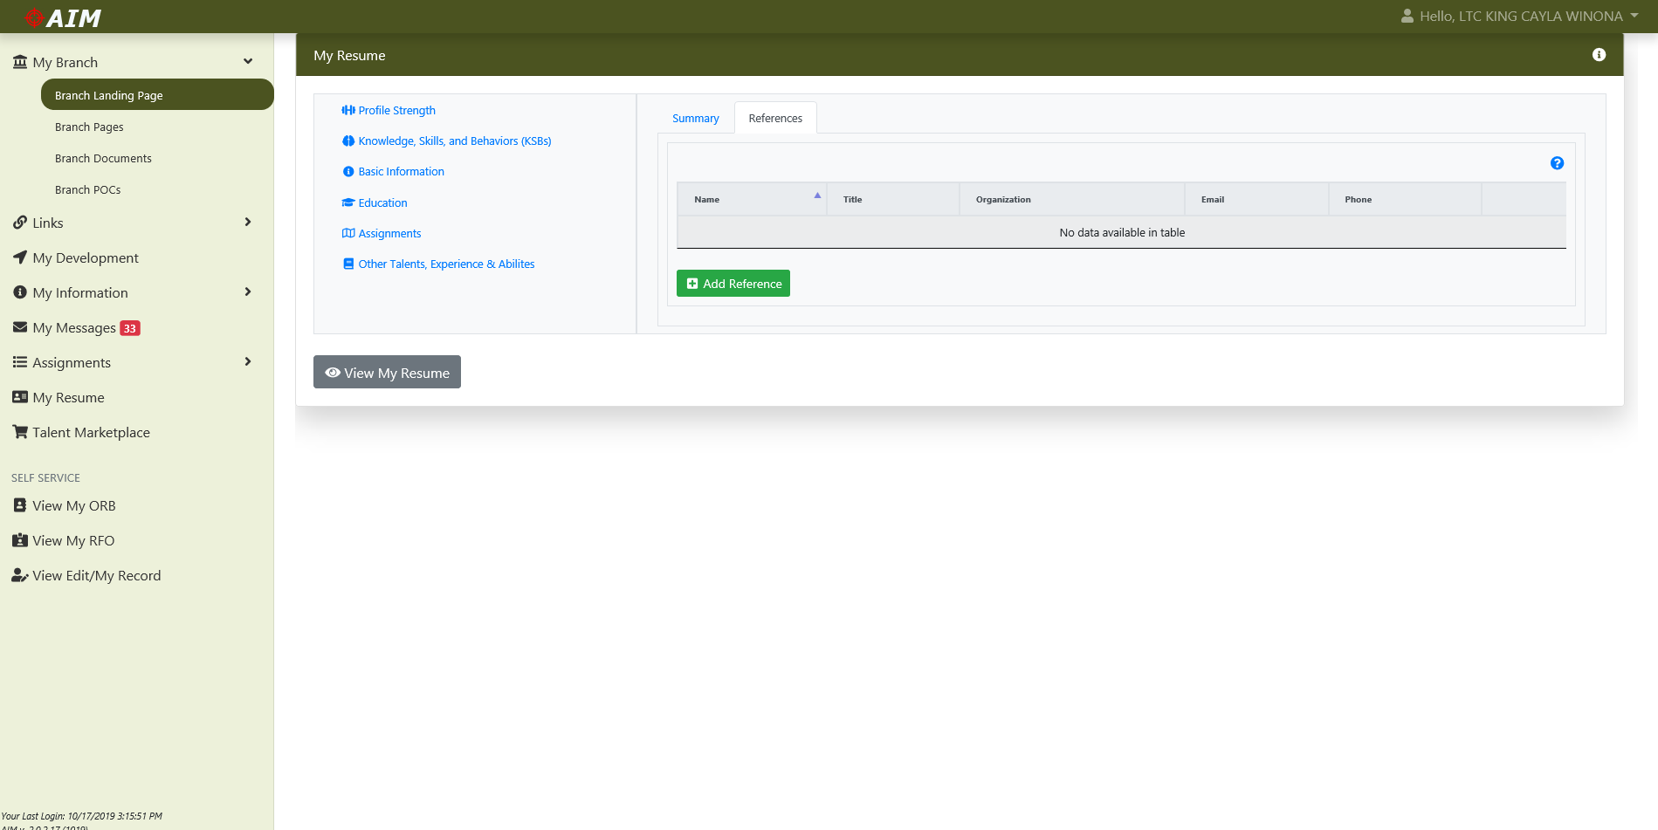
AIM 2.0 Résumé – Basic Information “References”
1
Officers can add key references for people who were, or currently are, your raters, senior raters, and mentors from current and prior jobs. These leaders can provide references to others wanting to learn more about your unique talents. Be prepared to add name, current organization and duty title, phone, and email.
2
It is highly recommended that your references know they are listed. If someone contacts them and they do not remember you or do not respond, it could reflect poorly on you.

Slide 19
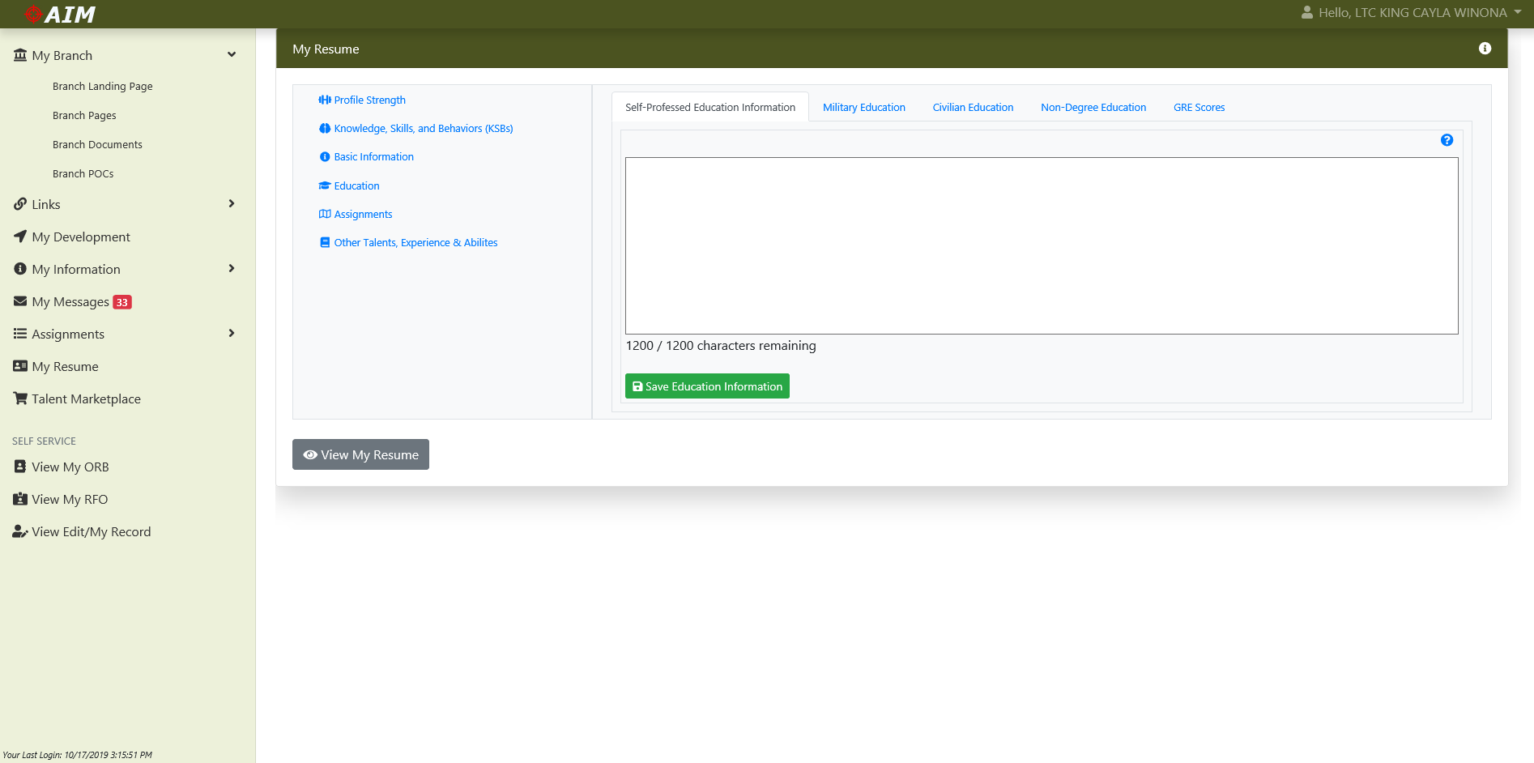
AIM 2.0 Résumé – Education “Self-Professed”
1
This tab provides a 1200 character free text field for officers to focus or expound upon education not captured on their Officer Record Brief (ORB). List any military and civilian education missing from your individual record brief, and list any non-degree education and coursework completed outside of the Army.

Slide 20
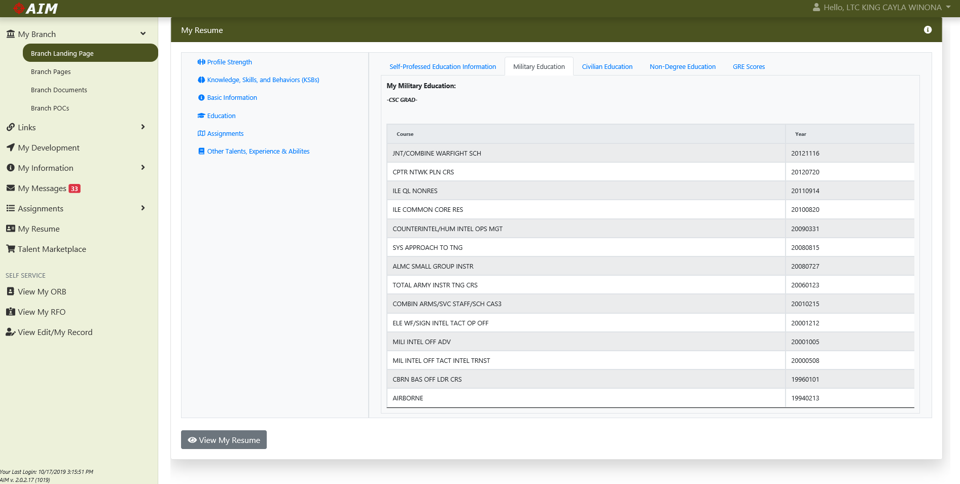
AIM 2.0 Résumé – Education “Military Education”
This tab captures your completed military training. This information populates under Section VI – Military Education on page one (1) of your ORB. Officers cannot manipulate this information and must contact their unit S1 for updates and corrections to this section.
1

Slide 21
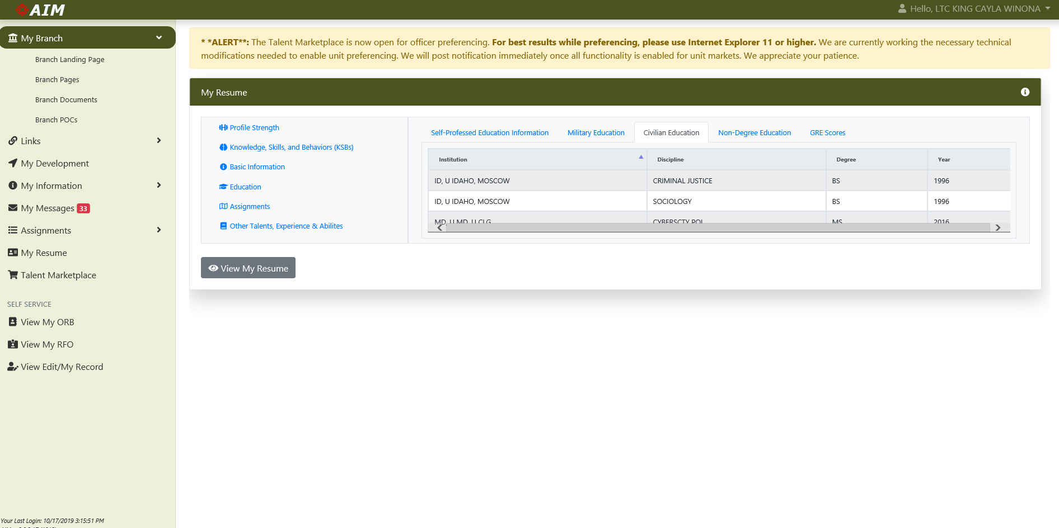
AIM 2.0 Résumé – Education “Civilian Education”
The “Civilian Education” tab captures your completed civilian education. This information populates under Section VII – Civilian Education on page one (1) of your ORB. Officers cannot manipulate this information and must contact their unit S1 for updates and corrections to this section.
1

Slide 22
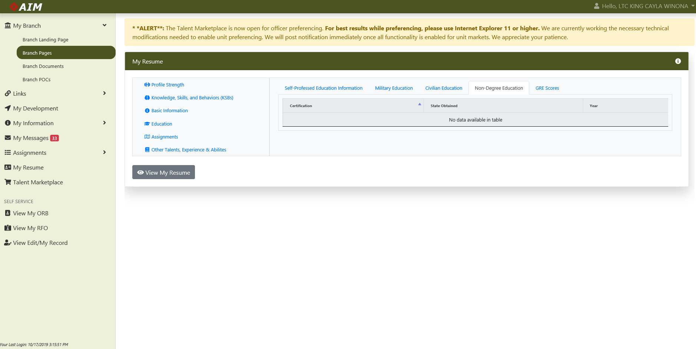
AIM 2.0 Résumé – Education “Non-Degree Ed.”
1
This tab captures certifications and experiences not provided under the civilian education section of your ORB. This information populates under Section X – Remarks on page one (1) of your ORB. Professional Registration Data such as Certified Lawyer, Certified Teacher, and Certified Facility Manager are examples of registrations an officer may possess.

Slide 23
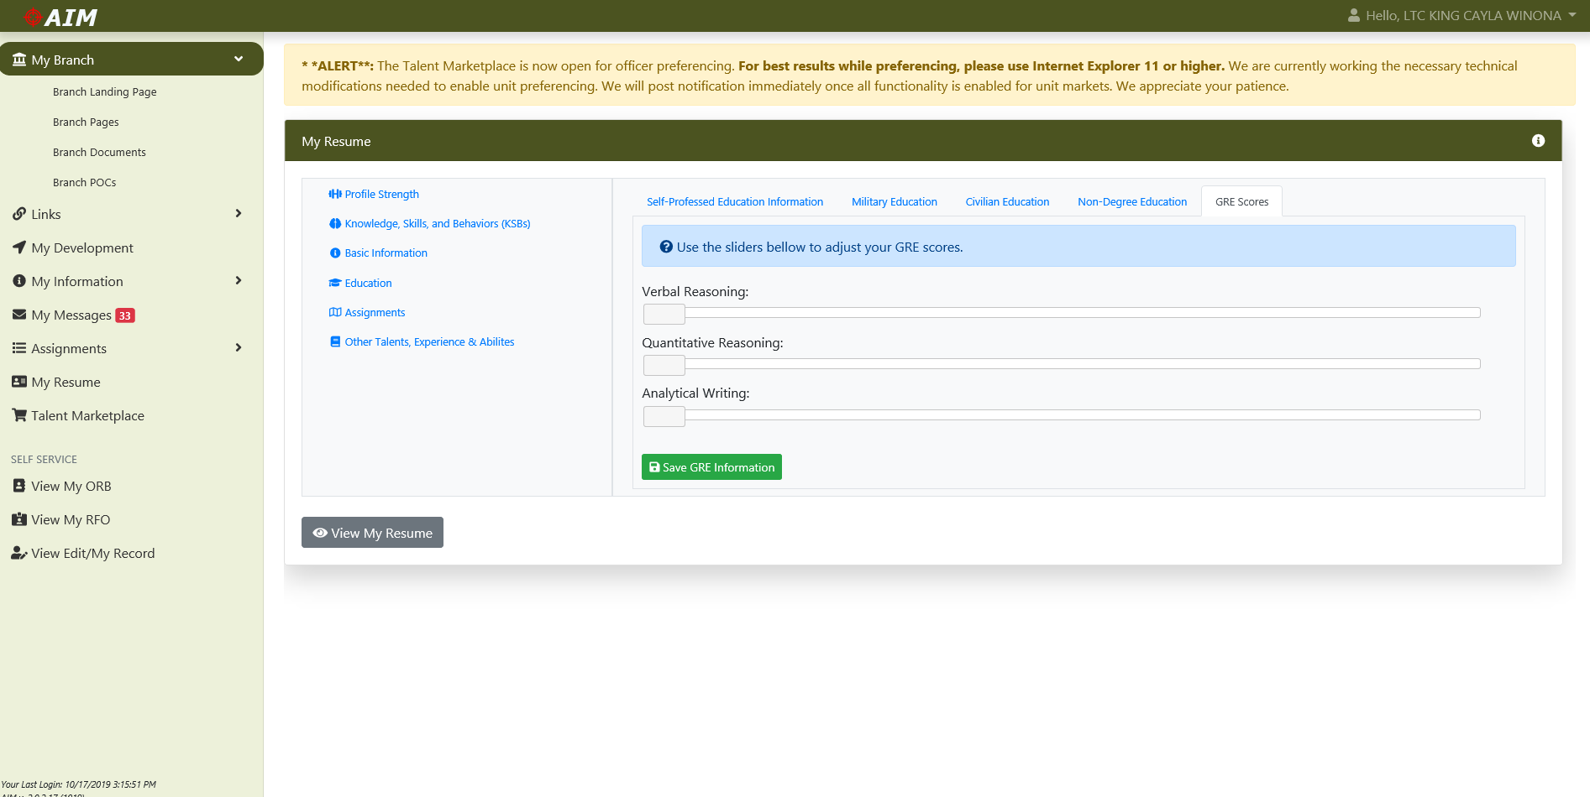
AIM 2.0 Résumé – Education “GRE Score”
1
This tab captures an officer’s scores on the GRE. This tab is only viewable by the officer and career manager. Units cannot see these scores.

Slide 24
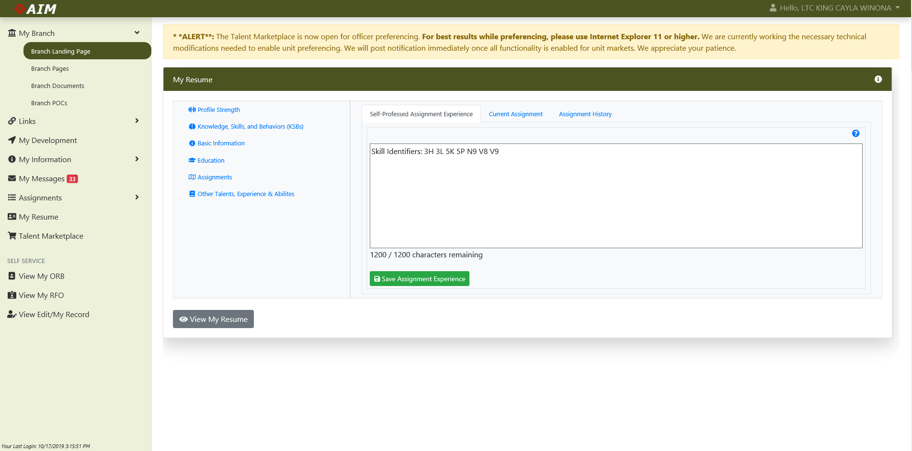
AIM 2.0 Résumé – Assignments “Self-Professed”
1
Duty titles only tell someone so much about your assignment experiences. The “Self-Professed Assignment Experience” tab is a 1200 character free text field, which allows officers to expound upon their challenges and accomplishments during specific assignments. This field populates on page two (2) of your résumé. Topics might include: Where were you; Who did you work with or support; What did your organization accomplish; What did you learn in a specific job; What KSBs did you acquire during an assignment?

Slide 25
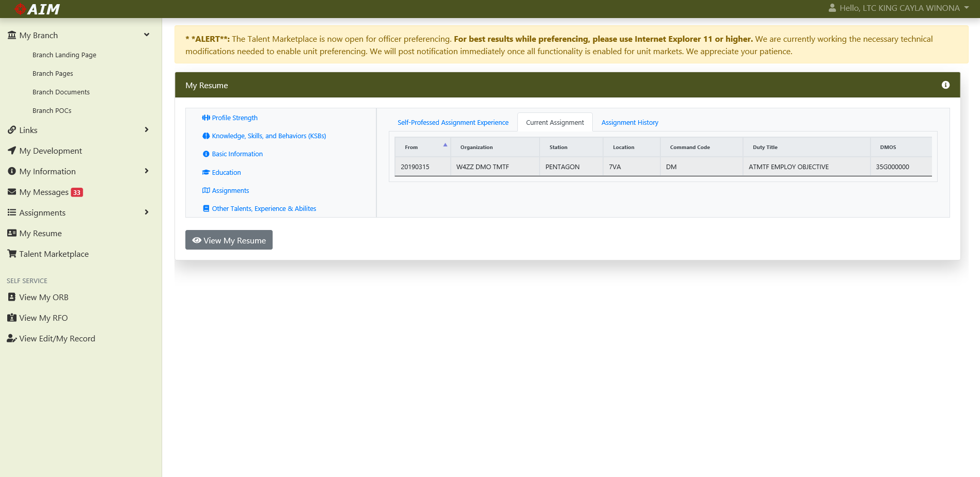
AIM 2.0 Résumé – Education “Current Assignment”
1
This tab highlights your current assignment and duty title. It is reflected on page one (1) of your résumé under Section IX: Assignment Information. Officers cannot manipulate this information and must contact their unit S1 for updates and corrections to this section.

Slide 26
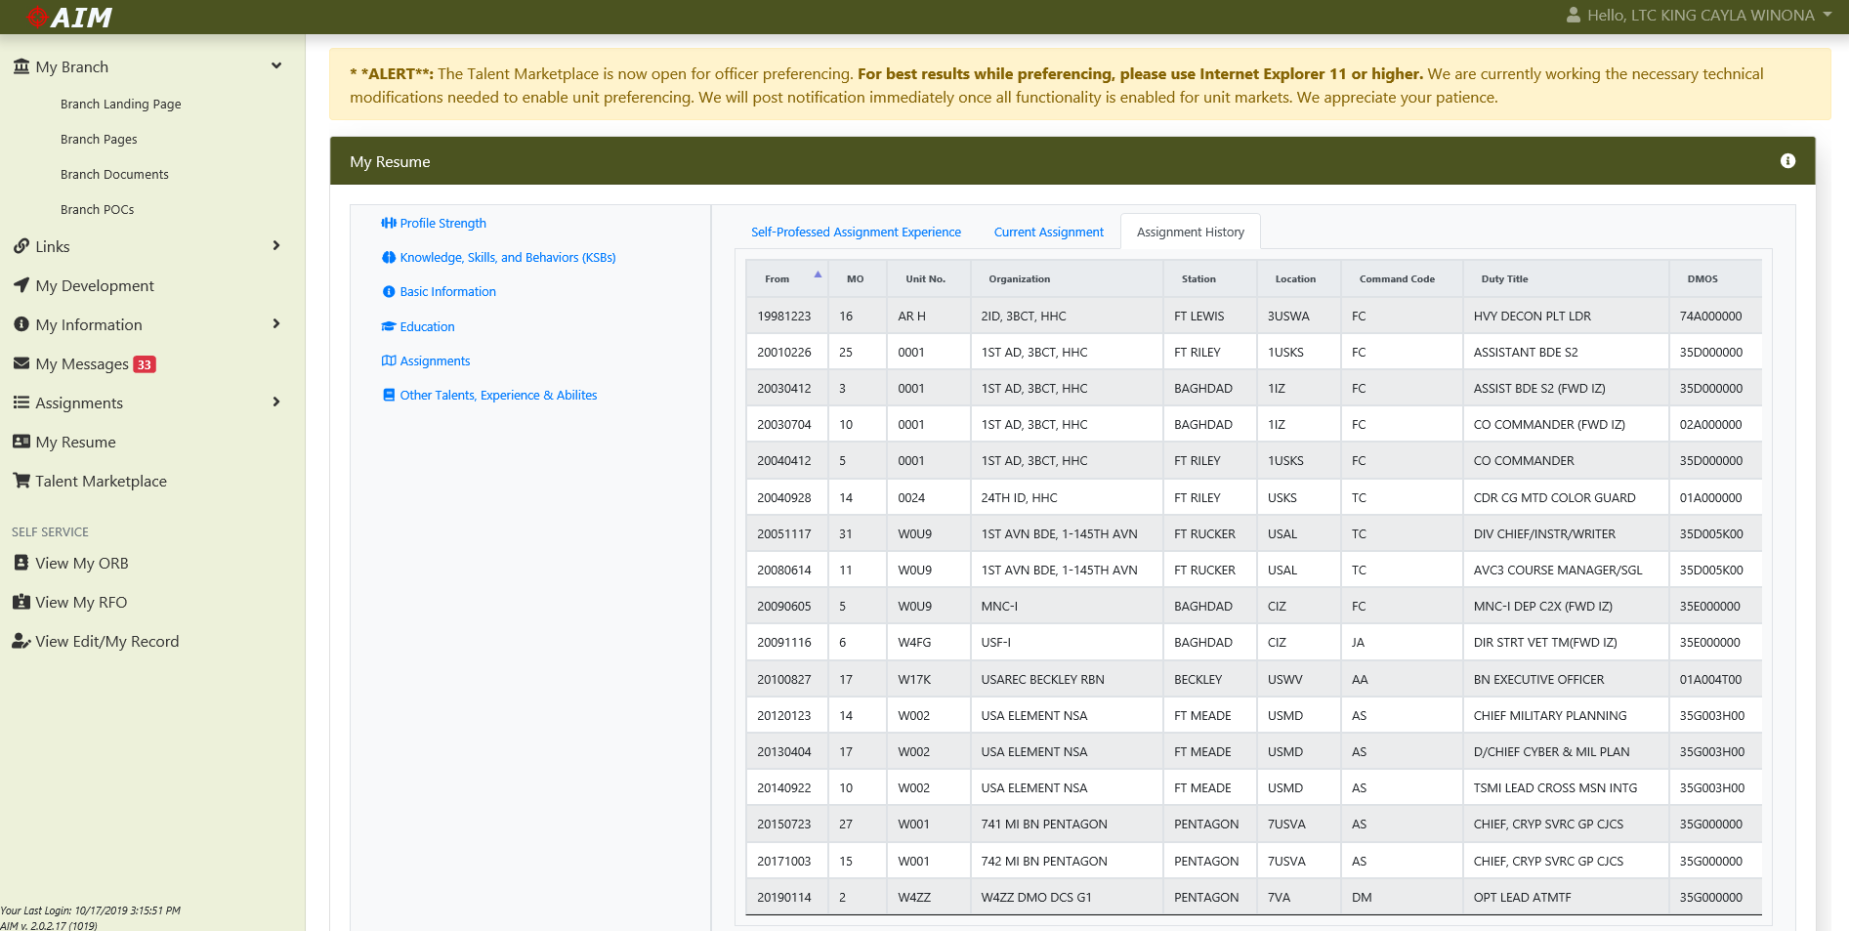
AIM 2.0 Résumé – Education “Assignment History”
This tab highlights your past assignments and duty titles. It is reflected on page one (1) of your résumé under Section IX: Assignment Information. Officers cannot manipulate this information and must contact their unit S1 for updates and corrections to this section.
1

Slide 27
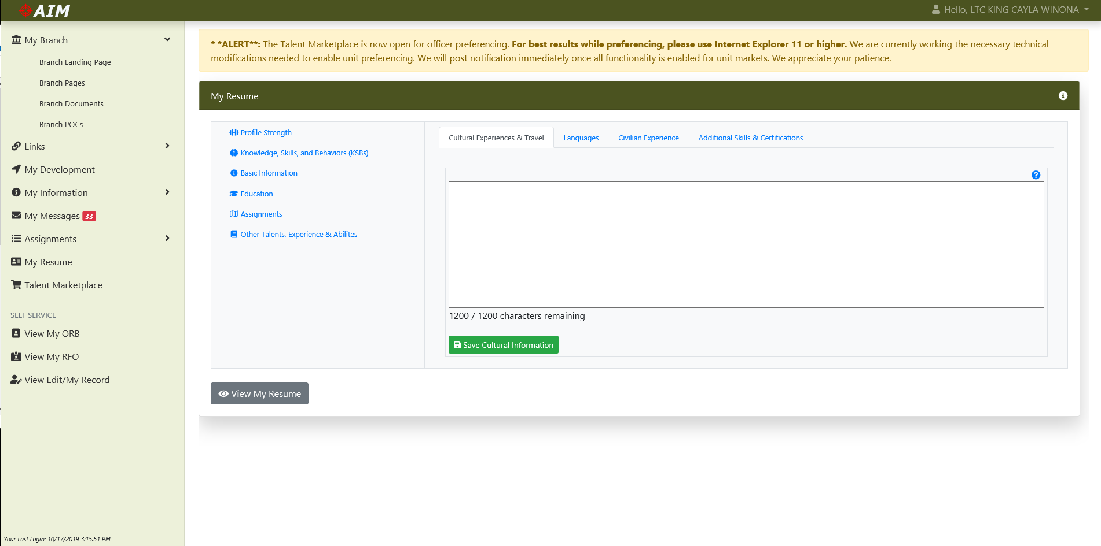
AIM 2.0 Résumé – Other Talents “Cultural Exp.”
This is a 1200 character tab that allows an officer to focus attention to official and non-official travel or overseas assignments not captured on their ORB. Travel and experiences listed in this section allows officers to highlight personal experiences, talents, and interests beyond what the Army may already know.
1
Some example questions are provided below to assist with development of this section.
-How have you used your experiences/ travel to improve the Army, your branch, or your unit?
-What have you done or experienced that sets you apart from your peers?
-Do you have any unique experiences that makes you better suited for the jobs you want?

Slide 28
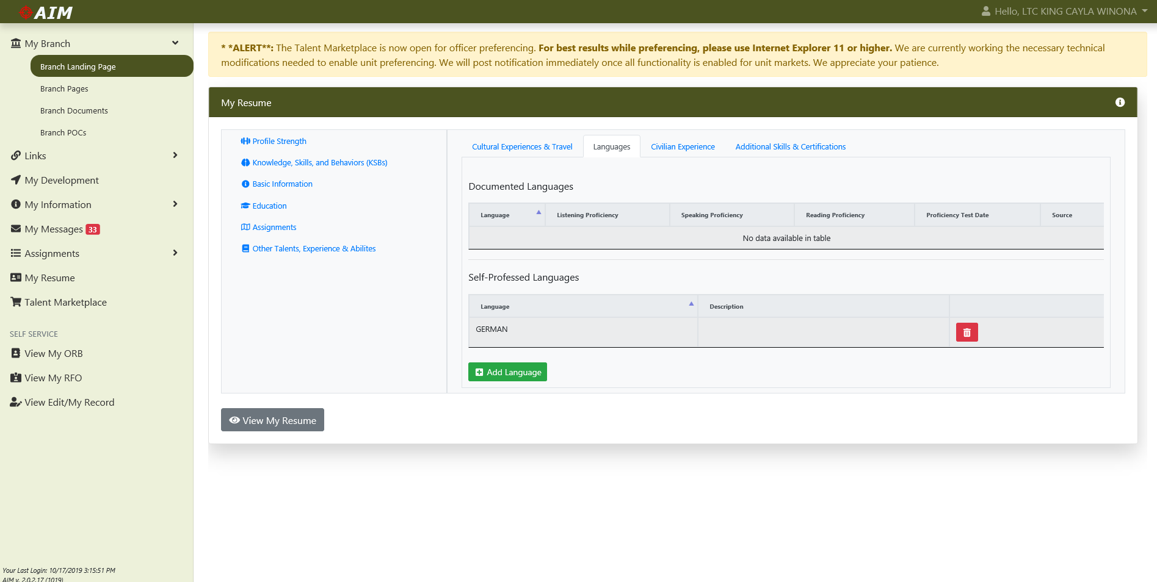
AIM 2.0 Résumé – Other Talents “Languages”
1
This section allows you to list languages you have studied or are proficient that are not listed on your ORB.

Slide 29
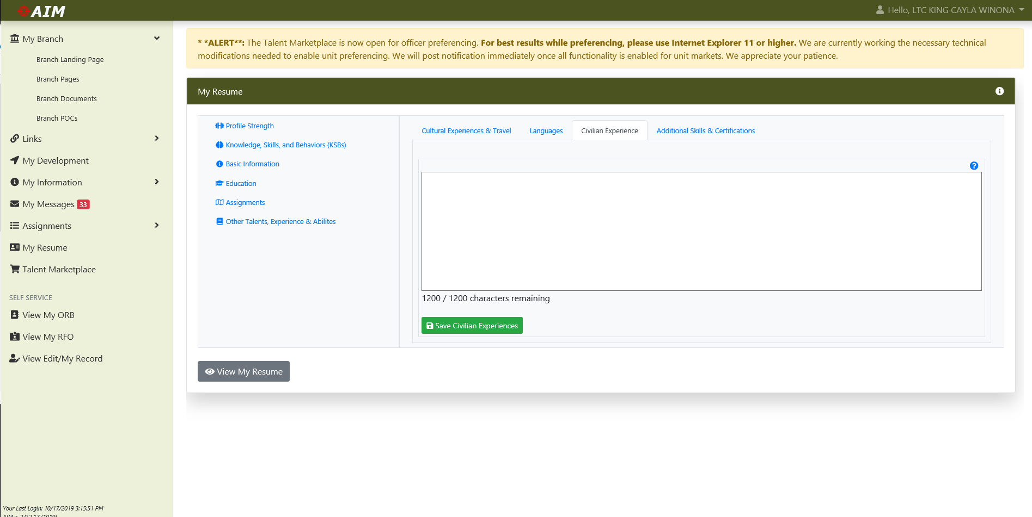
AIM 2.0 Résumé – Other Talents “Civilian Exp.”
1
Soldiers have a wealth of experience in non-military related areas and activities. Officers may reveal this experience in their non-duty hours by former employment, volunteering with community, educational, and charitable organizations, or through individual hobbies and interests. Officers can highlight their non-military employment/work, volunteer community service experiences and capabilities, hobbies and interests acquired outside of the military.

Slide 30
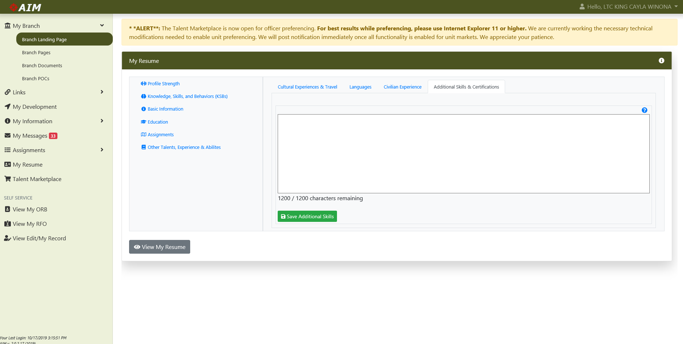
AIM 2.0 Résumé – Other Talents “Additional Skills”
1
In addition to the formal educational degrees officers may have earned, they may also have acquired other skills or certifications both inside and outside the Army that may not be captured on their ORB. Some examples of items that could be included in this section are below: List articles or writing samples that have been published; List military or civilian certifications not listed on the ORB; Include certifications you are working toward; Do you have a unique skill you have used to improve the Army?

Slide 31
USEFUL LINKS
Website: | URL:
Active Duty Officer Assignment Interactive Module Version 2 (AIM.2) | https://aim.hrc.army.mil/
AIM2 MER Training | https://www.milsuite.mil/book/docs/DOC-584295
AIM2 Marketplace Training | https://www.milsuite.mil/book/docs/DOC-609865
AIM Résumé Guidance – “A-Way” to Think of Constructing a Résumé | https://www.milsuite.mil/book/docs/DOC-675677
Army Talent Management Task Force | https://talent.army.mil
Army Talent Alignment Process (ATAP) Video | https://vimeo.com/341854451/8e1f7ed9dc
Army Talent Alignment Algorithm | https://www.youtube.com/watch?v=9mEBe7fzrmI&app=desktop
Maximize the Power of AIM2 KSB-Ps for Your Unit Vacancies | https://www.milsuite.mil/book/docs/DOC-635624
Maximize The Power of AIM2 KSB-P for Your Resume | https://www.milsuite.mil/book/docs/DOC-635623
United States Army Human Resources Command | https://www.hrc.army.mil

Slide 32
Questions?

Slide 33
BACKUPS

Slide 34
Talent, KSB, & Preference Definitions
Talent – Unique, measurable clusters of highly interrelated knowledge, skills, and behaviors possessed by an individual, which results in effective performance when properly aligned against a particular job.
WHAT I KNOW
Knowledge - A topically organized set of facts and information acquired by a person through experience, education, or training, which supports work related performance.
WHAT I CAN DO
Skill - a person’s proficiency and ability to perform a job-related activity that contributes to effective performance or learning.
HOW I ACT
Behavior - a person’s values, attitudes, and temperament as evidenced through their actions.
WHAT I PURSUE
Preference - Interests, career ambitions, and personal life goals.

