Slide 1




























































5 YEAR CAREER PLAN
CPT [Name]
DOR 01 NOV 2024 - FA
Field Artillery Officer
Top Three Short Term Career Goals
Battery Command
Second Command
ACS or Fellowship
Sus
Brigades & QM Petrl Company
ASCCs
Field Army
Corps
TSC
ESCs
CABs
School house
Fellow Board
BZ MAJ
Joint Assignment
1LT
CPT
CPT
CPT
CPT
CPT
CPT
CPT
CPT
CPT
CPT
2024
2024
2025
2025
2026
2026
2027
2027
2028
2028
2029
ILE, KS
Desired
Career
Path
PCS
BATTERY COMMAND – Fort Cav
2ND COMMAND – Fort Cav
Fellowship - Washington
PCS
BATTALION FSO – Fort Cav
PCS
Alternate
Path
BATTERY COMMAND – Fort Cav
PROJECT WARRIOR –NTC & Fort Sill
Might deactivate
BATTALION FSO – Fort Cav
PCS
PCS
Spouse’s / Personnel
Path
Masters Internship
Supervised Hours (3000)
Licensed Counselor
Denotes Job Change
National Guard
NC Exam & MFT Exam
Licensure
Denotes Key Career Decision Point
27
27
28
28
29
29
30
30
31
31
32
Fort Sill, Ok
Fort Sill, OK
Fort Cav, TX
Fort Cav, TX
Fort Cav, TX
Fort Cav, TX
Fort Cav, TX
5
5
6
6
7
7
8
8
9
9
10
CURRENT PATH
Student
BN FSO
Assignment Preference
1 | Kentucky | 4 | Belgium
2 | D.C. | 5 | Korea
3 | Washington | 6 | Italy
Next Assignment
1 | ACS or Fellow
2 | Project Warrior
3 | Branch MGR
Goals
1 | BTRY CDR
2 | 2ND CMD
3 | Published Article
Deployments
MA/ADC | OFS | 9 Mon | -- | -- | --
 |  |  | -- | -- | --
 |  |  | -- | -- | --
Notes:
Command and General Staff College, ILE Common Core (ILE-Core)
The focus of the 15-week ILE common core course is to establish a common Army operational warfighting culture which prepares all field grade officers for service in division, corps, EAC, and joint staffs. The ILE common core includes courses on leadership, the nature and conduct of war, and principles of combat, combat support, and combat service support. This is the first portion of the 10-month CGSC course or is the stand-alone course taught at satellite campuses (Fort Belvoir, Fort Lee, Redstone Arsenal and Fort Gordon).
Industrial College of the Armed Forces (ICAF)
The mission of this course is to prepare selected military officers and civilians for senior leadership and staff positions. It deals with the resource component of national power, places special emphasis on materiel acquisition and joint logistics, and focuses on their integration into national security strategy for peace and war. The academic program emphasizes postgraduate, executive-level education rather than training, and enduring principles and concepts rather than transient contemporary events. Structured to emphasize active learning, the curriculum employs the case method and is complemented by extensive student reading, written and oral presentations, classroom analyses, lectures by faculty members and prominent outside authorities, and a field study program. Graduates earn a master's degree in National Resource Strategy.

Slide 2
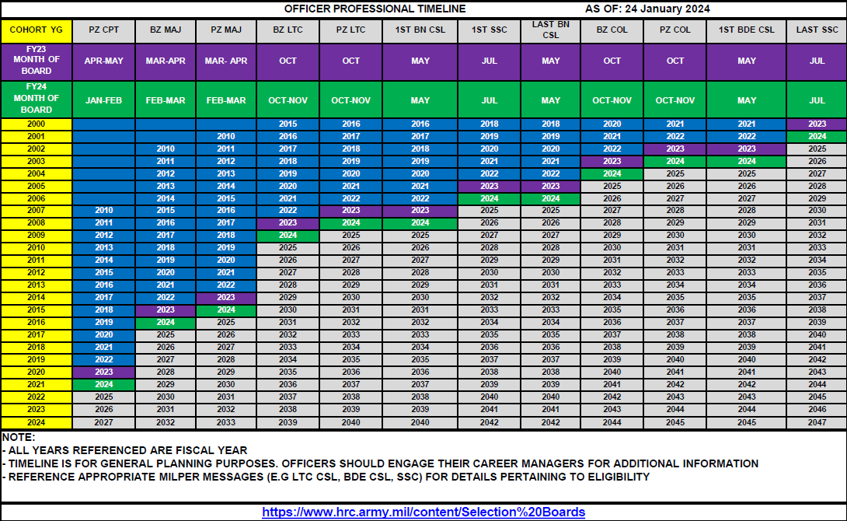

Slide 3























































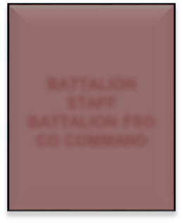





























Broadening Timeline
B O L C
KEY ASSIGNMENT
C C C
36 MONTHS
CPT BROAD
ILE
36 MO TOUR
(18-24 MO KD TIME)
MAJ BROAD
LTC CSL
SSC
BROAD / FBC
EXPERIENCE AND EXPERTISE
5 yrs
10 yrs
15 yrs
20 yrs
LTC PSB
LTC CSL
POST BN CMD BROADENING
MAJ PSB
JOINT NOMINATIVE HIGHER STAFF FELLOWSHIPS CTC
POST MAJ KD BROADENING
OC/T
SSC
FACCC
ROTC APMS JOINT POSITIONS
1st Army FELLOWSHIPS
BATTALIO N COMMAN D
POST COMMAND BROADENING
CGSC
BN S3/XO BRIGADE FSO BDE S3/XO
BATTALION
SGI
CTC/1st Army ROTC APMS USMA FELLOWSHIP
CPT PSB
FIRE SUPPORT OFFICER FIRE DIRECTION OFFICER
PLATOON LEADER
STAFF
BATTALION FSO CO COMMAND
LIEUTENANT ~4 YRS
CAPTAIN~6 YRS
MAJOR ~7 YRS
LIEUTENANT COLONEL
Objective: a broad range of experiences that provide officers fundamentally different perspectives of the Army as an element of strategic landpower
Experience compounds over a career between tactical, operational and broadening assignments.
PME at right time preserves opportunities for KD and broadening assignments.
Balance the needs of the Army (readiness), the Field Artillery (progression IAW AR 600-3) and the Officer (preference).
Serve in multiple formations and echelons (operating, generating, and joint force) to diversify professional experience.

Slide 4
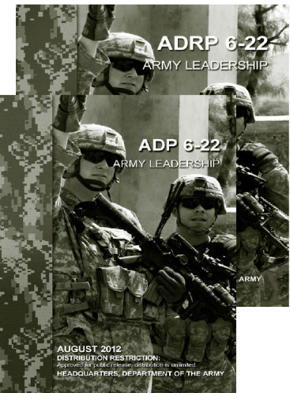




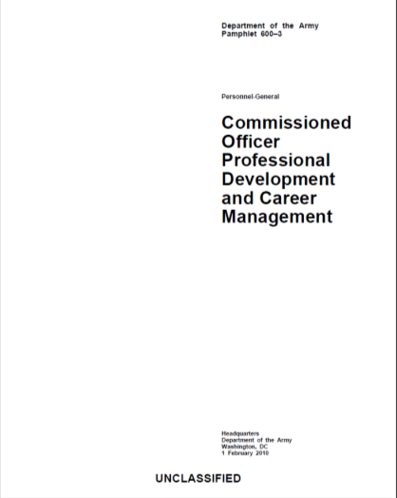



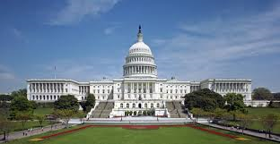
Growing Strategic Leaders
Balancing Key & Developmental Assignments with Broadening Opportunities
~ 2 yrs
~ 4 yrs
~ 10.5 yrs
~ 16 yrs
~ 22 yrs
BROAD / FBC
BOLC
KEY ASSIGNMENT
CCC
36 MO TOUR
(12-18 MO KD TIME)
CPT
Broad
ILE
36 MO TOUR
(18-24 MO KD TIME)
MAJ
Broad
LTC CSL
SSC
COL CSL
COL
Broad /
FBC
~ 10.5 yrs
~ 16 yrs
~ 22 yrs
CAPTAIN
Fellowship
TRADOC
Project Warrior
Army Staff
ACS
TWI
MAJOR
Joint
Army Staff
COCOM
ACOM / ASCC
LIEUTENANT COLONEL
Joint
OCLL
Army Staff
Joint Staff
ACOM / ASCC
ENTERPRISE
Officers Prepared to Effectively Operate at DA, ACOM, ASCCs, Joint, and COCOMS
Notes:
-Balancing Key & Developmental assignments with Broadening opportunities
Pin on dates
CPTs and MAJs Broadening
Interns and Fellowships

Slide 5
(13A / FA)
DIVARTY, 1CD – YG 2020
AS OF: 30 OCT 24
Arrived FHTX | Arrived in Position | Months in Position | Months in KD
02-JUL-24 | 02-JUL-24 | 4 | TBD
Short-term Goals (1 - 2 Years) | Long-term Goals (2 - 5 Years)
Enhance DIVARTY’s combat effectiveness by integrating space-base assets and capabilities to bolster lethality Ensure consolidation of FA BNs under DIVARTY Establish a junior officer career mentorship initiative to nurture and retain FA Officers Publish 3nd and 4rd article Obtain 600 on ACFT | Successfully complete MAJ KD time at the BN & BDE levels Selected for ASP3 (PhD) program Joint utilization billet Remain competitive for LTC promotion Maintain 600 on ACFT
Professional >
ASP3 Board
BZ LTC Board
PZ LTC Board/
BZ BCAP
PZ LTC Board
Promoted to MAJ
(July 2023)
Pre-KD | KD | KD | ASP3 (SAMS) | ASP3 (SAMS) | ASP3 (SAMS) | Joint Utilization
DIVARTY Staff
BN XO (Tentative)
DIVARTY XO (Tentative)
CoA 2: Joint Assignment
CoA 2: Nominative Assignment
Personal >
’25
‘26
’27
’28
’29
’30
’31
FAMILY TIMELINE
SCHOOL YR | 2023-2024 | 2024-2025 | 2025-2026 | 2026-2027 | 2027-2028 | 2028-2029 | 2029-2030
GRADE(S) | 3rd / 4th | 4th / 5th | 5th / 6th | 6th / 7th | 7th / 8th | 8th / 9th | 9th / 10th
AGE(S) | 8 / 9 | 9 / 10 | 10 / 11 | 11 / 12 | 12 / 13 | 13 / 14 | 14 / 15
PREVIOUS POSITIONS (3) | SUSTAINS (3) | FAMILY GOALS/NOTES
Career Manager (HRC, Ft Knox) Future Readiness Officer (HRC, Ft Knox) Battery Commander (1-82FA, Ft Cavazos) | Mentorship (Inside & Outside the Army) Resiliency and Patience Building and Maintaining Relationships | Maintain a strong, spiritual family through routines Plan and conduct yearly family vacations Celebrate important milestones for each family member
FUTURE POSITIONS (3) | AREAS TO GROW (3)
BN XO DIVARTY/BDE XO Joint Utilization or Nominative Assignment | Work/ Family Balance Personal & Professional Reading & Writing Strategic Thinking | NEXT OER THRU-DATE
 |  | 20-JUNE-25

